Slide 1
CSSE 220
Final Project Kick-off
Fall 2025

Slide 2
Final Project Goals
Synthesize what you’ve learned into a cohesive whole
  Object-oriented design process (OODP checklist, UML diagrams)
  Java fundamentals: data structures, primitives, object types
  Object-oriented programming (inheritance, interfaces, polymorphism)
  File input/output, a.k.a. I/O
  Java Swing graphics library, including event-based programming
  Exception handling (try-catch)
Build something you’ll want to talk about
  with friends, family, interviewers
Have fun!

Slide 3
Core Requirements
Every final project (including GARP) will include:
  File input/output with custom exception handling
  A Java Swing GUI with event-based programming (Key/Mouse/Action)
  Inheritance and interfaces with polymorphism to avoid duplicate code
  JUnit tests of some critical components (don’t have to cover all code)
  Self-assessment in terms of object-oriented design principles
  Appropriate data structures (ArrayLists, HashMaps, etc.)
  Presentation during the last week of class

Slide 4
Forming Project Teams
GARP-interested students
Pitches with full teams (3-4) already planned
Pitches needing additional team members
https://docs.google.com/spreadsheets/d/1If31pPylp5y6DLYBDu3rE33MLF83ufOqczV5ebBpWhs/edit?usp=sharing
https://tinyurl.com/csse220-F2526-project-teams

Slide 5
GenAI Use
Sense of craftsmanship, ownership, agency
  “We built this” vs. “we told Claude to build this”
Limited use allowed in Milestone 4 when adding extra features:
  Search for how to do new things, like add animations
  Generate small code snippets
For any genAI use in M4, MUST clearly indicate any and all genAI-produced/genAI-assisted code
  Comments before/after:
  // START of genAI-assisted code: [link to conversation]
  ...
  // END of genAI-assisted code

Slide 6
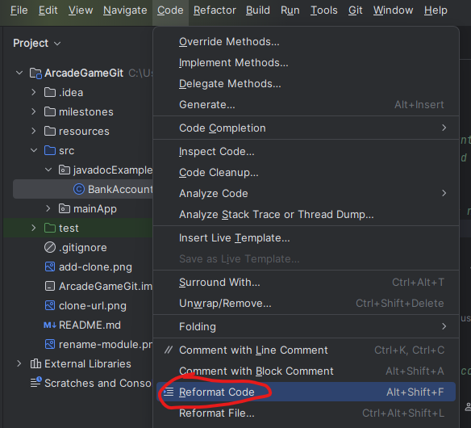
Expectations at Each Milestone
Clear milestone commit
  “This is the M1 commit,
  ready for grading”
Report is thorough and accurate
Compiles and runs without errors
Clean code
  JavaDoc for every class
  (ideally, methods too)
  TODO comments where needed
  Consistent, minimal indentation
  Good variable and method names

Slide 7
Final Project Grading
Four levels: Poor, Satisfactory, Good, Excellent
  See syllabus for impact on final grade
Along the way (M0-M3): projected project level based on WIP
  …can move up/down in later milestones
  what is actually graded is the final M4 submission and presentation
  If you’re not sure where your team stands, just ask
Motive: Focus on building cool things well and communicating your work, not on calculating partial credit to aim for

Slide 8
Final Project Grading (continued)
What do the four levels look like?
Poor: doesn’t compile or run, or is missing core requirement(s)
Satisfactory: Compiles and runs, but violates many OODPs, is deficient in core requirements (though present), and/or neglects style/documentation guide
Good: Mostly follows OODPs, meets all core requirements, and mostly follows style/documentation guide
Excellent: Goes above and beyond* core requirements, thoroughly follows OODPs and style/documentation guide
*GARP goes above and beyond, but so can other projects

Slide 9
Milestone 0: Plan Classes and Initial UML
Submit Gradescope (M0.a and M0.b) AND
Push a commit with completed M0_report.md

Slide 10
GitHub Classroom Setup Instructions
https://docs.google.com/document/d/1L9aUwMvniMmx79O7JsLlsOXOur_VRoDLkfEN9qzDcnI/edit?usp=sharing
https://tinyurl.com/csse220-gh-classroom

