Slide 1
Exam1 Preparation
CSSE220

Slide 2
Exam1 has Three Parts
First In-Class Part - Timed “Written” Exam
NO Eclipse!
Preparation #1: Do 1 or more example written exams
Preparation #2: Review Quizzes and Daily Slides
Second In-Class Part – Timed Coding Exam
Eclipse allowed!
Preparation #1: Do 1 or more example coding exams (SampleExam1…)
Preparation #2: Review your solutions and approaches to coding HW
Take-home Graphics Part
unlimited time Graphics Problem
Preparation #1: Complete Scenes Homework Assignment
Preparation #2: Do 1 or more example exam graphics problems

Slide 3
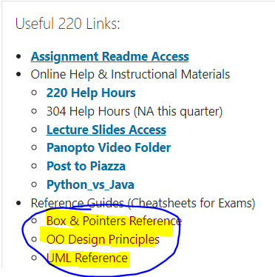
In-class “Written” Exam
Conducted via Gradescope (linked from Moodle)
First Day in-class: 110 minutes
Allowed resources:
1 sheet of hand-written note
UML Reference
OO Design Principles
Box & Pointer Reference
Expected Problem types:
Draw Box & Pointer diagrams
Predict what code will output (print to console)
Translate to/from UML Code
Design Problems
True/False Questions

Slide 4
In-class Coding Exam
Conducted via Moodle, submitted via Moodle
Second Day in-class: 110 minutes
Allowed resources:
All Written resources, textbook, slides, notes etc.
All code you have written
All code provided as a resource in CSSE220
Google Searches to find JavaDocs (Search: Java Oracle ArrayList )
Expected Problem types:
SmallProblems – similar to TwelveProblems
2DArrays
HashMaps

Slide 5
Take-Home Graphics Exam Problem
Conducted via Moodle, submitted via Moodle
Opens Friday NOT timed, but by end of weekend
Will involve coding a graphics problem similar to past exams
You should plan to complete Scenes BEFORE you try to do this part

Slide 6
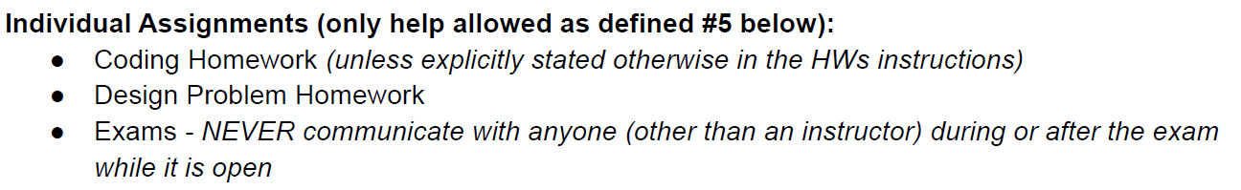
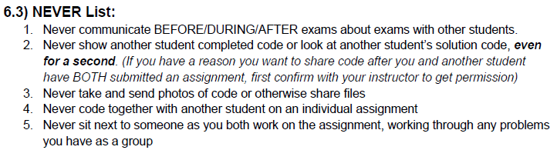
Disallowed on all exams
You cannot discuss the exam with anyone other than an instructor or CSSE220 TA (best to talk only to instructor)

Slide 7
Let’s practice importing a .zip file now!

