Slide 1
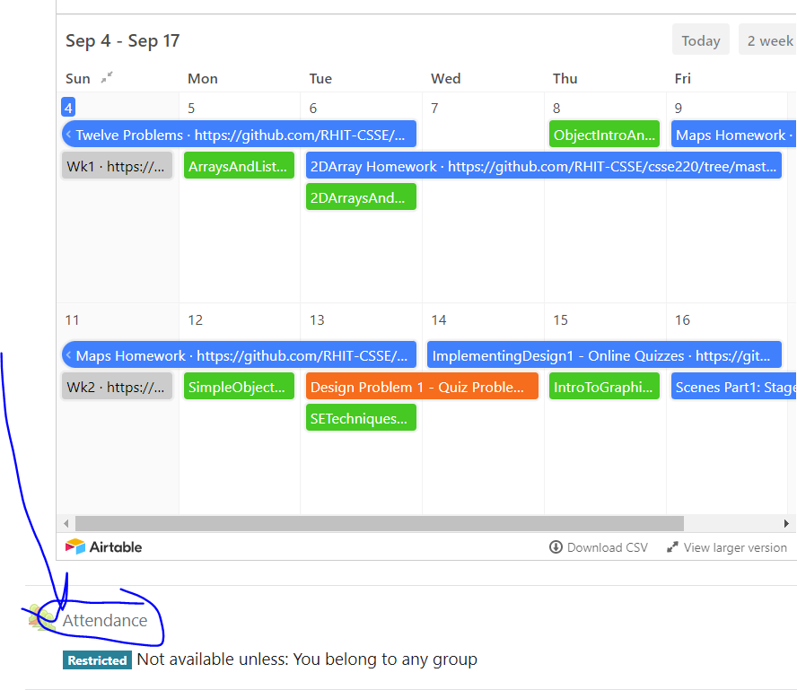
CSSE 220
Today’s Attendance password
__________
Variable Scope
Console Input
Unit Testing
The git projects for today are:
PracticeConsoleAndUnitTesting
PracticeConsoleAndUnitTestingSolution
Notes:
Bring hard copy of code from UnitTesting

Slide 2
Outline
Review: Dependencies, Coupling, Cohesion
Variable Scoping
Console Input
Unit Testing

Slide 3
Review
Encapsulation
Collocate within a class data fields and the methods that work on those fields
Use private keyword for most data fields, this is called compiler enforced encapsulation

Slide 4
Review
Minimize Dependencies by (low coupling):
Using tell don’t ask – when a client of a class has an algorithm that could be located within that class (this is an ask algorithm), move that algorithm/method from client into the class (so it becomes a tell algorithm)
Don’t use message chains – instead instrument the called-on classes to provide methods to do the work
Low coupling means dependencies are minimized

Slide 5
Review
High Cohesion Rule for Classes
Make each class do one thing well
Micro-Cohesion Rules for Class Implementations
Make each operation do one thing well
Make each loop do only one thing

