Slide 1
CSSE 220
Unit Testing
The git projects for today are:
PracticeConsoleAndUnitTesting
PracticeConsoleAndUnitTestingSolution
Notes:
Bring hard copy of code from UnitTesting

Slide 2
Unit Testing
Idea: Test “small pieces” of larger program
Do the expected values match what you ACTUALLY get?
How to test in this manner?
Could make a main method that calls all the methods
Use Java's JUnit testing framework
Creating a Tester JUnit class
Q2

Slide 3
Why Unit Testing?
There are several goals of unit testing:
Make sure your code works (as specified!)
Keep it working
Confirm understanding of the specification
Confirm pieces of code in isolation
Provide Documentation
Q3

Slide 4
Unit Tests (as done in CSSE120)
Construct one or more objects of the class that is being tested
Invoke one or more methods
Print out one or more results
Print the expected results
Do 3 and 4 match?
(Pages 102-103 in book)

Slide 5
Why JUnit?
Provides a Framework
Framework: Collection of classes to be used by another program
Provides easy-to-read output in Eclipse
Printouts require you to analyze all lines
What if it scrolls off the page?
What if it’s only 1 character different?

Slide 6
What are quality unit tests?
Unit tests should be small pieces that test:
The most common cases
The edge cases or boundary cases (minimum, maximum, switching from positive to negative, etc.)
All specific/special cases (e.g., when 0 or null the behavior is different than for any other value)
When you find and fix a defect, then at that same time, create a unit test that would have revealed that defect. Then in future modifications to the code, if that defect gets reintroduced, the new unit test you created will reveal its presence
Any overly complex code that 1-4 above don’t cover
Q4

Slide 7
What is a poor quality test case?
A test case that provides illegal input to the operation
For example, the deposit method from the BankAccount class
It has a requires clause that states the depositAmount > 0
Testing it with a negative number is a poor test case because it requires non-negative input
Q4

Slide 8
Unit Testing
Use JUnit “assert” to make sure results match https://junit.org/junit4/javadoc/latest/org/junit/Assert.html
Let’s look at BadFrac.java and BadFracTest.java
Let’s make some unit tests and figure out why this project has been yielding some strange results
Notes:
You can decide whether you want to show the students how to generate the toString and equals methods when testing the addFrac method to do an assertEquals(), or if you want to reduce the amount of time taken, you can also choose to simply compare the actual numerator and denominator as in the solution code.

Slide 9
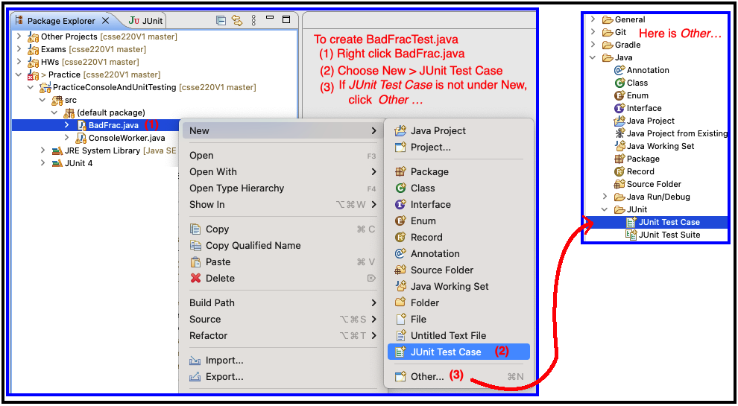
Unit Testing
Create BadFracTest.java – then create test cases
Notes:
You can decide whether you want to show the students how to generate the toString and equals methods when testing the addFrac method to do an assertEquals(), or if you want to reduce the amount of time taken, you can also choose to simply compare the actual numerator and denominator as in the solution code.

Slide 10
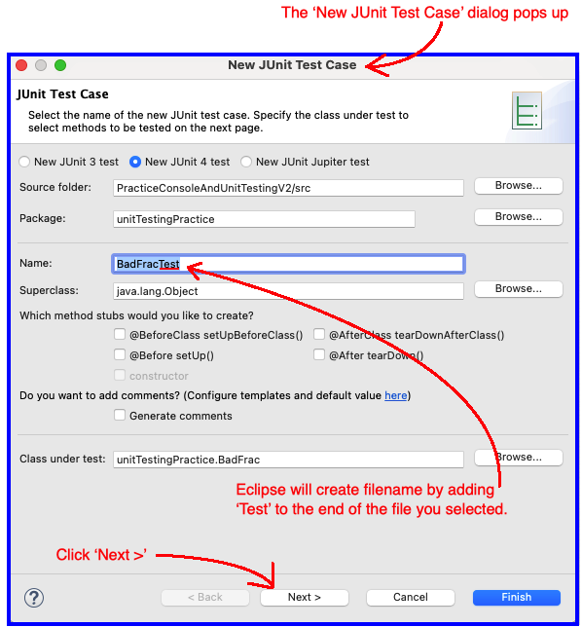
JUnit Test Case Dialog

Slide 11
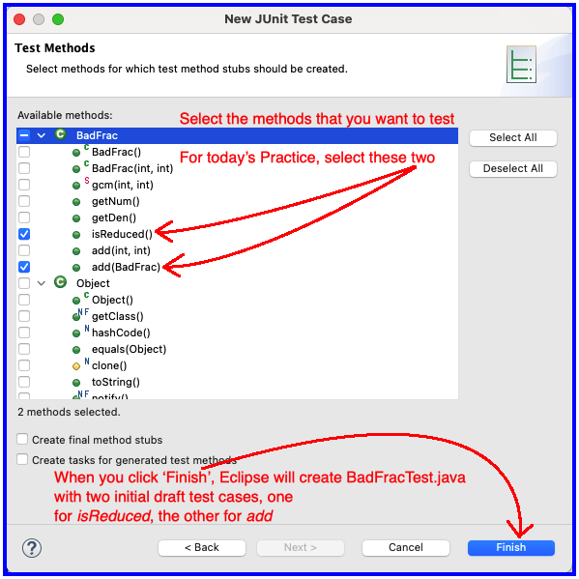
JUnit Test Case Dialog

Slide 12
UnitTesting Homework
To be assigned soon

