Slide 1
CSSE 220
Eclipse PlantUML Plugin
Notes:
No quiz today.
Bring printouts from the MergeSortSimpleSolution.

Slide 2
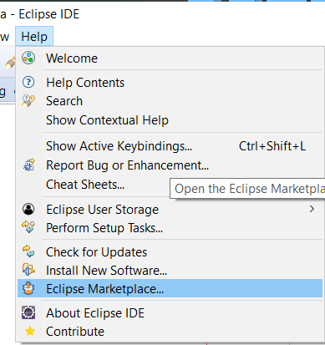
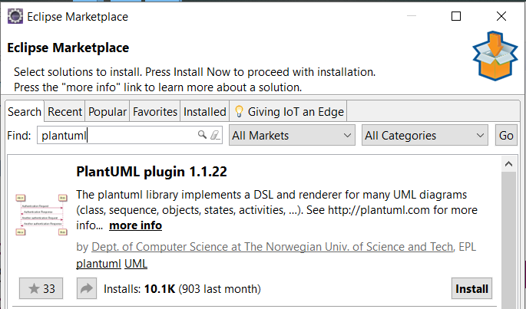
PlantUML Eclipse Plugin
https://plantuml.com/eclipse

Slide 3
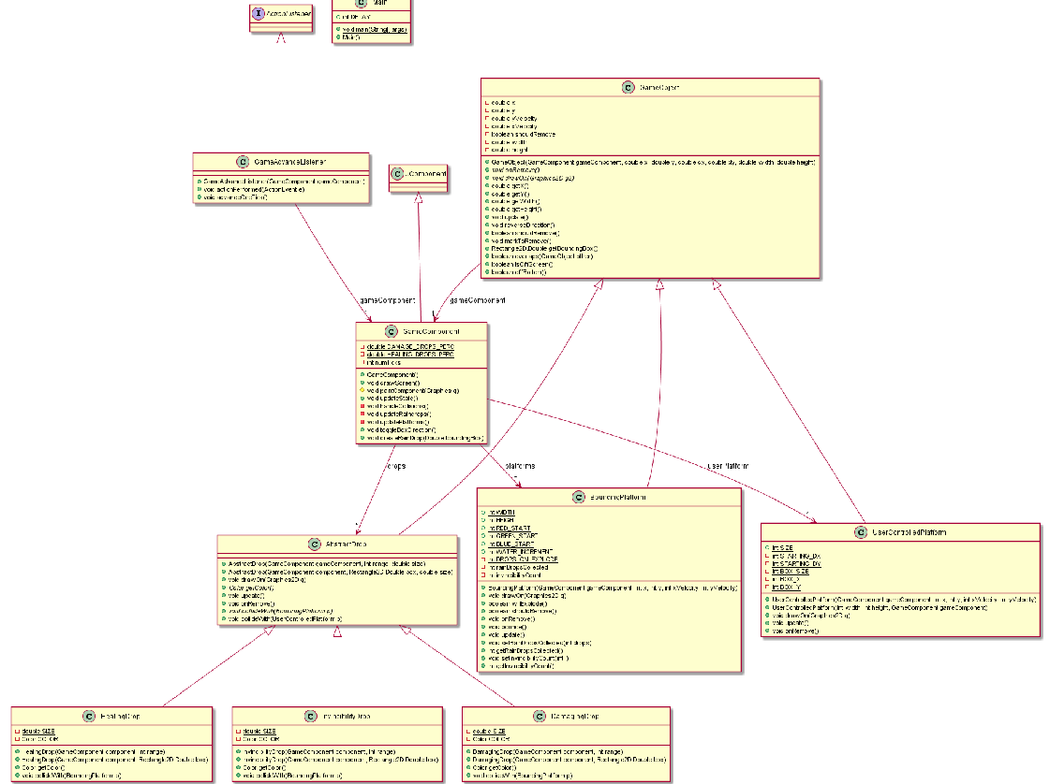
Information
Overload!

Slide 4
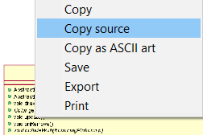
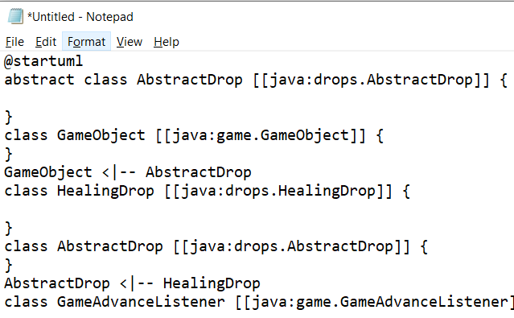
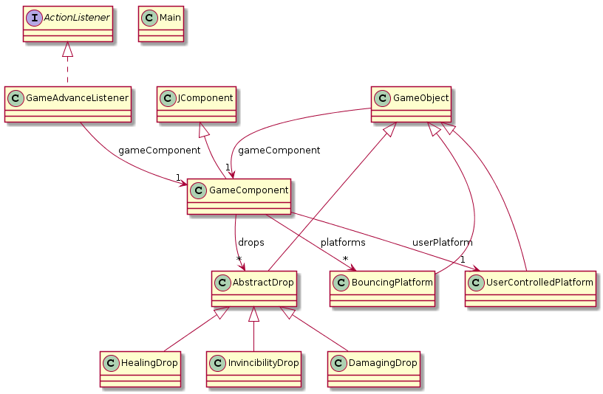
<- Copy UML source and
then remove extra ->

Slide 5
