Slide 1
Final Project Teams (so far)

Slide 2
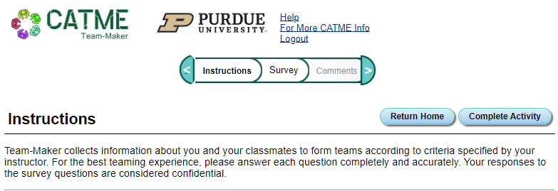
CATME
Look for an email (check spam)

Slide 3
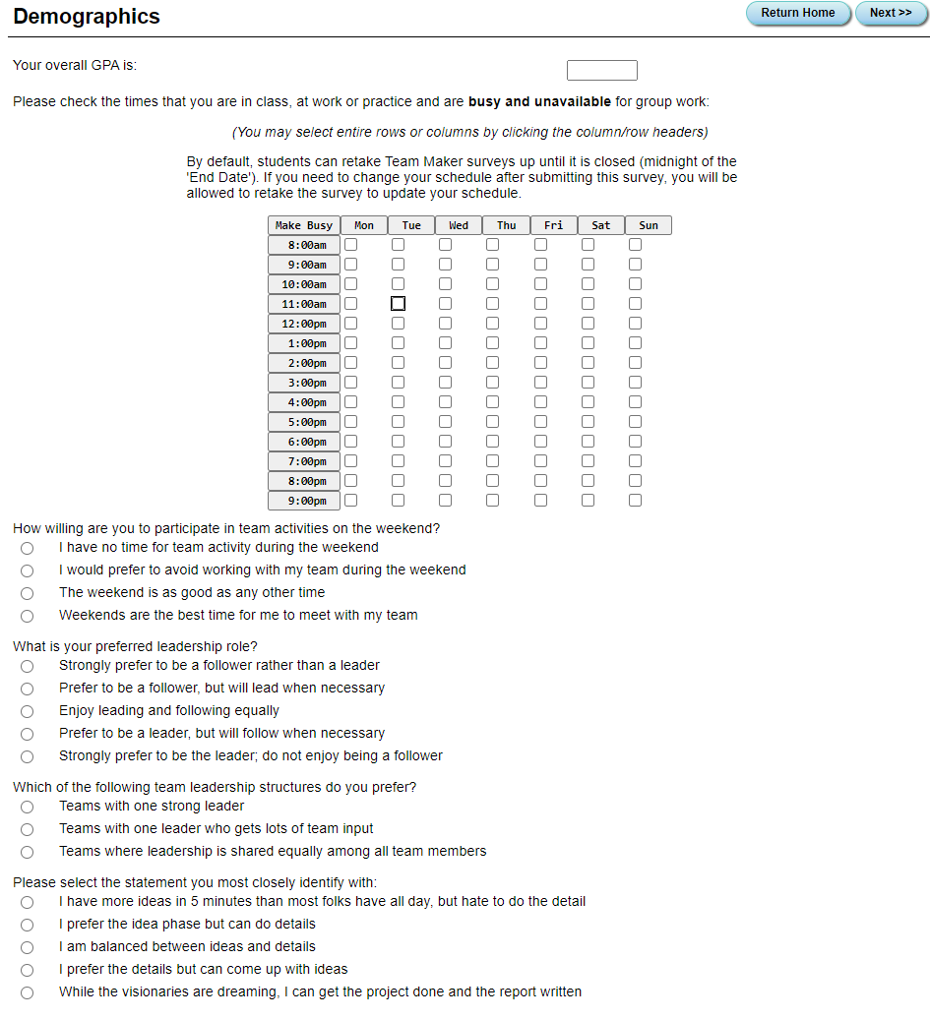

Slide 4
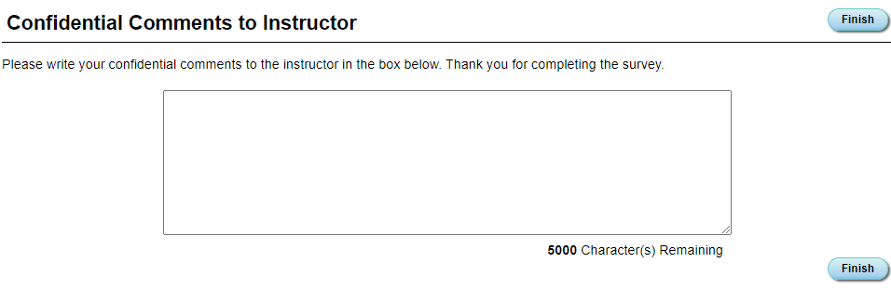
MAKE SURE TO:
Indicate 3 Things in this box (screenshot below)
Who you would like TO work with
Who you would NOT like to work with
Your preference of GARP or Arcade Game
If you did not complete the original survey you will NOT be eligible to do the GARP
This is mostly a sanity check for me

