Slide 1
CSSE 220: Object Design
Intro to UML Class Diagrams
The git projects for today are:
PracticeFirstOODesign
PracticeFirstOODesignSolution

Slide 2
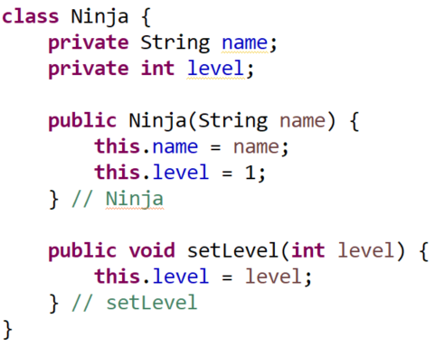
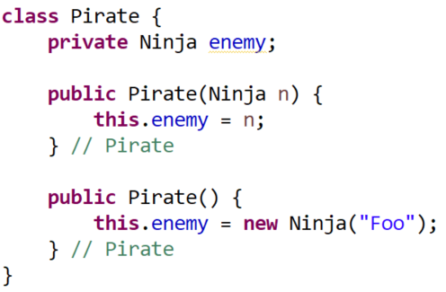
Remember our Ninja and Pirate examples?
We will look at how to write UML for them

Slide 3
A little class diagram will get you a long way
Classes are represented by a diagram with 3 sections
This is the initial version of UML we will teach
ClassName
Field names
Method names
Example – “Ninja” class from SimpleObjectsQuiz
Ninja
name level
setLevel( level )

Slide 4
Types for fields, parameters, and return types
Undesignated
Example – “Ninja” class from SimpleObjectsQuiz
Sometimes we do not designate:
type declarations for field names
types declarations for parameters
Return type declaration for a function method
Ninja
name level
setLevel( level )

Slide 5
Types for fields, parameters, and return types
Designated
Example – “Ninja” class from SimpleObjectsQuiz
Sometimes we do designate:
type declarations for field names
types declarations for parameters
Return type declaration for a function method
Ninja
name: String level: int
setLevel( level: int ): void

Slide 6
Connections Between Classes Require Arrows
A has a B (as a field)
A
Field names
Method names
B
Field names
Method names
Example
Pirate
enemy
Ninja
name level
setLevel( level )

Slide 7
Connections Between Classes Require Arrows
A has a B (as a field)
A
Field names
Method names
B
Field names
Method names
Example
Pirate
enemy
Ninja
name level
setLevel( level )
When there’s an arrow to another class,
then we often do NOT explicitly define the field at the tail of the arrow

Slide 8
Connections Between Classes Require Arrows
A has a B (as a field)
A
Field names
Method names
B
Field names
Method names
Example
Pirate
Ninja
name level
setLevel( level )
When there’s an arrow to another class,
then we often do NOT explicitly define the field at the tail of the arrow

Slide 9
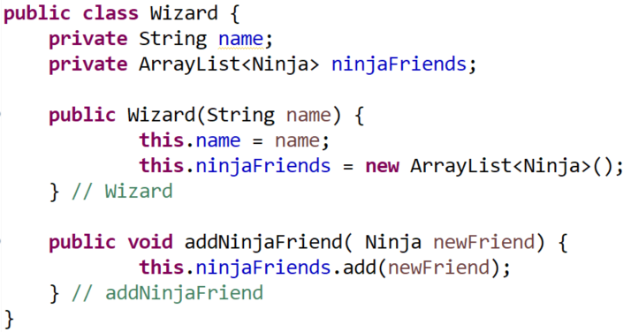
Ninja
name level
setLevel( level )
Let’s add a new class:
“Wizard” that:
- has a name
- has a list of ninjaFriends
What would it look like?

Slide 10
Arrows – to illustrate relationships
A has a B (field)
A
Field names
Method names
B
Field names
Method names
Example
This arrow means, Wizard has a field of type Ninja
The * says that field stores 0 to many Ninja objects
Wizard
name ninjaFriends
addNinjaFriend( ninja )
Ninja
name level
setLevel( level )
*

Slide 11
Arrows – to illustrate relationships
A has a B (field)
A
Field names
Method names
B
Field names
Method names
Example
Wizard
name ninjaFriends
addNinjaFriend( ninja )
Ninja
name level
setLevel( level )
*
Explicitly designated fields are often from Java provided types, e.g., int, String, etc.

Slide 12
Arrows – to illustrate relationships
A has a B (field)
A
Field names
Method names
B
Field names
Method names
Example
Wizard
name ninjaFriends
addNinjaFriend( ninja )
Ninja
name level
setLevel( level )
*
When there’s an arrow to another class,
then we often do NOT explicitly define the field at the tail of the arrow

Slide 13
Arrows – to illustrate relationships
A has a B (field)
A
Field names
Method names
B
Field names
Method names
Example
Wizard
name
addNinjaFriend( ninja )
Ninja
name level
setLevel( level )
*
When there’s an arrow to another class,
then we often do NOT explicitly define the field at the tail of the arrow

Slide 14
Now - practice
From the today’s in-class quiz do questions #1 and #2
About 10 minutes
For #2 ONLY write this down on paper for now…
Next, we will show you how to generate a digital UML Diagram

Slide 15
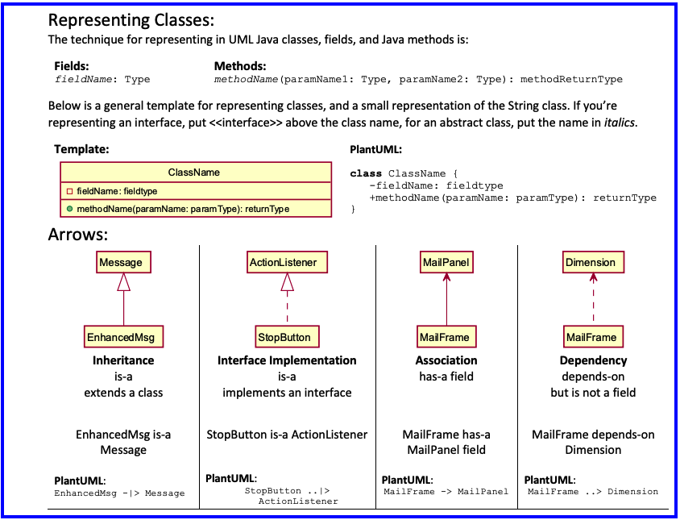
Notes:
For a future class

Slide 16
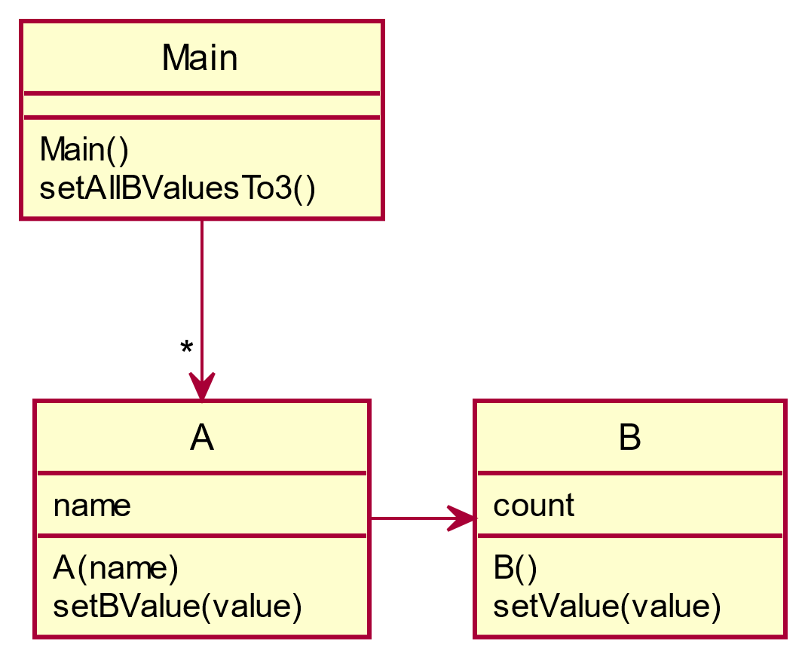
Code up a simple UML diagram!
Open up Eclipse and turn the UML diagram below into Java classes/code
Work in FirstOODesignPractice (Imported today)
Create classes for A and B, class Main has been created for you
Stub out the methods in A and B, i.e., do not provide code between the { and }
Finally, implement the methods in A, B, and Main
Use data types: String and int
Notes:
@startuml
skinparam style strictuml
class Main {
Main()
setAllBValuesTo3()
}
class A{
name
A( name )
setBValue( value)
}
class B{
count
B()
setValue( value )
}
Main -> "*" A
A-> B
@enduml

Slide 17
1. Draw by Hand OR 2. PlantUML
@startuml
skinparam style strictuml
class Main {
Main()
setAllBValuesTo3()
}
class A{
name
A(name)
setBValue(value)
}
class B{
count
B()
setValue(value)
}
A -right-> B
Main –down-> "*" A
@enduml
General website
https://plantuml.com/
Free Browser Based Online Server
http://www.plantuml.com/plantuml/

Slide 18
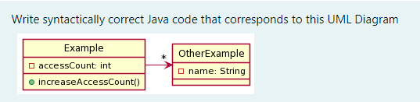
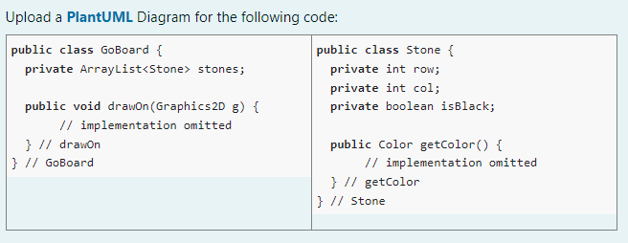
Now - practice
From the today’s in-class quiz do questions #1 and #2
About 10 minutes
For #2 ONLY write this down on paper for now…
Soon, we will show you how to generate a digital UML Diagram
#1
#2

Slide 19
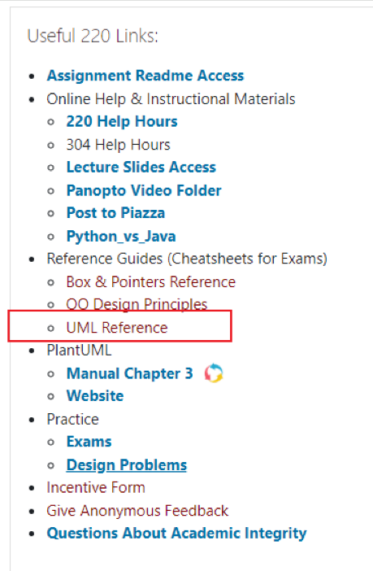
Notes:
For a future class

Slide 20
FUTURE - TODO
HOUSE EXAMPLE INSTEAD OF MAIN, A, B

Slide 21
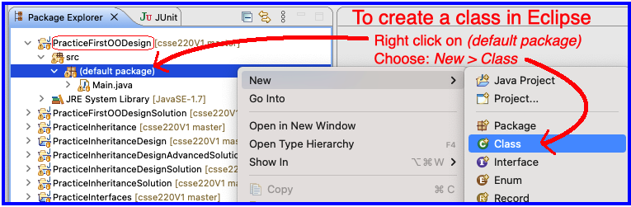
Code up a simple UML diagram!
Open up Eclipse and turn the UML diagram below into Java classes/code
Work in PracticeFirstOODesign (Imported today)
Create classes for A and B, class Main has been created for you
Stub out the methods in A and B, i.e., do not provide code between the { and }
Finally, implement the methods in A, B, and Main
Use data types: String and int
Notes:
@startuml
skinparam style strictuml
class Main {
Main()
setAllBValuesTo3()
}
class A{
name
A( name )
setBValue( value)
}
class B{
count
B()
setValue( value )
}
Main -> "*" A
A-> B
@enduml

Slide 22
Now, use PlantUML to recreate the diagram below Here’s the PlantUML code
@startuml
skinparam style strictuml
class Main {
Main()
setAllBValuesTo3()
}
class A{
name
A(name)
setBValue(value)
}
class B{
count
B()
setValue(value)
}
A -right-> B
Main –down-> "*" A
@enduml
General website
https://plantuml.com/
Free Browser Based Online Server
http://www.plantuml.com/plantuml/

Slide 23
Now - practice
Back to the hand drawn Quiz Question #2
Generate a digital UML Diagram now using PlantUML

