Slide 1
CSSE 220: Object Design
SE Techniques Principles
Principles 1 & 2
The git projects for today are:
PracticeFirstOODesign
PracticeFirstOODesignSolution

Slide 2
1. Make sure your design allows proper functionality
Must be able to store required information (one/many to one/many relationships)
Must be able to access the required information to accomplish tasks
Data should not be duplicated (id/identifiers are OK!)

Slide 3
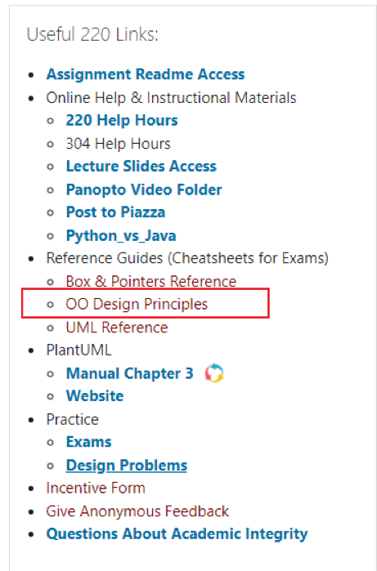
Overview: Principles of Design (for CSSE220)
Make sure your design allows proper functionality
Must be able to store required information (one/many to one/many relationships)
Must be able to access the required information to accomplish tasks
Data should not be duplicated (id/identifiers are OK!)
Structure design around the data to be stored
Nouns should become classes
Classes should have intelligent behaviors (methods) that may operate on their data
Functionality should be distributed efficiently
No class/part should get too large
Each class should have a single responsibility it accomplishes
Minimize dependencies between objects when it does not disrupt usability or extendibility
Tell don't ask
Don't have message chains
Don't duplicate code
Similar "chunks" of code should be unified into functions
Classes with similar features should be given common interfaces
Classes with similar internals should be simplified using inheritance

Slide 4
1. Make sure your design allows proper functionality
Must be able to store required information (one/many to one/many relationships)
Must be able to access the required information to accomplish tasks
Data should not be duplicated (id/identifiers are OK!)

Slide 5
An object oriented design must work!
Make sure all the data that you need is stored somewhere
Think as a client programmer: Can you access all the necessary data from the new Class? If not, then the design of the new class “doesn’t work”
The solution is not to keep 2 copies of the same data, one in the client and one in the new Class, change the new Class
Notes:
Maybe mention in passing there are other design approaches that divide things differently, but we’ll be focusing on OO in this course

Slide 6
2. Structure design around the data to be stored
Nouns should become classes
Classes should have intelligent behaviors (methods) that may operate on their data

Slide 7
A good object oriented design is structured around the data
Look for the nouns in your problem, consider making each of them a Class
…if work related to that now is complex enough
Put the data stored as fields in the Class
Add operations to the Class to accomplish what your need, i.e., manipulate the internal class fields
Avoid Plural Nouns – i.e., Class name singular and know that client can always make multiple object instances of this class
Notes:
Maybe mention in passing there are other design approaches that divide things differently, but we’ll be focusing on OO in this course

Slide 8
Learning to Design
PAUSE HERE for a couple minutes!
Try to see what you can think might be wrong
When you have an idea, then continue
You will be given “story problem” for a program(s) that you need to imagine coding
The story problem provides a list of requirements for necessary features that you will need to provide
You will practice designing in two ways:
1) Identifying problems with designs we give you (Red popups)
2) Developing your own design for problems (Blue popups)
You will have a number of opportunities to do practice designing:
In-class exercises/ daily quizzes (many!)
Homework Assignments (5)
Exam Questions (1+ on each exam)
Final Project Design (design from scratch)
PAUSE HERE for 5-10 minutes!
Try to make your own improved design
Either paper or using plantuml is OK!

Slide 9
Design Problem – Track Books
On the next slide is a story problem
To be successful at solving these types of problems you must first read the story problem and do the following “To Do”s
To Do #1 Identify all the primary nouns
A primary noun is a noun in the problem that has attributes (other nouns)
Nouns that designate actors of the system (i.e. The user can click…) can be excluded
To Do #2 Write down the attributes (other nouns) associated with the primary nouns
To Do #3 Identify all the verbs
To Do #4 Identify which primary nouns are worked on by the verbs
To Do #5 Design a system using UML to handle this problem
If you do this all well, then you should hopefully be able to make classes where:
Each primary noun becomes a Class
Each attribute (other noun) becomes a field for its respective class
Each verb becomes the method for the respective class

Slide 10
A website tracks books and the kids that read them. For each book the system stores the name and author. For each kid the system stores name and grade level. The teacher enters when a kid reads a particular book. It should be possible to print a report on a book that includes all kids who have read a particular book (with their grade level). It should be possible to print a report on a kid that includes the books (with authors) a particular kid has read.
To Do #1 Identify all the primary nouns
A primary noun is a noun in the problem that has attributes (other nouns)
Nouns that designate actors of the system (i.e. The user can click…) can be excluded
To Do #2 Write down the attributes (other nouns) associated with the primary nouns
To Do #3 Identify all the verbs
To Do #4 Identify which primary nouns are worked on by the verbs
To Do #5 Design a system using UML to handle this problem

Slide 11
A website tracks books and the kids that read them. For each book the system stores the name and author. For each kid the system stores name and grade level. The teacher enters when a kid reads a particular book. It should be possible to print a report on a book that includes all kids who have read a particular book (with their grade level). It should be possible to print a report on a kid that includes the books (with authors) a particular kid has read.
To Do #1 Identify all the primary nouns
A primary noun is a noun in the problem that has attributes (other nouns)
Nouns that designate actors of the system (i.e. The user can click…) can be excluded
To Do #2 Write down the attributes (other nouns) associated with the primary nouns
To Do #3 Identify all the verbs
To Do #4 Identify which primary nouns are worked on by the verbs
To Do #5 Design a system using UML to handle this problem

Slide 12
A website tracks books and the kids that read them. For each book the system stores the name and author. For each kid the system stores name and grade level. The teacher enters when a kid reads a particular book. It should be possible to print a report on a book that includes all kids who have read a particular book (with their grade level). It should be possible to print a report on a kid that includes the books (with authors) a particular kid has read.
To Do #1 Identify all the primary nouns
A primary noun is a noun in the problem that has attributes (other nouns)
Nouns that designate actors of the system (i.e. The user can click…) can be excluded
To Do #2 Write down the attributes (other nouns) associated with the primary nouns
To Do #3 Identify all the verbs
To Do #4 Identify which primary nouns are worked on by the verbs
To Do #5 Design a system using UML to handle this problem

Slide 13
A website tracks books and the kids that read them. For each book the system stores the name and author. For each kid the system stores name and grade level. The teacher enters when a kid reads a particular book. It should be possible to print a report on a book that includes all kids who have read a particular book (with their grade level). It should be possible to print a report on a kid that includes the books (with authors) a particular kid has read.
To Do #1 Identify all the primary nouns
A primary noun is a noun in the problem that has attributes (other nouns)
Nouns that designate actors of the system (i.e. The user can click…) can be excluded
To Do #2 Write down the attributes (other nouns) associated with the primary nouns
To Do #3 Identify all the verbs
To Do #4 Identify which primary nouns are worked on by the verbs
To Do #5 Design a system using UML to handle this problem

Slide 14

A website tracks books and the kids that read them. For each book the system stores the name and author. For each kid the system stores name and grade level. The teacher enters when a kid reads a particular book. It should be possible to print a report on a book that includes all kids who have read a particular book (with their grade level). It should be possible to print a report on a kid that includes the books (with authors) a particular kid has read.
To Do #1 Identify all the primary nouns
A primary noun is a noun in the problem that has attributes (other nouns)
Nouns that designate actors of the system (i.e. The user can click…) can be excluded
To Do #2 Write down the attributes (other nouns) associated with the primary nouns
To Do #3 Identify all the verbs
To Do #4 Identify which primary nouns are worked on by the verbs
To Do #5 Design a system using UML to handle this problem

Slide 15
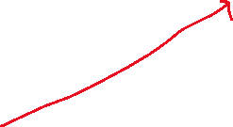



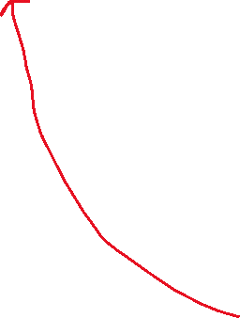

A website tracks books and the kids that read them. For each book the system stores the name and author. For each kid the system stores name and grade level. The teacher enters when a kid reads a particular book. It should be possible to print a report on a book that includes all kids who have read a particular book (with their grade level). It should be possible to print a report on a kid that includes the books (with authors) a particular kid has read.
To Do #1 Identify all the primary nouns
A primary noun is a noun in the problem that has attributes (other nouns)
Nouns that designate actors of the system (i.e. The user can click…) can be excluded
To Do #2 Write down the attributes (other nouns) associated with the primary nouns
To Do #3 Identify all the verbs
To Do #4 Identify which primary nouns are worked on by the verbs
To Do #5 Design a system using UML to handle this problem

Slide 16
A website tracks books and the kids that read them. For each book the system stores the name and author. For each kid the system stores name and grade level. The teacher enters when a kid reads a particular book. It should be possible to print a report on a book that includes all kids who have read a particular book (with their grade level). It should be possible to print a report on a kid that includes the books (with authors) a particular kid has read.
To Do #1 Identify all the primary nouns
A primary noun is a noun in the problem that has attributes (other nouns)
Nouns that designate actors of the system (i.e. The user can click…) can be excluded
To Do #2 Write down the attributes (other nouns) associated with the primary nouns
To Do #3 Identify all the verbs
To Do #4 Identify which primary nouns are worked on by the verbs
To Do #5 Design a system using UML to handle this problem

Slide 17
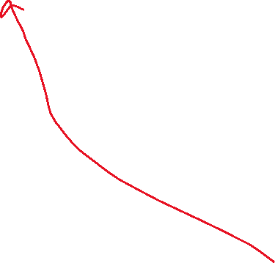


A website tracks books and the kids that read them. For each book the system stores the name and author. For each kid the system stores name and grade level. The teacher enters when a kid reads a particular book. It should be possible to print a report on a book that includes all kids who have read a particular book (with their grade level). It should be possible to print a report on a kid that includes the books (with authors) a particular kid has read.
To Do #1 Identify all the primary nouns
A primary noun is a noun in the problem that has attributes (other nouns)
Nouns that designate actors of the system (i.e. The user can click…) can be excluded
To Do #2 Write down the attributes (other nouns) associated with the primary nouns
To Do #3 Identify all the verbs
To Do #4 Identify which primary nouns are worked on by the verbs
To Do #5 Design a system using UML to handle this problem

Slide 18

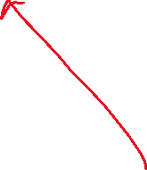
A website tracks books and the kids that read them. For each book the system stores the name and author. For each kid the system stores name and grade level. The teacher enters when a kid reads a particular book. It should be possible to print a report on a book that includes all kids who have read a particular book (with their grade level). It should be possible to print a report on a kid that includes the books (with authors) a particular kid has read.
To Do #1 Identify all the primary nouns
A primary noun is a noun in the problem that has attributes (other nouns)
Nouns that designate actors of the system (i.e. The user can click…) can be excluded
To Do #2 Write down the attributes (other nouns) associated with the primary nouns
To Do #3 Identify all the verbs
To Do #4 Identify which primary nouns are worked on by the verbs
To Do #5 Design a system using UML to handle this problem

Slide 19
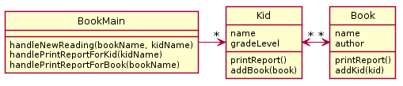
A website tracks books and the kids that read them. For each book the system stores the name and author. For each kid the system stores name and grade level. The teacher enters when a kid reads a particular book. It should be possible to print a report on a book that includes all kids who have read a particular book (with their grade level). It should be possible to print a report on a kid that includes the books (with authors) a particular kid has read.
Bad Design A
If you do this all well, then you should hopefully be able to make classes where:
Each primary noun becomes a Class
Each attribute (other noun) becomes a field for its respective class
Each verb becomes the method for the respective class
Notes:
There is no (sane) way to lookup a book to either lookup a book to add to a kid or print a report
Duplication of data

Slide 20


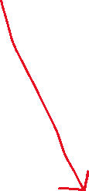
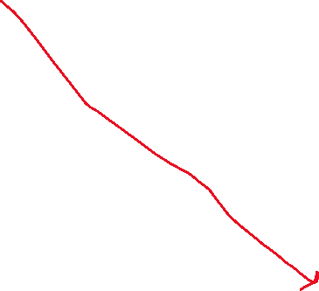
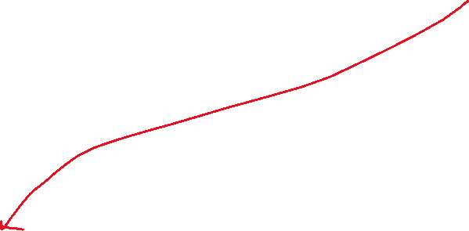
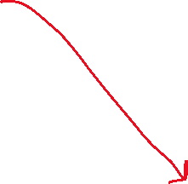
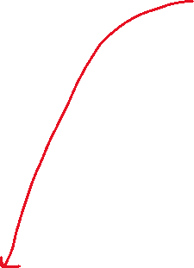
A website tracks books and the kids that read them. For each book the system stores the name and author. For each kid the system stores name and grade level. The teacher enters when a kid reads a particular book. It should be possible to print a report on a book that includes all kids who have read a particular book (with their grade level). It should be possible to print a report on a kid that includes the books (with authors) a particular kid has read.
Bad Design A
If you do this all well, then you should hopefully be able to make classes where:
Each primary noun becomes a Class
Each attribute (other noun) becomes a field for its respective class
Each verb becomes the method for the respective class
Notes:
There is no (sane) way to lookup a book to either lookup a book to add to a kid or print a report
Duplication of data

Slide 21
Good parts of the design - Main class
Every program starts somewhere, and any design should make clear where the starting point is. In our class, we will name the starting point class SomethingMain
We implicitly assume there exists:
constructors as needed
getters and setters as needed

Slide 22
Good parts of the design – “handle” methods
In our very simple designs, this class also deals with user input
handle methods will have special meaning for us, as they will represent places where user commands enter the system
Examine the UML diagram and use your analysis skills in order to determine:
If what is required by the story problem can be stored by the design presented in the UML diagram
If you can implement the handle methods in the UML Main class given the data stored in the different UML class diagram

Slide 23
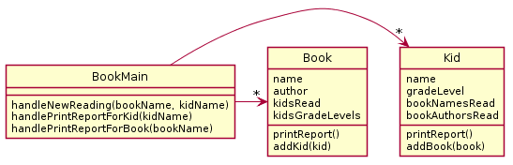
A website tracks books and the kids that read them. For each book the system stores the name and author. For each kid the system stores name and grade level. The teacher enters when a kid reads a particular book. It should be possible to print a report on a book that includes all kids who have read a particular book (with their grade level). It should be possible to print a report on a kid that includes the books (with authors) a particular kid has read.
PAUSE HERE for a couple minutes!
Try to see what you can think might be wrong
When you have an idea, then continue
Bad Design A
Bad Design B
Notes:
There is no (sane) way to lookup a book to either lookup a book to add to a kid or print a report
Duplication of data

Slide 24


This design does not function. There is no (sane) way to look up a book for printing a report or for associating with a Kid.

Slide 25




This design functions but there is a very large amount of duplication – which in general we want to avoid.
In particular, the author/title information in the kid is duplicated and the name/grade level information in the book is duplicated.
Notes:
@startuml
skinparam style strictuml
class Book {
name
author
printReport()
addKid(kid)
}
class Kid {
name
gradeLevel
printReport()
addBook(book)
}
class BookMain {
handleNewReading(bookname,kidname)
printReportForBook(bookname)
printReportForKid(kidname)
}
Kid "*" <-> "*" Book
BookMain -> "*" Book
BookMain -> "*" Kid
@enduml

Slide 26
What would be a better design?
PAUSE HERE for 5-10 minutes!
Try to make your own improved design
Either paper or using plantuml is OK!
A website tracks books and the kids that read them. For each book the system stores the name and author. For each kid the system stores name and grade level. The teacher enters when a kid reads a particular book. It should be possible to print a report on a book that includes all kids who have read a particular book (with their grade level). It should be possible to print a report on a kid that includes the books (with authors) a particular kid has read.
Problematic designs for reference:
Bad Design A
Bad Design B

Slide 27
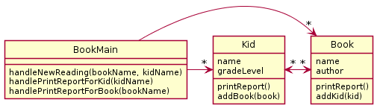
A Potential Solution
A website tracks books and the kids that read them. For each book the system stores the name and author. For each kid the system stores name and grade level. The teacher enters when a kid reads a particular book. It should be possible to print a report on a book that includes all kids who have read a particular book (with their grade level). It should be possible to print a report on a kid that includes the books (with authors) a particular kid has read.
If you do this all well, then you should hopefully be able to make classes where:
Each primary noun becomes a Class
Each attribute (other noun) becomes a field for its respective class
Each verb becomes the method for the respective class

Slide 28
In most cases non-workable design is caused by…
Not carefully analyzing the story problem.
Not carefully mapping the story problem to the proposed design (e.g., not noticing that each kid reads several books, not just one)
Not thinking about how specific required features might be implemented (e.g., how can we print a book report if we don’t have access to the book objects?)
Duplicating data (e.g., what does it matter if we store a copy of the author and title for every kid that reads the book)

Slide 29
Design Problem – Company Accounts

Slide 30
Do the in-class activity
A particular company keeps a variety of different accounts for its projects. Each account has an account number and a balance. When a deposit or withdrawal occurs, the transaction occurs immediately, and the current balance should be updated. The system should support getting the current balance.
The system should also support getting the balance as it existed at any date/time in the past. Note the input historical date/time may not correspond to a particular transaction time - e.g., if the system had a balance of $1 at 1 p.m. and then was changed to $2 at 3 p.m., a request for the balance at 2 p.m. should return $1.
To Do #1 Identify all the primary nouns
A primary noun is a noun in the problem that has attributes (other nouns)
Nouns that designate actors of the system (i.e. The user can click…) can be excluded
To Do #2 Write down the attributes (other nouns) associated with the primary nouns
To Do #3 Identify all the verbs
To Do #4 Identify which primary nouns are worked on by the verbs
To Do #5 Design a system using UML to handle this problem

Slide 31
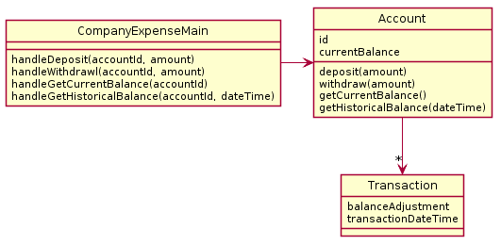
What is wrong with this design? This design?
PAUSE HERE for a couple minutes!
Try to see what you can think might be wrong
When you have an idea, then continue
A particular company keeps a variety of different accounts for its projects. Each account has an account number and a balance. When a deposit or withdrawal occurs, the transaction occurs immediately and the current balance should be updated. The system should support getting the current balance.
The system should also support getting the balance as it existed at any date/time in the past. Note the input historical date/time may not correspond to a particular transaction time - e.g. if the system had a balance of $1 at 1 pm and then was changed to $2 at 3 pm, a request for the balance at 2 pm should return $1.
Bad Design A
Quiz question
#6
Note:
Don’t read more into the English text than is there, e.g., “there ought to be a way to create accounts!”
6

Slide 32
This design does not function correctly. Why?
Main has only one account, but the system needs to support many. How do we know that from this diagram?
Also, computing the data for historic balances is moderately hard.

Slide 33
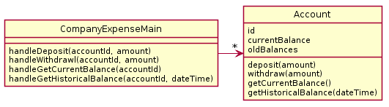
Questions #7 & #8 on today’s quiz
A particular company keeps a variety of different accounts for its projects. Each account has an account number and a balance. When a deposit or withdrawal occurs, the transaction occurs immediately and the current balance should be updated. The system should support getting the current balance.
The system should also support getting the balance as it existed at any date/time in the past. Note the input historical date/time may not correspond to a particular transaction time - e.g. if the system had a balance of $1 at 1pm and then was changed to $2 at 3pm., a request for the balance at 2pm should return $1.
Find the problem with this design
PAUSE HERE for a couple minutes!
Try to see what you can think might be wrong
When you have an idea, then continue
Bad Design B
7-8

Slide 34
This design does not function correctly.
Account does not have enough data to make getHistoricalBalance work. oldBalances stores perhaps a list of balances? But the date of the transactions is not stored, so we can't look up the balance on a particular day/time.

Slide 35
Questions #7 & #8 on today’s quiz
A particular company keeps a variety of different accounts for its projects. Each account has an account number and a balance. When a deposit or withdrawal occurs, the transaction occurs immediately and the current balance should be updated. The system should support getting the current balance.
The system should also support getting the balance as it existed at any date/time in the past. Note the input historical date/time may not correspond to a particular transaction time - e.g. if the system had a balance of $1 at 1pm and then was changed to $2 at 3pm., a request for the balance at 2pm should return $1.
Propose your own design
PAUSE HERE for 5-10 minutes!
Try to make your own improved design
Either paper or using plantuml is OK!
7-8

Slide 36

Here is a potential solution

Slide 37
Here is a potential solution
Note: balances & transactionDateTimes – are parallel ArrayLists
The 's' at the end of the names balances and transactionDateTimes this is an indicator that each stores multiple values – these are really parallel ArrayLists
Alternative to parallel ArrayLists: Create a single new class to capture balance and transactionDateTime, then create a single ArrayList of this new class

Slide 38
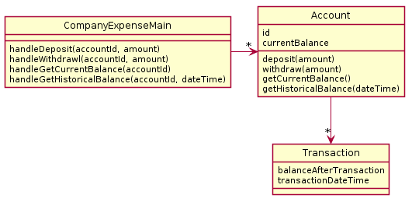
Here is second potential solution
Technically, this class is just a “dumb” data holder and has no methods that work on the data stored with the objects of this class.
Consider: is this design more flexible if we get new requirements, like for instance needing a transactionReport() method?

Slide 39
Design Problems 1 Homework
Before next class:
Solve the Design Problem 1 Homework (Moodle -> GradeScope)
These are due the day of next class in the morning at 7:55AM
Anything turned in late will be worth zero points
We will go over the solution at the start of class
We’ll discuss more design principles after Exam 1
One more example Design Problem you can practice on your own or with classmates on the slides that follow
Notes:
Briefly show the website description and how points are awarded on gradescope

Slide 40
Extra Practice – Complete on Your own
We are probably out of time by this point in class, but we have a practice problem setup for you to complete on your own outside of class on the next few slides.

Slide 41
Design Problem – Card Game
On the next slide is another story problem
To be successful at solving these types of problems you must first read the story problem and do the following “To Do”s
To Do #1 Identify all the primary nouns
A primary noun is a noun in the problem that has attributes (other nouns)
Nouns that designate actors of the system (i.e. The user can click…) can be excluded
To Do #2 Write down the attributes (other nouns) associated with the primary nouns
To Do #3 Identify all the verbs
To Do #4 Identify which primary nouns are worked on by the verbs
To Do #5 Design a system using UML to handle this problem

Slide 42
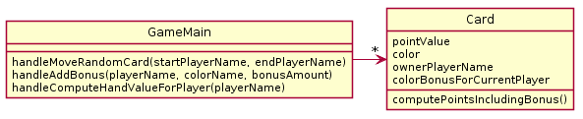
In a particular card game, players have hands of cards. Each card is worth some points and also has a color (red, blue, green). During play, players accrue bonuses that mean cards of a particular color are worth bonus points. During play, sometimes a random card is selected from one player's hand and moved to another player's hand. At the end of game, it is necessary to compute the total points for each player's hand.
What is wrong with this design? (Hint: look at and refer to your design principles by number). I see at least 2 separate categories violated.
PAUSE HERE for a couple minutes!
Try to see what you can think might be wrong
When you have an idea, then continue

Slide 43
My answer (in order of importance)
1a. The design does not function correctly
The player’s color bonus cannot be preserved if he/she loses all their cards of a particular color
It requires iterating over all objects to get the full set of cards in the players hands to move cards or compute final total
1c. Playername & player color bonus are duplicated across cards
2a. Player (common noun from problem) not represented
Notes:
Note for 1a – obviously you try to use nouns from the description. But its not required

Slide 44
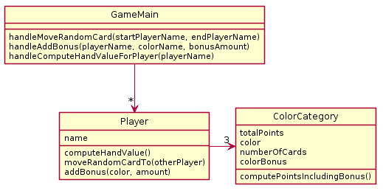
In a particular card game, players have hands of cards. Each card is worth some points and has a color (red, blue, green). During play, players accrue bonuses that mean cards of a particular color are worth bonus points. During play, sometimes a random card is selected from one player's hand and moved to another player's hand. At the end of game, it is necessary to compute the total points for each player's hand.
What is wrong with this design? (Hint: look at and refer to your design guidelines). I see at least 2 separate categories violated.
PAUSE HERE for a couple minutes!
Try to see what you can think might be wrong
When you have an idea, then continue

Slide 45
Some design flaws noticed (in order of importance)
1a. The design does not function correctly
Once a card is added to a player's hand, its specific point value is lost so the card cannot be randomly moved to another player's hand
2a. Card (common noun from problem) is not represented

Slide 46
In a particular card game, players have hands of cards. Each card is worth some points and has a color (red, blue, green). During play, players accrue bonuses that mean cards of a particular color are worth bonus points. During play, sometimes a random card is selected from one player's hand and moved to another player's hand. At the end of game, it is necessary to compute the total points for each player's hand.
Now design your solution that solves all problems.
PAUSE HERE for 5-10 minutes!
Try to make your own improved design
Either paper or using plantuml is OK!

Slide 47
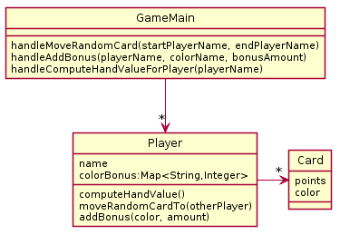
A Potential Solution
Reminder:
We implicitly assume there exists:
constructors as needed
getters and setters as needed
getPoints(), getColor() too
Notes:
Since UML is meant to be a simple way to communicate, we often omit simple methods like getters and setters.
If we want you to show all methods, we will tell you to do so

