Slide 1
CSSE 220
Main Game Loop with Timers

Slide 2
Objectives
Just-in-time Final Project Preparation
  Learn how to avoid common project errors
  Learn how to setup a timer to create events
    Practice with live-coding
  Practice interaction between game elements
  More practice with file I/O

Slide 3
Threads
Computers can run more than one thread of execution at the same time
  Even single core processor can simulate this by timesharing (more about this in future courses)
Main starts every Java program
Graphics start a separate thread
Multiple threads can create painful problems
  Can be hard to debug (race conditions, ConcurrentModificationException)
Notes:
Consider drawing a single diagram on the board showing separate thread of execution as lines

Slide 4
main's and Graphics' Threads
Time
Every program starts in main and begins executing one statement at a time
When a JFrame is created there is a second thread that starts running (at the same time, i.e., in parallel) and it will continue to run even if our main thread completes exits
The setting for JFrame setDefaultCloseOperation() determines if the Java Graphics thread continues to run after closing the window.
main's thread of control
Java Graphics'
thread of control
JFrame.EXIT_ON_CLOSE

Slide 5
Concurrent Modification Exceptions
Happens when you try to change something that is being used
Example:
  Removing something from a list while the list is itself being iterated through (drawing/updating)
Why?
Main Thread
Java Graphics Thread
for (Item item: myList){
item.draw();
}
myList.remove(0);
Notes:
Ask students:
Imagine a list gets changed while you try to move through it, what could go wrong?
Read from bad location in memory, get into infinite loop, double visit, skip, etc.

Slide 6
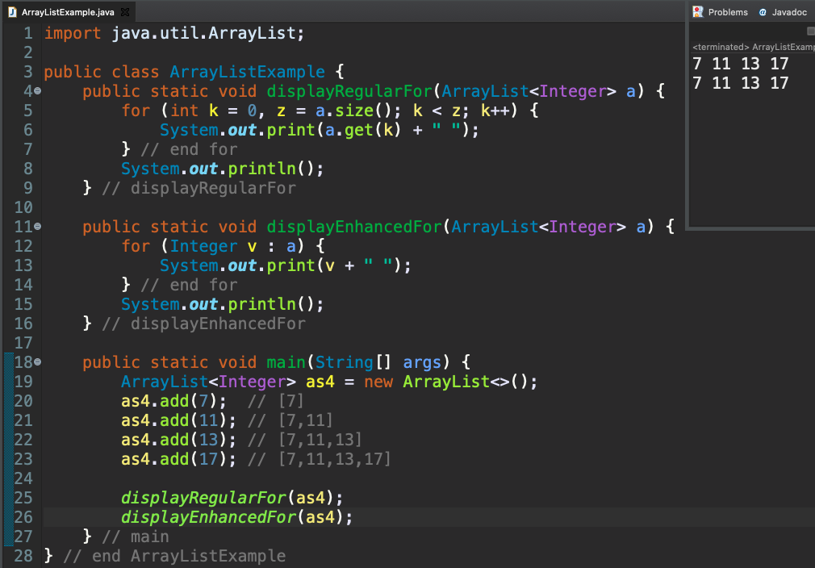
for Loops and ArrayList

Slide 7
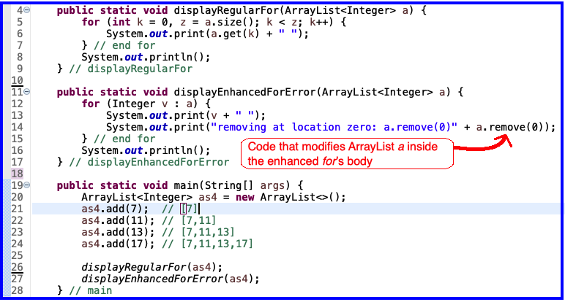
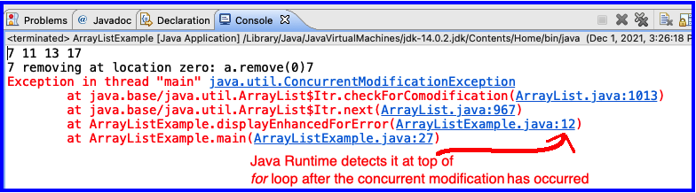
Concurrent Modification
This is a problem
for enhanced for
because length of 'a' has changed
But enhanced for is still using
original length of
'a'

Slide 8
Timer
An alternative to a thread that waits/sleeps
Creates events periodically
Allows main thread to finish
Designed to work in same thread as graphics
Superior approach for final project if game state needs to update automatically
  not just after user actions
Similar functionality required for GARP

Slide 9
Timer
Time
main thread
Java Graphics Thread
public void advanceOneTick() {
myComponent.updateState();
myComponent.drawScreen();
}
Exit
public void advanceOneTick() {
myComponent.updateState();
myComponent.drawScreen();
}
Each tick of the Timer
public void advanceOneTick() {
myComponent.updateState();
myComponent.drawScreen();
}

Slide 10
Live-coding
src/gameEventLoop
Notes:
* In this exercise, we develop each of these ideas.
* TODO: Replace the loop with button input to advance one tick.
* TODO: Replace the button with a timer.
* TODO: Make the button change the direction of motion.
* TODO: Add falling raindrops.
* TODO: Make the box "catch" drops that hit it.

