Slide 1
Final Project
Milestone 1
Project Teamwork and Roles

Slide 2
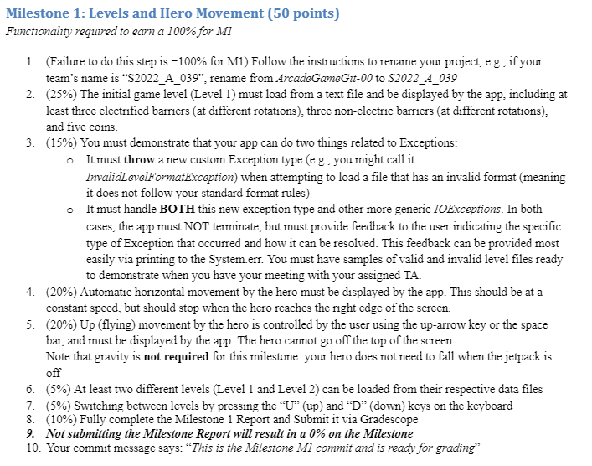
Old Arcade Game M1: Levels and Hero Movement

Slide 3
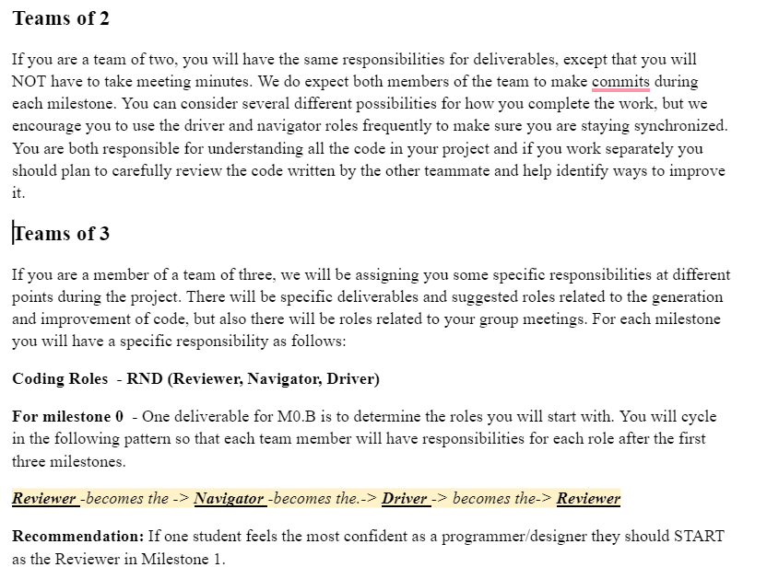
RND+T – Reviewer, Navigator, Drive, Tester
There is NO coding for M0. I recommend you all meet together since it is a critical part of setting up your design and you want to be in sync and in agreement as much as possible!

Slide 4
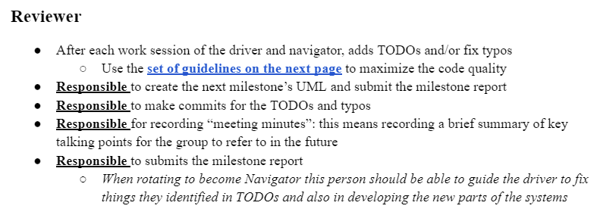
Reviewer

Slide 5
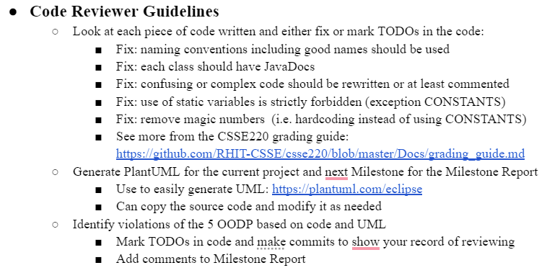
Code Review Guidelines

Slide 6
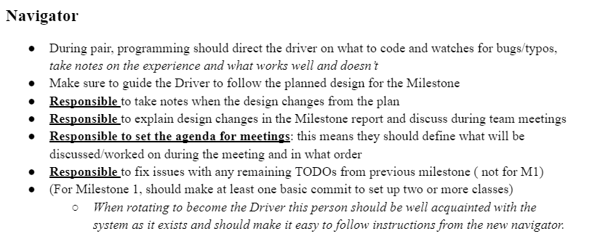
Navigator

Slide 7
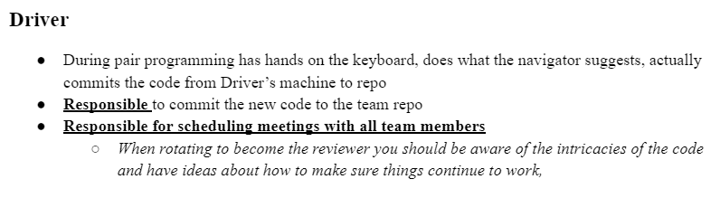
Driver

Slide 8
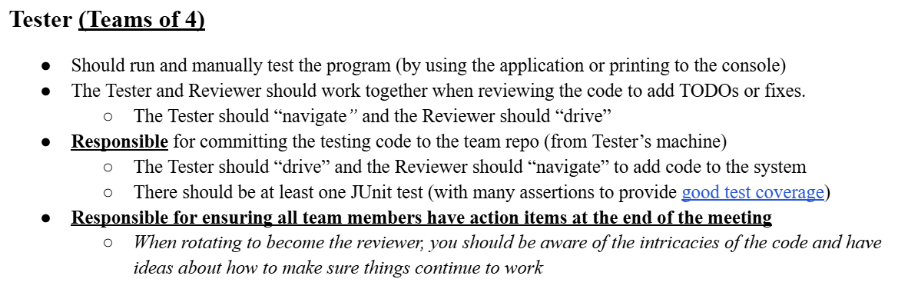
Tester (Teams of 4)

Slide 9
Code Testing Guidelines
Review slides from the class session on Unit Testing
Include assert statements to cover:
  The most common cases
  The edge cases or boundary cases (minimum, maximum, switching from positive to negative, etc.)
  All specific/special cases (e.g., when 0 or null the behavior is different than for any other value)
  When you find and fix a defect, then at that same time, create a unit test that would have revealed that defect.
  Any overly complex code that the items above don’t cover

Slide 10
Code Testing Guidelines
You should decide which code would be most helpful to test. The tests should be useful for your project and nontrivial. Here are some suggestions, but similarly scoped tests could be used instead:
  Milestone 1 - Make sure that a file is read in properly, correctly instantiates objects, and confirms their correct properties. (e.g., load level1.txt and make sure a Hero is created and positioned properly at (20,40)).
  Milestone 2 - Make sure that the Hero obeys Gravity and collisions with platforms (e.g., create a Hero that is created at position (20,40), falls at the rate of gravity until hitting a platform below it (20, 400). Make sure the Hero’s position is correct at each step and that the Hero’s position is correct after calling the relevant collision and update code.)
  Milestone 3 - Verify that a collision between a Hero and an Enemy is processed correctly as desired. (e.g., You can create a Hero and an Enemy, and then call the relevant code to handle their collision and make appropriate updates to each object, i.e., killing the Hero or killing the Enemy and increasing the score, etc.)
  Milestone 4 - Pick one of your bonus additional features and create tests to make sure that they work as desired.
Although not required, one approach to software development is Test Driven Development (TDD).
  We encourage you to employ TDD for at least one of these unit tests, Milestone 4 might be a good one since you will need to define how things should operate for a special feature.

