Slide 1
CSSE 220
Console Input
The git projects for today are:
PracticeConsoleAndUnitTesting
PracticeConsoleAndUnitTestingSolution
Notes:
Bring hard copy of code from UnitTesting

Slide 2
Console input with Scanner
Creating a Scanner object
import java.util.Scanner;
Scanner inputScanner = new Scanner(System.in);
Defines methods to read from keyboard
inputScanner.nextInt();
inputScanner.nextDouble();
inputScanner.nextLine();
inputScanner.next();
Exercise: Look at UnitTesting/src/ConsoleWorker.java. Add missing methods to read from console
Q1
Notes:
Do an example with students and have them do the rest on their own.

Slide 3



Tokens
Jason Yoder CSSE 220
Repeatedly calling scanner.next() will return the next token as a String and advance the cursor to the next token
Calling scanner.nextLine() will grab the entire line at once and return as a String.

Slide 4
Backslash (\ ) Escape Characters
The backslash symbol “\” is an escape character
“\n” means new line
When you press “enter” when typing, that is recorded as a special new line character
If you want to print a backslash in a Java string, you have to escape it as well i.e. “\\”
Similarly, to see a double quote you need to escape it: “Here is an escape double quote: \” in a string”
nextLine() reads until finding a “\n” character

Slide 5
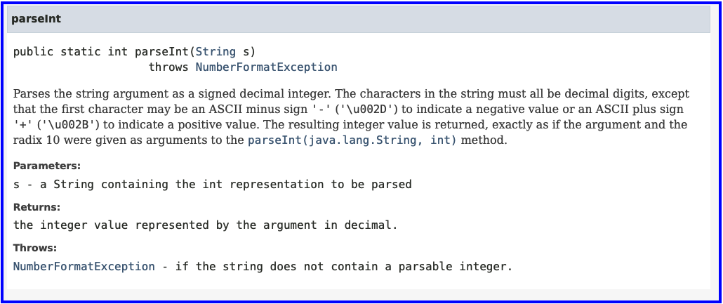
Parse Integer
String nextToken = inputScanner.next();
int x = Integer.parseInt(nextToken);
Notes:
Do an example with students and have them do the rest on their own.

Slide 6
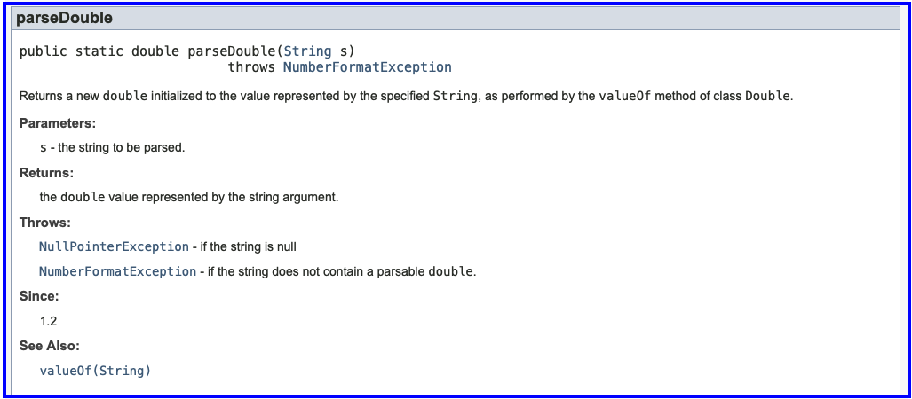
Parse Double
String nextToken = inputScanner.next();
double z = Double.parseDouble(nextToken);
Notes:
Do an example with students and have them do the rest on their own.

