Slide 1
CSSE 220
Variable Scope
Console Input
Unit Testing
The git projects for today are:
PracticeConsoleAndUnitTesting
PracticeConsoleAndUnitTestingSolution
Notes:
Bring hard copy of code from UnitTesting

Slide 2
Outline
Review: Dependencies, Coupling, Cohesion
Variable Scoping
Console Input
Unit Testing

Slide 3
Review
Encapsulation
Collocate within a class data fields and the methods that work on those fields
Use private keyword for most data fields, this is called compiler enforced encapsulation

Slide 4
Review
Minimize Dependencies by (low coupling):
Using tell don’t ask – when a client of a class has an algorithm that could be located within that class (this is an ask algorithm), move that algorithm/method from client into the class (so it becomes a tell algorithm)
Don’t use message chains – instead instrument the called-on classes to provide methods to do the work
Low coupling means dependencies are minimized

Slide 5
Review
High Cohesion Rule for Classes
Make each class do one thing well
Micro-Cohesion Rules for Class Implementations
Make each operation do one thing well
Make each loop do only one thing

Slide 6
Rule of Thumb: No Global Variables
Or static variables that are used like globals
A static variable can be accessed/modified in any function at any time
As a result many parts of the code can be coupled to a single class

Slide 7
Variable Scope
Notes:
Bring hard copy of code from UnitTesting

Slide 8
Rule of Thumb: No Global Variables
Or static variables that are used like globals
A static variable can be accessed/modified in any function at any time
As a result many parts of the code can be coupled to a single class
Why?
Increases coupling among all the clients that get or change value of the global variable

Slide 9
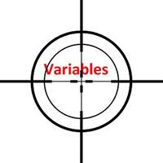
Variable Scope
Scope is the region of a program in which a variable can be accessed
Scope of a parameter: throughout the entire method body
public double myMethod(ArrayList<Point2D> pts)
{ double sum = 0.0; Point2D prev = pts.get(pts.size() - 1); for (Point2D p : pts) { sum += prev.getX() * p.getY(); sum -= prev.getY() * p.getX(); prev = p; } // end for return Math.abs(sum / 2.0); } // myMethod
Notes:
Scope refers to the lifetime and accessibility of a variable.
How large the scope is depends on where a variable is declared. For example, if a variable is declared at the top of a class then it will be accessible to all of the class methods. If it’s declared in a method then it can only be used in that method.
Show scope of:
- sum
- prev
- p

Slide 10
Variable Scope
Scope is the region of a program in which a variable can be accessed
A block is created by curly braces, here is a block: { … }
Scope of a local variable: from its declaration to end of block it is declared in
public double myMethod(ArrayList<Point2D> pts) { double sum = 0.0; Point2D prev = pts.get(pts.size() - 1); for (Point2D p : pts)
{ sum += prev.getX() * p.getY(); sum -= prev.getY() * p.getX(); prev = p; } // end for return Math.abs(sum / 2.0); } // myMethod
sum
prev
Notes:
Scope refers to the lifetime and accessibility of a variable.
How large the scope is depends on where a variable is declared. For example, if a variable is declared at the top of a class then it will be accessible to all of the class methods. If it’s declared in a method then it can only be used in that method.
Show scope of:
- sum
- prev
- p

Slide 11
Member Scope (Field or Method)
Member Variable Scope
Scope of a class's member: anywhere in the class, including before its declaration
Allows a method to call another method that appears anywhere else in the class
public static class members can be accessed from outside by using the class's name:
Math.sqrt()
System.in
Class MyClass {
. . .
// member variable declarations
. . .
public void aMethod(params…) {
. . .
// local variable declarations
. . .
for(int k = 0; k < 10; k++)
{. . . }
. . .
}
. . .
}
Method Parameter Scope
Local Variable Scope
Block scope

Slide 12
Overlapping Scope and Shadowing
public class TempReading {
private double temp;
public void setTemp(double temp) {
… temp …
}
// …
}
this.temp = temp;
Always qualify field references with this.
It prevents accidental shadowing.
Notes:
this.temp = temp; line is animated
The scope of this.temp overlaps with the scope of the parameter temp.
In Java, if you do not quality the field with “this”, the local variable shadows the instance field with the same name (local variable wins!)
Always… callout is animated
this will always recover the instance variable.
Shadowing is hiding a variable by defining another variable with the same name.

Slide 13
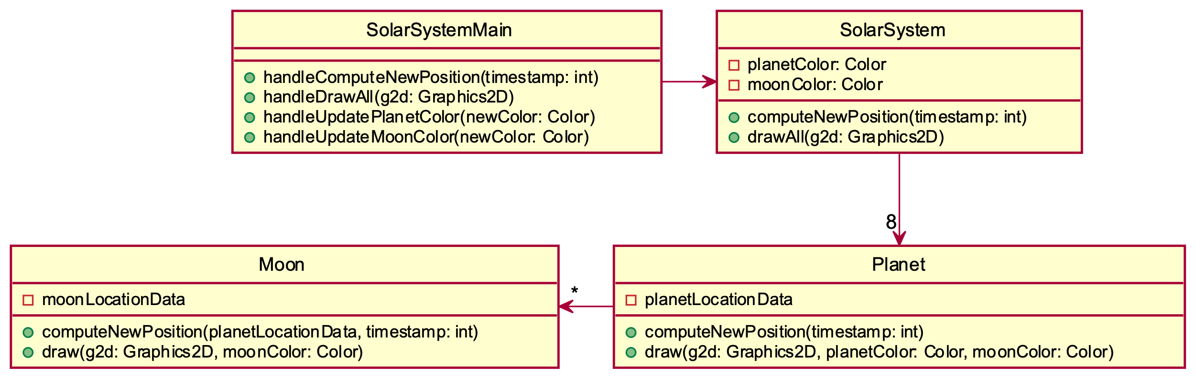
Global/Static Variables are bad, why?
For example, what if planetColor, moonColor were static?
Notes:
What if we suddenly wanted to add a second solar system…
Static makes for bad design, i.e. hard to use/reuse/extend

Slide 14
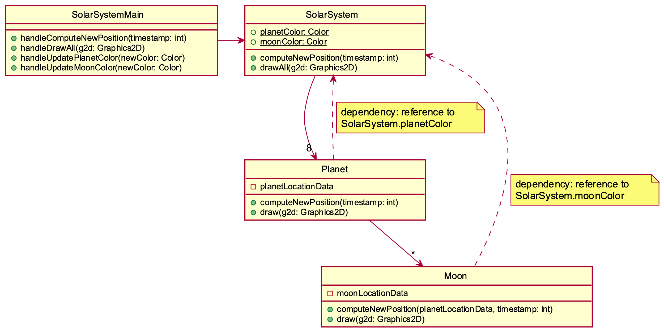
Global/Static Variables are bad, why?
This design has more dependencies, higher coupling! Poorer design!
planetColor and moonColor are now public static fields in SolarSystem
So, they are not passed as parameters to the draw methods
Now the draw methods directly access those static variables
void draw(Graphics g2d) {
// ... g2d.setColor(SolarSystem.moonColor);
} // draw

Slide 15
Console Input with java.util.scanner
Reading keyboard input from the console

Slide 16
Console input with Scanner
Creating a Scanner object
import java.util.Scanner;
Scanner inputScanner = new Scanner(System.in);
Defines methods to read from keyboard
inputScanner.nextInt();
inputScanner.nextDouble();
inputScanner.nextLine();
inputScanner.next();
Exercise: Look at UnitTesting/src/ConsoleWorker.java. Add missing methods to read from console
Q1
Notes:
Do an example with students and have them do the rest on their own.

Slide 17
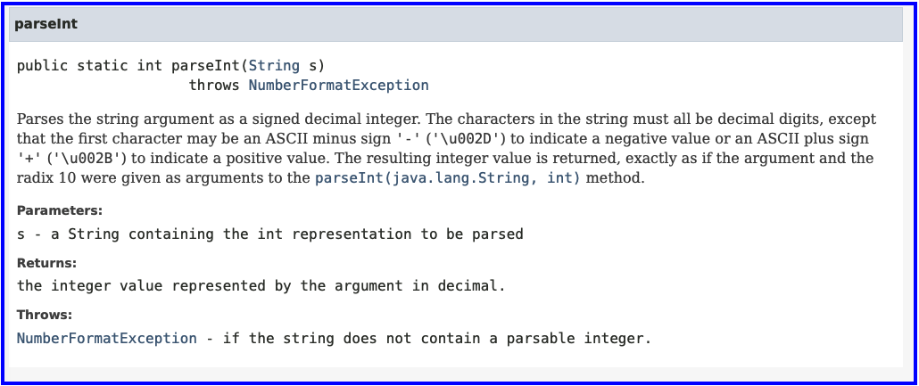
Parse Integer
String nextToken = inputScanner.next();
int x = Integer.parseInt(nextToken);
Notes:
Do an example with students and have them do the rest on their own.

Slide 18
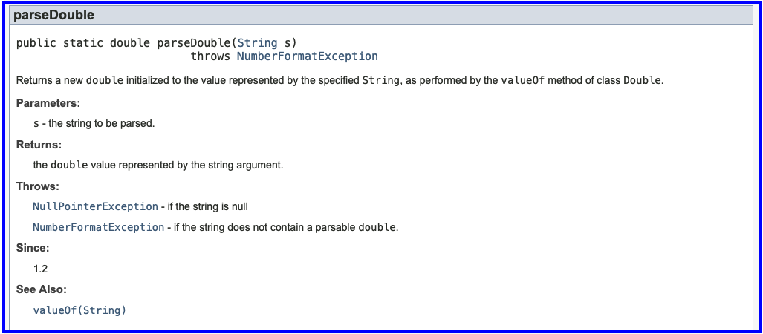
Parse Double
String nextToken = inputScanner.next();
double z = Double.parseDouble(nextToken);
Notes:
Do an example with students and have them do the rest on their own.

Slide 19
Unit Testing
Notes:
Bring hard copy of code from UnitTesting

Slide 20
Unit Testing
Idea: Test “small pieces” of larger program
Do the expected values match what you ACTUALLY get?
How to test in this manner?
Could make a main method that calls all the methods
Use Java's JUnit testing framework
Creating a Tester JUnit class
Q2

Slide 21
Why Unit Testing?
There are several goals of unit testing:
Make sure your code works (as specified!)
Keep it working
Confirm understanding of the specification
Confirm pieces of code in isolation
Provide Documentation
Q3

Slide 22
Unit Tests (as done in CSSE120)
Construct one or more objects of the class that is being tested
Invoke one or more methods
Print out one or more results
Print the expected results
Do 3 and 4 match?
(Pages 102-103 in book)

Slide 23
Why JUnit?
Provides a Framework
Framework: Collection of classes to be used by another program
Provides easy-to-read output in Eclipse
Printouts require you to analyze all lines
What if it scrolls off the page?
What if it’s only 1 character different?

Slide 24
What are quality unit tests?
Unit tests should be small pieces that test:
The most common cases
The edge cases or boundary cases (minimum, maximum, switching from positive to negative, etc.)
All specific/special cases (e.g., when 0 or null the behavior is different than for any other value)
When you find and fix a defect, then at that same time, create a unit test that would have revealed that defect. Then in future modifications to the code, if that defect gets reintroduced, the new unit test you created will reveal its presence
Any overly complex code that 1-4 above don’t cover
Q4

Slide 25
What is a poor quality test case?
A test case that provides illegal input to the operation
For example, the deposit method from the BankAccount class
It has a requires clause that states the depositAmount > 0
Testing it with a negative number is a poor test case because it requires non-negative input
Q4

Slide 26
Unit Testing
Use JUnit “assert” to make sure results match https://junit.org/junit4/javadoc/latest/org/junit/Assert.html
Let’s look at BadFrac.java and BadFracTest.java
Let’s make some unit tests and figure out why this project has been yielding some strange results
Notes:
You can decide whether you want to show the students how to generate the toString and equals methods when testing the addFrac method to do an assertEquals(), or if you want to reduce the amount of time taken, you can also choose to simply compare the actual numerator and denominator as in the solution code.

Slide 27
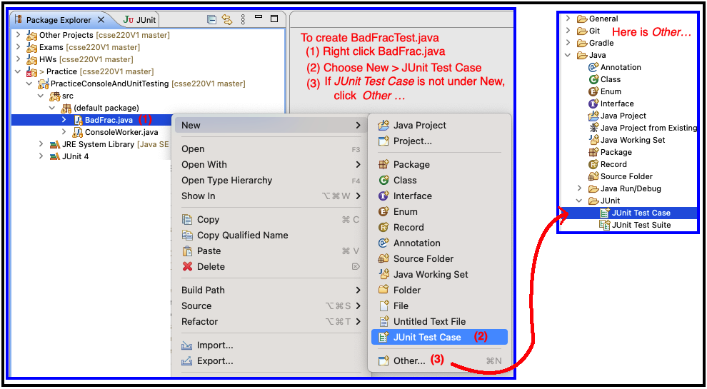
Unit Testing
Create BadFracTest.java – then create test cases
Notes:
You can decide whether you want to show the students how to generate the toString and equals methods when testing the addFrac method to do an assertEquals(), or if you want to reduce the amount of time taken, you can also choose to simply compare the actual numerator and denominator as in the solution code.

Slide 28
UnitTesting Homework
Import from your repo
Go to Moodle to see due date

Slide 29
Exam 1 Review - Written
Review for written portion of Exam 1

