Slide 1
CSSE 220
Variable Scope
The git projects for today are:
PracticeConsoleAndUnitTesting
PracticeConsoleAndUnitTestingSolution
Notes:
Bring hard copy of code from UnitTesting

Slide 2
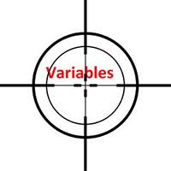
Variable Scope
Scope is the region of a program in which a variable can be accessed
Scope of a parameter: throughout the entire method body
public double myMethod(ArrayList<Point2D> pts)
{ double sum = 0.0; Point2D prev = pts.get(pts.size() - 1); for (Point2D p : pts) { sum += prev.getX() * p.getY(); sum -= prev.getY() * p.getX(); prev = p; } // end for return Math.abs(sum / 2.0); } // myMethod
Notes:
Scope refers to the lifetime and accessibility of a variable.
How large the scope is depends on where a variable is declared. For example, if a variable is declared at the top of a class then it will be accessible to all of the class methods. If it’s declared in a method then it can only be used in that method.
Show scope of:
- sum
- prev
- p

Slide 3
Variable Scope
Scope is the region of a program in which a variable can be accessed
A block is created by curly braces, here is a block: { … }
Scope of a local variable: from its declaration to end of block it is declared in
public double myMethod(ArrayList<Point2D> pts) { double sum = 0.0; Point2D prev = pts.get(pts.size() - 1); for (Point2D p : pts)
{ sum += prev.getX() * p.getY(); sum -= prev.getY() * p.getX(); prev = p; } // end for return Math.abs(sum / 2.0); } // myMethod
sum
prev
Notes:
Scope refers to the lifetime and accessibility of a variable.
How large the scope is depends on where a variable is declared. For example, if a variable is declared at the top of a class then it will be accessible to all of the class methods. If it’s declared in a method then it can only be used in that method.
Show scope of:
- sum
- prev
- p

Slide 4
Member Scope (Field or Method)
Member Variable Scope
Scope of a class's member: anywhere in the class, including before its declaration
Allows a method to call another method that appears anywhere else in the
public static class members can be accessed from outside using the class's name:
Math.sqrt()
System.in
Class MyClass {
. . .
// member variable declarations
. . .
public void aMethod(params…) {
. . .
// local variable declarations
. . .
for(int i = 0; i < 10; i++)
{. . . }
. . .
}
. . .
}
Method Parameter Scope
Local Variable Scope
Block scope

Slide 5
Overlapping Scope and Shadowing
public class TempReading {
private double temp;
public void setTemp(double temp) {
… temp …
}
// …
}
this.temp = temp;
Always qualify field references with this.
It prevents accidental shadowing.
Notes:
this.temp = temp; line is animated
The scope of this.temp overlaps with the scope of the parameter temp.
In Java, if you do not quality the field with “this”, the local variable shadows the instance field with the same name (local variable wins!)
Always… callout is animated
this will always recover the instance variable.
Shadowing is hiding a variable by defining another variable with the same name.

Slide 6
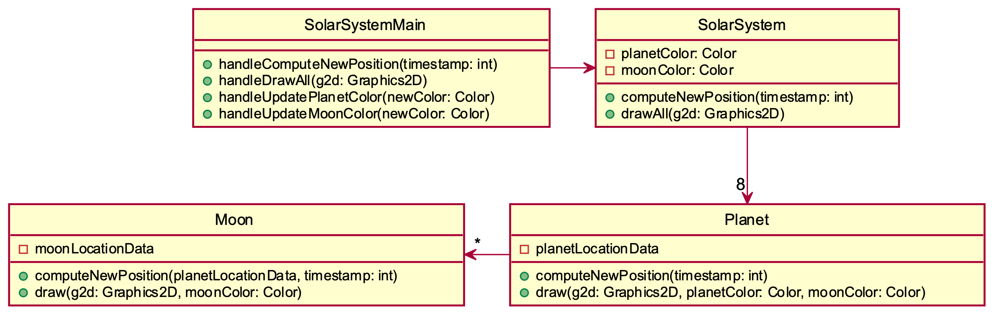
Global/Static Variables are bad, why?
For example, what if planetColor, moonColor were static?
Notes:
What if we suddenly wanted to add a second solar system…
Static makes for bad design, i.e. hard to use/reuse/extend

Slide 7
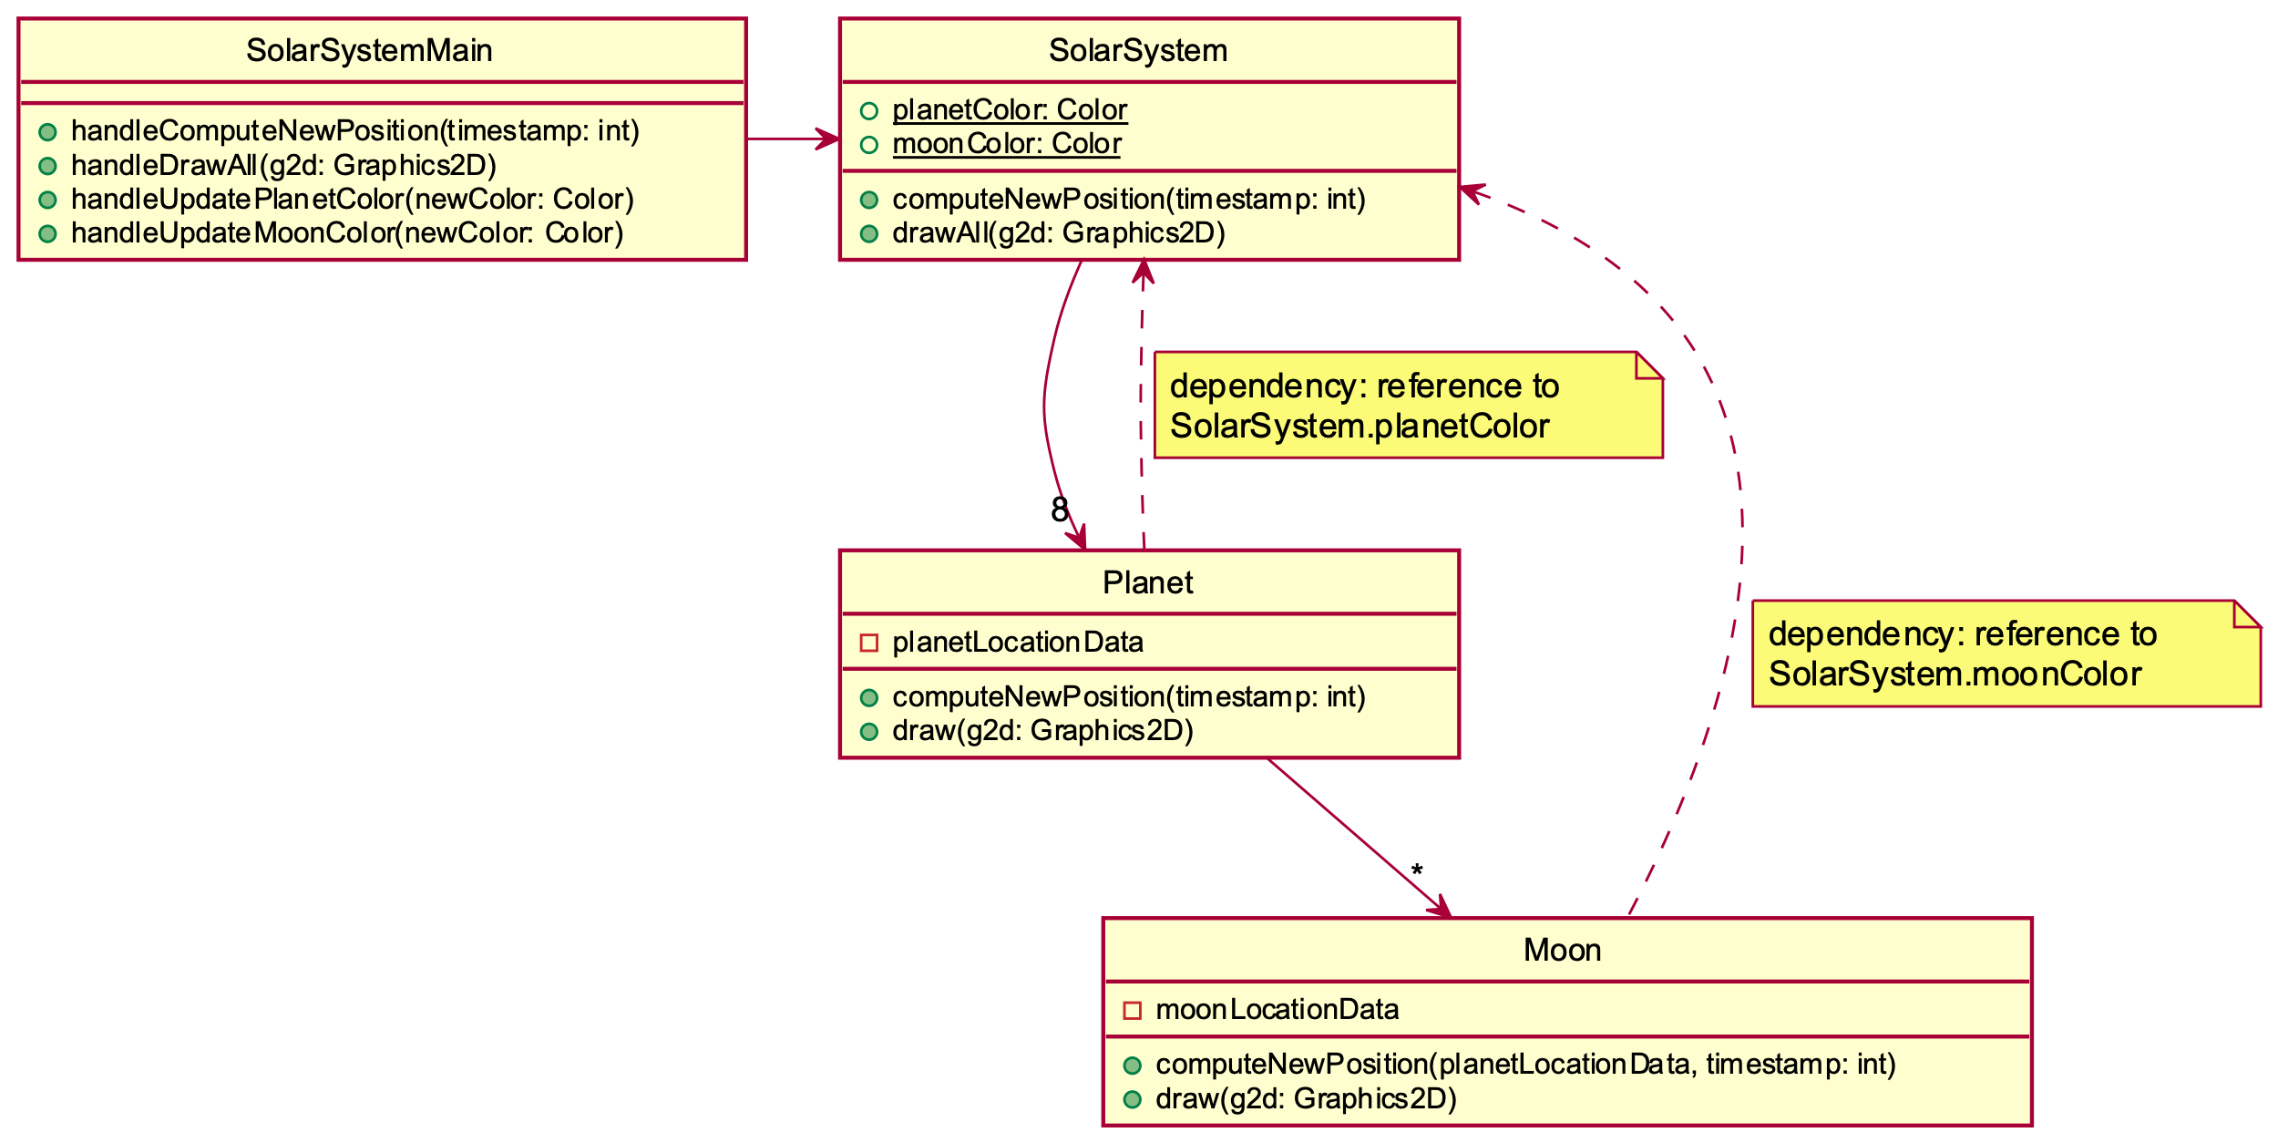
Global/Static Variables are bad, why?
This design has more dependencies, higher coupling! Poorer design!
planetColor and moonColor are now public static fields in SolarSystem
So, they are not passed as parameters to the draw methods
Now the draw methods directly access those static variables
void draw(Graphics g2d) {
// ... g2d.setColor(SolarSystem.moonColor);
} // draw

