Slide 1

Slightly Spooky
Project Reminders
BEWARE
of these common mistakes, design flaws, and faux pas
CSSE 220, Fall 2025

Slide 2

Magic Numbers

Slide 3
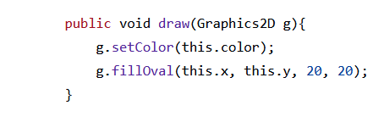
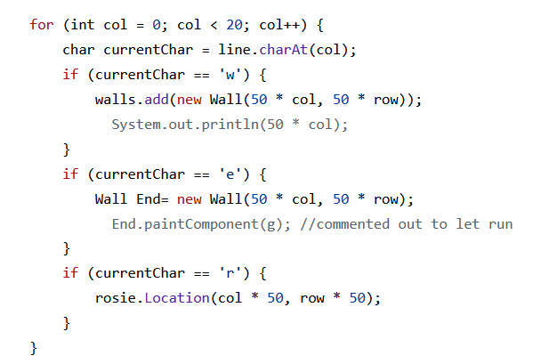
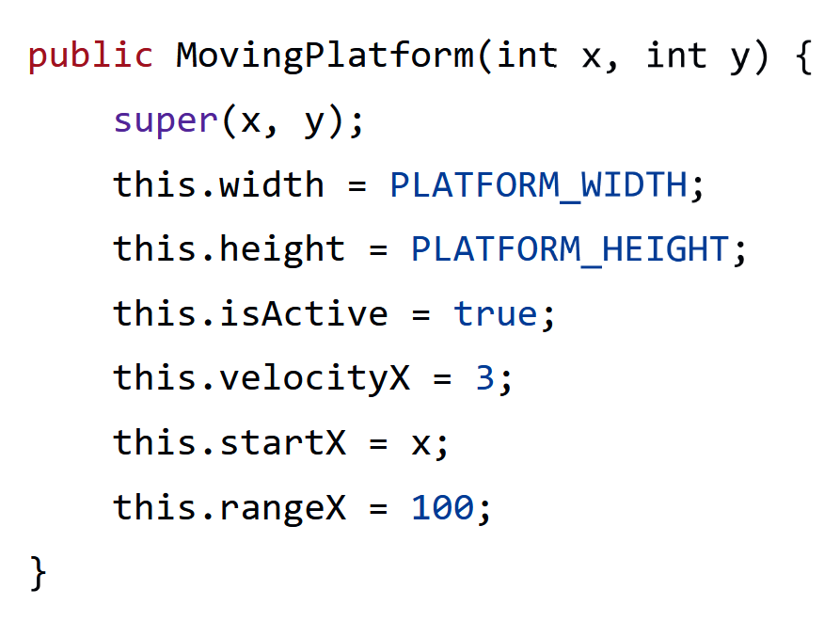
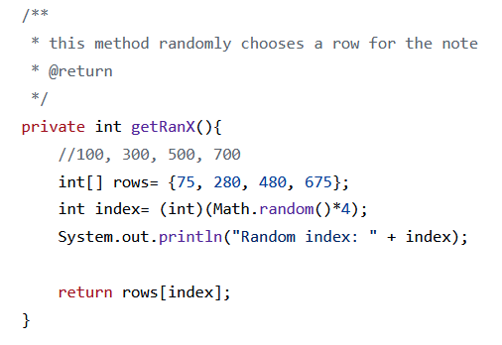
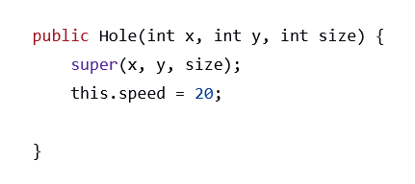
Magic Numbers: Examples

Slide 4

Headless Classes
(Missing class-level JavaDoc)

Slide 5
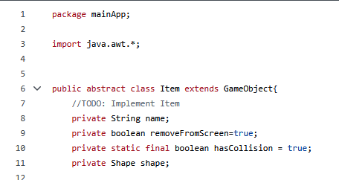
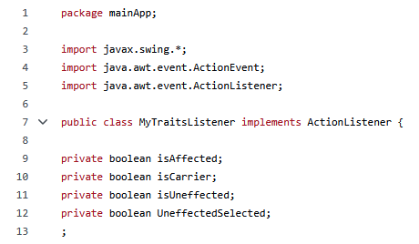
Headless Classes: Examples

Slide 6

Spaghetti Monster Methods
(Too long/convoluted)

Slide 7
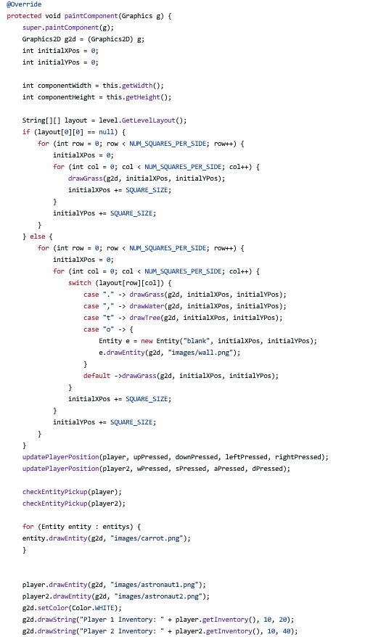
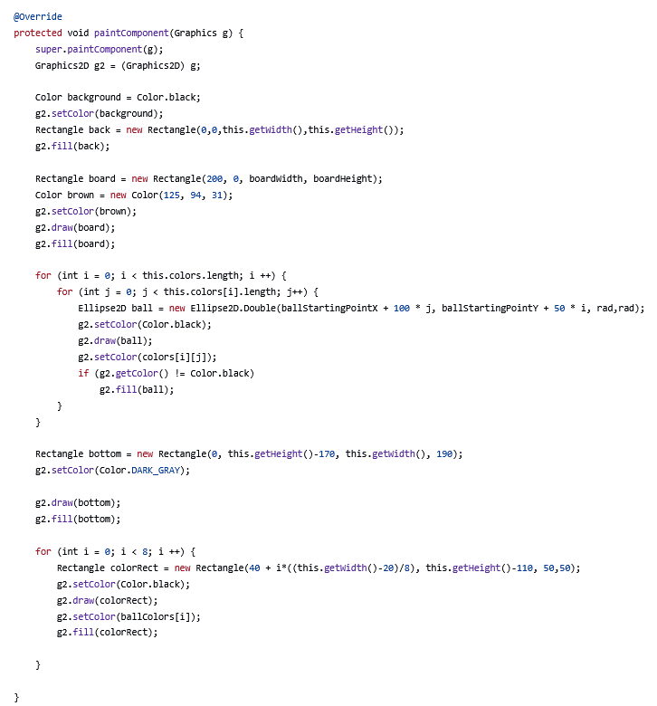
Spaghetti Monster
Methods: Examples
There’s no one “right” length;
but there are wrong lengths
5-20 lines is a good rule of thumb; longer is OK if clearly related

Slide 8

Variable & Method Names from the
Black Lagoon

Slide 9
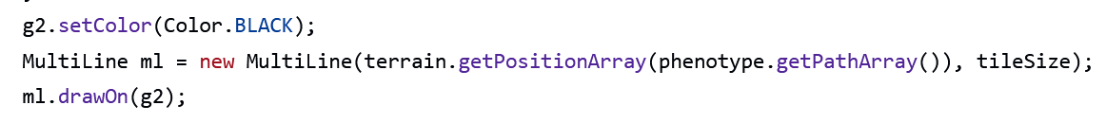
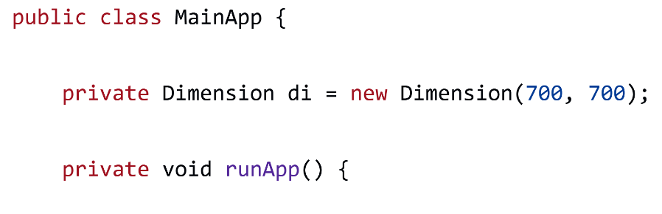
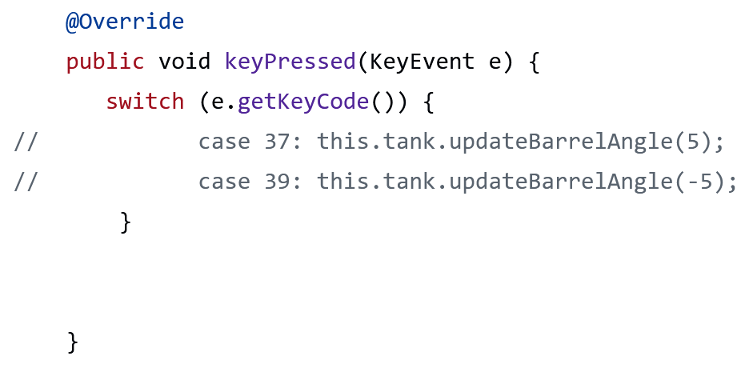
Black Lagoon Names: Examples

Slide 10

Ghost Variables
(Variable Shadowing)

Slide 11
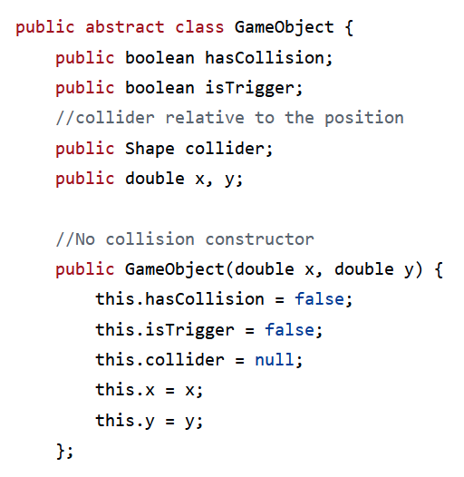
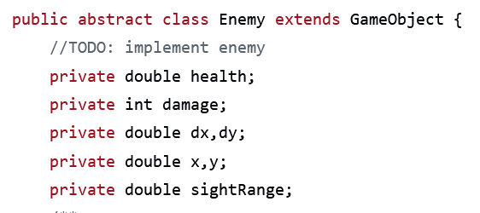
Ghost Variables: Examples

