Slide 1
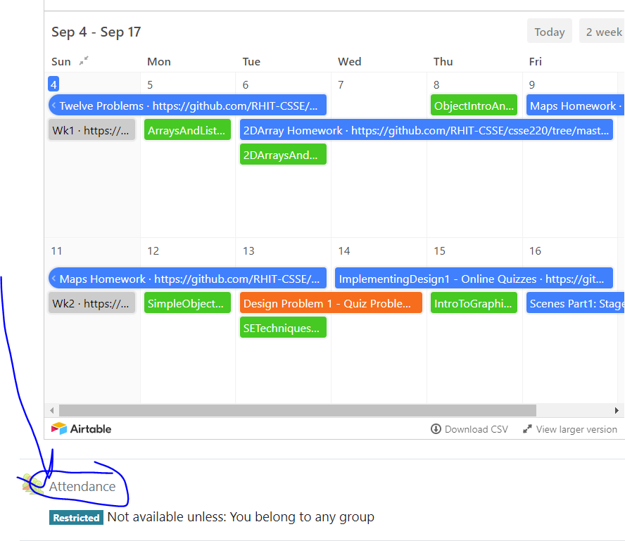
Today’s Attendance password
__________
CSSE 220
Files & Exceptions Day
The git projects for today are:
PracticeFilesAndExceptions
PracticeFilesAndExceptionsSolution
PracticeFilesAndExceptionsTooManyScoresSolution
The Quiz for today is:
OOAndExceptionsQuiz
Notes:
1

Slide 2
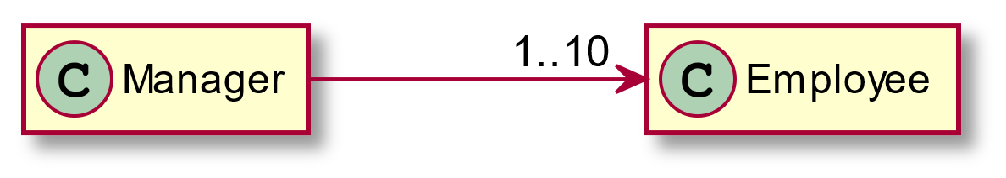
Review and Expand UML Notation: Cardinality
When no number appears, then implicitly 1
Each manager has between 1 and 10 employees. Maybe stored in an ArrayList
Plant UML Code to generate this diagram:
Manager ->"1..10" Employee

Slide 3
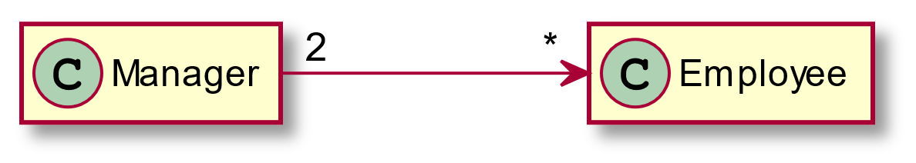
More Cardinality
Managers have any number of employees.
The '*' means “zero to infinity” – any arbitrary number. You can also occasionally see something like 4..* to mean 4 or more.
Every employee has exactly 2 managers. Note that this can be used even if there is no reference from Employee to Manager
Plant UML Code to generate this diagram:
Manager "2"->"*" Employee

Slide 4
What does this diagram mean?
EventParser
How many EventParser objects?
How many EventType objects?
How many Event objects?
*
EventType
2
0..1
Where are the references to these objects stored?
Event

Slide 5
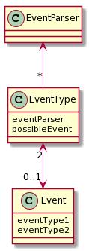
What does this diagram mean?
EventParser
EventParser
Only a single parser object is used by the entire system
EventType
*
EventType
All EventType instances use the same EventParser. Each EventType can have AT MOST 1 Event
2
Event
0..1
Event
An Event always has two EventTypes
E.g., maybe there is are:
National level EventType (large categories like entertainment/conference/etc.)
Regional level EventType (more specific to local area: parade, county fair, etc.)
Notes:
http://www.plantuml.com/plantuml/uml/SoWkIImgAStDuKhEIImkLd0jIyqh2KWiAaujgkRYvAhbGXOFgIn8hUPIK518HQW2SGloYuipat9ImOhGz01DIONfDUHIW0Aua158EHVST0KbBINTqW9TEsI784iRATdefkINv-dQAHdewHagGTHnEQJcfG0z0G00

Slide 6
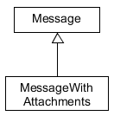
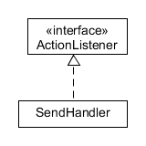
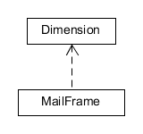
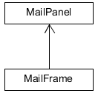



Summary of
UML Class Diagram Arrows
Interface
Implementation
(is-a)
Association
(has-a-field)
Inheritance
(is-a)
Dependency
(depends-on)
Two-way Association
Two-Way Dependency
Cardinality
(one-to-one, one-to-many)
One-to-many is shown on left
Q1
Notes:
Questions 2 will be done before question 1.
6

