Slide 1
CSSE 220
Arrays with Object Types
Association via Parallel Arrays

Slide 2
Array Types
Syntax for declaring: ElementType[] name;
Same as primitives we just list type
Declaration examples:
A local variable in an operation: double[] gradeAverages;
Parameters to an operation: public int sumValues(int[] values) {…}
A field inside a class: private Investment[] mutualFunds;

Slide 3
Allocating the Array's Storage
Syntax for allocating storage: new ElementType[length]
Examples:
double[] polls = new double[50];
int[] votesPerDistrict = new int[5];
Dog[] dogs = new Dog[10];

Slide 4

Initial Value Details
Java automatically sets values to defaults
false for boolean type
0 for number types
null for object types
Examples:
double[] polls;
int[] votesPerDistrict = new int[5];
Dog[] dogs = new Dog[10];
null
polls
votesPerDistrict
dogs
0 | 0 | 0 | 0 | 0
null
null
null
null
null
null
null
null
null
null

Slide 5

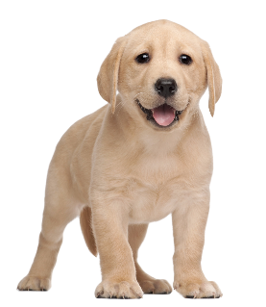
Dog[] dogs = new Dog[10];
This does NOT construct any Dogs. It just allocates space for referring to Dogs (all the Dogs start out as null )
null
dogs[0] = new Dog(“Barkley”);
This does construct ONE Dog and places it in the first position of the array (first kennel).

Slide 6
Finding a Dog by Name
Consider storing an Array of Dogs
Say each Dog has a name ( .getName() )
How can we find a Dog based on its name?
Doug!
Which one of these dogs is Doug?
Notes:
[Ask the students to guess until they guess Doug correctly (middle one)]

Slide 7

Finding a Dog by Name
Which one of these dogs is Pickles?
Pickles?
Nope.
Pickles?
Pickles?
Pickles?
Pickles?
Notes:
[ Ask the students to guess until they guess Adam correctly (4th one) ]
[ This is somewhat inefficient because we have to go through the whole list and ask EVERY dog for its name! ]

Slide 8
Algorithm (Ask Each Dog)
Dog findDogByName(String name, Dog[] dogs) {
for (Dog d: dogs){
if (name.equals( d.getName() ){
return d;
}
}
return null;
}

Slide 9
Associating a Dog with a Name
If we have an array of Dogs
Could we also store an array of Strings?
Ally | Buddy | Doug | Pickles | Yolanda

Slide 10
Parallel Arrays
Dog[] dogs = ….
String[] names = {‘Ally’, ‘Buddy’, … }
0 1 2 3 4
Ally | Buddy | Doug | Pickles | Yolanda
0 1 2 3 4

Slide 11
Algorithm (Parallel Arrays)
Dog findDog (String name, String[] names, Dog[] dogs) {
for (int i=0; i < names.length; i++){
if ( name.equals( names[i]){
return dogs[i];
}
}
return null;
}
If we are clever, we can use a system to sort the names alphabetically and jump around in a more efficient manner.
Notes:
[ This improves things since we don’t have to ask ANY dogs their name, we can just find the correct index and then go to that Dog]

Slide 12
Better Way?
It turns out there is an even FASTER and BETTER way to associate data together like this…
Next, we will talk about Maps, which allow us to more directly associate two different types together

Slide 13
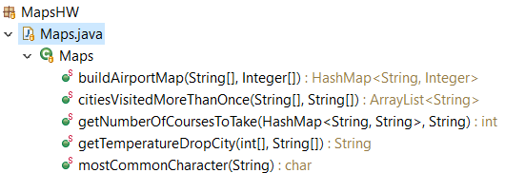
HWMaps
Can collaborate with a partner on exactly 1 of the operations
Consider draw a few map diagrams for test data for getNumberOfCoursesToTake
Each list the other’s name in Help Citation at top of file
Both responsible for submitting own code
Right Now: Take out a sheet of paper now and tear off a small piece.
Put your name on it
Put the name of 1 or more people you would LIKE to work with
You can say you don’t know anyone, but would like to work with someone
You can say you want to work alone
Put the name of anyone you would prefer NOT to work with
Hand this to our TA and they will make pairs for you to use
Notes:
TAs can handle this with a form or something else if they prefer

