Slide 1
Strings – What, When, Why, How?
What:
They are an array of characters but written in a class that come with operations
… so we can worry about using them
When:
When you need “strings” of characters
We won’t use char arrays much otherwise

Slide 2
Strings – What, When, Why, How?
Why:
Sooooo much easier than char arrays!
How:
String myString = “hello”;
String otherString = new String(“hello2”);
String combinedString = myString + “ “ + otherString + “!”;
Retrieving data
Need the API

Slide 3
Java API Documentation
What’s an API?
Application Programming Interface
The Java API on-line
Google for: java api documentation 8
Or go to: http://download.oracle.com/javase/8/docs/api/
Also hopefully on your computer at
C:\Program Files\Java\jdk1.8.0_9\docs\api\index.html
You need the 8 to get the current version of Java
Note: Your version may be something other than 8.0_9.
We recommend that you bookmark this page in your browser, so you can refer to it quickly, with or without an internet connection.
Notes:
Find the documentation for the String class from one of the above links, as follows:
Click java.lang in the top-left pane
Then click String in the bottom-left pane
Describe the parts of the String API documentation:
- description of the class
- summaries of all the fields, constructors, and method
detailed descriptions of everything

Slide 4
Quick Rule for Comparisons
Fast rule for now:
Use .equals() for comparing Strings
String alpha = “aaa”;
if (alpha.equals(“bbb”) {
System.out.println(“Yes!”)
}
Use == for comparing for primitives
boolean a = (5 == 6);
boolean b = (‘T’ == ‘F’ );
Notes:
Can decide to say this for next class or mention it now at least…

Slide 5
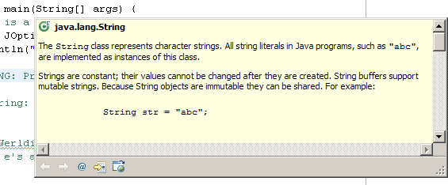
Java Documentation in Eclipse
Setting up Java API documentation in Eclipse
Should be done already,
Using the API documentation in Eclipse
Hover text
Open external documentation (Shift-F2)
Notes:
Point students to the link in the homework if everyone does not have the docs setup.
Demo hover text, F2 to focus on hover text, icon to open in web browser.
Shift-F2 to open external browser immediately.

Slide 6
Work Time
Let’s work in StringProbs.java

