Slide 1
CSSE 220
ArrayList
Using for loops with ArrayList

Slide 2
What is a Java ArrayList?
A container object that holds a variable number of values of a single type
Similar to a Java array, an ArrayList allows for fast random access at any location
Fast random access means a client program can access any location in constant time, written as O(1)
This is covered in the final part of the course in more depth
For now, just understand that it is FAST!

Slide 3
When should an ArrayList be used?
When two conditions exist:
When you need to store multiple values of the same type
When the number of values to be stored is known at the time you declare the array and will not change during execution
The ArrayList object can grow and shrink during program execution, unlike an array which has a fixed size
not

Slide 4
How is an ArrayList declared?
In general:
ArrayList<Type> as1 = new ArrayList<Type>(); Creates a new ArrayList object which can store objects of type Type
For example:
The declaration for an ArrayList that will hold String objects looks like this: ArrayList<String> as1 = new ArrayList<String>();
Note:
Unlike Java arrays, the declaration for ArrayList does not include the number of elements to be stored

Slide 5
Wrapper Classes
primitive type | wrapper class
boolean | Boolean
byte | Byte
char | Character
short | Short
int | Integer
long | Long
float | Float
double | Double
Java is an object-oriented language
A primitive type is not an object in Java
Sometimes, Java requires us to use objects, not primitive types
So Java provides object versions of each primitive type
These are called wrapper classes

Slide 6
Wrapper Class Example
primitive type | wrapper class
boolean | Boolean
byte | Byte
char | Character
short | Short
int | Integer
long | Long
float | Float
double | Double
Line #4 declares an Integer object x1 which stores (and wraps) int values
Line #5 declares the a1 (an object instance) to be an ArrayList that holds Integer objects
Line #7 calls an ArrayList method add x1 to insert x1 at the right end of a1
Line #8 outputs "Location zero of a1 = 31"
Finally it is illegal to declare an ArrayList to hold type int, so Integer must be used
1 import java.util.ArrayList;
2 public class WrapperClient {
3 public static void main(String[] args) {
4 Integer x1 = 31;
5 ArrayList<Integer> a1 = new ArrayList<Integer>();
6
7 a1.add(x1);
8 System.out.println("Location zero of a1 = " + a1.get(0));
9 } // main
10 } // end class WrapperClient

Slide 7
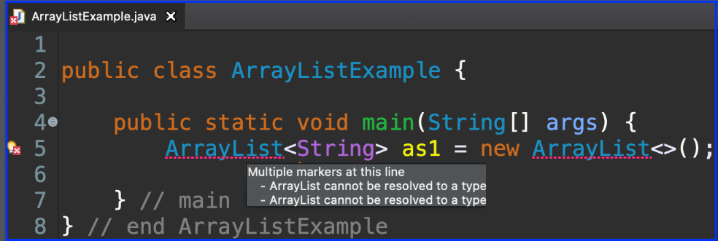
ArrayList Details – Import java.util
ArrayList is provided by Java through a package the must be imported
Failure to import, produces a red squiggly and an error message

Slide 8
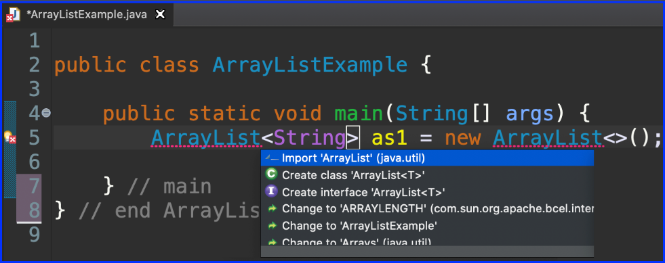
ArrayList Details – Import java.util
ArrayList is provided by Java through a package the must be imported
Failure to import, produces a red squiggly and an error message
Hover over the red squiggly and Eclipse will pop up suggested help

Slide 9
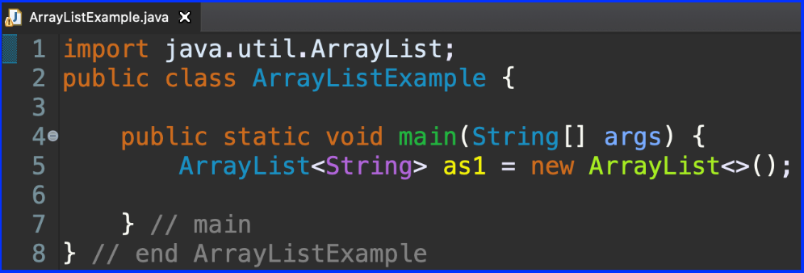
ArrayList Details – Import java.util
ArrayList is provided by Java through a package the must be imported
Failure to import, produces a red squiggly and an error message
Hover over the red squiggly and Eclipse will pop up suggested help
In this case, select Import 'ArrayList' (java.util)
Eclipse will insert import line

Slide 10
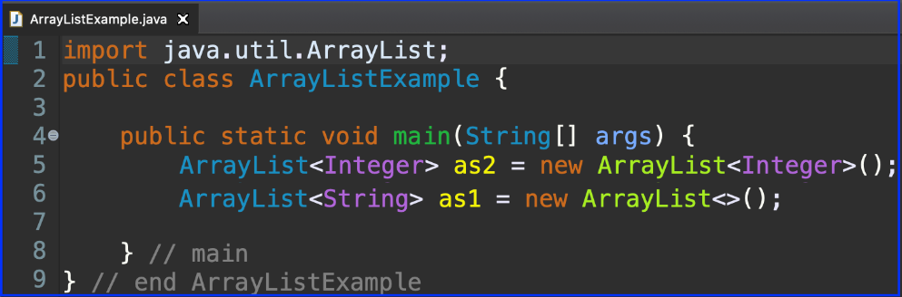
ArrayList Details – Generic Parameter
The type inside the angle brackets is called a type parameter ArrayList<type>
Line 5 – as2 holds Integer objects
Line 6 – as1 holds String objects
This is how you tell Java what type of data the ArrayList will be holding
The generic parameter to the constructor is optional – line 6

Slide 11
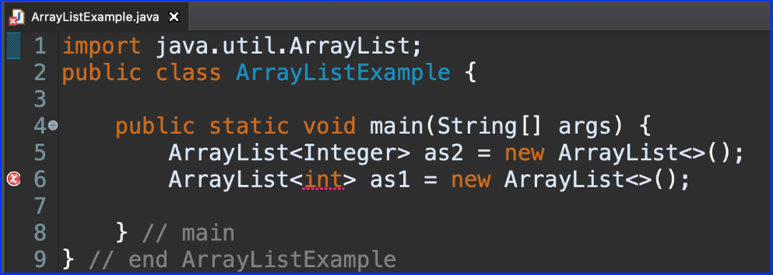
ArrayList Details – No Primitive Types
The type parameter must be -- an object type -- it cannot be a primitive type
Line 5 – as2 holds Integer objects
Line 6 – attempts to declare as1 to hold type int, but only ends up with a red squiggly (compiler error)
For primitive types, use the corresponding wrapped type

Slide 12
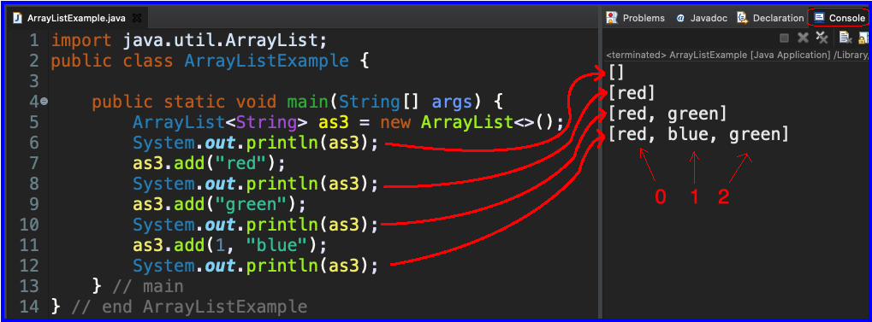
ArrayList Details – .add method
2 versions of the add method exist for putting items into an ArrayList object
Lines 7 & 9 use the 1-parameter add This adds items to the rightmost end of an ArrayList object
Like Java arrays, non-empty ArrayLists are indexed from: [0, size – 1]
Line 11 uses the add that takes 2 parameters: 1st parameter is the location to add, where location is in [0, size] 2nd parameter is the item to be added

Slide 13
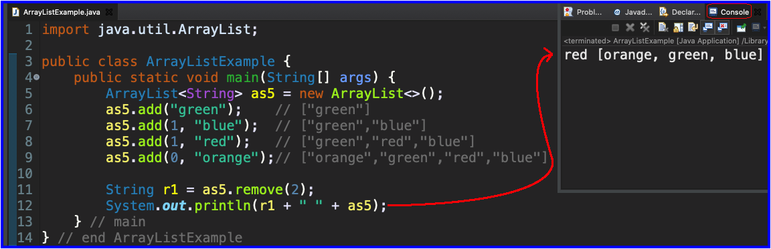
ArrayList Details – .remove method
The remove method allows a client program to remove an item from any existing location in the range from [0, size – 1]
remove returns a reference to the item removed
Line 11: uses remove to get "red" out from location 2 the variable r1 catches the returned reference

Slide 14
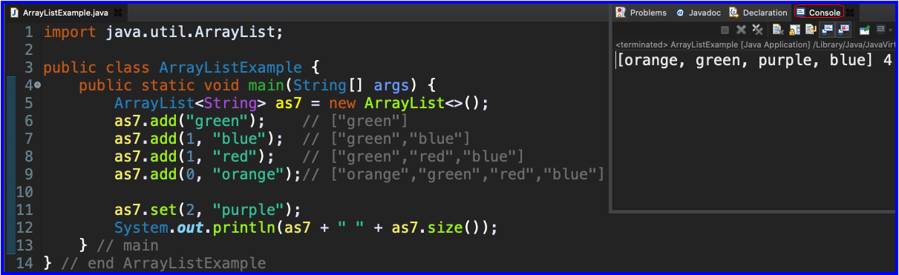
ArrayList Details – .set method
The set method allows a client program to overwrite an item in any existing location in the range from [0, size – 1]
Line 11: uses set to overwrite "red" at location 2
Line 12: outputs the updated ArrayList outputs the current size of the ArrayList

Slide 15
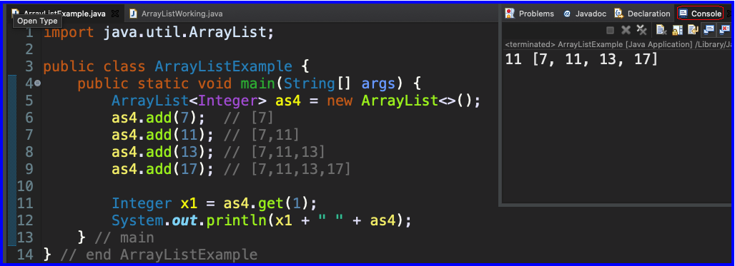
ArrayList Details – .get method
The get method allows a client program to obtain a reference to an item in any existing location in the range from [0, size – 1]
Line 11: uses get to obtain a reference to the value 11 stored at location 1 the variable x1 catches the returned reference
Line 12: outputs value referenced by x1 and the unchanged ArrayList

Slide 16
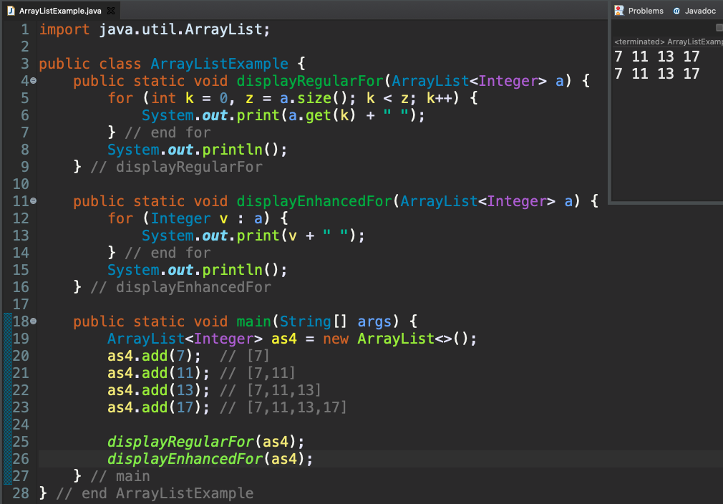
for Loops and ArrayList

Slide 17
Enhanced For and ArrayList’s
ArrayList<State> states = new … int total = 0; for (State oneState : states) {
total += oneState.getElectoralVotes();
} // end for
State is a user defined class
getElectoralVotes() is a method in State which returns an int

Slide 18
Work Time
Completing the ArrayList practice
Complete Daily Quiz
Work on TenProblems
Notes:
As time allows:
1. See if anyone is asking about static, give simple explanation
2. Possible elaborate on an auto-boxing diagram

