Slide 1
CSSE 220 Final Project:
M3 code worth imitating
An incomplete sampling of good designs,
documentation, methods, etc.
Fall 2025

Slide 2
Slick method for staying on screen
Some nice features:
Uses constant HOLE_OFFSET instead of magic number
Has self-documenting variable names
Allows other code to tell this object to adjust itself to stay within the screen (instead of asking for its position info)

Slide 3
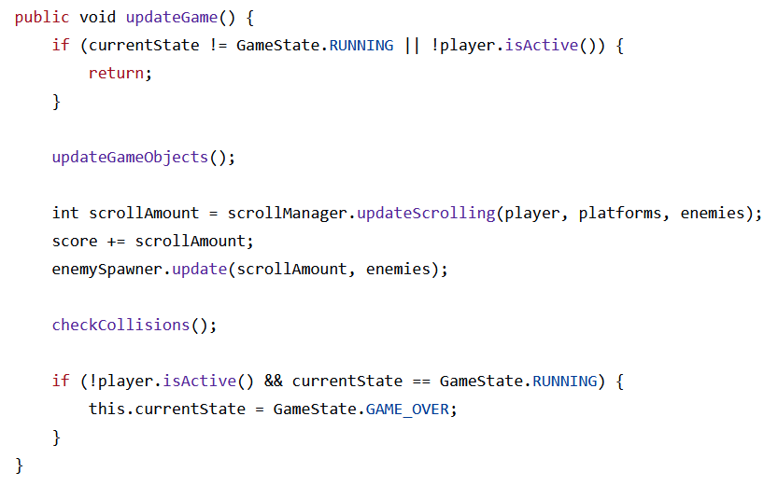
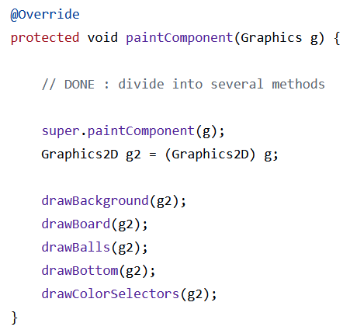
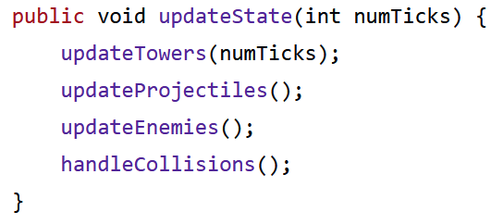
Effective use of helper methods

Slide 4
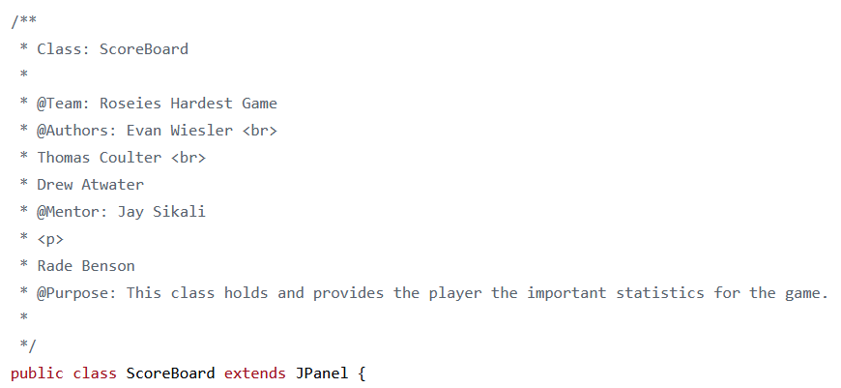
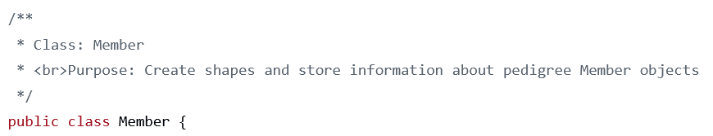
Class-level JavaDoc comments

Slide 5
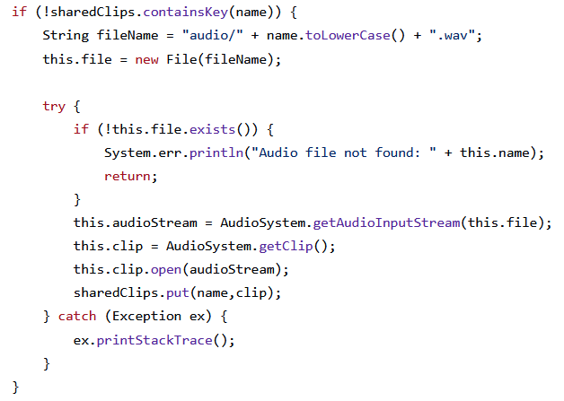
Error-handling (and saving audio resources for reuse)

Slide 6
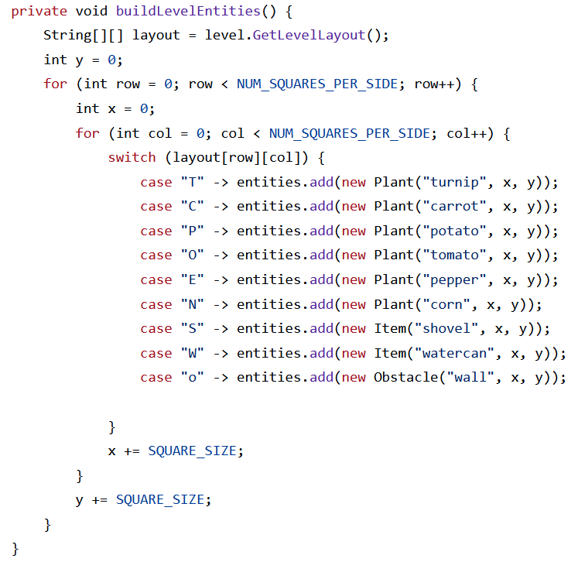
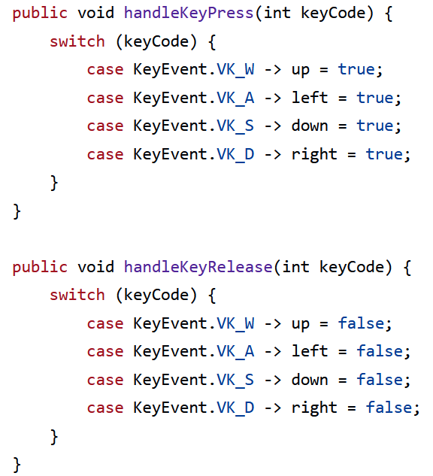
Effective uses of switch statements

