Slide 1
CSSE 220
Main Game Loop with Timers
File IO
Exception Introduction
The git projects for today are:
PracticeEventBasedGameLoop
PracticeEventBasedGameLoopSolution

Slide 2
Objectives
Final Project Preparation/Kickoff
Learn how to avoid common project errors
Learn how to setup a timer to create events
Practice with live-coding
Practice interaction between game elements
Learn how to read and write from files
Practice with live-coding
Required for Milestone 1

Slide 3
Final Project Introduction

Slide 4
Threads
Computers can run more than one thread of execution at the same time
Even single core processor can simulate this by timesharing (more about this in future courses)
Main starts every Java program
Graphics start a separate thread
Multiple threads can create very painful problems
Can be hard to debug (race conditions)
Example include ConcurrentModificationExceptions
Notes:
Consider drawing a single diagram on the board showing separate thread of execution as lines

Slide 5
main's and Graphics' Threads
Time
Every program starts in main and begins executing one statement at a time
When a JFrame is created there is a second thread that starts running (at the same time, i.e., in parallel) and it will continue to run even if our main thread completes exits
The setting for JFrame setDefaultCloseOperation() determines if the Java Graphics thread continues to run after closing the window.
main's thread of control
Java Graphics'
thread of control
JFrame.EXIT_ON_CLOSE

Slide 6
Concurrent Modification Exceptions
Happens when you try to change something that is being used
Example:
Removing something from a list while the list is itself being iterated through (drawing/updating)
Why?
Main Thread
Java Graphics Thread
for (Item item: myList){
item.draw();
}
myList.remove(0);
Notes:
Ask students:
Imagine a list gets changed while you try to move through it, what could go wrong?
Read from bad location in memory, get into infinite loop, double visit, skip, etc.

Slide 7
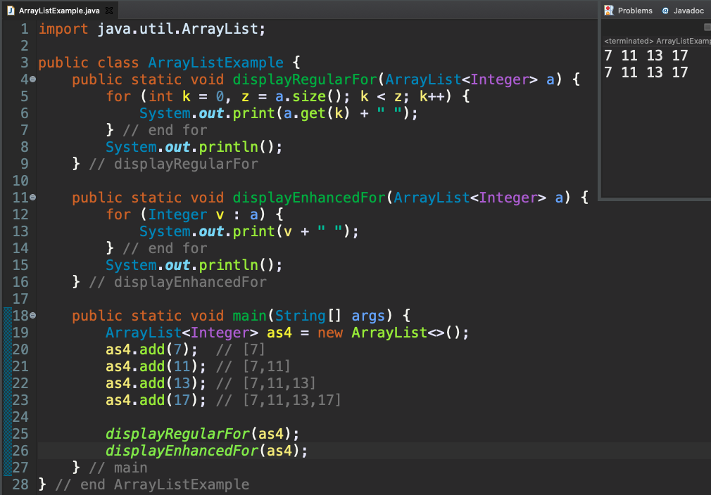
for Loops and ArrayList

Slide 8
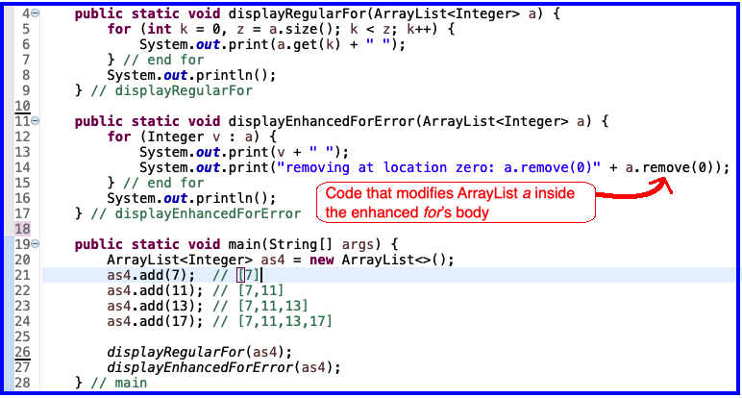
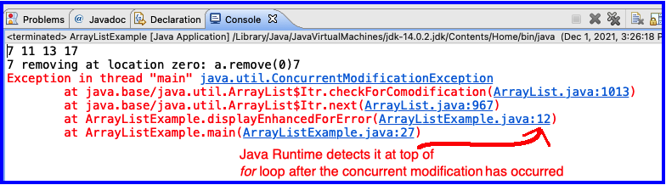
Concurrent Modification Error
This is a problem
for enhanced for
because length of 'a' has changed
But enhanced for is still using
original length of
'a'

Slide 9
Timer
An alternative to a thread that waits/sleeps
Creates events periodically
Allows main thread to finish
Designed to work in same thread as graphics
Superior approach for ArcadeGame project

Slide 10
Timer
Time
main thread
Java Graphics Thread
public void advanceOneTick() {
myComponent.updateState();
myComponent.drawScreen();
}
Exit
public void advanceOneTick() {
myComponent.updateState();
myComponent.drawScreen();
}
Each tick of the Timer
public void advanceOneTick() {
myComponent.updateState();
myComponent.drawScreen();
}

Slide 11
Live-coding
Today's import: PracticeEventBasedGameLoop
Subpackage: game_event_loop
Notes:
* In this exercise, we develop each of these ideas.
* TODO: Replace the loop with button input to advance one tick.
* TODO: Replace the button with a timer.
* TODO: Make the button change the direction of motion.
* TODO: Add falling raindrops.
* TODO: Make the box "catch" drops that hit it.

Slide 12
M0: UML Class Diagram & Shared Calendar Setup (50 points)
To earn 100% for M0
You must complete Steps 1 – 5 (below)
Your UML diagram should look at least somewhat like the provided examples – see Appendix A
Step 1 – (10%) Set up your shared calendar
See Section 2.1 (above) of ArcadeGame.docx for instructions
Step 2 – Brainstorm possible classes
We suggest that you will come up with about 6 to 10 classes, but more are certainly possible
Step 3 – (60%) Assign responsibilities to classes
Determine how classes need to collaborate to carry out those responsibilities, and what responsibilities those collaborating classes need to have.
Will inheritance or interfaces help you to organize the responsibilities?
Keep iterating through this step until all the program’s responsibilities have been assigned to classes.
Reference Appendix A examples
Step 4 – (30%) Construct a UML class diagram based on Steps 1 and 2
Your diagram MUST be computer generated – use PlantUML
Save your diagram as a PDF, JPG, PNG, or SVG file
Step 5 – Upload your UML class diagram to the Milestone 0 Moodle assignment
If you do not do this, then you earn zero percent for M0
Step 6 – Begin implementation
Create your classes, commenting and testing your code, milestone by milestone.
You are always free to work ahead, e.g., if you finish Milestone 1, you can immediately move on to working on Milestone 2
Document your code as you go along – use JavaDoc comments as well as non-JavaDoc comments
Notes:
* In this exercise, we develop each of these ideas.
* TODO: Replace the loop with button input to advance one tick.
* TODO: Replace the button with a timer.
* TODO: Make the button change the direction of motion.
* TODO: Add falling raindrops.
* TODO: Make the box "catch" drops that hit it.

Slide 13
M1: Levels and Hero Movement (50 points)
Functionality required to earn a 100% for M1
At the least, M1 Items 1 – 4 (listed below)
Successful completion of all M1 Items (1 through 6) at M1 grading time will be noted This successful completion has potential to benefit your overall grade for the project
(Failure to do this step is −100% for M1) Follow the instructions to rename your project, e.g., if your team’s name is “A_039”, rename from ArcadeGameGit-00 to ArcadeGameGit-A_039
(30% toward M1) The initial game level (Level 1) must load from a file and be displayed by the app
(35% toward M1) Left and right movement by the hero controlled by the user using the left and right arrow keys
(35% toward M1) Up (flying) movement by the hero controlled by the user using the up-arrow key
No automatic movement by your software required for this milestone, this includes falling
No diagonal movement by hero is required for this milestone, this movement combines left/right movement simultaneously with up movement
(5% toward M2) Two different levels (Level 1 and Level 2) can be loaded from their respective files
(5% toward M2) Switching between levels by pressing the “U” (up) and “D” (down) keys on the keyboard

Slide 14
Reading & writing files
When the unexpected happens
Files and Exceptions
Notes:
14

Slide 15
File I/O: Key Pieces
Input: File and Scanner
Output: PrintWriter and println
☺ Be kind to your OS: close() all files
Letting users choose: JFileChooser and File
Expect the unexpected: Exception handling
Refer to examples when you need to…
Notes:
15

Slide 16
Live code a level loader
Today's import: PracticeEventBasedGameLoop
Subpackage: fileIO
Notes:
Can live-code a quick example to save a list of numbers or a simple game Level to a file, then read them/it back in again. There is an example in the solution code.

Slide 17
Exceptions – What, When, Why, How?
Examples from today’s class:
ConcurrentModificationException
FileNotFoundException

Slide 18
Exceptions – What, When, Why, How?
What:
Used to signal that something in the code has gone wrong
When:
An error has occurred that cannot be handled in the current code
Why:
Breaks the execution flow and passes exception up the stack

Slide 19
Exceptions – How?
Handling (catching) an exception:
try {
//code that could throw an exception
}
catch (ExceptionType ex) {
//code to handle exception
}
When caught you can:
Recover from the error OR exit gracefully
Notes:
Try to read from file when the file does not exist
19

Slide 20
A Checkered Past
Java has two sorts of exceptions
Checked exceptions: compiler checks that calling code isn’t ignoring the problem
Used for expected problems
Example: FileNotFoundException
Unchecked exceptions: compiler lets us ignore these if we want
Used for fatal or avoidable problems
Are subclasses of RunTimeException or Error
Example: ConcurrentModificationException

Slide 21
Team Project
Work time
Be sure everyone is getting a chance to drive.

