Slide 1
Object Intro and Miscellaneous
The git projects for today are:
PracticeObjectIntroAndMisc
PracticeObjectIntroAndMiscSolution

Slide 2
Agenda
Coding Conventions, Style, Grading
Debugging
Objects and Classes

Slide 3
Writing clean code
Comments are only the last resort

Slide 4
Functions
Give functions descriptive names
Don’t make functions too long
Rather than commenting an unclear function, modify the code so it is clear

Slide 5
Naming in Java
Having good names for functions and variables is one of the best things you can do to make your program understandable
The conventions:
variableNamesLikeThis
methodNamesLikeThis(…)
ClassNamesLikeThis
You should follow the conventions!

Slide 6
Javadoc comments
/**
* Has a static method for computing n!
* (n factorial) and a main method that
* computes n! for n up to Factorial.MAX.
*
* @author Mike Hewner & Delvin Defoe
*/
public class Factorial {
/**
* Biggest factorial to compute.
*/
public static final int MAX = 17;
/**
* Computes n! for the given n.
*
* @param n
* @return n! for the given n.
*/
public static int factorial (int n) {
...
}
...
}
Java provides Javadoc comments (they begin with /**) for both:
Internal documentation for when someone reads the code itself
External documentation for when someone re-uses the code
Notes:
We require Javadoc comments for classes and any “significant” method. If Javadoc comments are already provided for methods (e.g., instructions…) they do not need to add any further.
Most “conventions” mention that you should have Javadoc comments for each class member variable, but we DON’T require that.
Students often have trouble distinguishing between these and regular comments, it is good to take a bit and explain that there are different types of comments, and they each are used for different reasons.

Slide 7
Writing Javadocs
Written in special comments: /** … */
Can come before:
Class declarations
Field declarations
Constructor declarations
Method declarations
Eclipse is your friend!
It will generate Javadoc comments automatically
It will notice when you start typing a Javadoc comment
Notes:
We can continue to repeat this by modeling the idea whenever we write code.
That requires discipline on our part. It’s easy to blow off writing the docs in class in the interest of time, but this may be modeling bad behavior.

Slide 8
In all your code:
See: https://github.com/RHIT-CSSE/csse220/blob/master/Docs/grading_guide.md
Write appropriate comments:
Javadoc comments primarily for classes.
Explanations of anything else that is not obvious in any spot.
Give self-documenting variable and method names:
Use name completion in Eclipse, Ctrl-Space, to keep typing cost low and readability high
Use Ctrl-Shift-F in Eclipse to format your code.
Q1

Slide 9
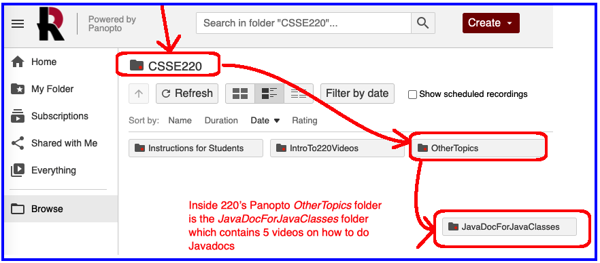
Follow Javadoc Instructions in Videos:
Panopto video folder

Slide 10
Agenda
Coding Conventions, Style, Grading
Debugging
Objects and Classes

Slide 11
Debugging
Notes:
Breakpoint: tells debugger where to pause the program
Single stepping: moving through a program one line at a time
Inspecting variables: using debugger to examine values of variables at a particular point in the execution

Slide 12
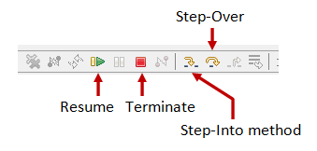
Debugging—Demo
Debugging Java programs in Eclipse:
Set a breakpoint where you want to start
Launch using the bug icon
Single stepping: step over and step into
Inspecting variables
Q2-4
Notes:
[Demonstrate the techniques in Eclipse by solving a problem or two from DebugMeTest together, give them time to answer the quiz question, then have them complete DebugMeTest.]
[You can also point them to WhackABug to get more practice when running a Java Application instead of JUnit)]
DebugMeTest make sure to demo:
uppercaseIfExclaimation which ends up showing the gotcha “string are immutable” in two slides

Slide 13
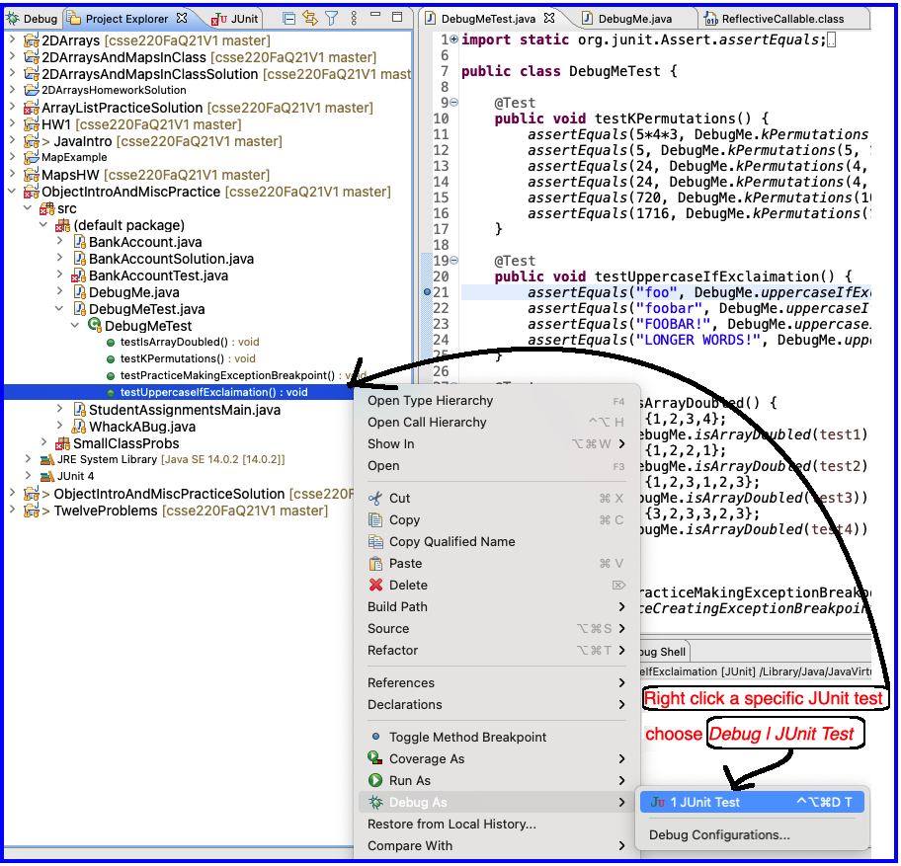
Running in Debug Mode

Slide 14
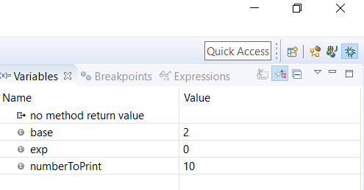

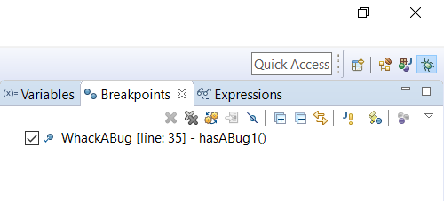
The Debugger Up Close
Java Perspective
Debugging Perspective

Slide 15


ALWAYS (1) stop the debugger AND (2) clear it when done!
Even after you click the red STOP SQUARE, if you ran it multiple times before, you have to repeatedly clear it (or restart Eclipse)
Indicates that the program is still running
Notes:
CAREFUL- if you do not stop the running debugger, you can have multiple instances running and the debugger variables you see might be from a different running

Slide 16
Debugger Controls Up Close
Step Into
method
Step Over
method
Step Return (Out)
Resume
(until next break point or complete)
Suspend
Terminate
Notes:
CAREFUL- if you do not stop the running debugger, you can have multiple instances running and the debugger variables you see might be from a different running

Slide 17
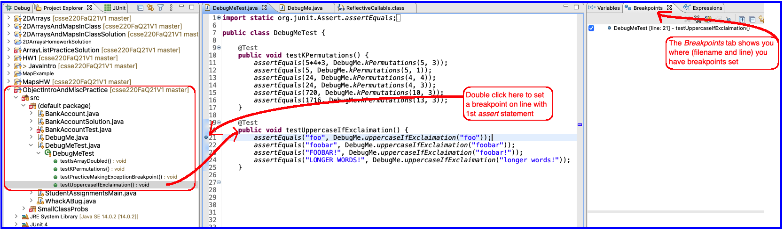
Setting Breakpoint

Slide 18
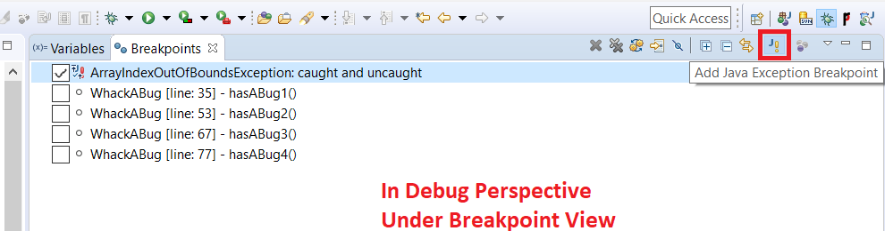
Exception Breakpoint
Very useful when an exception is happening but you don’t know where or why
Exception Tab
Exclamation point button
Find the exception type you want
Add a breakpoint
Notes:
Only spend time on this if you want to show the DebugMeTest examples, in particular the final test which you can use to demonstrate this approach.

Slide 19
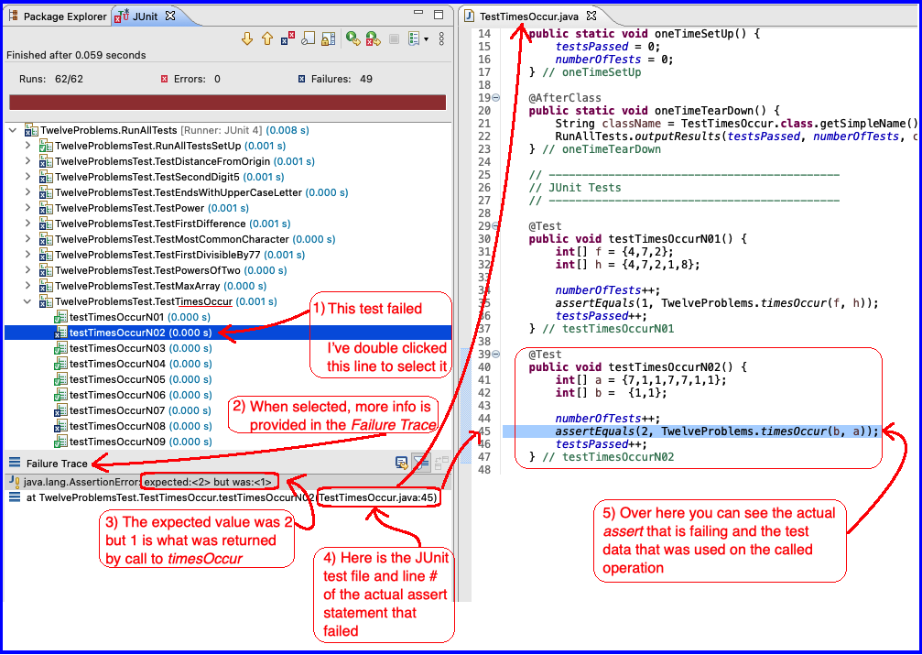
Interpreting a JUnit Test Failure

Slide 20
Important gotcha: Strings in java are immutable
No method on the string class will modify the content of a String variable
All methods instead return a reference to a new String object
String newSentence = sentence.toUpperCase();
Declare a new String variable
Have new variable catch the returned String
Notes:
uppercaseIfExclaimation ends up showing this

Slide 21
Agenda
Coding Conventions, Style, Grading
Debugging
Objects and Classes

Slide 22
Object Basics

Slide 23
Class – What, When, Why, & How?
What:
A blueprint for a custom type
When:
Define a class when you’re representing a concept (think nouns)
When no other existing type can do what you want/need

Slide 24
Class – What, When, Why, & How?
Why:
Keep similar concepts together
Encapsulation (we’ll expand on this next time)
How:
public class ClassName {
//fields – appear here
//methods – come next
}

Slide 25
Using Objects and Methods
“Who does what, with what?”
Works just like Python:
object.method(argument, ...)
Two examples in Java:
The controlling object
is an implicit argument
passed to method
Explicit arguments always appear inside the ( and )
HashMap<String, Integer> scores = new HashMap<>();
scores.put(“Bob”, 78); // scores is controlling object
String name = "Bob Forapples";
int nameLen = name.length(); // name is controlling object

Slide 26
Constructors – What, When, Why, How?
What:
Special method called when a new instance of a class is created
Initializes the new instance
Like the __init__ method in Python
When:
Define a constructor when special initialization of a class is required
Otherwise, Java implicitly creates a no-argument constructor if you don’t add one

Slide 27
Constructors – What, When, Why, How?
Why:
Allows you to ensure that a new object instance is initialized exactly how it needs to be before calling other methods/fields
Puts object in a legal initial state
How: always has the same name as the class.
public class MyClass {
public MyClass() {
//init code of parameterless constructor
}
public MyClass(ParamType paramName) {
//init code of 1 parameter constructor
}
}

Slide 28
Object Constructors
int num = 5;
bool isEmpty = true;
This works for primitive data types
What about how do we initialize an “object” that is made from a class?

Slide 29
Using Constructors
This constructor's arguments specifies that the new Rectangle whose reference is stored in box should be at the origin (0, 0) with a height and width of 5.
In Java, all variables must have a type
Rectangle box = new Rectangle(0, 0, 5, 5);
Every variable must have a name.
The new operator is what actually creates the new object, in this case a new Rectangle
Q5
Notes:
Argument for main is not optional. Must be there.

Slide 30
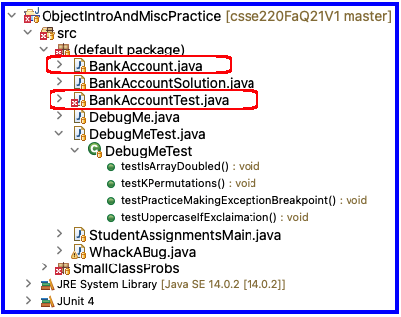
Object Constructors
Open BankAccount.java
Let’s do the first few, then work on your own
Have Eclipse help us
When you’re done and it works, solve the last quiz question

Slide 31
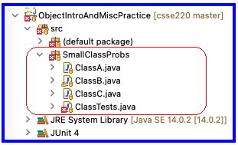
Practice
Work in SmallClassProbs
Finish:
ClassA.java
ClassB.java
ClassC.java
Make these classes work with the tests provided in ClassTests.java

Slide 32
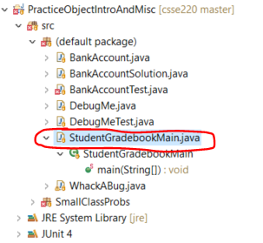
Now code the StudentGradebook class yourself
Uncomment the code found in StudentGradebookMain to see what the class should do
Then create the class and add the constructors and methods you need
If you finish early, add a function to compute the student’s average grade
Notes:
Do not spend too much time on this since students will need time outside of class to complete this. Be sure to reserve time for the rest of the material and for students to complete the quiz.

