Slide 1
CSSE 220: Object Design
Part 1 of Many
Also Class Diagrams
The git projects for today are:
PracticeFirstOODesign
PracticeFirstOODesignSolution
Notes:
We ask them to draw the Quiz Question 2 UML on paper FIRST and then
Later in class we teach them how to use plantUML to convert it
You will have trouble having enough time to get to the Cards problem,
but leave that as an outside of class exercise

Slide 2
Designing Classes
Programs typically begin as abstract ideas – I want Twitter, for dogs
These ideas form a set of requirements (i.e. what the user wants)
This is a difficult process – see CSSE 371 for learning basics for how to do this
In this class, instructors hand you the requirements – you build the software system from these
We must take these requirements, and figure out an approach for our coding
Usually the approach is not obvious
So we propose designs, then iteratively refine them into something that might work (continued…)

Slide 3
Designing Classes
We propose designs, then iteratively refine them into something workable
Many bad ideas in the process
as we iteratively define the design, we’ll end up tossing them out
We don’t want to implementing bad ideas in code!
It’s too time and resource costly!
Need better way to determine if it’s an incomplete/inconsistent solution
We need a way to communicate/think concretely about these half-baked program approaches
We need a diagram language!
Can be put together with reasonable cost (time/energy)
We can test out idea for solutions
Helps us eliminate the incomplete/inconsistent approaches early

Slide 4
Tools of the Trade - Diagramming
Class Diagrams (UML)
UML – Unified Modeling Language
Language unspecific
Has a lot of different diagrams it provides specifications for – but the class diagram language is the most widely used

Slide 5
Begin UML Part of Today’s Discussion

Slide 6
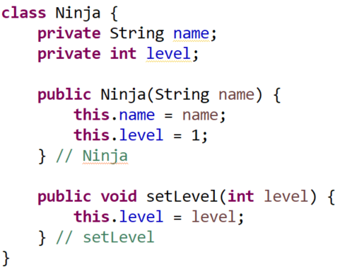
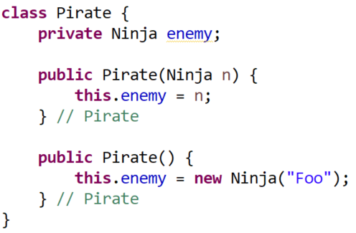
Remember our Ninja and Pirate examples?
We will look at how to write UML for them

Slide 7
A little class diagram will get you a long way
Classes are represented by a diagram with 3 sections
This is the initial version of UML we will teach
ClassName
Field names
Method names
Example – “Ninja” class from SimpleObjectsQuiz
Ninja
name level
setLevel( level )

Slide 8
Types for fields, parameters, and return types
Undesignated
Example – “Ninja” class from SimpleObjectsQuiz
Sometimes we do not designate:
type declarations for field names
types declarations for parameters
Return type declaration for a function method
Ninja
name level
setLevel( level )

Slide 9
Types for fields, parameters, and return types
Designated
Example – “Ninja” class from SimpleObjectsQuiz
Sometimes we do designate:
type declarations for field names
types declarations for parameters
Return type declaration for a function method
Ninja
name: String level: int
setLevel( level: int ): void

Slide 10
Connections Between Classes Require Arrows
A has a B (as a field)
A
Field names
Method names
B
Field names
Method names
Example
Pirate
enemy
Ninja
name level
setLevel( level )
1-2

Slide 11
Connections Between Classes Require Arrows
A has a B (as a field)
A
Field names
Method names
B
Field names
Method names
Example
Pirate
enemy
Ninja
name level
setLevel( level )
When there’s an arrow to another class,
then we often do NOT explicitly define the field at the tail of the arrow
1-2

Slide 12
Connections Between Classes Require Arrows
A has a B (as a field)
A
Field names
Method names
B
Field names
Method names
Example
Pirate
Ninja
name level
setLevel( level )
When there’s an arrow to another class,
then we often do NOT explicitly define the field at the tail of the arrow
1-2

Slide 13
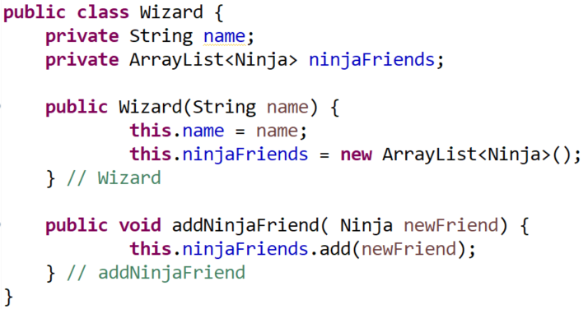
Ninja
name level
setLevel( level )
Let’s add a new class:
“Wizard” that:
- has a name
- has a list of ninjaFriends
What would it look like?

Slide 14
Arrows – to illustrate relationships
A has a B (field)
A
Field names
Method names
B
Field names
Method names
Example
This arrow means, Wizard has a field of type Ninja
The * says that field stores 0 to many Ninja objects
Wizard
name ninjaFriends
addNinjaFriend( ninja )
Ninja
name level
setLevel( level )
*
1-2

Slide 15
Arrows – to illustrate relationships
A has a B (field)
A
Field names
Method names
B
Field names
Method names
Example
Wizard
name ninjaFriends
addNinjaFriend( ninja )
Ninja
name level
setLevel( level )
*
1-2
Explicitly designated fields are often from Java provided types, e.g., int, String, etc.

Slide 16
Arrows – to illustrate relationships
A has a B (field)
A
Field names
Method names
B
Field names
Method names
Example
Wizard
name ninjaFriends
addNinjaFriend( ninja )
Ninja
name level
setLevel( level )
*
When there’s an arrow to another class,
then we often do NOT explicitly define the field at the tail of the arrow
1-2

Slide 17
Arrows – to illustrate relationships
A has a B (field)
A
Field names
Method names
B
Field names
Method names
Example
Wizard
name
addNinjaFriend( ninja )
Ninja
name level
setLevel( level )
*
When there’s an arrow to another class,
then we often do NOT explicitly define the field at the tail of the arrow
1-2

Slide 18
Now - practice
From the today’s in-class quiz do questions #1 and #2
About 10 minutes
For #2 ONLY write this down on paper for now…
Next, we will show you how to generate a digital UML Diagram

Slide 19
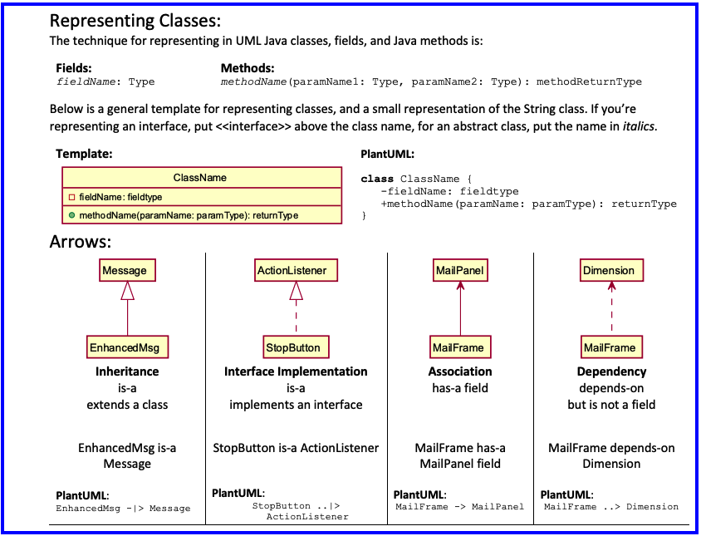
Notes:
For a future class

Slide 20
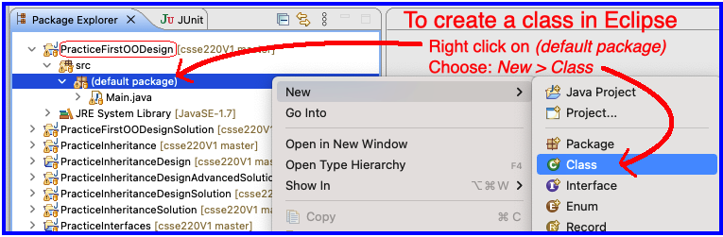
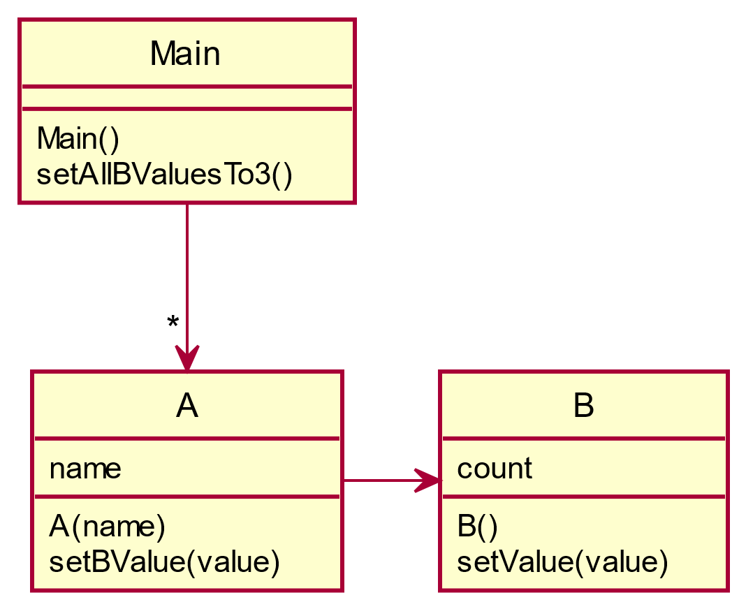
Code up a simple UML diagram!
Open up Eclipse and turn the UML diagram below into Java classes/code
Work in PracticeFirstOODesign (Imported today)
Create classes for A and B, class Main has been created for you
Stub out the methods in A and B, i.e., do not provide code between the { and }
Finally, implement the methods in A, B, and Main
Use data types: String and int
Notes:
@startuml
skinparam style strictuml
class Main {
Main()
setAllBValuesTo3()
}
class A{
name
A( name )
setBValue( value)
}
class B{
count
B()
setValue( value )
}
Main -> "*" A
A-> B
@enduml

Slide 21
Now, use PlantUML to recreate the diagram below Here’s the PlantUML code
@startuml
skinparam style strictuml
class Main {
Main()
setAllBValuesTo3()
}
class A{
name
A(name)
setBValue(value)
}
class B{
count
B()
setValue(value)
}
A -right-> B
Main –down-> "*" A
@enduml
General website
https://plantuml.com/
Free Browser Based Online Server
http://www.plantuml.com/plantuml/

Slide 22
Now - practice
Back to the hand drawn Quiz Question #2
Generate a digital UML Diagram now using PlantUML
2

Slide 23
Begin Software Engineering Techniques Part of Today’s Discussion

Slide 24
Overview: Principles of Design (for CSSE220)
Make sure your design allows proper functionality
Must be able to store required information (one/many to one/many relationships)
Must be able to access the required information to accomplish tasks
Data should not be duplicated (id/identifiers are OK!)
Structure design around the data to be stored
Nouns should become classes
Classes should have intelligent behaviors (methods) that may operate on their data
Functionality should be distributed efficiently
No class/part should get too large
Each class should have a single responsibility it accomplishes
Minimize dependencies between objects when it does not disrupt usability or extendibility
Tell don't ask
Don't have message chains
Don't duplicate code
Similar "chunks" of code should be unified into functions
Classes with similar features should be given common interfaces
Classes with similar internals should be simplified using inheritance
Avoid all type-predicated code by using inheritance

Slide 25
1. Make sure your design allows proper functionality
Must be able to store required information (one/many to one/many relationships)
Must be able to access the required information to accomplish tasks
Data should not be duplicated (id/identifiers are OK!)

Slide 26
An object oriented design must work!
Make sure all the data that you need is stored somewhere
Think as a client programmer: Can you access all the necessary data from the new Class? If not, then the design of the new class “doesn’t work”
The solution is not to keep 2 copies of the same data, one in the client and one in the new Class, change the new Class
Notes:
Maybe mention in passing there are other design approaches that divide things differently, but we’ll be focusing on OO in this course

Slide 27
2. Structure design around the data to be stored
Nouns should become classes
Classes should have intelligent behaviors (methods) that may operate on their data

Slide 28
A good object oriented design is structured around the data
Look for the nouns in your problem, consider making each of them a Class
…if work related to that now is complex enough
Put the data stored as fields in the Class
Add operations to the Class to accomplish what your need, i.e., manipulate the internal class fields
Avoid Plural Nouns – i.e., Class name singular and know that client can always make multiple object instances of this class
Notes:
Maybe mention in passing there are other design approaches that divide things differently, but we’ll be focusing on OO in this course

Slide 29
Learning to Design
PAUSE HERE for a couple minutes!
Try to see what you can think might be wrong
When you have an idea, then continue
You will be given “story problem” for a program(s) that you need to imagine coding
The story problem provides a list of requirements for necessary features that you will need to provide
You will practice designing in two ways:
1) Identifying problems with designs we give you (Red popups)
2) Developing your own design for problems (Blue popups)
You will have a number of opportunities to do practice designing:
In-class exercises/ daily quizzes (many!)
Homework Assignments (5)
Exam Questions (1+ on each exam)
Final Project Design (design from scratch)
PAUSE HERE for 5-10 minutes!
Try to make your own improved design
Either paper or using plantuml is OK!

Slide 30
Design Problem – Track Books
On the next slide is a story problem
To be successful at solving these types of problems you must first read the story problem and do the following “To Do”s
To Do #1 - Identify all the primary nouns
To Do #2 - Identify the associated other nouns that go with the primary nouns
To Do #3 - Identify all the verbs
To Do #4 - For each verb identify all the nouns that the verb works on
To Do #5 – Analyze at the proposed Solution A and Solution B for their problems

Slide 31
A website tracks books and the kids that read them. For each book the system stores the name and author. For each kid the system stores name and grade level. The teacher enters when a kid reads a particular book. It should be possible to print a report on a book that includes all kids who have read a particular book (with their grade level). It should be possible to print a report on a kid that includes the books (with authors) a particular kid has read.
To Do #1 - Identify all the primary nouns
To Do #2 - Identify the associated other nouns that go with the primary nouns
To Do #3 - Identify all the verbs
To Do #4 - For each verb identify all the nouns that the verb works on
To Do #5 – Analyze at the proposed Solution A and Solution B for their problems

Slide 32
A website tracks books and the kids that read them. For each book the system stores the name and author. For each kid the system stores name and grade level. The teacher enters when a kid reads a particular book. It should be possible to print a report on a book that includes all kids who have read a particular book (with their grade level). It should be possible to print a report on a kid that includes the books (with authors) a particular kid has read.
To Do #1 - Identify all the primary nouns
To Do #2 - Identify the associated other nouns that go with the primary nouns
To Do #3 - Identify all the verbs
To Do #4 - For each verb identify all the nouns that the verb works on
To Do #5 – Analyze at the proposed Solution A and Solution B for their problems

Slide 33
A website tracks books and the kids that read them. For each book the system stores the name and author. For each kid the system stores name and grade level. The teacher enters when a kid reads a particular book. It should be possible to print a report on a book that includes all kids who have read a particular book (with their grade level). It should be possible to print a report on a kid that includes the books (with authors) a particular kid has read.
To Do #1 - Identify all the primary nouns
To Do #2 - Identify the associated other nouns that go with the primary nouns
To Do #3 - Identify all the verbs
To Do #4 - For each verb identify all the nouns that the verb works on
To Do #5 – Analyze at the proposed Solution A and Solution B for their problems

Slide 34
A website tracks books and the kids that read them. For each book the system stores the name and author. For each kid the system stores name and grade level. The teacher enters when a kid reads a particular book. It should be possible to print a report on a book that includes all kids who have read a particular book (with their grade level). It should be possible to print a report on a kid that includes the books (with authors) a particular kid has read.
To Do #1 - Identify all the primary nouns
To Do #2 - Identify the associated other nouns that go with the primary nouns
To Do #3 - Identify all the verbs
To Do #4 - For each verb identify all the nouns that the verb works on
To Do #5 – Analyze at the proposed Solution A and Solution B for their problems

Slide 35
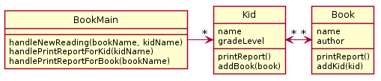
A website tracks books and the kids that read them. For each book the system stores the name and author. For each kid the system stores name and grade level. The teacher enters when a kid reads a particular book. It should be possible to print a report on a book that includes all kids who have read a particular book (with their grade level). It should be possible to print a report on a kid that includes the books (with authors) a particular kid has read.
Bad Design A
Notes:
There is no (sane) way to lookup a book to either lookup a book to add to a kid or print a report
Duplication of data

Slide 36
Good parts of the design - Main class
Every program starts somewhere, and any design should make clear where the starting point is. In our class, we will name the starting point class SomethingMain
We implicitly assume there exists:
constructors as needed
getters and setters as needed

Slide 37
Good parts of the design – “handle” methods
In our very simple designs, this class also deals with user input
handle methods will have special meaning for us, as they will represent places where user commands enter the system
Examine the UML diagram and use your analysis skills in order to determine:
If what is required by the story problem can be stored by the design presented in the UML diagram
If you can implement the handle methods in the UML Main class given the data stored in the different UML class diagram

Slide 38
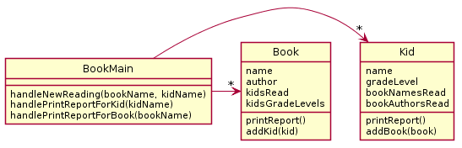
A website tracks books and the kids that read them. For each book the system stores the name and author. For each kid the system stores name and grade level. The teacher enters when a kid reads a particular book. It should be possible to print a report on a book that includes all kids who have read a particular book (with their grade level). It should be possible to print a report on a kid that includes the books (with authors) a particular kid has read.
PAUSE HERE for a couple minutes!
Try to see what you can think might be wrong
When you have an idea, then continue
Bad Design A
Bad Design B
3-5
Notes:
There is no (sane) way to lookup a book to either lookup a book to add to a kid or print a report
Duplication of data

Slide 39
This design does not function. There is no (sane) way to look up a book for printing a report or for associating with a Kid.

Slide 40
This design functions but there is a very large amount of duplication – which in general we want to avoid.
In particular, the author/title information in the kid is duplicated and the name/grade level information in the book is duplicated.
Notes:
@startuml
skinparam style strictuml
class Book {
name
author
printReport()
addKid(kid)
}
class Kid {
name
gradeLevel
printReport()
addBook(book)
}
class BookMain {
handleNewReading(bookname,kidname)
printReportForBook(bookname)
printReportForKid(kidname)
}
Kid "*" <-> "*" Book
BookMain -> "*" Book
BookMain -> "*" Kid
@enduml

Slide 41
What would be a better design?
PAUSE HERE for 5-10 minutes!
Try to make your own improved design
Either paper or using plantuml is OK!
A website tracks books and the kids that read them. For each book the system stores the name and author. For each kid the system stores name and grade level. The teacher enters when a kid reads a particular book. It should be possible to print a report on a book that includes all kids who have read a particular book (with their grade level). It should be possible to print a report on a kid that includes the books (with authors) a particular kid has read.
Problematic designs for reference:
Bad Design A
Bad Design B

Slide 42
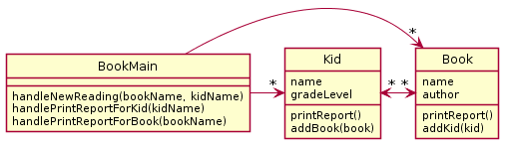
A Potential Solution

Slide 43
In most cases non-workable design is caused by…
Not carefully analyzing the story problem.
Not carefully mapping the story problem to the proposed design (e.g., not noticing that each kid reads several books, not just one)
Not thinking about how specific required features might be implemented (e.g., how can we print a book report if we don’t have access to the book objects?)
Duplicating data (e.g., what does it matter if we store a copy of the author and title for every kid that reads the book)

Slide 44
Design Problem – Company Accounts

Slide 45
Do the in-class activity
A particular company keeps a variety of different accounts for its projects. Each account has an account number and a balance. When a deposit or withdrawal occurs, the transaction occurs immediately, and the current balance should be updated. The system should support getting the current balance.
The system should also support getting the balance as it existed at any date/time in the past. Note the input historical date/time may not correspond to a particular transaction time - e.g., if the system had a balance of $1 at 1 p.m. and then was changed to $2 at 3 p.m., a request for the balance at 2 p.m. should return $1.
To Do #1
Identify all the primary nouns in the Problem Statement (above). A primary noun has other nouns associated with it.
To Do #2
For each primary noun listed in To Do #1 (above), write down its associated other nouns - write these down in the second column above next to the corresponding primary noun.
To Do #3
Identify all the verbs in the Problem Statement.
To Do #4
For each verb in To Do #3, identify all the nouns (Primary and/or other) in the Problem Statement that the verb works on

Slide 46
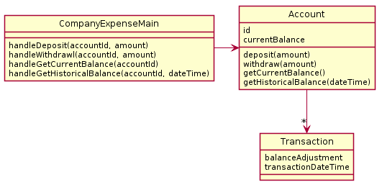
What is wrong with this design? This design?
PAUSE HERE for a couple minutes!
Try to see what you can think might be wrong
When you have an idea, then continue
A particular company keeps a variety of different accounts for its projects. Each account has an account number and a balance. When a deposit or withdrawal occurs, the transaction occurs immediately and the current balance should be updated. The system should support getting the current balance.
The system should also support getting the balance as it existed at any date/time in the past. Note the input historical date/time may not correspond to a particular transaction time - e.g. if the system had a balance of $1 at 1 pm and then was changed to $2 at 3 pm, a request for the balance at 2 pm should return $1.
Bad Design A
Quiz question
#6
Note:
Don’t read more into the English text than is there, e.g., “there ought to be a way to create accounts!”
6

Slide 47
This design does not function correctly. Why?
Main has only one account, but the system needs to support many. How do we know that from this diagram?
Also, computing the data for historic balances is moderately hard.

Slide 48
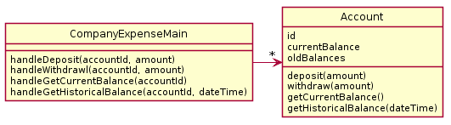
Questions #7 & #8 on today’s quiz
A particular company keeps a variety of different accounts for its projects. Each account has an account number and a balance. When a deposit or withdrawal occurs, the transaction occurs immediately and the current balance should be updated. The system should support getting the current balance.
The system should also support getting the balance as it existed at any date/time in the past. Note the input historical date/time may not correspond to a particular transaction time - e.g. if the system had a balance of $1 at 1pm and then was changed to $2 at 3pm., a request for the balance at 2pm should return $1.
Find the problem with this design
PAUSE HERE for a couple minutes!
Try to see what you can think might be wrong
When you have an idea, then continue
Bad Design B
7-8

Slide 49
This design does not function correctly.
Account does not have enough data to make getHistoricalBalance work. oldBalances stores perhaps a list of balances? But the date of the transactions is not stored, so we can't look up the balance on a particular day/time.

Slide 50
Questions #7 & #8 on today’s quiz
A particular company keeps a variety of different accounts for its projects. Each account has an account number and a balance. When a deposit or withdrawal occurs, the transaction occurs immediately and the current balance should be updated. The system should support getting the current balance.
The system should also support getting the balance as it existed at any date/time in the past. Note the input historical date/time may not correspond to a particular transaction time - e.g. if the system had a balance of $1 at 1pm and then was changed to $2 at 3pm., a request for the balance at 2pm should return $1.
Propose your own design
PAUSE HERE for 5-10 minutes!
Try to make your own improved design
Either paper or using plantuml is OK!
7-8

Slide 51

Here is a potential solution

Slide 52
Here is a potential solution
Note: balances & transactionDateTimes – are parallel ArrayLists
The 's' at the end of the names balances and transactionDateTimes this is an indicator that each stores multiple values – these are really parallel ArrayLists
Alternative to parallel ArrayLists: Create a single new class to capture balance and transactionDateTime, then create a single ArrayList of this new class

Slide 53
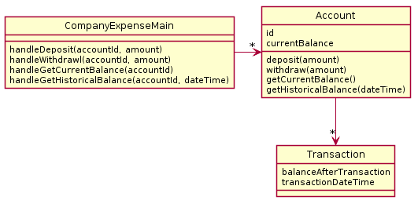
Here is second potential solution
Technically, this class is just a “dumb” data holder and has no methods that work on the data stored with the objects of this class.
Consider: is this design more flexible if we get new requirements, like for instance needing a transactionReport() method?

Slide 54
Design Problems 1 Homework
Before next class:
Solve the Design Problem 1 Homework (Moodle -> GradeScope)
These are due the day of next class in the morning at 7:55AM
Anything turned in late will be worth zero points
We will go over the solution at the start of class
We’ll discuss more design principles after Exam 1
One more example Design Problem you can practice on your own or with classmates on the slides that follow
Notes:
Briefly show the website description and how points are awarded on gradescope

Slide 55
Design Problem – Card Game
On the next slide is another story problem
To be successful at solving these types of problems you must first read the story problem and do the following “To Do”s
To Do #1 - Identify all the primary nouns
To Do #2 - Identify the associated other nouns that go with the primary nouns
To Do #3 - Identify all the verbs
To Do #4 - For each verb identify all the nouns that the verb works on
To Do #5 – Analyze at the proposed Solution A and Solution B for their problems

Slide 56
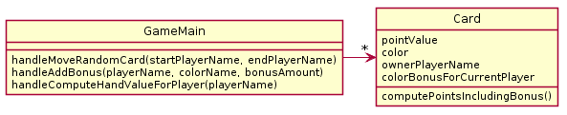
In a particular card game, players have hands of cards. Each card is worth some points and also has a color (red, blue, green). During play, players accrue bonuses that mean cards of a particular color are worth bonus points. During play, sometimes a random card is selected from one player's hand and moved to another player's hand. At the end of game, it is necessary to compute the total points for each player's hand.
What is wrong with this design? (Hint: look at and refer to your design principles by number). I see at least 2 separate categories violated.
PAUSE HERE for a couple minutes!
Try to see what you can think might be wrong
When you have an idea, then continue

Slide 57
My answer (in order of importance)
1a. The design does not function correctly
The player’s color bonus cannot be preserved if he/she loses all their cards of a particular color
It requires iterating over all objects to get the full set of cards in the players hands to move cards or compute final total
1c. Playername & player color bonus are duplicated across cards
2a. Player (common noun from problem) not represented
Notes:
Note for 1a – obviously you try to use nouns from the description. But its not required

Slide 58
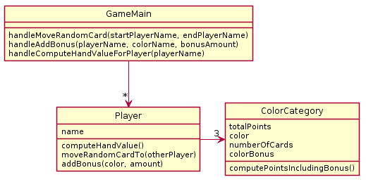
In a particular card game, players have hands of cards. Each card is worth some points and also has a color (red, blue, green). During play, players accrue bonuses that mean cards of a particular color are worth bonus points. During play, sometimes a random card is selected from one player's hand and moved to another player's hand. At the end of game, it is necessary to compute the total points for each player's hand.
What is wrong with this design? (Hint: look at and refer to your design guidelines). I see at least 2 separate categories violated.
PAUSE HERE for a couple minutes!
Try to see what you can think might be wrong
When you have an idea, then continue

Slide 59
My answer (in order of importance)
1a. The design does not function correctly
Once a card is added to a players hand, its specific point value is lost so the card cannot be randomly moved to another players hand
2a. Card (common noun from problem) not represented

Slide 60
In a particular card game, players have hands of cards. Each card is worth some points and also has a color (red, blue, green). During play, players accrue bonuses that mean cards of a particular color are worth bonus points. During play, sometimes a random card is selected from one player's hand and moved to another player's hand. At the end of game, it is necessary to compute the total points for each player's hand.
Now design your solution that solves all problems.
PAUSE HERE for 5-10 minutes!
Try to make your own improved design
Either paper or using plantuml is OK!

Slide 61
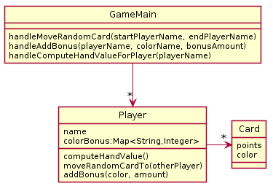
A Potential Solution
Reminder:
We implicitly assume there exists:
constructors as needed
getters and setters as needed
getPoints(), getColor() too
Notes:
Since UML is meant to be a simple way to communicate, we often omit simple methods like getters and setters.
If we want you to show all methods, we will tell you to do so

