Slide 1
CSSE 220
Sorting Algorithms
Algorithm Analysis and Big-O
Searching
The git projects for today are:
PracticeSortingAndSearching
PracticeSortingAndSearchingSolution
Notes:
Bring a few playing cards or preferably BIG LETTERS or BIG NUMBERS.
Bring a copy of the yellow pages. Make sure the page numbers on the “Searching” slide are correct.

Slide 2
Questions?

Slide 3
What is sorting?
Let’s see…
Notes:
Odd term, "sorting". Knuth: He was sort of out of sorts from sorting that sort of data.
My boss ordered me to order a new tape drive so we can order our data several orders of magnitude faster.

Slide 4
Why study sorting?
At least 5 well-known algorithms that have the same functionality:
Heap sort
Insertion sort
Merge sort
Quick sort
Selection sort
Can do an analysis of each algorithm and compare the results
Sorting is done every day all the time – think of the results of a google search
Notes:
[see story on next hidden slide]

Slide 5
Course Goals for Sorting: You should…
Be able to describe basic sorting algorithms:
Selection sort – O(N²)
Insertion sort – O(N²)
Merge sort – O(N * log₂(N))
Know the run-time efficiency of each
Know the best and worst case inputs for each

Slide 6
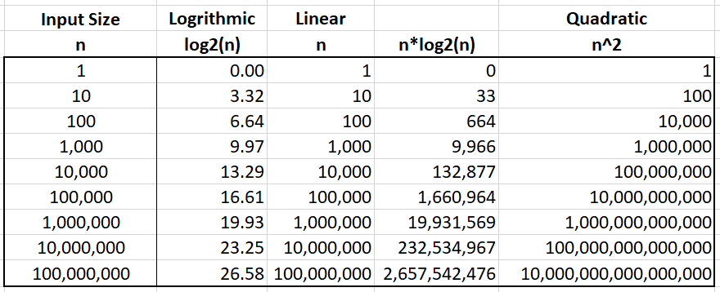
Course Goals for Sorting: You should…
Sorting Terminology:
Non-decreasing: use ≥
Non-increasing: use ≤
Notes:
reversed

Slide 7
Selection Sort
Basic idea:
Think of the list array as having a sorted part (at the beginning) and an unsorted part (the rest)
Find the smallest value in the unsorted part
Move it to the end of the sorted part (making the sorted part bigger and the unsorted part smaller)
Repeat until unsorted part is empty
Notes:
Review algorithm with a few of the cards or preferably the BIG LETTERS or big numbers
Look at sortAndSearch.SelectionSort(), briefly explain use of generic methods.
Takeaways:
Start iterating from index 0 (firstUnsortedIndex)
Smallest remaining starts with value at index 0;
When smallest remaining element is found, swap with value at index from outer loop (firstUnsortedIndex).

Slide 8
Selection Sort

Slide 9
Profiling Selection Sort
Profiling: collecting data on the run-time behavior of an algorithm
In Eclipse, determine how long does selection sort take on:
10,000 elements?
20,000 elements?
…
80,000 elements?
Q1
Notes:
[Plot data on whiteboard after they’re done]
[Or use Excel]
https://docs.google.com/spreadsheets/d/19V1f8brgzNm9bcj1giJqIg5MVgJjqbOTsFt9p6tBq_o/edit#gid=0

Slide 10
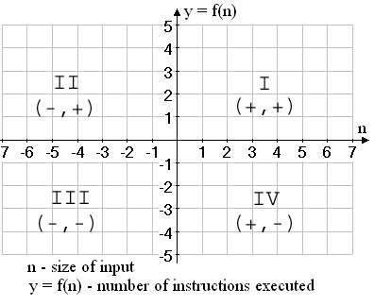
Performance Analysis Basics
Come up with a math function f(n) such that it does the following:
input: n = size of the problem to be solved by the algorithm
output: y = f(n) - the number of instructions executed
Only care about Quadrant I

Slide 11
Analyzing Selection Sort
Analyzing: calculating the performance of an algorithm by studying how it works, typically mathematically
Typically we want the relative performance as a function of input size
Example: For an array of length n, how many times does selectionSort() call compareTo()?
Look at number of times compareTo() is called as a shortcut way to determine the Big-O
Q2-Q7
Notes:
- Remember Shlemiel. His technique worked well for small inputs (i.e., short roads), but got worse and worse.
Handy fact is animated. Note that we can derive the fact for even n by working outside in.
Have them work on Q2-6. Solve Q7 together on board.
After solving, ask: For very large n, what term of solution matters most? What term grows fastest? Do the other terms contribute much to the growth of the function?

Slide 12

Summation Notation & Facts
$$\sum_{k=0}^{n−1}{k= ?}$$
$$\sum_{k=0}^{n−1}{k=0+1+2+…+n −1}$$
$$\sum_{k=0}^{n−1}{k= \frac{n∗ \left(n−1\right)}{2}}$$
Open form
Closed form
Induction is used to prove this

Slide 13

Summation Notation & Facts
$$\sum_{k=1}^{n}{k= ?}$$
$$\sum_{k=1}^{n}{k=1+2+…+n}$$
$$\sum_{k=1}^{n}{k= \frac{n∗ \left(n+1\right)}{2}}$$
Open form
Closed form
Induction is used to prove this

Slide 14
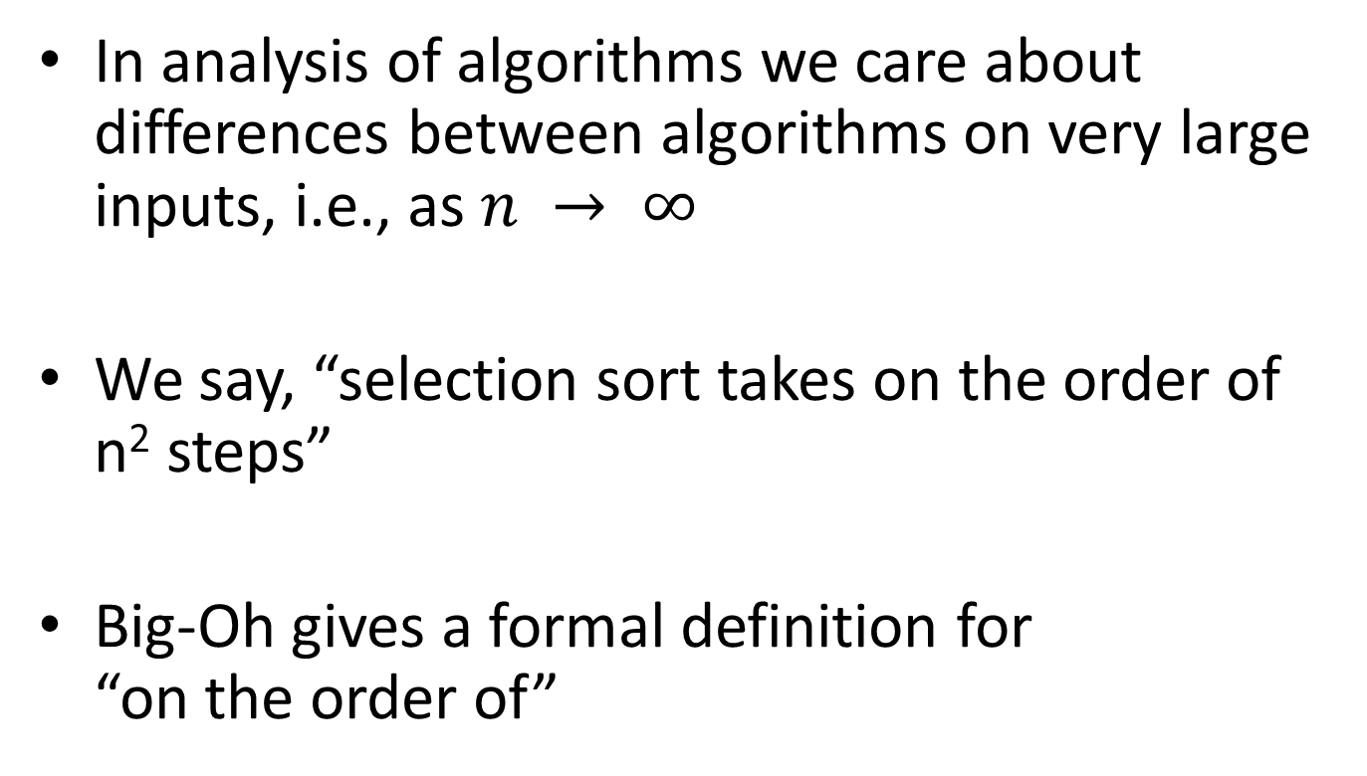
Big-Oh Notation
In analysis of algorithms we care about differences between algorithms on very large inputs, i.e., as $n → ∞$
We say, “selection sort takes on the order of n² steps”
Big-Oh gives a formal definition for “on the order of”
Q8

Slide 15
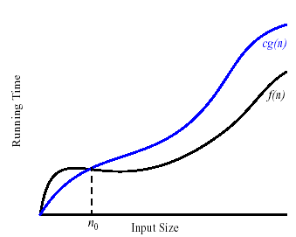
Formally
We write f(n) = O(g(n)), and say “f is big-Oh of g”
if there exists positive constants c and n₀ such that
0 ≤ f(n) ≤ c g(n) for all n > n₀
g is a ceiling on f
Notes:
Work out c and n0 for each of the examples on the quiz.

Slide 16
Insertion Sort
Basic idea:
Think of the list array as having a sorted part (at the beginning) and an unsorted part (the rest)
Get the first value in the unsorted part
Insert it into the correct location in the sorted part, moving larger values up to make room
Repeat until unsorted part is empty
Notes:
[Review algorithm using cards or BIG LETTERS]
Takeaways:
First item in the array is in the sorted part.
start iterating over the unsorted part from index 1
Bubble elements up from sorted part to make room for next element in unsorted part.
Put that element at rightful location in sorted part.

Slide 17
Insertion Sort

Slide 18
Insertion Sort Exercise
Profile insertion sort
Analyze insertion sort assuming the inner while loop runs the maximum number of times
What input causes the worst case behavior? The best case?
Does the input affect selection sort?
Ask for help if you’re stuck!
Q9-Q18

Slide 19
Searching
Guess a number from 1 to 100
It was 63
Guess a number from 1 to 1000
It was 864
Guess a number from 1 to 1000 (+/- )
It was 265
Notes:
Slides animated to do an activity in class to force student to realize how long it takes to figure out a number.
Script: Ask students to guess the number from 1 to 100
After a while they will probably get systematic about guessing it
Ask students to do the same for 1 to 1000, they will say Nooooo that’s too hard, reveal the answer after asking one student to take a guess (which they should miss)
Now, as them to guess the number but you will tell them if the answer is lower or higher than their guess.

Slide 20
Searching
How many guesses to guess a number from 1 to 1,000,000?
Notes:
1,000,000/ (2^X) <= 1
1,000,000 <= 2^X
Log2(1,000,000) = X
2^X = 1,000,000 => log 2( 1,000,000) = X
Binary search log2( N) -> cuts possibilities in half each time
Those

Slide 21
Searching
Consider:
Find China Express’s number in the phone book
Find who has the number 208-2063
Is one task harder than the other? Why?
For searching unsorted data, what’s the worst case number of comparisons we would have to make?
Brute force approach is required
Notes:
BEFORE animating any bullets:
Ask student to find China Express’s number; time them. (You may need to hint that they go to the restaurant section… they don’t understand phone books ☺ )
Ask if anyone thinks they can beat that time. (page 337 of yellow book 2008-2009 phone book)
Ask them to find who has the number 208-2063.
208-2063 is Precision Lawn Plus (page 252 of yellow book 2008-2009 phone book)
Then build by major bullet
- n, for n items

Slide 22
Binary Search of Sorted Data
A divide and conquer strategy
Basic idea:
Divide the list array in half
Decide whether result should be in upper or lower half
Recursively search that half
Notes:
Look at code for binary search.

Slide 23
Analyzing Binary Search
Analyze Binary search assuming the value searched for is at the start or end of the list array
Question: How many times can you divide a number by 2, and then repeatedly divide the result by 2 until the result ≤ 1?
What’s the best case of Binary Search?
What’s the worst case Binary Search?
Q19
Notes:
Solve Q19 together

Slide 24
Work Time
Study MergeSort for next class
Q20-Q21

