Slide 1
CSSE 220
ClassMaterials/ArraysAnd2DArrays
The git projects for today are:
PracticeArraysAnd2DArrays
PracticeSolutionArraysAnd2DArrays
Notes:
JAY: Introduce FIRST row today (Identity Pie)
Aim to have them working on arrays in the 1st hour and 2d arrays in the second

Slide 2
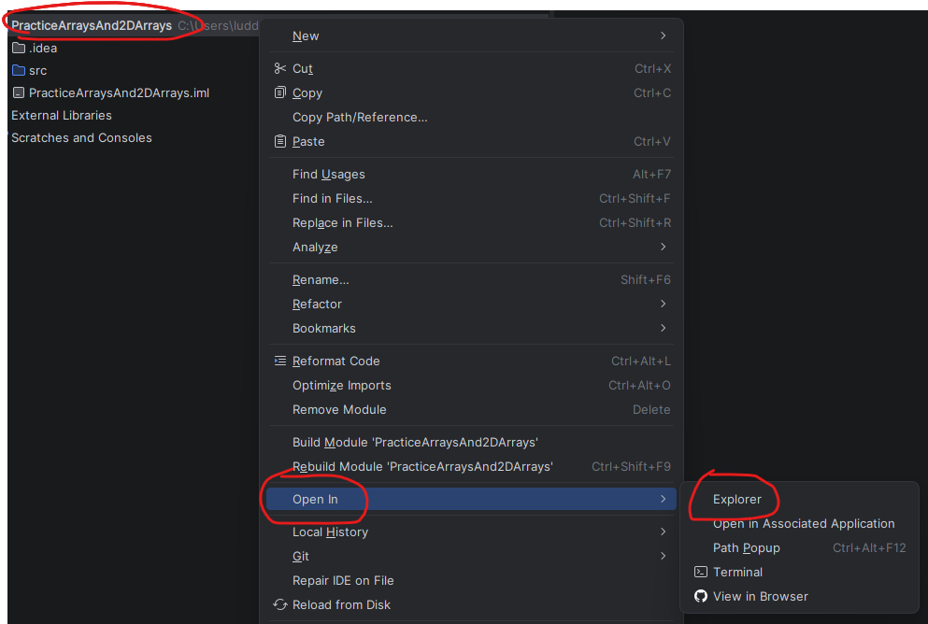
How to access slides (from IntelliJ)
Right-click project folder, then select “Open In > Explorer”.
Move up one directory (a.k.a. folder) to find the “Slides” folder.

Slide 3
How to access slides (from Internet)

Slide 4
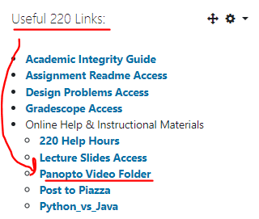
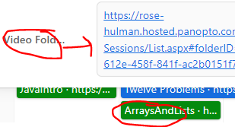
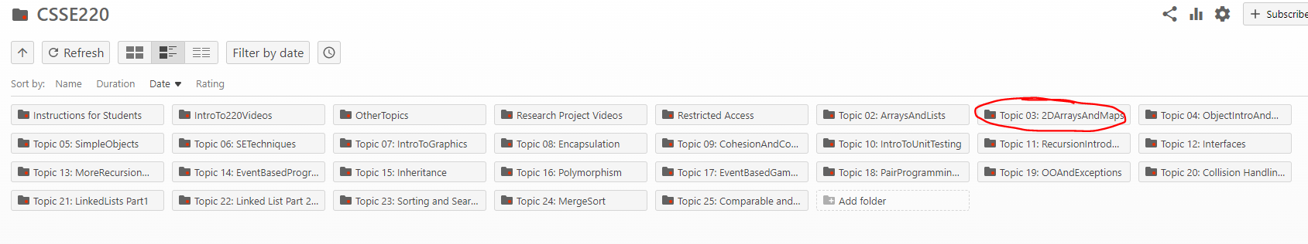
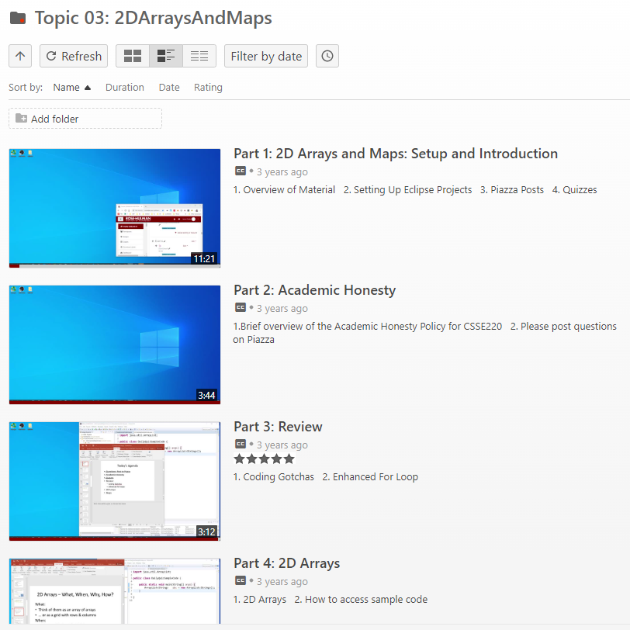
Panopto Videos
Videos cover the content, sometimes slightly different, but always an options for extra review and practice

Slide 5


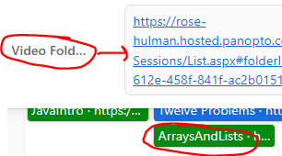

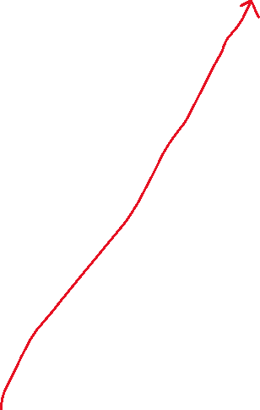

Speed With Which Things Move
Moving up a level in speed
Anticipate as time allows:
  Go through slides before class
  Familiarize yourself with terminology
  Write down questions for instructor
  Ask questions in class, or hand piece of paper with questions to instructor at beginning of class
  Read the Big Java chapters
  Watch pre-recorded videos

Slide 6
Getting things done
If something has a hard deadline, then set a reminder in your smart device
Live by: “if I don’t do it now, it won’t get done”
Speaking of which… HW0…
Notes:
Go over solution from HW0 to make sure students get the answer
intentionally introduce error in HW0 as you go. order of operations. different approaches.

Slide 7
JavaIntro, HW0, HWSmallProblems
Any questions: feel free to ask individually
JavaIntro will not be collected and graded
  Intended to help you learn
  Not intended as busy work
HWSmallProblems
  Due date on schedule page
  First half you can probably do already

Slide 8
Syllabus Highlights

Slide 9

Syllabus Highlights
Course policies
  Late Assignments
  Grading
  Collegiality
  Schedule
  Etc.

Slide 10
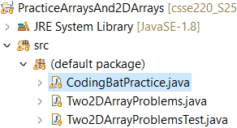

Array Practice Opportunity
Form groups of 2
Navigate to: http://codingbat.com/java/Array-2
  Work in your groups to solve:
  fizArray3, bigDiff, shiftLeft
  If you finish early, try: zeroFront
  Save your codingbat work by copy and paste into CodingBatPractice.java

Slide 11
Work Time
Completing the Array Practice
Start looking at HWSmallProblems
Notes:
As time allows:
1. See if anyone is asking about static, give simple explanation
2. Possible elaborate on an auto-boxing diagram

Slide 12
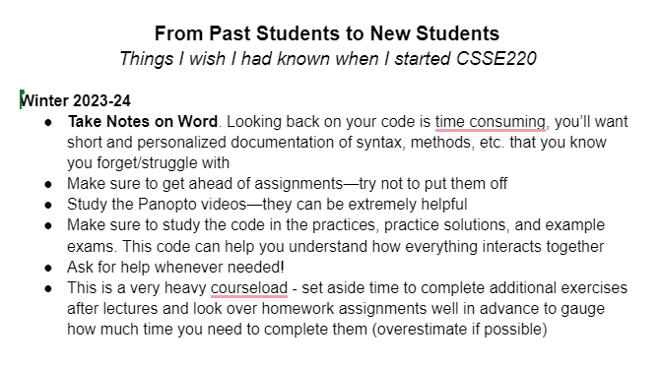
Advice from Former Students
https://docs.google.com/document/d/1gWrR8fe7Qs5B9MgRkFW4wBa-tnRdFXGTDRnqi2ps1i4/edit

