Slide 1
Object Introduction
The git projects for today are:
PracticeObjectIntroAndMisc
PracticeObjectIntroAndMiscSolution

Slide 2
Class – What, When, Why, & How?
What:
A blueprint for a custom type
When:
Define a class when you’re representing a concept (think nouns)
When no other existing type can do what you want/need

Slide 3
Class – What, When, Why, & How?
Why:
Keep similar concepts together
Encapsulation (we’ll expand on this next time)
How:
public class ClassName {
//fields – appear here
//methods – come next
}

Slide 4
Using Objects and Methods
“Who does what, with what?”
Works just like Python:
object.method(argument, ...)
Two examples in Java:
The controlling object
is an implicit argument
passed to method
Explicit arguments always appear inside the ( and )
HashMap<String, Integer> scores = new HashMap<>();
scores.put(“Bob”, 78); // scores is controlling object
String name = "Bob Forapples";
int nameLen = name.length(); // name is controlling object

Slide 5
Constructors – What, When, Why, How?
What:
Special method called when a new object instance of a class is created
Initializes the new object instance
Like the __init__ method in Python
When:
Define a constructor when special initialization of a class's fields is required
Otherwise, Java implicitly creates a no-argument constructor if you don’t add one, but it does not do anything

Slide 6
Constructors – What, When, Why, How?
Why:
Allows you to ensure that a new object instance is initialized exactly how it needs to be before calling other methods/fields
Puts object in a legal initial state
How: always has the same name as the class.
public class MyClass {
public MyClass() {
//init code of parameterless constructor
}
public MyClass(ParamType paramName) {
//init code of 1 parameter constructor
}
}

Slide 7
Object Constructors
int num = 5;
bool isEmpty = true;
This works for primitive data types
What about how do we initialize an “object” that is made from a class?

Slide 8
Using Constructors
This constructor's arguments specifies that the new Rectangle whose reference is stored in box should be at the origin (0, 0) with a height and width of 5.
In Java, all variables must have a type
Rectangle box = new Rectangle(0, 0, 5, 5);
Every variable must have a name.
The new operator is what actually creates the new object, in this case a new Rectangle
Q5
Notes:
Argument for main is not optional. Must be there.

Slide 9
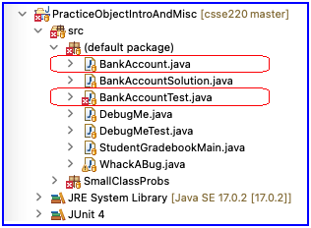
Object Constructors
Open BankAccount.java
Let’s do the first few, then work on your own
Have Eclipse help us
When you’re done and it works, solve the last quiz question

Slide 10
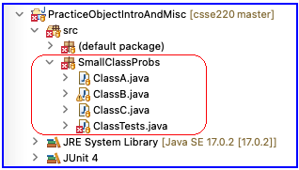
Additional Practice
Work in SmallClassProbs
Finish:
ClassA.java
ClassB.java
ClassC.java
Make these classes work with the tests provided in ClassTests.java

Slide 11
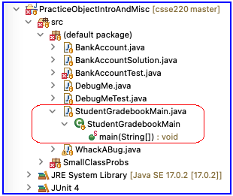
Now code the StudentGradebook class yourself
Uncomment the code found in StudentGradebookMain to see what the class should do
Then create the class and add the constructors and methods you need
If you finish early, add a function to compute the student’s average grade
Notes:
Do not spend too much time on this since students will need time outside of class to complete this. Be sure to reserve time for the rest of the material and for students to complete the quiz.

Slide 12
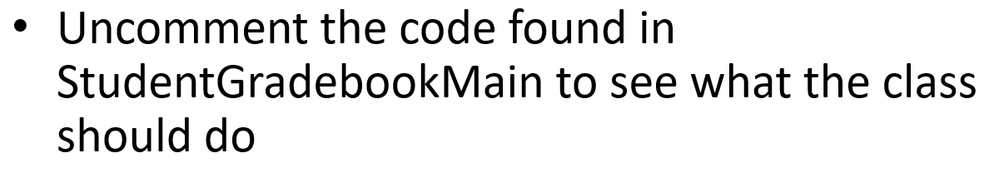

Terminology Review
client – uses the services of a primitive type or class by declaring variables from these types and then calling operations to manipulate these variables
object – a variable that stores a reference to an object instance
primitive type – boolean, byte, character, short, int, float, double variables of these these types are not objects in Java
variable – stores either primitive data (e.g., from type int) or reference data (i.e., a reference to an object instance)
wrapper class – a built-in Java class that turns a Java primitive type into an object version of the primitive type, e.g., Integer wrapper class is an object version of the primitive type int

