Slide 1
CSSE 220
Project Presentation Details
M4 Expectations

Slide 2
Goals for the presentation
Every team member plays a significant role.
Confidently & professionally describe your project and results.
Demonstrate your project (recording or live).
Describe the basic design of your project and discuss the amount of cohesion and coupling in your design.

Slide 3
Your Presentations - Specifics
10 minutes long (Rehearse! Aim to be within 60 seconds +/- )
~4 min. describing and demonstrating your project
  Recommended: record a video
  Live demo is “acceptable” (but beware Murphy’s law)
~3 min. Explaining your overall design (major classes, NOT all)
  “Coupling/Cohesion” or other “Good/Bad” aspects of design
  Discuss OODPs explicitly in your presentation
  OK to say your design is lacking; say what you'd do differently
~3 min. Design decision, feature implementation, or tricky bug
  Be explicit in stating your “Special Item” (decision/feature/bug)
  Be careful about code examples (good – but in moderation)
  Be sure to include prepared slides, usually including diagrams
  Be sure to explain the item, not just mention it
Notes:
3

Slide 4
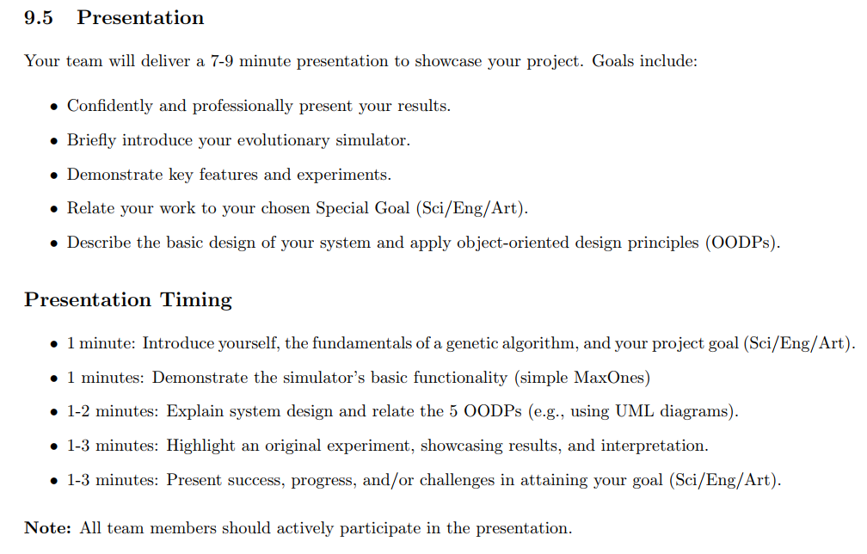

From the project specification document (GARP Spec.)
9-11 minute

Slide 5

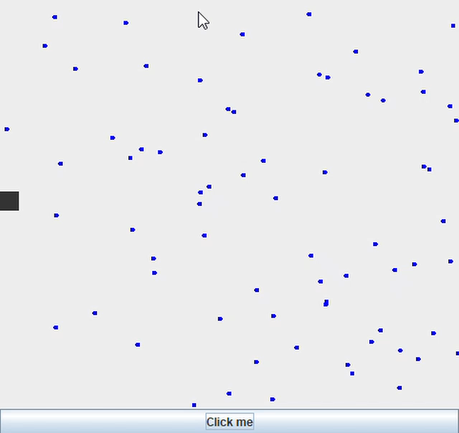

How to Make Screen Recordings
(Windows 11)
Press Print Screen
Or
Window + Shift + S

Slide 6
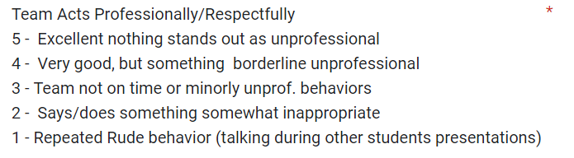
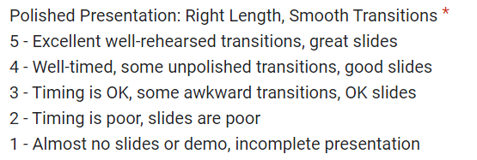
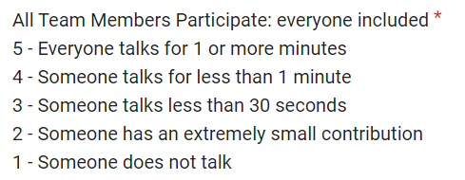
Rubric for Scoring Presentations

Slide 7
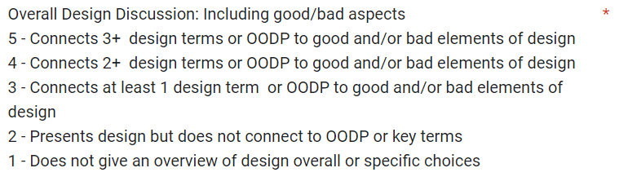
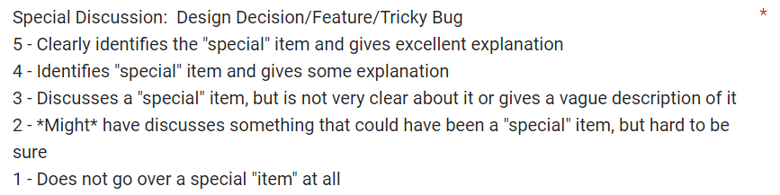
Rubric for Scoring Presentations

Slide 8
Student Voted Awards!
Best Art/Visuals/Sound Effects
Best OODP Discussion
Best Technical Explanation
(of design decision, feature implementation, or tricky bug)

Slide 9
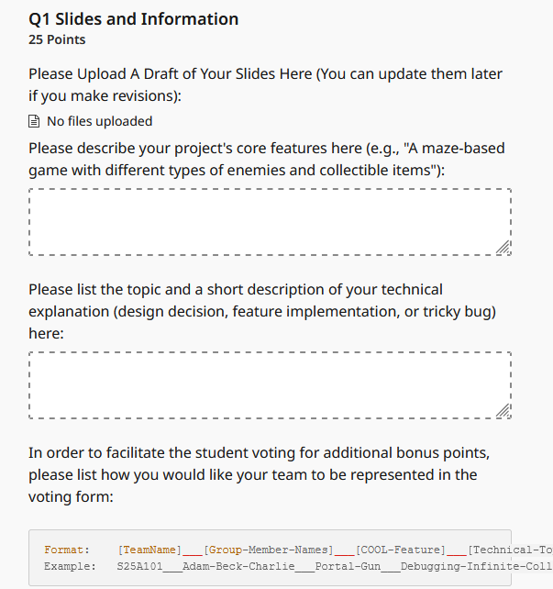
Submit Draft of Slides
in Gradescope
by Wednesday, 5 p.m.

Slide 10
M4 Expectations
Finish core functionality
  Discuss with me/TA mentor whether to scale back target features (e.g., 2 enemy types instead of 3)
  Review core requirements checklist
Add some pizzazz (extra features)
  optionally with genAI help
  See next slide for reminder of genAI code policy
Clean up/refactor codebase
  Remove commented-out/unused code
  Add Javadocs, fix OODP violations, etc.

Slide 11
GenAI Use
Sense of craftsmanship, ownership, agency
  “We built this” vs. “we told Claude to build this”
Limited use allowed in Milestone 4 when adding extra features:
  Search for how to do new things, like add animations
  Generate small code snippets
For any genAI use in M4, MUST clearly indicate any and all genAI-produced/genAI-assisted code
  Comments before/after:
  // START of genAI-assisted code: [link to conversation]
  ...
  // END of genAI-assisted code

Slide 12
Some ideas for pizzazz
Add a help/about screen (e.g., JFrame pop-up when you press F1) with usage instructions, controls, credits, etc.
Add a leaderboard (enter name/initials)
Allow the user to change key bindings, saved in a text/csv file
Change the Swing Look and Feel (e.g., to FlatLaf, similar to what IntelliJ uses)
Add sprites/animations/sound effects
  Make sure to clearly cite sources if not original

