Slide 1
CSSE 220
Event Based Programming
The git projects for today are:
PracticeEventBasedProgramming
PracticeEventBasedProgrammingSolution
Notes:
Bring hardcopy of BreakfastMain from EventBasedProgrammingSolution.
Stay focused. No time for tangents. Give them time to work at the end.

Slide 2

Graphical User Interfaces in Java
We write code to tell Java what to draw
Java windowing library:
Draws it
Gets user input
Calls back to us with events
Our code handles events
Hmm, donuts
Gooey
Notes:
Define each of the highlighted terms
A callback is a mechanism for specifying a block of code so it can be executed later.
An event is a notification to the program that a user action (key press, mouse move, menu selection, etc) has occurred.
We handle events by writing code that respond to them so that the user receives the appropriate response.

Slide 3
Next Assignment Preview
Two stages
Part 1: Ball Strike Counter (individual)
Part 2: Optionally work with 1 partner
Each list the other’s name in javadoc at top of file
Both responsible for submitting own code
Right Now!
Take out a sheet of paper now and tear off a small piece.
Put your name on it
Put the name of 1 or more people you would LIKE to work with
You can say you don’t know anyone, but would like to work with someone
You can say you want to work alone
Hand this to the TA and they will make pairs for you to use
Notes:
Demo both of the solutions while they start to do this

Slide 4

Handling Events
Many kinds of events:
Mouse pressed, mouse released, mouse moved, mouse clicked, button clicked, key pressed, menu item selected, …
We create event listener objects
that implement the right interface
that handle the event as we wish
We register our listener with an event source
Sources: buttons, menu items, graphics area, …
Q1
Notes:
QUIZ QUESTION 1 - things that happen, where they come from
An event source is an object that can notify other classes of events.
ActionListener is an interface that MUST be implemented as a class.
MouseListener is an interface that declares the mouse functions listed in the first bullet.

Slide 5
Events
Event
Listeners
Event
Sources
Mouse
(MouseListener)
MouseEvents
ActionListener
Button
Register!
ActionEvents
Keyboard
KeyEvents
(KeyListener)
Notes:
Animated to walk through the idea of events being generated and then Listeners which can be registered to them.
If we do not register/attach our listener to an event source, then nothing happens
We have to decide what happens when our listener is triggered

Slide 6
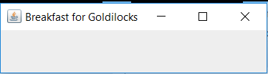
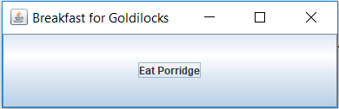
Simple Interactive GUI Workflow
1. Create JFrame (Needs additional configuration)
2. Create JButton
(JButton initially untethered and invisible)
3. Add JButton to JFrame (Can also be added to a JPanel)
4. Create ActionListener (must code what it does)
(Not connected to JButton, does nothing!)
5. Attach ActionListener to JButton
JFrame frame = new JFrame(“Breakfast for Goldilocks”);
JButton button = new JButton(“Eat Porridge”);
frame.add( button );
ActionListener ear = new MyListener();
button.addActionListener( ear );
Notes:
This slide is animated and offers a chance to show how what is happening conceptually in the code connects to the code that causes it.
This could be used before live coding or after if desired to review what was done.

Slide 7
Live Coding
Breakfast with Goldilocks
Notes:
This is a reminder to do the first part only (external listener) of BreakfastMain.java in the slides package.
Might want to demo how to have the button update the frame’s title (by passing in the frame to the listener’s constructor and calling back).

Slide 8

In Class Activity 1
In pairs or individually
Look at the code in the capitalization example
Then solve the addLettersProblem
Get buttons and text to show up FIRST!
JLabel
JButton
Notes:
Students will try to add multiple Buttons to the Frame and wonder where they went.
Let them do this for just a minute or two before you show them about JPanels.

Slide 9
Key Layout Ideas
JFrame’s add(Component c) method
Adds a new component to be drawn
Throws out the old one!
JFrame also has method add(Component c, Object constraint)
Typical constraints:
BorderLayout.NORTH, BorderLayout.CENTER
Can add one thing to each “direction”, plus center
JPanel is a container (a thing!) that can display multiple components
Q2,3
Notes:
DRAW N,S,E,W,CENTER on board or use next slide
Q How many components can be added to a JFrame?
BorderLayout.NORTH, BorderLayout.SOUTH, BorderLayout.EAST, BorderLayout.WEST, BorderLayout.CENTER = 5
Q What about a JPanel, how many components can be added to it?
JPanel can hold as many as we want.

Slide 10
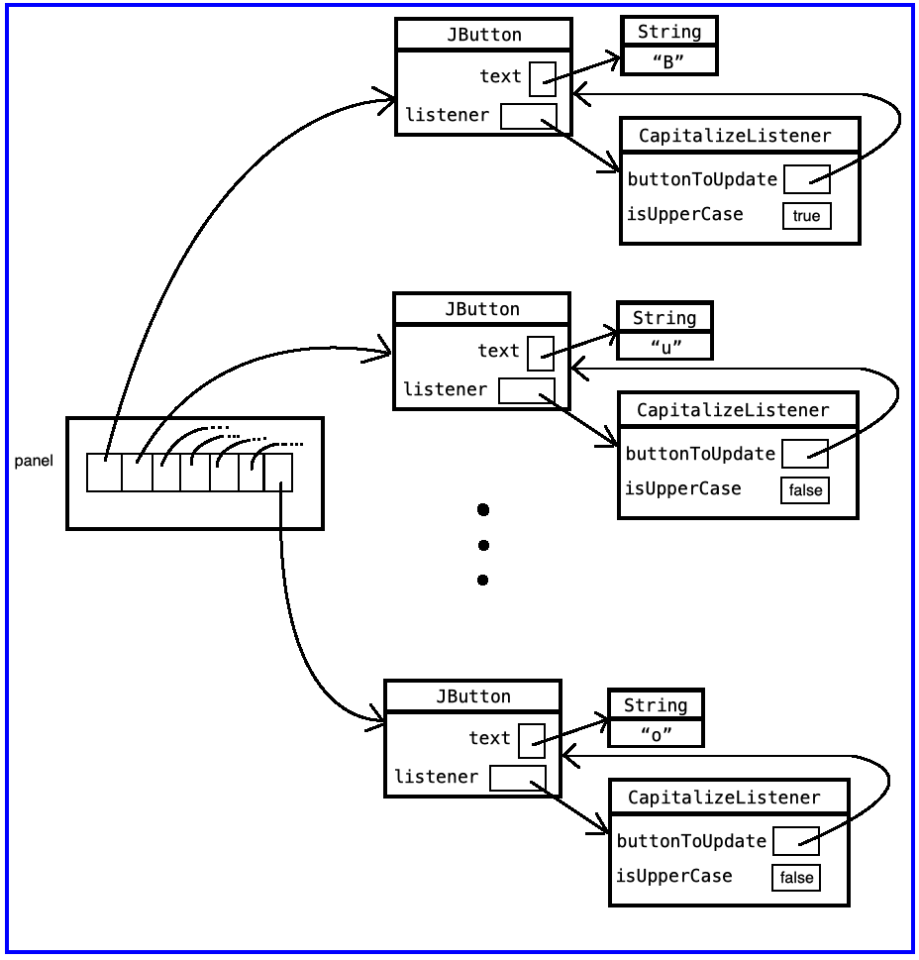
Capitalization panel variable

Slide 11
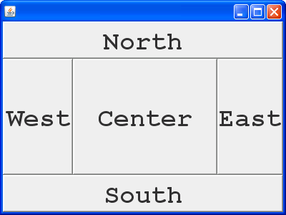
JFrame BorderLayout

Slide 12
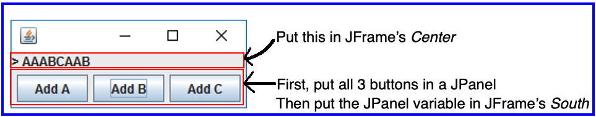
In Class Activity 1
JLabel
JButton
Notes:
Students will try to add multiple Buttons to the Frame and wonder where they went.
Let them do this for just a minute or two before you show them about JPanels.

Slide 13
Advice
Look at the code in the capitalization example
Then solve the addLettersProblem
Stage 1:
Make sure buttons show up
Make sure you can get message (JLabel) to appear
Stage 2: Make sure buttons do ANYTHING
Just have them System.out.println(“pressed”)
Stage 3:
Have the buttons perform desired behavior

Slide 14
General GUI Development Workflow
1. Create JFrame (configure!)
2. Create JPanel
3. Put JButtons (or JComponents) into JPanel
4. Add JPanel to JFrame
5. Create ActionListener
(Might need to create class!)
6. Attach ActionListener to JButton
7. Does ActionListener have what it needs?
(If not, pass it in the constructor!)

Slide 15

Mouse Listeners
public interface MouseListener {
public void mouseClicked(MouseEvent e);
public void mouseEntered(MouseEvent e);
public void mouseExited(MouseEvent e);
public void mousePressed(MouseEvent e);
public void mouseReleased(MouseEvent e);
}
Q5
Notes:
Implement draw listener for adding squares/circles to DrawComponent
[[[Probably won’t have time to add LinearCharges to space. Just use mouseClicked to add PointCharges. Talk about issues we would need to address for LinearCharges, like tracking down location and seeing if up location is different.]

Slide 16
Repaint (and then no more)
To update graphics:
We tell Java library that we need to be redrawn:
drawComponent.repaint()
Library calls paintComponent() when it’s ready
Don’t call paintComponent() yourself! It’s just there for Java’s call back.
Q4
Notes:
- User decides which actions to take
- Library decides when to update window

Slide 17
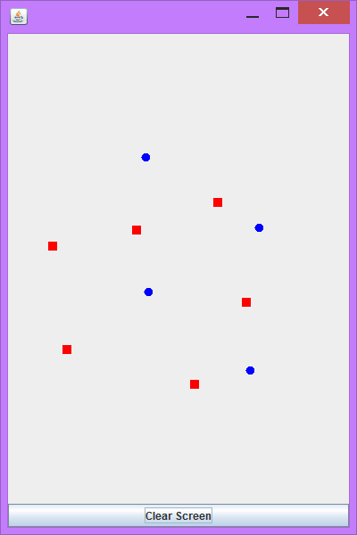
Activity 2
Read the code in the rectangleExample, then individually or in pairs solve the clicksProblem.
Draw a 20x20 blue circle upon left-click, centered on click
Clear screen button does what it says.
If you have time, make a right click make a red square
Notes:
Get ideas for adding buttons to JPanel, then adding JPanel to the SOUTH of the JFrame.
Work on ChargesMain:
- add JPanel and JButtons, but no listeners
- add zoom in and zoom out listeners, requires mutators in Space also

Slide 18
Using Inner Classes
Classes can be defined inside other classes or methods
Used for “smallish” helper classes
Example: Ellipse2D.Double
Often used for ActionListeners…
Add to Breakfast program?
Outer class
Inner class
Q6
Notes:
Edit previous example: add an inner class, MamaBearListener that prints “Eww, too Cold!” (Don’t include tasteDescription, let them do that later.)
STRESS TO THE STUDENTS that Java 8 messes up the whole idea about inner class variables… We will be testing this on the exam, and if they use Java 8, they can REALLY mess this up.

Slide 19
Anonymous Classes
Sometimes very small helper classes are only used once
This is a job for an anonymous class!
Anonymous → no name
A special case of inner classes
Used for the simplest ActionListeners…
Notes:
Edit example again: add an anonymous class, print “Hmm. Just right.”

Slide 20
Inner Classes and Scope
Inner classes can access any variables in surrounding scope
Caveats:
Can only use instance fields of surrounding scope if we’re inside an instance method
Example:
Prompt user for what porridge tastes like
Notes:
Finish last TODO in BreakfastMain – tasteDescription.

Slide 21
Work Time
LinearLightsOut

