Slide 1
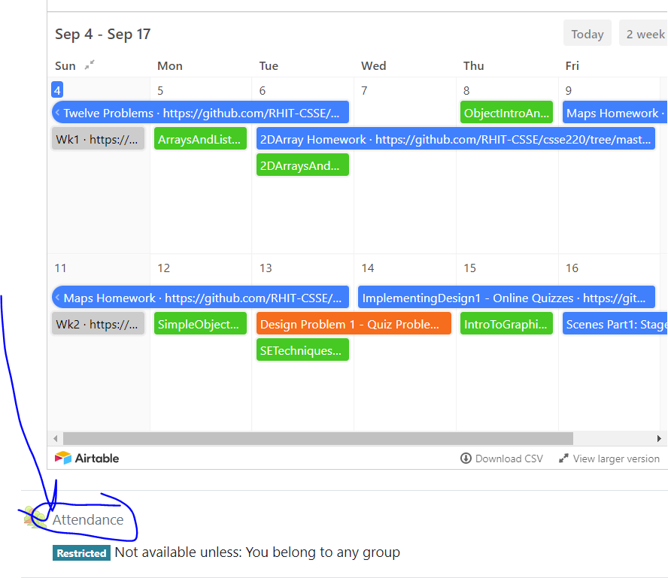
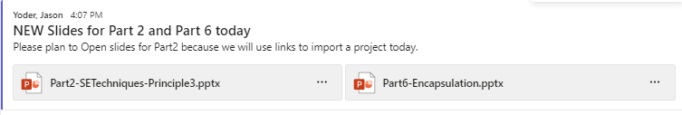
CSSE 220
Today’s Attendance password
oneclassonejob
Part 1 - UML Code
There are NO git projects for today. Have paper/plantUML ready!

Slide 2

PlantUML Previous Example
@startuml
skinparam style strictuml
class Main {
Main()
setAllBValuesTo3()
}
class A{
name
A( name )
setBValue( value)
}
class B{
count
B()
setValue( value )
}
Main -> "*" A
A-> B
@enduml
Notes:
Can refer them to:
http://plantuml.com/class-diagram

Slide 3
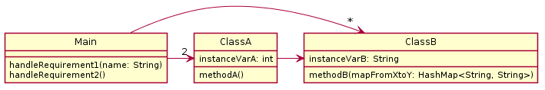
PlantUML adding types
@startuml
skinparam style strictuml
class Main{
handleRequirement1(name: String)
handleRequirement2()
}
class ClassA {
instanceVarA: int
methodA()
}
class ClassB{
instanceVarB: String
methodB(mapFromXtoY: HashMap<String, String>)
}
Main ->"2" ClassA
Main ->"*" ClassB
ClassA -> ClassB
@enduml
Notes:
@startuml
skinparam style strictuml
class Main{
handleRequirement1(name: String)
handleRequirement2()
}
class ClassA {
instanceVarA: int
methodA()
}
class ClassB{
instanceVarB: String
methodB(mapFromXtoY: HashMap<String, String>)
}
Main ->"2" ClassA
Main ->"*" ClassB
ClassA -> ClassB
@enduml

Slide 4
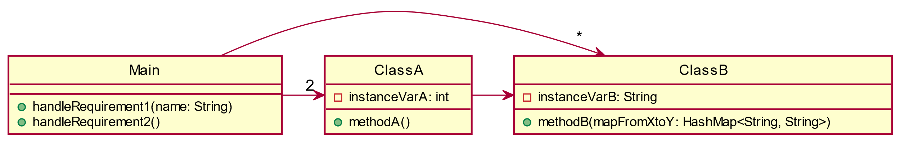
PlantUML adding private/public
@startuml
skinparam style strictuml
class Main{
+handleRequirement1(name: String)
+handleRequirement2()
}
class ClassA {
-instanceVarA: int
+methodA()
}
class ClassB{
-instanceVarB: String
+methodB(mapFromXtoY: HashMap<String, String>)
}
Main ->"2" ClassA
Main ->"*" ClassB
ClassA -> ClassB
@enduml
Notes:
@startuml
skinparam style strictuml
class Main{
handleRequirement1(name: String)
handleRequirement2()
}
class ClassA {
instanceVarA: int
methodA()
}
class ClassB{
instanceVarB: String
methodB(mapFromXtoY: HashMap<String, String>)
}
Main ->"2" ClassA
Main ->"*" ClassB
ClassA -> ClassB
@enduml

Slide 5
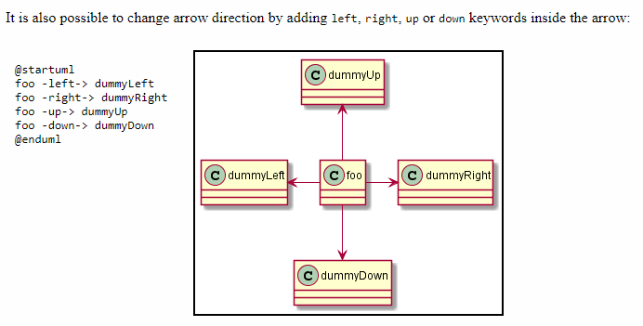
Controlling Layout in PlantUML

Slide 6
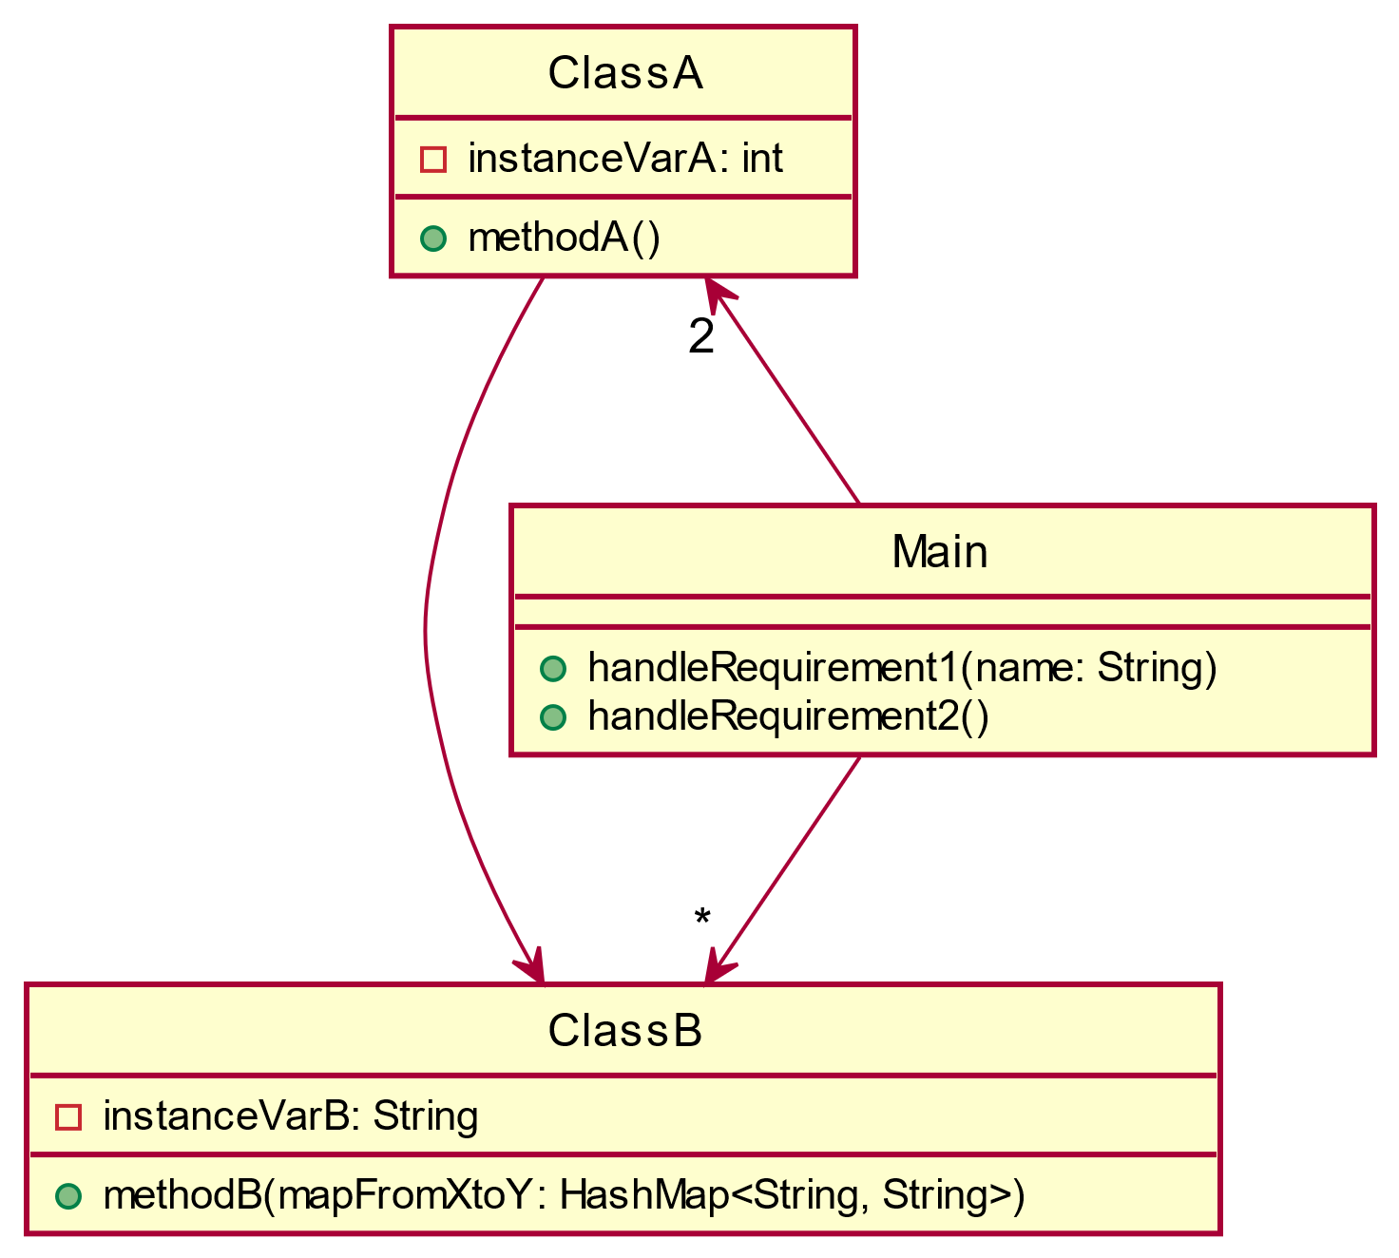
PlantUML Adding Layout
@startuml
skinparam style strictuml
class Main{
+handleRequirement1(name: String)
+handleRequirement2()
}
class ClassA {
-instanceVarA: int
+methodA()
}
class ClassB{
-instanceVarB: String
+methodB(mapFromXtoY: HashMap<String, String>)
}
Main -up->"2" ClassA
Main -down->"*" ClassB
ClassA -> ClassB
@enduml
Notes:
@startuml
skinparam style strictuml
class Main{
handleRequirement1(name: String)
handleRequirement2()
}
class ClassA {
instanceVarA: int
methodA()
}
class ClassB{
instanceVarB: String
methodB(mapFromXtoY: HashMap<String, String>)
}
Main ->"2" ClassA
Main ->"*" ClassB
ClassA -> ClassB
@enduml

