Slide 1
CSSE 220
Design Principle #3
Encapsulation

Slide 2
Major Goals of ALL Program Design
Suppose someone has written a program that works and it has no bugs, but it is poorly designed.
What does that mean?
Why do we care?
There are two major goals:
Easy to understand
Easy to modify
Q1
Notes:
Animation for the two major goals

Slide 3
CSSE220 Design Principles
Make sure your design allows proper functionality
Must be able to store required information (one/many to one/many relationships)
Must be able to access the required information to accomplish tasks
Data should not be duplicated (id/identifiers are OK!)
Structure design around the data to be stored
Nouns should become classes
Classes should have intelligent behaviors (methods) that may operate on their data
Functionality should be distributed efficiently
No class/part should get too large
Each class should have a single responsibility it accomplishes
Minimize dependencies between objects when it does not disrupt usability or extendibility
Tell don't ask
Don't have message chains
Don't duplicate code
Similar "chunks" of code should be unified into functions
Classes with similar features should be given common interfaces
Classes with similar internals should be simplified using inheritance
Avoid all type-predicated code by using inheritance

Slide 4
E.g., What if there were no String class?
Instead, what if we just passed around arrays of characters - char[]
And every String function that exists now, would instead be a function that operated on arrays of characters
E.g., char[] stringSubstring(char[] input, int start, int end)
Would things be any different? Discuss this with the person next to you.
Notes:
Hopefully they will come up with at least two ideas:
Makes it less convenient to know what functions exist
Stuck implementing strings as character arrays

Slide 5
Concatenate… compare
String stringName1 = “ian";
String stringName2 = “ludden";
String stringConcat = stringName1.concat( stringName2 );
System.out.println( stringConcat );
----------------------------------------------------------
char[] charName1 = {'i','a','n'};
char[] charName2 = {'l','u','d','d','e','n'};
char[] charConcat =
new char[charName1.length + charName2.length];
for (int i = 0; i < charName1.length; i++) {
charConcat[i] = charName1[i];
}
for (int i = 0; i < charName2.length; i++) {
charConcat[charName1.length + i] = charName2[i];
}
System.out.println( Arrays.toString(charConcat) );
Notes:
Which is easier to use?
Which is easier to understand?
Clearly classes make sense

Slide 6
Class sizes
Why not put all the Math utilities in the String class?
Math Java docs
String Java docs
We could just get anything we need done with Strings and Math with one library instead of two!
Q2
Notes:
Makes it harder to know what is meant when you have a function say “add” or length
Means you are loading more things than you might actually need
Try to keep conceptual separation!

Slide 7
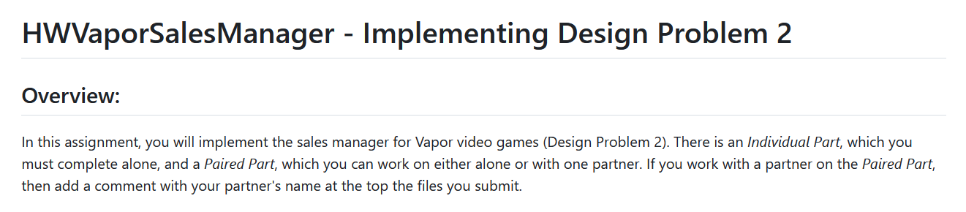



Pairing Up
On a small piece of paper write down either:
A list of people you’d be interested in working with
OR that you don’t know anyone BUT you’d like to work with someone
You prefer NOT to work with anyone
Hand these to our TA who will try to pair people:

Slide 8
HWVaporSalesManager
New HW this quarter!
Design Problem due Friday night
No extensions possible:
Solution shared via Piazza Sat. Morning
You have a homework to implement the solution to this design problem
We will import the new Project now…

Slide 9
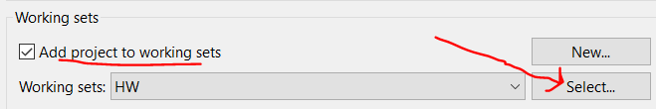
Importing HWVaporSalesManager
Instructions:
https://github.com/RHIT-CSSE/csse220/tree/master/Homework/HWVaporSalesManager
Download this (clicking the link will start the download):
https://github.com/RHIT-CSSE/csse220/raw/master/Homework/HWVaporSalesManager/HWVaporSalesManager.zip
Save it to a place you can find easily (Downloads folder is OK)
Next Open Eclipse and Import it (screenshots on next slide)
Import -> General ->Existing Projects into Workspace-> Next
Select archive file: ….. HWVaporSalesManager.zip -> Finish
If you are using “Working sets” you may want to add it to your Homework “Working set” for easily finding it later

Slide 10
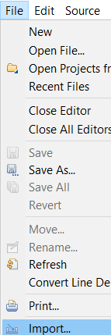
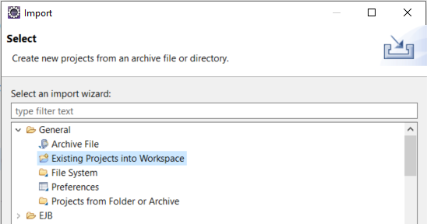
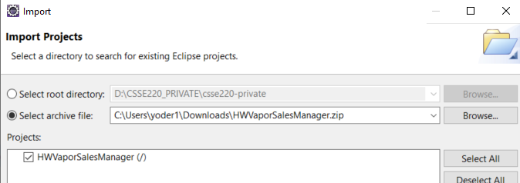
#2
#1
#3
1. Eclipse File->Import
2. Import -> General ->Existing Projects into Workspace -> Next
3. Select archive file: ….. HWVaporSalesManager.zip
4. Select Working set
#4

