Slide 1
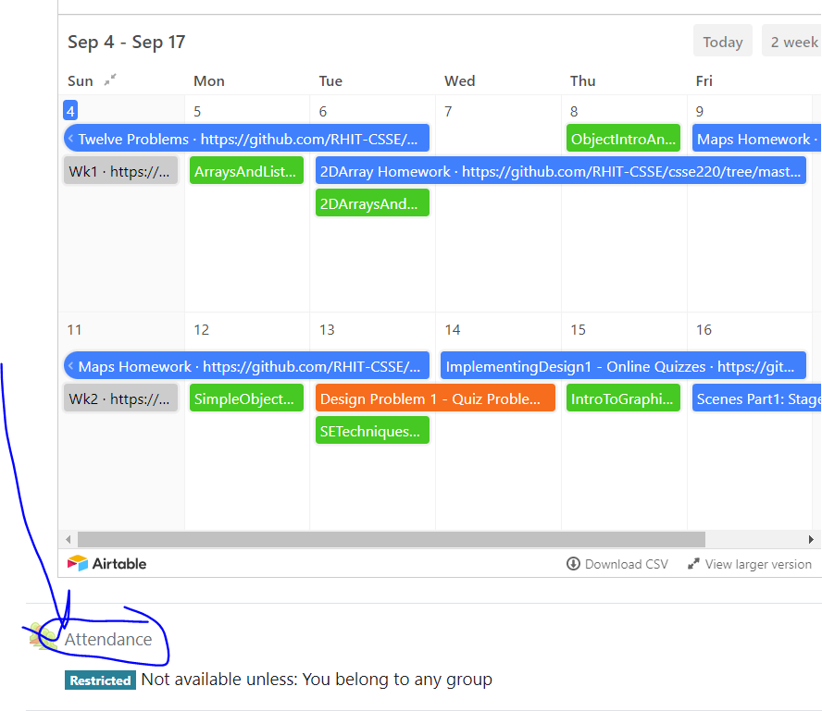
CSSE 220
Today’s Attendance password
linkedlists
Linked List Implementation
The git projects for today are:
PracticeLinkedListSimple
PracticeLinkedListSimpleSolution
Notes:
Doing everything in LinkedListSimple today
Quiz given in next slide

Slide 2
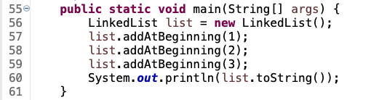
Quiz
Get into pairs
Look at/run the code in LinkedList.java main
Draw a box-and-pointer diagram of what’s happening in the main code.
To figure it out, you’ll have to look at the LinkedList constructor and addAtBeginning.
If you’ve forgotten how to do box-and-pointer diagrams, checkout the next slide
Q1
Notes:
This diagram is their quiz for the day

Slide 3
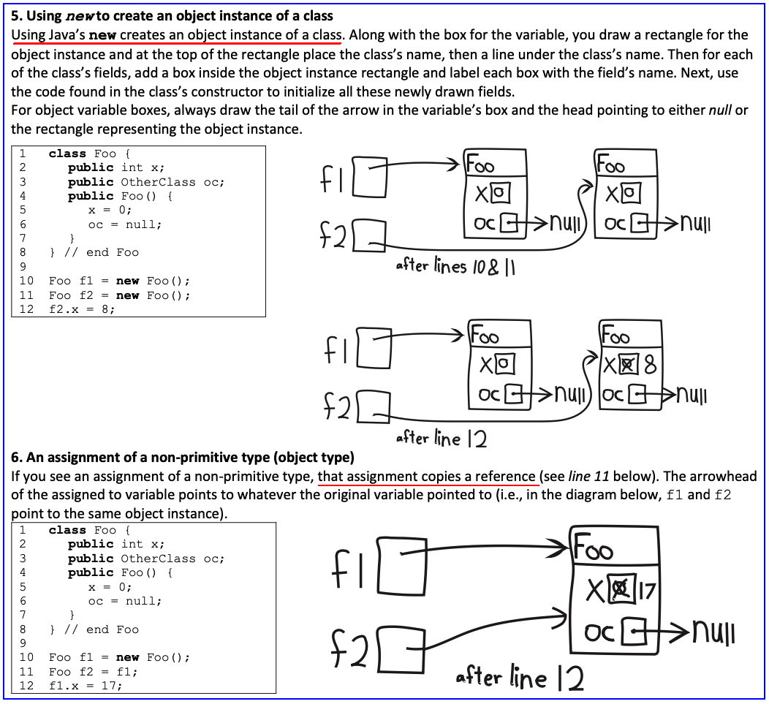

Slide 4
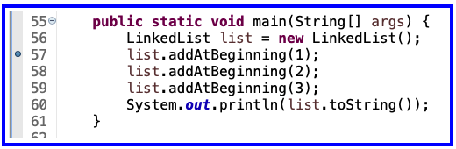
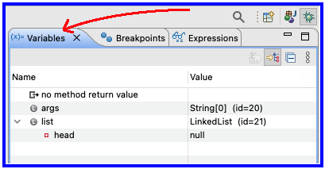
Optional - Now Walk Through Together
Set a breakpoint at first addAtBeginning
Execute in the debugger
Step over and keep an eye on debugger’s Variables tab

Slide 5
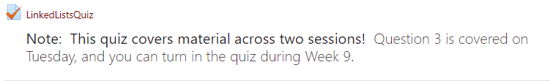
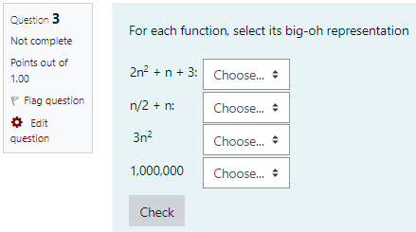
Solve the Other Problems in LinkedListSimple
Look at toString to get an idea of how to do size, then go from there
They are in approximate difficulty order
Get help if you get stuck!

Slide 6
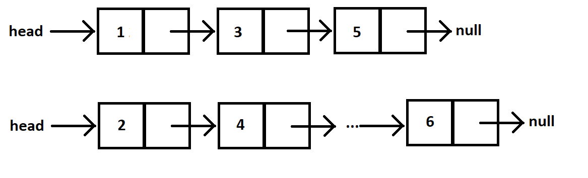
Shorthand Diagramming Notation
Using pictures will be extremely helpful
We can use System.out.println( this ) to see what the current list looks like (does it match diagram?)

Slide 7
Loops in Arrays vs. LinkedLists
int[] nums = ……
for (int k = 0; k < nums.length; k++) {
// do stuff with
// arbitrary element nums[k]
}
Equivalent in while loop
int k = 0;
while ( k < nums.length ) {
// do stuff with
// arbitrary element nums[k]
k++;
}
LinkedList list = ……
//Another Day!
Node current = this.head;
while ( ? ) {
//do stuff with
//arbitrary element
?
}
For an array, use a ‘for’ because we know exact length of array at the outset.
This is known as a definite loop

Slide 8
Loops in Arrays vs. LinkedLists
int[] nums = ……
for (int k = 0; k < nums.length; k++) {
// do stuff with
// arbitrary element nums[k]
}
LinkedList list = ……
Node current = this.head;
while ( current != null ) {
// do stuff with
// arbitrary element
current.value++;
current = current.next;
}
For linked lists, use a ‘while’ because we do not know exact length of a linked list at outset.
This is known as an indefinite loop

Slide 9
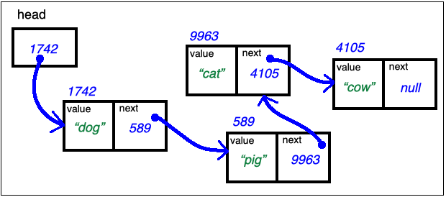
Traverse Linked List Stop at the End
LinkedList list = …… current's values:
Node current = this.head; _1742_____________
while ( current.next != null ) { __________________
// do stuff with __________________
// arbitrary element __________________
current = current.next; __________________
} // end while
current.next = new Node(vToAdd, null); // adds new node at end

Slide 10
Traverse Linked List With Trailer
LinkedList list = …… current trailer:
Node trailer = null; _0__________
Node current = this.head; _1742_______ ____________
while ( current != null ) { ____________ ____________
// do stuff w/ node values ____________ ____________
trailer = current; ____________ ____________
current = current.next; ____________ ____________
} // end while

Slide 11
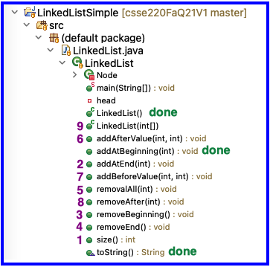
Solve the Other Problems in LinkedListSimple
Look at toString to get an idea of how to do size, then go from there
Recommended order
Get help if you get stuck!

Slide 12
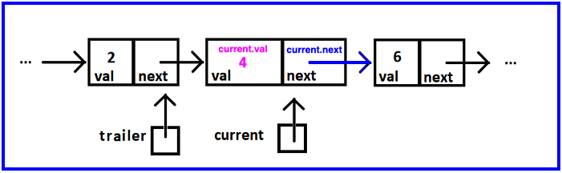
Reminder: Shorthand Diagramming Notation
Use arrows:
To represent the references stored in:
a node’s next
the variables current, and trailer
To connect the list’s nodes

Slide 13
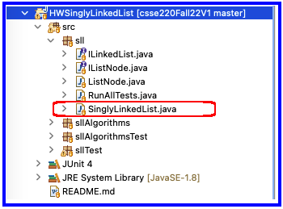
Homework
SinglyLinkedList
Requires you to implement a SinglyLinkedList
Additional algorithm questions which make use of the SinglyLinkedList

Slide 14
Project advice
When done with Milestone1 (or beyond)
Add “final Milestone1 Commit”
To your commit message so graders will know to check out that version
Build an end-to-end solution
Build the next thing you can TEST
Don’t focus on cool graphics and other extra items early in the project, focus on basic functionality
Complete the milestone and keep moving forward!
Notes:
This is the end of Monday’s class, pick up from here on Wednesday to complete quiz

Slide 15
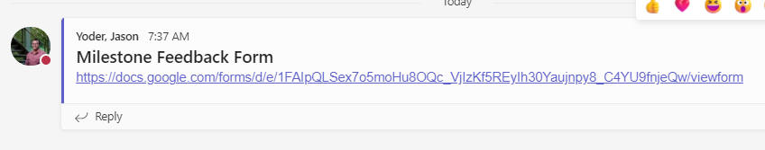
Project FEEDBACK SO FAR
Please complete this short feedback form so we can help improve the process moving forward!
______________

Slide 16
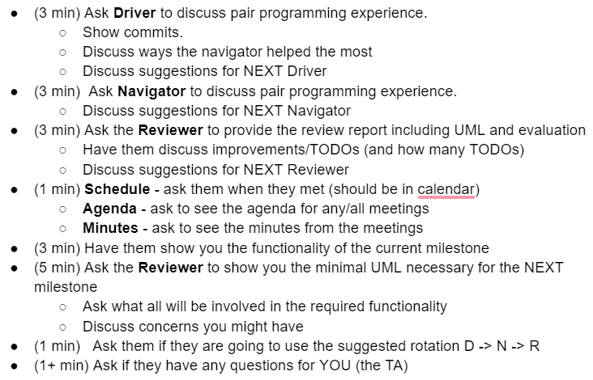
Meeting (Milestone 1) with your TA
Agenda and Plan
Make sure you are ready to show the TA everything you are responsible for
Must have UML for current and next milestone
Have your code ready to run
Have your git commits ready to show

Slide 17
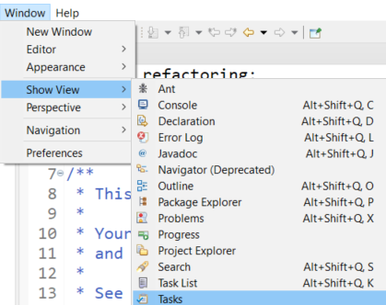



DNR: Driver, Navigator, Reviewer
Reviewer - The review has a number of important responsibilities
Look at each piece of code and either correct or mark TODOs in the code
If its easy and obvious, just fix it
If NOT, add a TODO to complete later
Eclipse can provide a view of your TODOs in a project
Generate the PlantUML for the current project and next Milestone before the TA meeting
Use to easily generate UML: https://plantuml.com/eclipse
Can copy the source code and modify as needed
Identify violations of the 5 OODP based on code and UML
Mark TODOs in code or add comments to review document (notes for meeting with TA)
Provide a log of the results of the review
This is easily done with a good commit record
Evaluation of the current UML
Production of the planned UML for the next milestone with notes
During the TA meeting, the reviewer will discuss their review of the code and discuss concerns they have

