Slide 1

Design Problems 1 Homework
Before next class:
Solve the Design Problem 1 Homework (Moodle -> GradeScope)
These are due BEFORE class
Anything turned in late will be worth zero points
We will go over the solution at the START of class
We’ll discuss more design principles as the course progresses
One more example Design Problem you can practice on your own or with classmates on the slides that follow
Notes:
Briefly show the website description and how points are awarded on gradescope

Slide 2
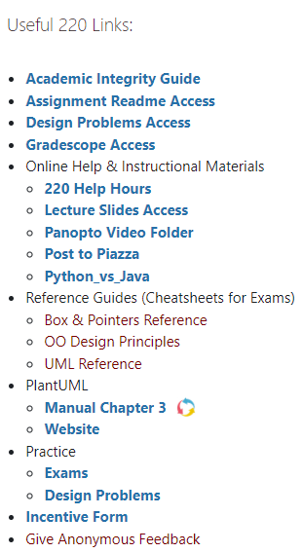
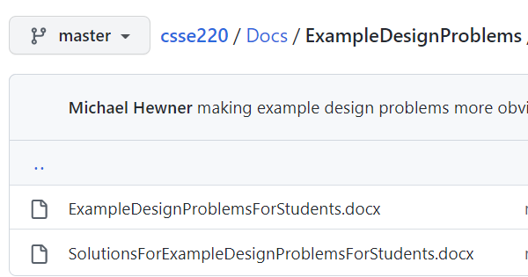
Extra Practice – Complete on Your own
The next set of slides has an example problem, but we have additional collections of exam problem with solutions for you to review here

