Slide 1
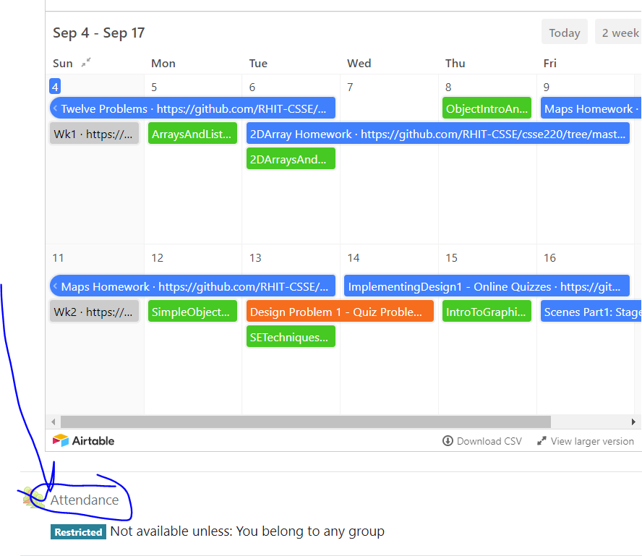
CSSE 220
Today’s Attendance password
boxandpointers
MapsHW & StudentGradebook
The git projects for today are:
PracticeSuperSimpleObjects
PracticeSuperSimpleObjectsSolution
PracticeSuperSimpleObjectsBoxAndPointers

Slide 2
Plan for today
Talk about object references and box and pointer diagrams
Talk about static methods
Continue working on writing your own classes
Get started on your new assignment

Slide 3
HWMaps
Collaborate with a partner on exactly 1 of the operations
Draw a few map diagrams for test data for getNumberOfCoursesToTake

Slide 4
Finishing up from last time...
Complete the StudentGradebook problem in the SuperSimpleObject project (or the one from last class)
Notes:
4

