Slide 1
CSSE 220
Static Fields & Methods
The git projects for today are:
PracticeSuperSimpleObjects
PracticeSuperSimpleObjectsSolution
PracticeSuperSimpleObjectsBoxAndPointers
Notes:
Start at second hour 0:30 minutes to have the 20 minutes needed to go over this
Look at schedule, EXAM soon! Non-coding/Written part first, programming part second.
Review Exams
Grades – see me at break or after class if you feel your grade is wrong.

Slide 2
Why fields can’t always be static – StudentV1
public class StudentV1 {
private String name;
private char grade;
public StudentV1(
String name,
char grade){
this.name = name;
this.grade = grade;
}
@Override
public String toString(){
return name +
" has a grade of "
+ grade;
}
}
Client program – of StudentV1 Class
// StudentV1Driver
public static void main(String[] args) {
Student a = new StudentV1("Adam", 'A');
Student b = new StudentV1("Becky", 'B');
Student c = new StudentV1("Casey", 'C');
System.out.println(a);
System.out.println(b);
System.out.println(c);
}
OUTPUT – from Client program:
Adam has a grade of A
Becky has a grade of B
Casey has a grade of C

Slide 3
Why fields can’t always be static – StudentV2
Client program – of StudentV2 Class
public class StudentV2 {
private String name;
private static char grade;
public StudentV2(
String name,
char grade){
this.name = name;
StudentV2.grade = grade;
}
@Override
public String toString(){
return name +
" has a grade of "
+ grade;
}
}
// StudentV2Driver
public static void main(String[] args) {
Student a = new StudentV2("Adam", 'A');
Student b = new StudentV2("Becky", 'B');
Student c = new StudentV2("Casey", 'C');
System.out.println(a);
System.out.println(b);
System.out.println(c);
}
OUTPUT – from Client program:
Adam has a grade of C
Becky has a grade of C
Casey has a grade of C
Static means there's only one shared copy of a field/method for ALL instances of a class that's created.
So when you change a grade, they all change.

Slide 4
In Eclipse
In PracticeSuperSimpleObjects
Right now – draw Box & Pointer diagram of StudentV1Driver
Work in pairs
After you all finish I’ll do Box & Ptr of StudentV2Driver

Slide 5
When do we make methods static?
Utility Methods
Things like Math class's abs, sqrt, etc.
Don’t need an instance of a class to run them
Examples { double y = -3.3; double absY = Math.abs(y); double ySqR = Math.sqrt(absY); }
How do I know if it is static?
No references to non-static fields/methods
No “this” keyword used in method
Notes:
Math.pow( )
Math.sqrt( )
Utilities, nothing specific to an instance

Slide 6
When do we make fields static?
Never
Seriously, this is disallowed for all the code you submit in CSSE220 (exception: CONSTANTS)
It almost always makes your designs worse
If it wasn’t disallowed, when would you use it?
Very rarely for memory efficiency, state that can’t be duplicated, or really meta code/variables
BUT even professional programmers misuse static and cause themselves major problems
They’ll talk about some positive uses in CSSE374

Slide 7
Two Example Classes With Static
Car
Bicycle

Slide 8
public class Car {
private double mileage;
//other stuff
public double getMilesTravelled() {
return this.mileage;
}
public static double convertMilesToKm(double numberOfMiles) {
return numberOfMiles * 1.609344f;
}
}
//Elsewhere in a client program of Car class
//requires you to have a car object
Car myCar = new Car();
// getMilesTravelled requires you to have a car object
System.out.println(myCar.getMilesTravelled());//output depends on code
//convertMilesToKm can be called on the class Car itself
System.out.println(Car.convertMilesToKm(77));//output is 123.919488

Slide 9
public class Bicycle {
private int speed;
private static int numCreated = 0;
public Bicycle(int speed) {
this.speed = speed;
Bicycle.numCreated++;
}
public int getSpeed() {
return this.speed;
}
public static int getNumCreated() {
return Bicycle.numCreated;
}
}
// Client does not need Bicycle object for calling getNumCreated
System.out.println(Bicycle.getNumCreated());
Bicycle myBike1 = new Bicycle(18);
Bicycle myBike2 = new Bicycle(1);
System.out.println(Bicycle.getNumCreated() + " " + myBike1.getSpeed());
0
2 18
Q12 - Q16
Notes:
NOT allowed to write code like this ☺

Slide 10
Two ways to do one thing: Static and Instance
Consider the Point class we used as a Quiz
Let’s write code to enable the following to run
Point a = new Point( 0, 0 );
Point b = new Point( 3, 4);
System.out.println( Point.distanceBetween(a,b) );
System.out.println( a.distanceTo( b ) );
Notes:
Prompt the students, which is static? Which is non-static/instance?
Might consider asking the students to role play as point A and point B and point C, ask a random student how far apart A and B are?
Then ask A how far away he/she is from B? Then ask C how far away they are from B?
It DEPENDS upon who you ask with and instance call, but it does matter who you ask with a static call.
Then live code the class methods with them. distanceFormulaCalc is provided to make this as quick as possible.

Slide 11
Live code

Slide 12

Static vs. Instance Variables
Static
Belongs to the CLASS
Does NOT require any objects to be created
NOT related to any specific object
CANNOT use the keyword this
The main method is static
Instance
Belongs to an INSTANCE or specific object
Requires creating a specific object since it pertains to a specific object
CAN use the keyword this
The main method is NOT an instance method

Slide 13
Exercise
Work on the HWMaps Work with a partner on 1 of the operations
If you are confused about what to do, get help!
Fail in front of Instructor or TA -> Now is the time to fail, not at 23:45 the night it is due
Notes:
13

Slide 14
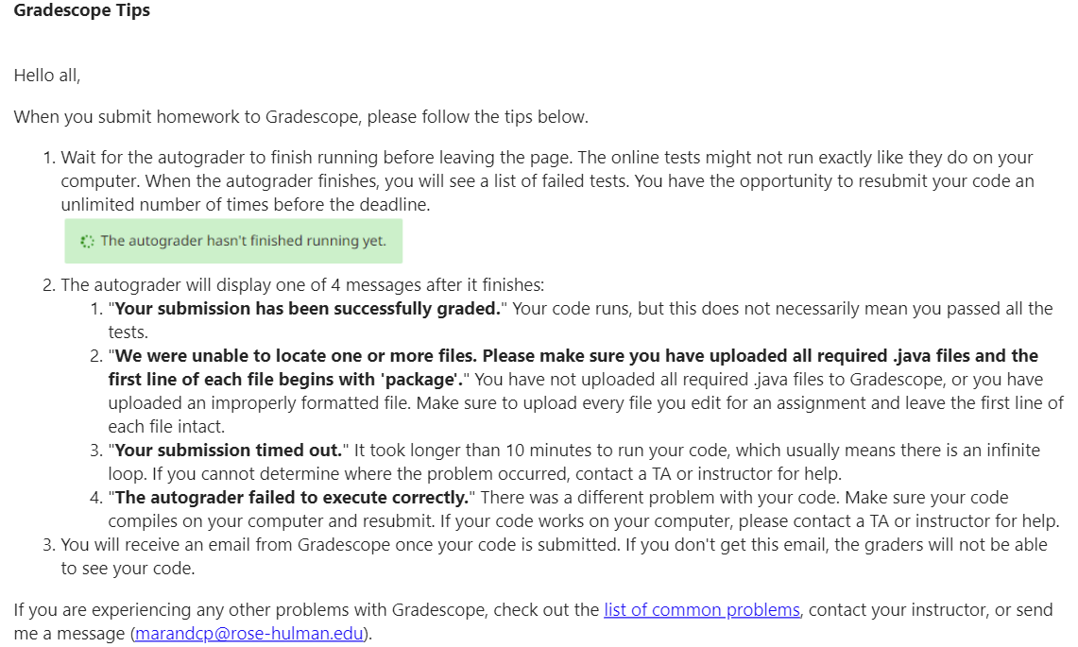
Submitting to GradeScope

