Slide 1
CSSE 220
Big-O and Data Structures
Notes:
Timing: Plan to finish by the end of the first hour so they can work on the HW or project in the second hour
Good day to use:
https://rosepseudorandom.web.app/
Doing everything in LinkedListSimple today
Quiz given in next slide

Slide 2
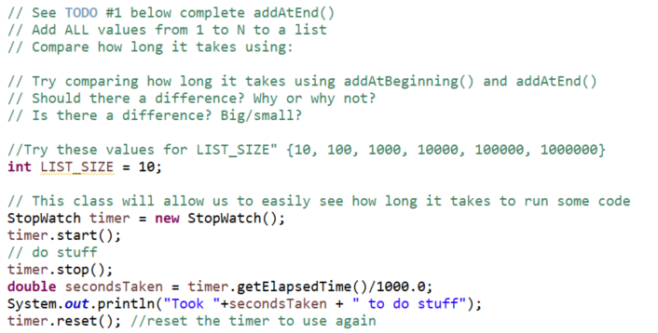
addAtEnd vs. addAtBeginning
Open up LinkedList.java in simple
Let’s see how long it takes to add 100,000 numbers to a LinkedList…
Notes:
Code is in the solution. Try to add using addAtEnd FIRST and then addAtBeginning second.
Ask students to guess which will take longer/short- how much shorter longer?
Develop solution from the day before
if (this.head == null) {
this.head = new Node(value, null);
// return; //// omit this line intentionally to show an error and use debugger <- or just provide the correct solution to save time
}
Node current = this.head;
while (current.next != null) {
current = current.next;
}
//current.next is null
current.next = new Node(value, null);

Slide 3
Data Structures
We need efficient ways to store data based on how we’ll use it
"How we'll use it" = algorithms used to access/update data stored in the data structure
The main theme for the rest of the course

Slide 4
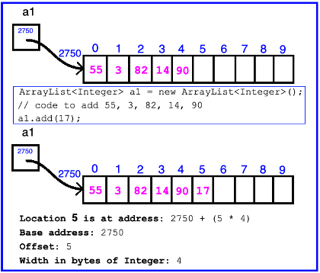
ArrayList Data Structure in Java
  Fast addition to end of list
  Requires 1 multiplication and 1 addition to compute address
Notes:
Very fast to add to end of list.
Q: How fast?
A: It does not matter how long the list is (N does not matter)

Slide 5
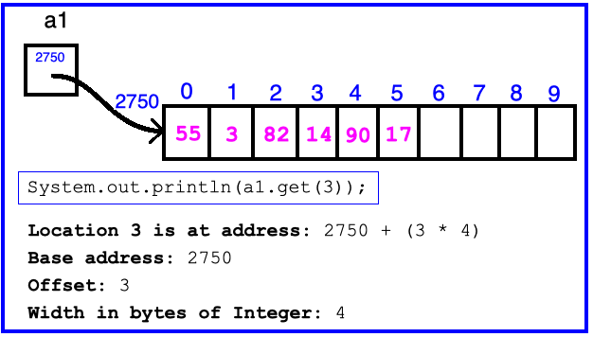
ArrayList Data Structure in Java
  Fast access to any existing position
  Requires 1 multiplication and 1 addition to compute address
Notes:
Very fast access in list.
Q: How fast?
A: It does not matter how long the list is (N does not matter)

Slide 6
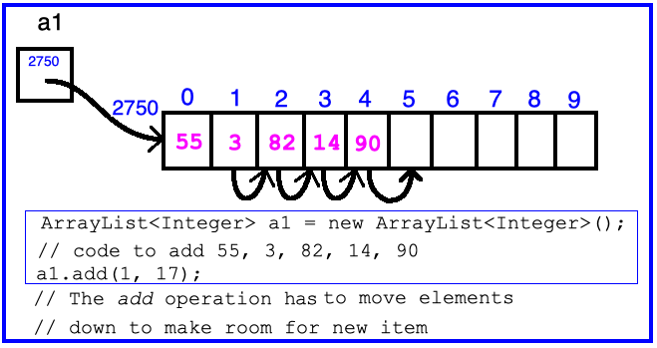
ArrayList Data Structure in Java
  Slow inserts to and deletes from middle of list
Notes:
Q: How slow is it to insert?
A: Because you have to move all the other elements up or down to make/use room. Twice as long twice as many shifts O(N)

Slide 7
Big-O Notation
Describes the limiting, worst-case behavior
  How slow it can possibly run?
Used for Classifying Algorithm Efficiency
“O” for “Order”
  O(n) → “Order n”, O(n^2) → “Order n-squared”
What is n?
  Input size (however it makes sense to measure for the given problem)
    For example: number of elements in list
Notes:
How to define fast and slow more precisely

Slide 8
Big-O Notation (continued)
Don’t Care About Constant Coefficients
  O(2n + 7) → O(n)
  Note: f(n) = 2n + 7 = 2n¹ + 7n⁰
Don’t Care About Lower Order Terms
  O(6n² + 7n¹) →O(n²)
  Algorithm grows asymptotically no faster than n²
If constant value, we say O(1) → “Order 1”
  O(48) → O(1)
Notes:
We care about which part of the expression grows the fastest as n, the input size, grows.

Slide 9
ArrayList Performance (Revisited)
Fast addition to end of list:
  Fast access to any existing position – O(1) (like array)
  Keep extra capacity for list growth
    Fast access includes items in capacity not yet filled – O(1)
  Capacity management is best left for CSSE230
Slow inserts to and deletes from middle of list
  Can get to insert/delete location quickly
  For insert, shift all items right to accommodate - O(n)
  For delete, shift all items left to fill gap – O(n)

Slide 10
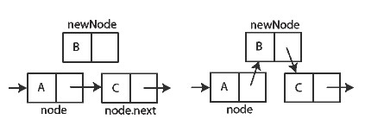
Another List Data Structure
What if we have to add/remove data from a list frequently?
LinkedLists support this:
  Fast insertion and removal of elements
    Once we know where they go
  Slow access to arbitrary elements
data
data
data
data
null
data
Insertion, per Wikipedia
Notes:
- Examples: employee list, music play list
Sketch a linked list on the board for “two more weeks” (quiz #3)
Then show insertion and deletion.

Slide 11
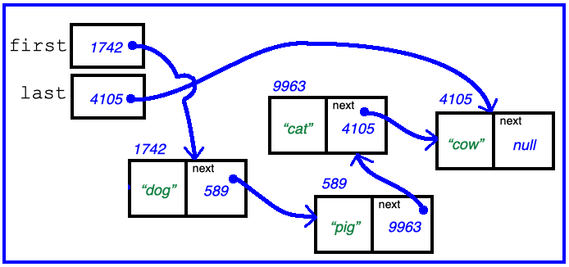
Big-O LinkedList<E> Methods?
O(1)
void addFirst(E element) _____________
void addLast(E element) _____________
E getFirst() _____________
E getLast() _____________
E removeFirst() _____________
E removeLast() _____________
O(1)
O(1)
O(1)
O(1)
O(N)
HW13 SinglyLinkedList
adds this!
Notes:
Big-Oh of each?
All of the operations perform as could be expected for a doubly-linked list.
Thus, these operations all take O(1) time. – except for remove last (which is O(N) since you must iterate through to get to the second to the last element

Slide 12
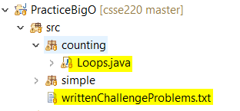
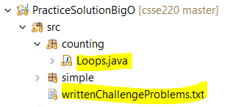
Extra Practice
Good preparation for CSSE230
Good way to confirm understanding of Big O

