Slide 1
CSSE 220
SimpleObjects
The git projects for today are:
PracticeSuperSimpleObjects
PracticeSuperSimpleObjectsSolution
PracticeSuperSimpleObjectsBoxAndPointers
Notes:
JAY: Introduce FOURTH row today (Identity Pie)
Aim to start quiz with 5+ minutes to spare in the first hour.

Slide 2
Plan for today
Talk about how to get help, academic integrity
Talk about object references and box and pointer diagrams
Talk about static methods
Continue working on writing your own classes
Get started on your new assignment

Slide 3
Several good ways to get help
Ask instructor or in-class TA during class
Visit instructor’s office drop-in hours
  Or, book an appointment
Email instructor
Visit Learning Center tutors/Sophomore Resident Tutors (SRTs)
Review Panopto Videos (see next slide)
Notes:
Most time will be spent on the last two items

Slide 4
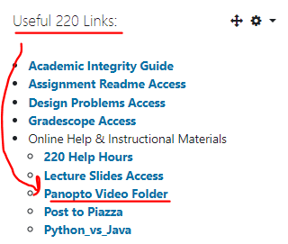
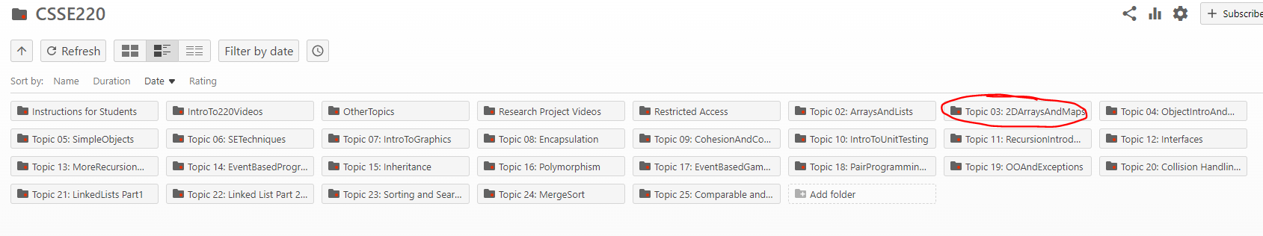
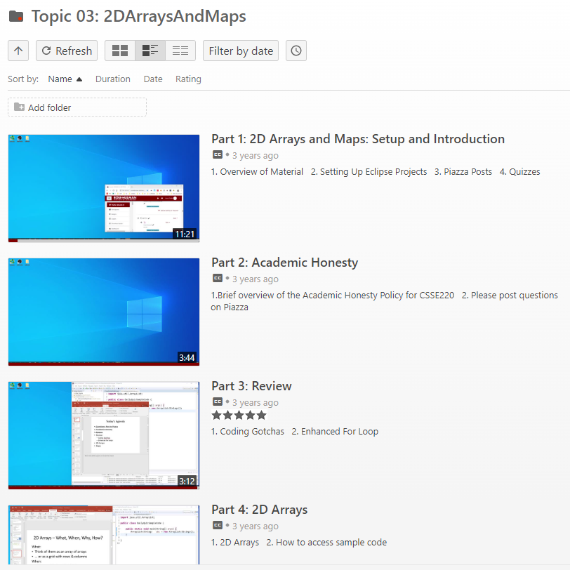
Panopto Videos
Videos cover the content, sometimes slightly different, but always an options for extra review and practice

Slide 5
Academic Integrity in CSSE
Please do not collaborate on homework assignments beyond what is allowed
What is definitely not OK:
Looking at someone else’s solution, “just for a reference” as you write your own code
Pair programming on an individual assignment
Sitting next to someone as you both work on the assignment, working through any problems you have as a group
Notes:
When individual assignment, pair programming is not allowed!

Slide 6
How much help is too much help?
“So you loop across the array elements, getting each element and seeing if it’s in the hashtable. If it is, you get the value and increment it…”
Borderline but OK
“So you write a for loop, 0 to array length - 1. Your key variable is gonna be array[i]. You check if hashMap.get(key) is null, if not, you get the value with get, then hashMap.put(key, oldValue + 1)…”
Giving away the
answer. Cheating.
Notes:
More vague than top OK
Less vague than bottom, NOT OK!

Slide 7
Penalties – see link in syllabus
Automatic F in the course
Drop 1 letter grade
-100% score on assignment
Yes, you can get an automatic F for cheating on one assignment one time.
You should always credit anyone you get help from on an assignment. If you do, it lets us assign one of the weaker penalties.
Notes:
Exam, just immediately F
Worse than a 0% actually negative 100%
1 or 2 lines from stackoverflow is ok, but not 8-10
Its ok to ask for help when you have one small thing.
Unlimited help with Eclipse Git tools etc

Slide 8
Coding Gotchas – the size of things
int[] numbers = { 2, 4, 8, 16};
int numbersCount = numbers.length;
// Java array uses 'length'
ArrayList<String> words = new ArrayList<String>();
words.add("Hello!");
int wordsCount = words.size();
// ArrayList uses 'size()'
String word = "Hello";
int characterCount = word.length();
// String uses length()

Slide 9
Enhanced For Loops
Convenient syntax for iterating through collections
More readable
Less Typing
Less Error Prone
Works for Arrays, ArrayList, Map (later)
Similar to Python:
for num in nums:

Slide 10
Enhanced For Loop and Arrays
Old school
double[] scores = …
double sum = 0.0;
for (int i = 0; i < scores.length; i++) {
sum += scores[i];
} // end for
New, whiz-bang, enhanced for loop
double[] scores = …
double sum = 0.0;
for (double score : scores) {
sum += score;
} // end for
No index variable (easy, but limited in 2 respects)
Gives a name (score here) to each element
Say “in”
Notes:
Call-outs animated
Like python’s “for num in nums:”
Convenient when we just need to iterate over the objects.
The two limitations:
We CAN’T USE the indices.
We CAN’T MODIFY the element and stick it back in the array. CONCURRENT MODIFICATION EXCEPTION!

