Slide 1
Introduction to generative artificial intelligence (genAI) for CSSE 220
Several of these slides are adapted from a presentation by Dr. Kyle Wilson for ME 123.

Slide 2
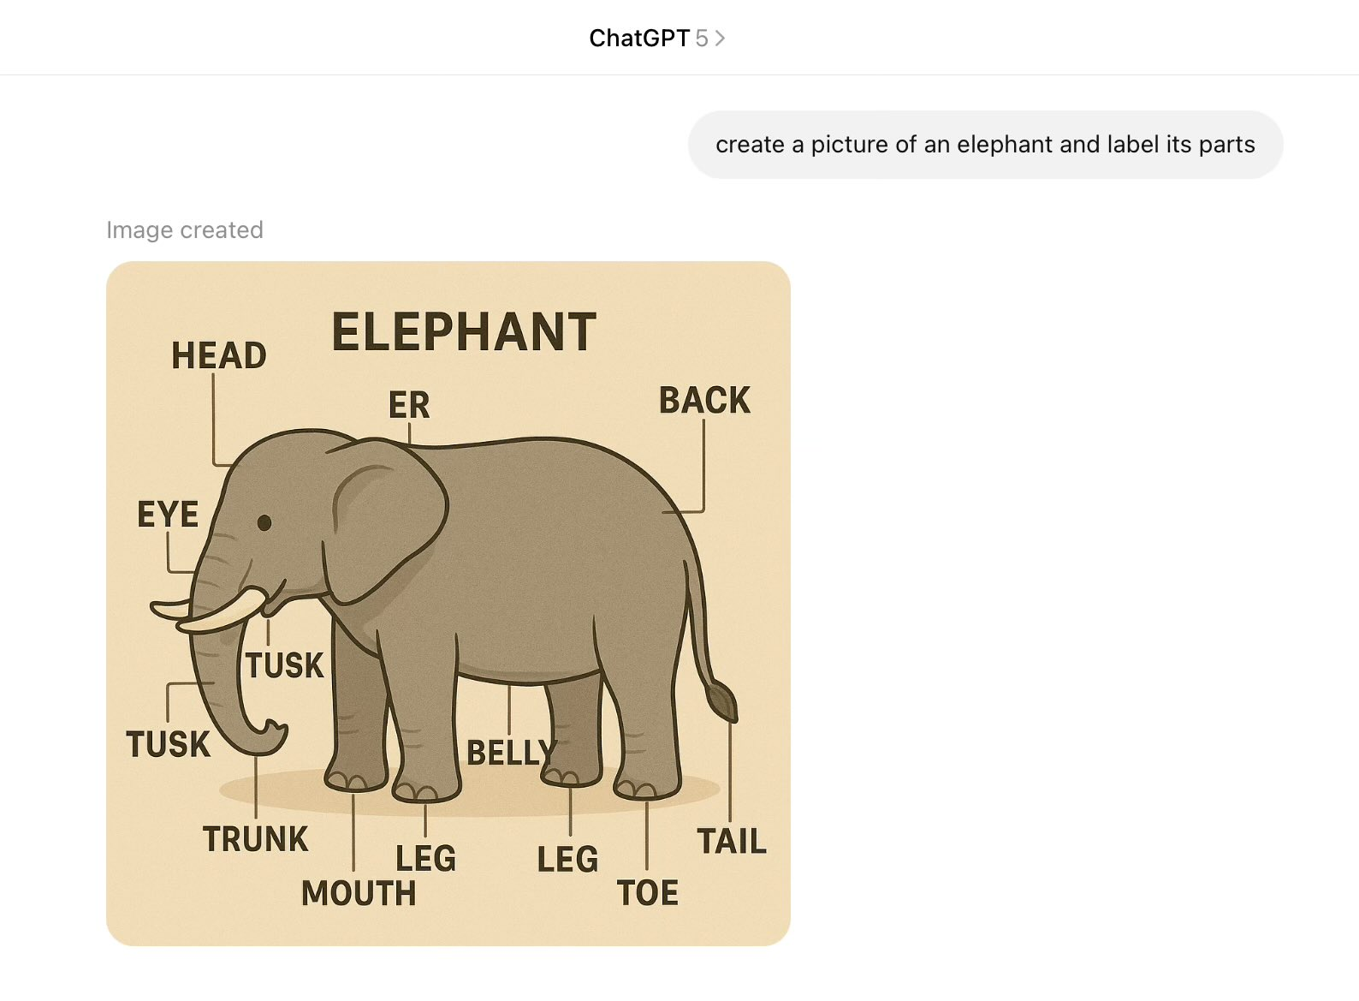
Rosie’s anatomy?
Notes:
This is actual output from ChatGPT 5.1 retrieved in August 2025. At the time this was the latest, most powerful model from OpenAI. The longer you look, the more you see. Point out the in-your-face parallel: we only spot these things because we know stuff about elephants. Students who don’t know anything about code will be like people who don’t know anything about elephants looking at this slide.

Slide 3
When you use AI in this course:
Coding ability
If you DON’T use AI in this course
If you DO use AI in this course
now
end of course
time
Notes:
This is a no-AI course. The reason is simple: you don’t learn nearly as much.

Slide 4
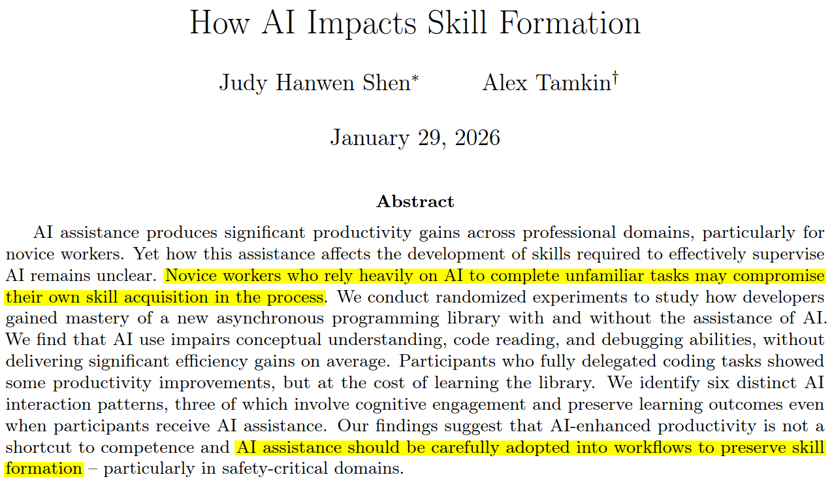
What does the research say?
[link]
Notes:
This is a paper from Anthropic, the makers of Claude. It shows that many (most?) people, when they use AI, use it in a way that compromises skill acquisition.
If you read the abstract more closely, there were some participants who used AI differently and “preserved cognitive engagement”, but this doesn’t seem to be most people’s default.

Slide 5
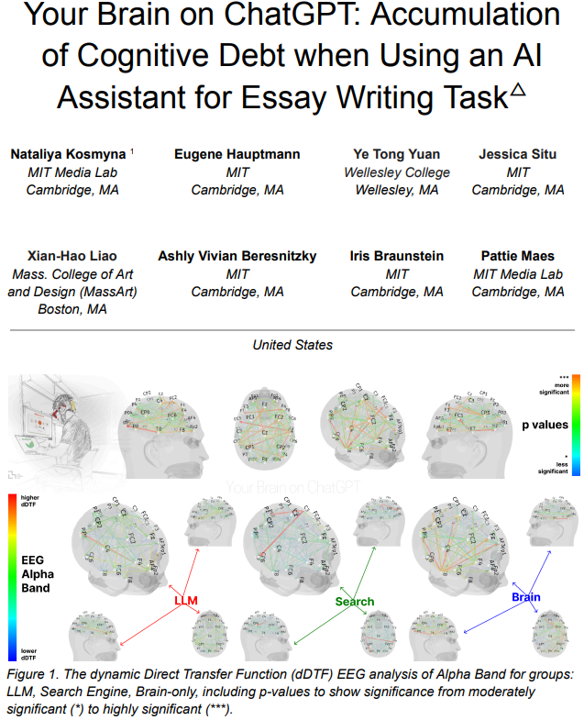
What does the research say?
Abstract
This study explores the neural and behavioral consequences of LLM-assisted essay writing. Participants were divided into three groups: LLM, Search Engine, and Brain-only (no tools). Each completed three sessions under the same condition. In a fourth session, LLM users were reassigned to Brain-only group (LLM-to-Brain), and Brain-only users were reassigned to LLM condition (Brain-to-LLM). A total of 54 participants took part in Sessions 1-3, with 18 completing session 4. We used electroencephalography (EEG) to assess cognitive load during essay writing, and analyzed essays using NLP, as well as scoring essays with the help from human teachers and an AI judge. Across groups, NERs, n-gram patterns, and topic ontology showed within-group homogeneity. EEG revealed significant differences in brain connectivity: Brain-only participants exhibited the strongest, most distributed networks; Search Engine users showed moderate engagement; and LLM users displayed the weakest connectivity. Cognitive activity scaled down in relation to external tool use. In session 4, LLM-to-Brain participants showed reduced alpha and beta connectivity, indicating under-engagement. Brain-to-LLM users exhibited higher memory recall and activation of occipito-parietal and prefrontal areas, similar to Search Engine users. Self-reported ownership of essays was the lowest in the LLM group and the highest in the Brain-only group. LLM users also struggled to accurately quote their own work. While LLMs offer immediate convenience, our findings highlight potential cognitive costs. Over four months, LLM users consistently underperformed at neural, linguistic, and behavioral levels. These results raise concerns about the long-term educational implications of LLM reliance and underscore the need for deeper inquiry into AI's role in learning.
Notes:
This this study, MIT researchers had college students write essays while hooked up to brain scanners (fMRI). Some students wrote “Brain-only”, others were allowed to use web search, and others were instructed to use an LLM as much as they wanted.
It turns out you can see the difference. LLM users’ brains showed lower levels of cognitive activity, and the patterns they did show were less connected across the brain. Most concerningly, when the study was continued for a longer period of time, the LLM users consistently underperformed.

Slide 6
When you use AI for coding:
Legend:
You
You + AI
Problem solving ability
now
end of course
end of course (if you used AI)
Notes:
But there’s another layer to this. Someone without any coding skills can muddle through an AI session and get something that sort of works. But someone else with real skills, using the same AI system, will be able to create a much better solution, or solve a much harder problem. AI doesn’t replace skills. It augments them. The more skilled you are, the more benefit you’ll see.

Slide 7
Course Policy
Jump to syllabus
Highlight relevant section(s)

Slide 8
Takeaways
AI is useful for many technical tasks. It will probably be part of your job one day.
AI + skills is much better than AI without skills.
This course is about teaching you useful skills.
But AI will keep you from learning those skills.
So don’t use it in this course when you’re not supposed to!

Slide 9
Want to learn how to use AI well?
Check out MDS 211 this Spring Quarter!
In MDS211 AI Fundamentals for STEM Professionals, we’ll do a series of mini-units on these topics to introduce you to key terms and math concepts underlying AI and Data Science. Weekly homework will include problems, videos, and some python code to write or experiment with. You’ll learn how to train small AI models on standard datasets. We also plan to introduce limitations of AI related to correctness, ethics of data copyright violations, and sustainability, and have guest lectures from various faculty across the Institute. The class will culminate with a short presentation you’ll do in week 10.
This 2-credit course runs in Spring quarter.

Slide 10

CSSE 220 genAI icons
These will be used throughout the course to help you know when and where genAI tool use is allowed.
No AI use (for design problems, most programming assignments, etc.)
Limited genAI use allowed (for parts of some assignments)
clanker-free zone
cite your AI use
Source: https://icons8.com/icons/set/robot-face

Slide 11
LLMs/genAI in CSSE 220
https://ianludden.com/csse220-genai-guide/
Foundational skills and understanding when LLMs can/can’t help
Healthy skepticism
If the design is bad, then it doesn’t matter how quickly genAI can fill in the code!
There is nothing so useless as doing efficiently that which should not be done at all.
Peter Drucker

Slide 12
How not to use LLMs
“Cognitive offload”: delegating your thinking/learning
Finishing homework assignments when you run out of time
Just ask for an extension, and prioritize your learning
Solving timed assessment problems
I can’t give feedback on your learning progress if an LLM did the work

