Slide 1
CSSE 220
Main Game Loop with Timers
File IO
Exception Introduction
The git projects for today are:
PracticeEventBasedGameLoop
PracticeEventBasedGameLoopSolution

Slide 2
Objectives
Final Project Preparation/Kickoff
Learn how to avoid common project errors
Learn how to setup a timer to create events
Practice with live-coding
Practice interaction between game elements
Learn how to read and write from files
Practice with live-coding
Required for Milestone 1

Slide 3
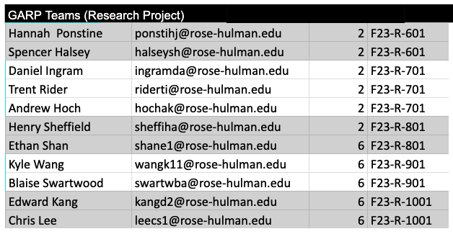
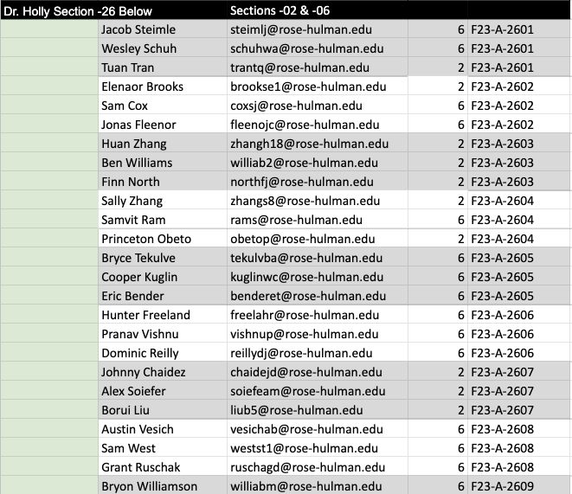
Final Project Introduction
Fall 2022-23 Team Sheet:
https://docs.google.com/spreadsheets/d/11VEZpyO9JbBNNPT8cp_Hx2FCmROW7r-KNrNEMYIBmwU/edit

Slide 4
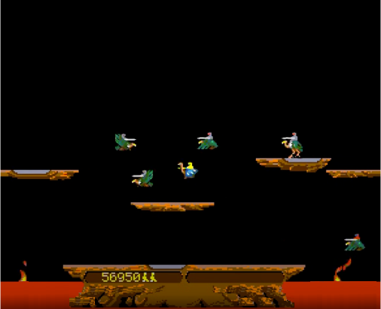
Project Specifications (Link on Moodle)
CSSE220 Joust Team Project
CSSE220 Genetic Algorithm Research Project

Slide 5
Threads
Computers can run more than one thread of execution at the same time
Even single core processor can simulate this by timesharing (more about this in future courses)
Main starts every Java program
Graphics start a separate thread
Multiple threads can create very painful problems
Can be hard to debug (race conditions)
Example include ConcurrentModificationExceptions
Join Daniel Ignram we welcom efree agents
Notes:
Consider drawing a single diagram on the board showing separate thread of execution as lines

Slide 6
main's and Graphics' Threads
Time
Every program starts in main and begins executing one statement at a time
When a JFrame is created there is a second thread that starts running (at the same time, i.e., in parallel) and it will continue to run even if our main thread completes exits
The setting for JFrame setDefaultCloseOperation() determines if the Java Graphics thread continues to run after closing the window.
main's thread of control
Java Graphics'
thread of control
JFrame.EXIT_ON_CLOSE

Slide 7
Concurrent Modification Exceptions
Happens when you try to change something that is being used
Example:
Removing something from a list while the list is itself being iterated through (drawing/updating)
Why?
Main Thread
Java Graphics Thread
for (Item item: myList){
item.draw();
}
myList.remove(0);
Notes:
Ask students:
Imagine a list gets changed while you try to move through it, what could go wrong?
Read from bad location in memory, get into infinite loop, double visit, skip, etc.

Slide 8
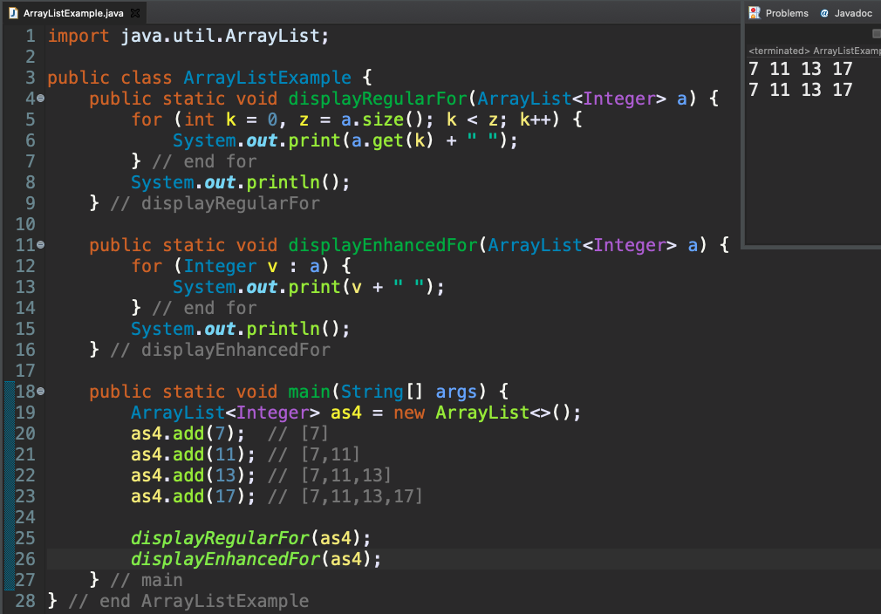
for Loops and ArrayList

Slide 9
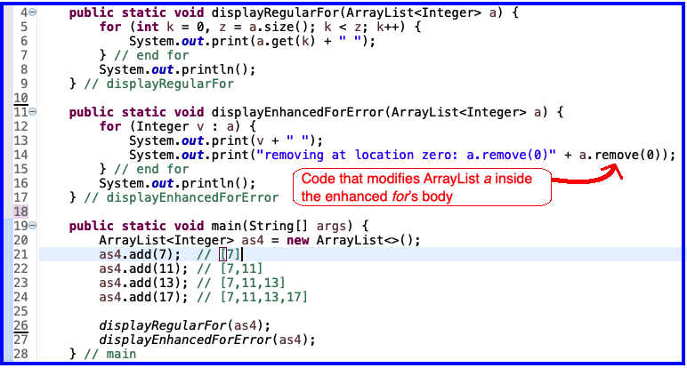
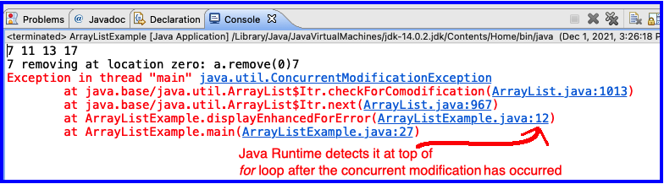
Concurrent Modification Error
This is a problem
for enhanced for
because length of 'a' has changed
But enhanced for is still using
original length of
'a'

Slide 10
Timer
An alternative to a thread that waits/sleeps
Creates events periodically
Allows main thread to finish
Designed to work in same thread as graphics
Superior approach for ArcadeGame project
Similar functionality required for GARP

Slide 11
Timer
Time
main thread
Java Graphics Thread
public void advanceOneTick() {
myComponent.updateState();
myComponent.drawScreen();
}
Exit
public void advanceOneTick() {
myComponent.updateState();
myComponent.drawScreen();
}
Each tick of the Timer
public void advanceOneTick() {
myComponent.updateState();
myComponent.drawScreen();
}

Slide 12
Live-coding
Today's import: PracticeEventBasedGameLoop
Subpackage: gameEventLoop
Notes:
* In this exercise, we develop each of these ideas.
* TODO: Replace the loop with button input to advance one tick.
* TODO: Replace the button with a timer.
* TODO: Make the button change the direction of motion.
* TODO: Add falling raindrops.
* TODO: Make the box "catch" drops that hit it.

Slide 13
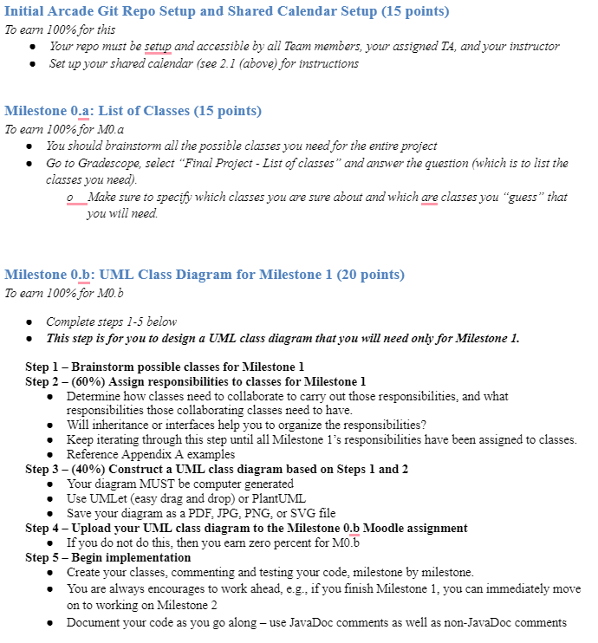
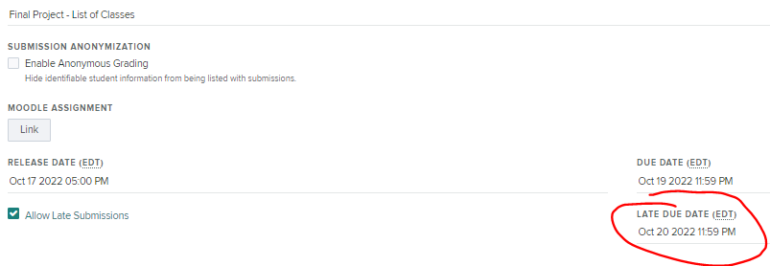
M0: UML Class Diagram & Shared Calendar Setup (50 points)
I will grant you all until Thursday night to submit M0.a

Slide 14
M0: UML Class Diagram & Shared Calendar Setup (50 points)

Slide 15
Plan your first meeting NOW!
What day?
What time?
Where?
Communication? (email/teams/txt/discord/imleagues/etc)
Preparation beforehand?
I’d recommend people coming with their own list of suggested nouns

Slide 16
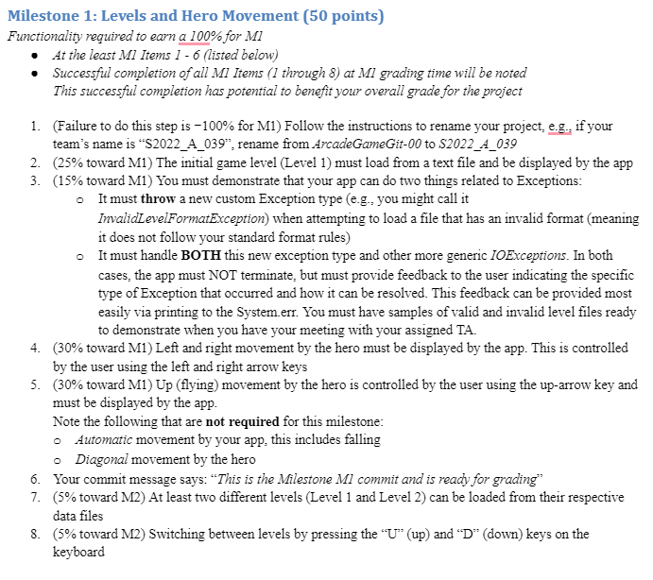
M1: Levels and Hero Movement (50 points)

Slide 17
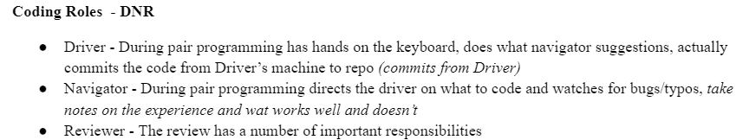
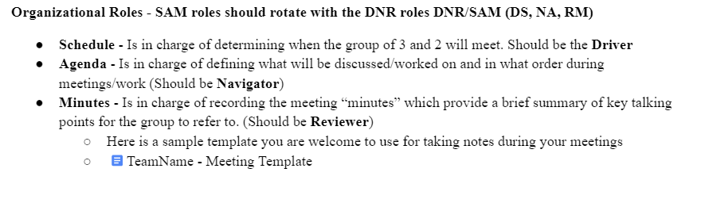
DNR - SAM
There is NO coding for M0. I recommend you all meet together since it is a critical part of setting up your design and you want to be in sync and in agreement as much as possible!

Slide 18
Reading & writing files
When the unexpected happens
Files and Exceptions
Notes:
18

Slide 19
File I/O: Key Pieces
Input: File and Scanner
Output: PrintWriter and println
☺ Be kind to your OS: close() all files
Letting users choose: JFileChooser and File
Expect the unexpected: Exception handling
Refer to examples when you need to…
Notes:
19

Slide 20
Live code a level loader
Today's import: PracticeEventBasedGameLoop
Subpackage: fileIO
Notes:
Can live-code a quick example to save a list of numbers or a simple game Level to a file, then read them/it back in again. There is an example in the solution code.

Slide 21
Exceptions – What, When, Why, How?
Examples from today’s class:
ConcurrentModificationException
FileNotFoundException

Slide 22
Exceptions – What, When, Why, How?
What:
Used to signal that something in the code has gone wrong
When:
An error has occurred that cannot be handled in the current code
Why:
Breaks the execution flow and passes exception up the stack

Slide 23
Exceptions – How?
Handling (catching) an exception:
try {
//code that could throw an exception
}
catch (ExceptionType ex) {
//code to handle exception
}
When caught you can:
Recover from the error OR exit gracefully
Notes:
Try to read from file when the file does not exist
23

Slide 24
A Checkered Past
Java has two sorts of exceptions
Checked exceptions: compiler checks that calling code isn’t ignoring the problem
Used for expected problems
Example: FileNotFoundException
Unchecked exceptions: compiler lets us ignore these if we want
Used for fatal or avoidable problems
Are subclasses of RunTimeException or Error
Example: ConcurrentModificationException

Slide 25
Team Project
Work time
Be sure everyone is getting a chance to drive.

