Slide 1
CSSE 220
Part 1 Review:
Access Levels, UML Diagramming Details
The git projects for today are:
PracticeIPolymorphism
PracticeIPolymorphismSolution
Notes:
Bring code for all the classes in PolymorphismSolution that have TODO items. Highlight the TODO items so you can keep moving.
Bring code for Ball and Pulsar from BallWorldsSolution.
Bring BallWorlds DesignQuestions Quiz. The UML design is linked from the instructions page.

Slide 2
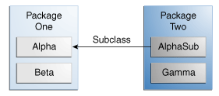
Access Levels: Review
Modifier | Class | Package | Subclass | World
public | Y | Y | Y | Y
protected | Y | Y | Y | N
no modifier | Y | Y | N | N
private | Y | N | N | N
Notes:
This can be used to help demonstrate that instance variables/methods INSIDE Alpha will be accessible by various other classes

Slide 3
Access Levels: Review
Modifier | Alpha | Beta | Alphasub | Gamma
public | Y | Y | Y | Y
protected | Y | Y | Y | N
no modifier | Y | Y | N | N
private | Y | N | N | N
Notes:
This can be used to help demonstrate that instance variables/methods INSIDE Alpha will be accessible by various other classes

Slide 4
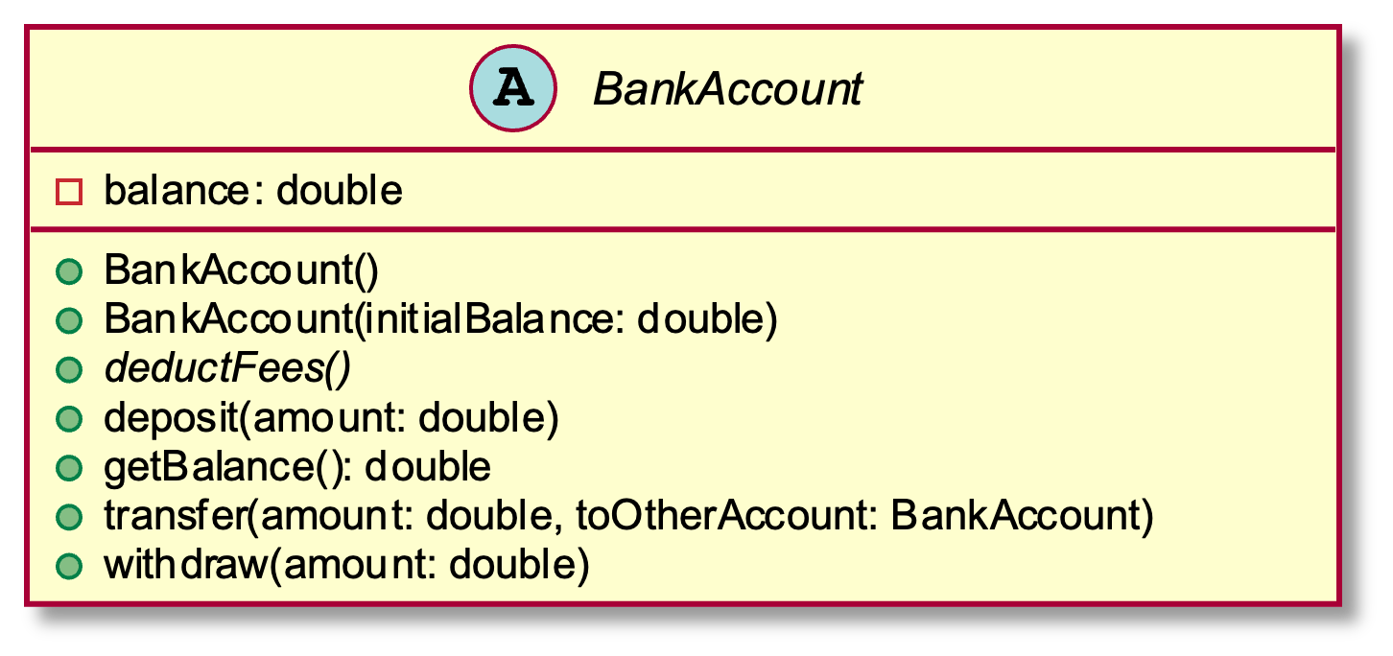
Abstract Class Example - UML
As appears in class diagram
UML code for abstract class
abstract class BankAccount {
-balance: double
+BankAccount()
+BankAccount(initialBalance: double)
+deposit(amount: double)
+getBalance(): double
{abstract}+deductFees()
+transfer(amount: double, toOtherAccount: BankAccount)
+withdraw(amount: double)
}

Slide 5
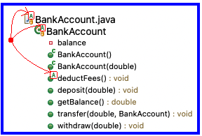
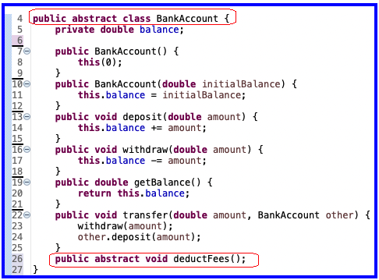
Abstract Class Example - Eclipse
Eclipse Package Explorer
Java code for abstract class

Slide 6
UML Class Diagram Review
Inheritance, Associations, and Dependencies

Slide 7
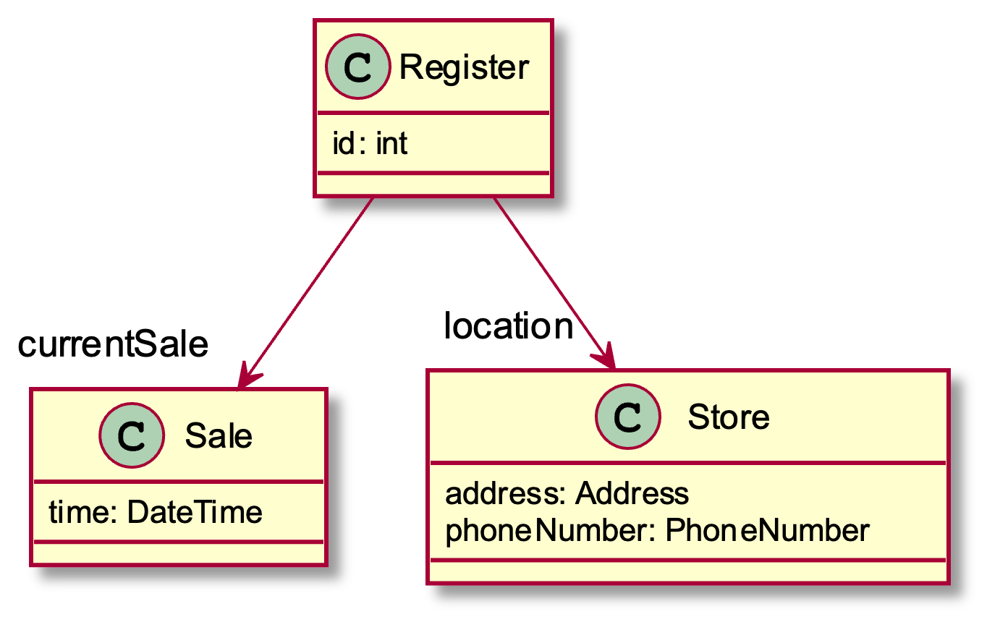
Recall UML: Associations
Solid line, open arrowhead = “has-a”
Answer me this:
Register has how many fields?
What are their names?
PlantUML code for placing field name at arrowhead:
Register -down->"currentSale" Sale
Register -down->"location" Store
Notes:
Showing Sale & Store attributes as associations visually emphasizes relationships important in object collaboration
[How many attributes does Register have? 3
What are their names? Id, currentSale, and location]

Slide 8
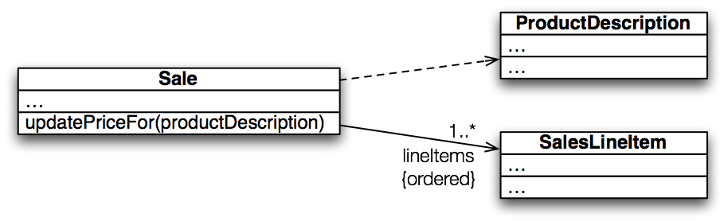
Recall UML: Dependencies
Dependency lines are dashed
Field association lines are solid
Use association lines only when an item is stored as a field. Solid = stronger rel.
Two types of open arrowheads: open and closed
Notes:
A dependency is a “using relationship” that states a change in specification of one thing may affect another thing that uses it
>>>On board (and quiz): global variable, parameter, local variable, static method call
[Which of these are we showing here? Parameter]
• labels

Slide 9
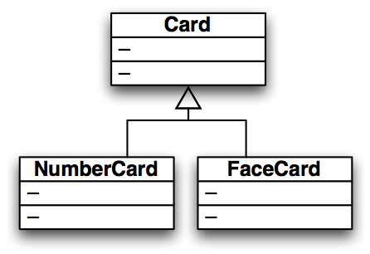
Recall UML: Inheritance
Generalization (superclass)
Specialization (subclass)
Closed arrowhead = “is-a”. Two types: solid line= inherits, dotted line = implements. Solid = stronger rel.

