Slide 1
CSSE 220
Interfaces and Polymorphism
The git projects for today are:
PracticeInterfaces
PracticeInterfacesSolution
Notes:
Bring print-outs of code from InterfacesSolution,
Current schedule:
Tomorrow – reactive GUI programming using interfaces (covered today)
Next week – extend to Inheritance
Two weeks to next test
Questions about current recursion assignment? Due tonight
You can use helper functions if you know how, but not needed for any of the problems

Slide 2
Object-Oriented Programming
The three pillars of Object-Oriented Programming
Encapsulation (already covered)
Polymorphism (start idea today)
Inheritance (next week)

Slide 3
Interfaces – What, When, Why, How?
What:
Code structure that looks like a class
Used to express operations that multiple classes have in common
Differences from classes:
No fields.
Methods contain no code.
When:
When abstracting an idea that has multiple, different implementations
Notes:
Talk about Vehicle interface as concept.
Do simple example now.

Slide 4
Interface Types: Key Idea
Interface types are like contracts
A class can promise to implement an interface
Any code that uses the interface can automatically use new classes that implement the interface!
Notes:
QUIZ QUESTION 1
When thinking about interfaces, I like to give the example of a car:
I don’t care if it’s a truck, car, van, electric car, etc. When I get in a new car (or rental car, or friend’s car, etc.) … I know that the car will have the same “interface” for me to interact with. I’ll always have a brake and accelerator, a steering wheel, etc. I don’t need to know how the car works or how it’s different from another car, I just need to know how to use the interface.

Slide 5
Notation: In Code
public interface InterfaceName{
/**
* regular javadocs
*/
void methodName(int x, int y);
/**
* regular javadocs here
*/
int doSomething(Graphics2D g);
}
Automatically public, so we don’t specify it
No method body, just a semi-colon
public class SomeClass implements InterfaceName { … }
SomeClass promises to implement all the methods declared in the InterfaceName interface
Notes:
callouts animated
201710: have them study and do the numberSequence example. They don’t need to write all 3, just enough to get the feel for it.
Old:
Ask students to use this information to create a Function interface in the textCalculator project that fixes the errors in the code.
Once they’ve done that, they should implement the add and multiply classes that implement the Function interface.

Slide 6
Notation: In Code
Automatically public, so we don’t specify it
No method body, just a semi-colon
public interface Drivable {
void turn(double dir);
void accelerate(double force);
}
public class Car implements Drivable { @Override
public void turn(double direction) {
...
}
@Override
public void accelerate(double force) {
...
} }
Notes:
callouts animated
201710: have them study and do the numberSequence example. They don’t need to write all 3, just enough to get the feel for it.
Old:
Ask students to use this information to create a Function interface in the textCalculator project that fixes the errors in the code.
Once they’ve done that, they should implement the add and multiply classes that implement the Function interface.

Slide 7
Notation: In Code
Automatically public, so we don’t specify it
No method body, just a semi-colon
public interface Drivable {
void turn(double dir);
void accelerate(double force);
}
public class Truck implements Drivable { @Override
public void turn(double direction) {
...
}
@Override
public void accelerate(double force) {
...
} }
Notes:
callouts animated
201710: have them study and do the numberSequence example. They don’t need to write all 3, just enough to get the feel for it.
Old:
Ask students to use this information to create a Function interface in the textCalculator project that fixes the errors in the code.
Once they’ve done that, they should implement the add and multiply classes that implement the Function interface.

Slide 8
Notation: In Code
Automatically public, so we don’t specify it
No method body, just a semi-colon
public interface Drivable {
void turn(double dir);
void accelerate(double force);
}
public class Hovercraft implements Drivable { @Override
public void turn(double direction) {
...
}
@Override
public void accelerate(double force) {
...
} }
Notes:
callouts animated
201710: have them study and do the numberSequence example. They don’t need to write all 3, just enough to get the feel for it.
Old:
Ask students to use this information to create a Function interface in the textCalculator project that fixes the errors in the code.
Once they’ve done that, they should implement the add and multiply classes that implement the Function interface.

Slide 9
Why?
Interfaces help to reduce coupling by tying your code to the interface, not the class implementation.
Q1

Slide 10
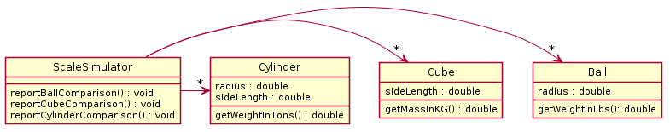
Open simpleExample
UML of current code
Three classes with different weight measurements
Notes:
Imagine three different people developed these three classes. We have a scale simulator where we write code to compare/weigh things.
What if we wanted to compare all of them at the same time?

Slide 11
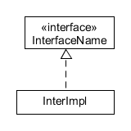
Notation: In UML
Closed triangle with a dashed line in UML is an “is-a” relationship
Read this as:
InterImpl is-an InterfaceName
PlantUML:
Class .-|> Interface
Q3
Notes:
Might be good to draw the Pet, Cat, Dog UML diagram here.

Slide 12
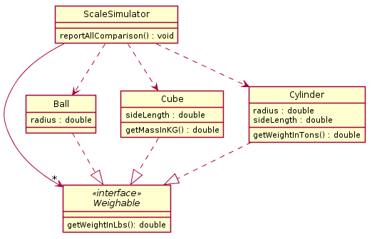
Code Refactoring
Before refactoring:
After refactoring:
PlantUML:
Ball .-|> Weighable
Cube .-|> Weighable
Cylinder .-|> Weighable
Notes:
From the Interface Eclipse project, simpleExample package

Slide 13
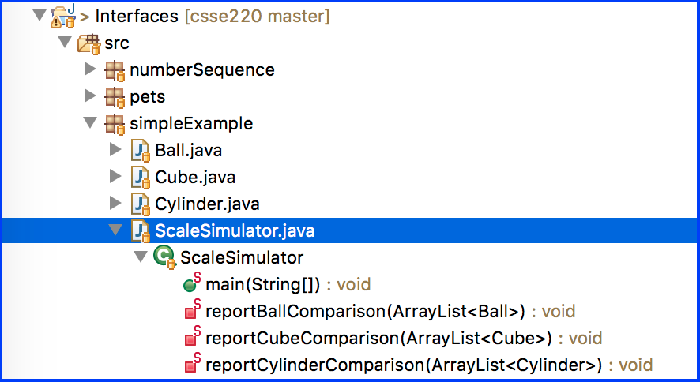

Before
Refactoring

Slide 14
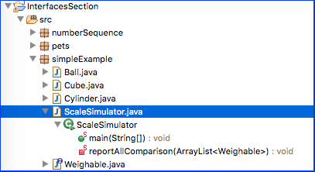

After
Refactoring

Slide 15
Interface Types can replace class types
If Dog & Cat implement the Pet interface:
Variable Declaration:
Pet d = new Dog(); Pet c = new Cat();
Parameters:
public static void feedPet(Pet p) {…} Can call with any object of type Pet:
feedPet(new Dog()); feedPet(c); // from above
Fields:
private Pet pet;
Generic Type Parameters:
ArrayList<Pet> pets = new ArrayList<Pet>();
pets.add(new Dog()); pets.add(new Cat());

Slide 16
Check your understanding…
public interface Pet{
private String name;
public Pet(String name){
this.name = name;
}
public void speak(){
System.out.println(name);
}
}
Is this interface valid? Why or why not?

Slide 17
Valid interface
public interface Pet{
public void speak();
}
What happened to name?
Notes:
Name is an implementation detail.
It was needed to construct the Pet, not to use it.
Interfaces only describe how things are used, not how they are created.
Implementations, that is: classes that implement interfaces, describe how they are created.

Slide 18
A valid Pet with a name
public class Cat implements Pet {
private String name;
public Cat(String name){
this.name = name;
}
public void speak(){
System.out.println(name);
}
}

Slide 19
Why is this OK?
Pet p = new Dog(); p.feed();
p = new Cat(); p.feed();
p = new Pet(); // NO!
Any child type may be stored into a variable of a parent type, but not the other way around.
A Dog is a Pet, and a Cat is a Pet, but a Pet is not required to be a Dog or a Cat.
And how could you construct a Pet?
Q2
Notes:
Draw box-and-pointer diagram

Slide 20
NumberSequence Example
Notes:
If students finish quickly suggest that they add to the Sequence interface
int prevNum();
and implement it
(has interesting functionality if you run Fibonacci in reverse (with two int implementation))

Slide 21
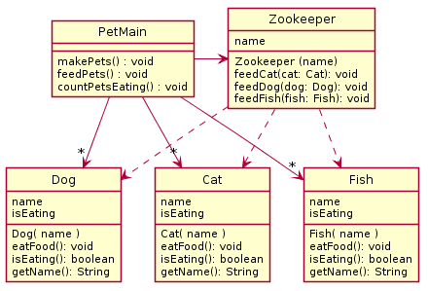
In the following scenario we have a Pet Zoo, with a Zookeeper who is in charge of feeding different types of animals. When the simulator runs, various pets are made and fed. Also, there is a way to count the number of pets that are eating. The animals include cats, dogs, and fish. All the animals have names, and can be told to eat food, as well as report that they are eating (once fed they always report eating). Show how an improved approach using interfaces can remove code duplication from the following design.
PAUSE THIS VIDEO HERE
for 5-10 minutes!
Try to make your own
improved design
Using plantuml is good practice!
Notes:
Leading questions to help:
What do they all have in common? So what goes in interface?
What can we do instead of the three feed methods?

Slide 22
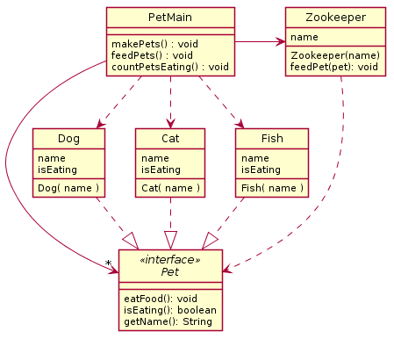
Solution
Q4
Notes:
Now that we have developed an interface, let’s implement the changes in code.

Slide 23
Solution
Method makePets()
still must directly call
constructor for Dog,
Cat, and Fish
That’s why we have
the 3 dependency arrows
Method feedPet()
calls eatFood() from Pet
That’s why we have
this dependency arrow
1 of List<Pet> in PetMain
Notes:
Now that we have developed an interface, let’s implement the changes in code.

Slide 24
Polymorphism! (A quick intro)
Etymology:
Poly → many
Morphism → shape
Polymorphism means: An Interface can take many shapes.
A Pet variable could actually contain a Cat, Dog, or Fish
Notes:
If you find it helpful you can ask:
If I run “Pet p = new Dog();”
What is the type? (confusion… Both?)
There is a declared (Pet) and actual (Dog) type.

Slide 25
Polymorphic method calls
pet.feed() could call:
Dog’s feed()
Cat’s feed()
Fish’s feed()
Your code is well designed if:
You don’t need to know which implementation is used.
The end result is the same. (“pet is fed”)
Q5

Slide 26
How does all this help reuse?
Can pass an instance of a class where an interface type is expected
But only if the class implements the interface
We could add new functions to a NumberSequence’s abilities without changing the runner itself.
Sort of like application “plug-ins”
We can use a new Pet interface without changing the method that uses the Pet instance. (When adding a Zebra class to PetMain, Zookeeper does not have to change!)
Use interface types for field, method parameter, and return types whenever possible. Like Pet instead of Dog, and List for ArrayList.
List<Pet> pets= new ArrayList<Pet>();
Next time: because of interfaces, we can add classes that listen for Button presses and mouse clicks, without changing the Button or window.
Notes:
[Skipped downcasting from interface types to class types. Better to make interface type general enough. We’ll cover downcasts with inheritance.]

