Slide 1
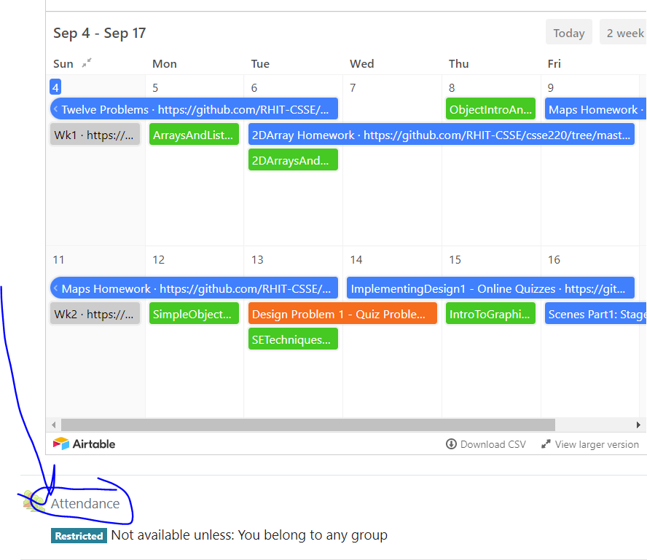
CSSE 220
Today’s Attendance password
inheritcollisions
Collision Handling without instanceof
The git projects for today are:
PracticeInheritanceDesign
PracticeInheritanceDesignSolution

Slide 2
The specific problem
Monsters can collide with the Player.
Players can take powerups
Players can collide with eggs
Bonus: Player collide with another Player?
So many collisions! How do we handle them all?

Slide 3
Handling Collisions in General
Many ways it can be done
Good design principles
Make it easy to use and extend code
Functional but bad design principles
Use what is known as: type predicated code: if (instanceof, getClass(), getType(), == / equals) if (gameObject instanceof DamagingDrop) { ... }
Type predicated code is OUTLAWED in your project design!
I.e., your design and implementation must not use these at all!

Slide 4
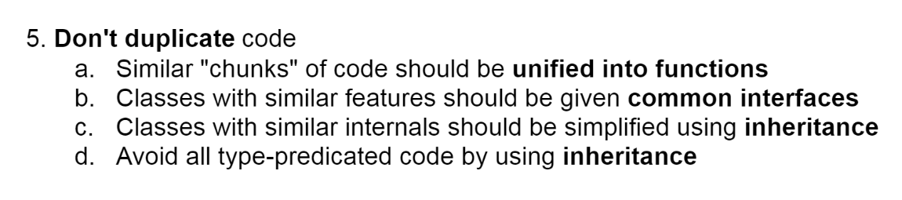
Final OODP #5
Let’s unpack this phrase: type predicted code
Type = the specific class
Predicated = conditionally dependent upon
If you are using a condition to check the type of an object to decide what to do, you are using type predicated code.
Note: Creating a field in your classes (e.g. String type=“Enemy”) is NOT fixing the problem, you are still using type predicated code!

Slide 5
Live Coding
Why is type predicated code bad?
Harder to understand/read
Harder to extend
Let’s actually see how this looks in practice
We will consider a simulator with collisions
More Raindrops More Platforms
Run Main.java
Notes:
Run the game and explain what is happening

Slide 6
Extend Functionality
Implement an InvincibilityDrop
makes a BouncingPlatform invincible for 50 ticks
drops should not affect platforms when invincible
color should be Yellow
size should be 20
absorbed by UserControlledPlatform like others
Notes:
Explain that we want to consider how hard/easy it would be to extend this codebase
to provide the functionality of a new type of drop

Slide 7
GameComponent.java
Let’s look how collisions are handled
Where would changes in code need to happen?
Look for examples of “type predicated code”
Why is this hard to use/extend?
Notes:
Go through the file and point out the really ugly code because of how hard it is to understand and how many places you would have to make changes.

Slide 8
Collision Chart
When do collisions happen?
 | UserPlat | BouncePlat | DamageDrop | HealDrop
UserPlat
BouncePlat
DamageDrop
HealDrop

Slide 9
Collision Chart
When do collisions happen?
 | UserPlat | BouncePlat | DamageDrop | HealDrop
UserPlat |  |  | X | X
BouncePlat |  |  | X | X
DamageDrop | X | X
HealDrop | X | X

Slide 10
Collision Chart
When we have multiple objects which interact with the same object, we can use inheritance to help us make a design to deal with the collisions. We should have the classes which differ provide the functionality to deal with the collisions.
 | UserPlat | BouncePlat | DamageDrop | HealDrop
UserPlat |  |  | X | X
BouncePlat |  |  | X | X
DamageDrop | X | X
HealDrop | X | X

Slide 11
Collision Chart
When we have multiple objects which interact with the same object, we can use inheritance to help us make a design to deal with the collisions. We should have the classes which differ provide the functionality to deal with the collisions.
So in this case, the different drops (and InvincibilityDrop) differ in how they affect the platform. Thus, we can could create an abstract class and require an implementation of the collideWith(BouncingPlatform) method. Similarly, we can provide a collideWith( UserControlledPlatform) method, this will allow us to put the code in the drop classes and make the processing MUCH cleaner as we will see.

Slide 12
Live-coding
Notes:
At this point go through the script and make all the changes. If time allows let students try to implement the InvincibilityDrop on their own

Slide 13
Design Activity
Quiz on Moodle

Slide 14
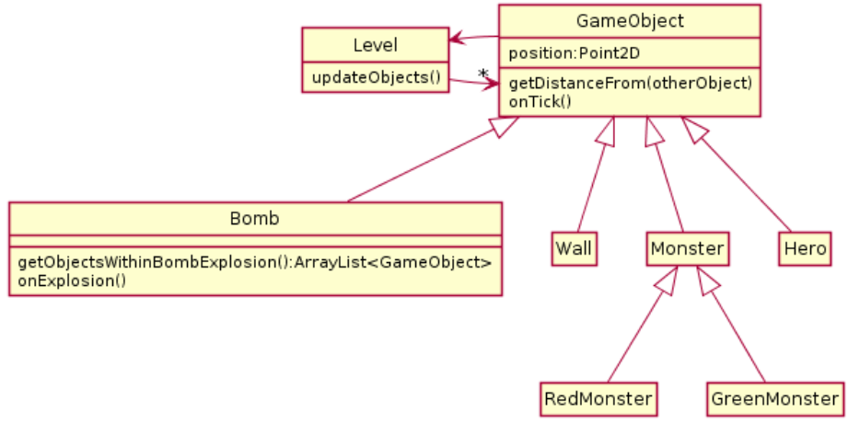
In the game Bomberman, everything has special behavior if caught in a bomb explosion. Heroes die and restart the level, monsters are killed and score points, walls are destroyed, and bombs explode themselves. In the design below, the Bomb class has an onExplosion method which handles this behavior and (you can assume) works correctly.

Slide 15
Collision Code
for(GameObject g : getObjectsWithinBombExplosion()) {
if(g instanceof Bomb) {
// bomb specific code
}
if(g instanceof Wall) {
//wall specific code
}
//pattern continues...
}
1. What is wrong with the design?
2. Propose a new design that does not have the problem you identified in #1. You only need include in your UML diagram classes that are *different* from their version in the given diagram. Also include a sample for what the analogous code on onExplosion looks like
Notes:
Have students work in groups of 2 or 3 to answer these

Slide 16
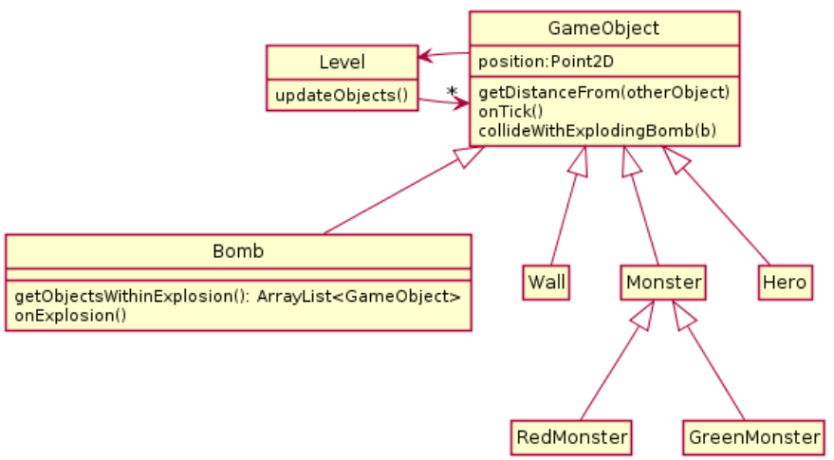
A Solution

Slide 17
Each subclass will process the effects of a collision inside of the collideWithExplodingBomb method. No instanceof is required. Additionally, the code to handle collisions can be done inside onExplosion as before:
for(GameObject g : getObjectsWithinBombExplosion()) {
g.collideWithExplodingBomb(this);
}
Each subclass will deal with handling the class specific effects of being hit by a bomb

Slide 18
Team Project
Work time
Be sure everyone is contributing and has something to work on.

Slide 19
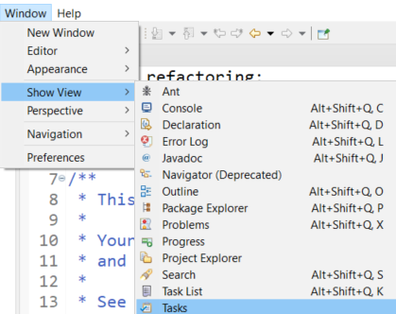
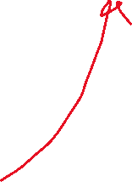


DNR: Driver, Navigator, Reviewer
Reviewer - The review has a number of important responsibilities
Look at each piece of code and either correct or mark TODOs in the code
If its easy and obvious, just fix it
If NOT, add a TODO to complete later
Eclipse can provide a view of your TODOs in a project
Generate the PlantUML for the current project and next Milestone before the TA meeting
Use to easily generate UML: https://plantuml.com/eclipse
Can copy the source code and modify as needed
Identify violations of the 5 OODP based on code and UML
Mark TODOs in code or add comments to review document (notes for meeting with TA)
Provide a log of the results of the review
This is easily done with a good commit record
Evaluation of the current UML
Production of the planned UML for the next milestone with notes
During the TA meeting, the reviewer will discuss their review of the code and discuss concerns they have

Slide 20
SAM: Schedule, Agenda, Minutes
Driver = Schedule Job
Navigator = Agenda Job
Reviewer = Minutes Job
Organizational Roles - SAM roles should rotate with the DNR roles DNR/SAM (DS, NA, RM)
Schedule - Is in charge of determining when the group of 3 and 2 will meet. Should be the Driver
Agenda - Is in charge of defining what will be discussed/worked on and in what order during meetings/work (Should be Navigator)
Minutes - Is in charge of recording the meeting “minutes” which provide a brief summary of key talking points for the group to refer to. (Should be Reviewer)
Here is a sample template you are welcome to use for taking notes during your meetings
TeamName - Meeting Template (updated)

Slide 21
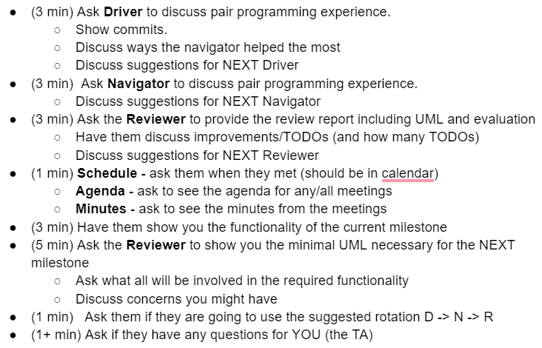
Next Meeting (Milestone 1) with your TA
Agenda and Plan
Make sure you are ready to show the TA everything you are responsible for
Must have UML for current and next milestone
Have your code ready to run
Have your git commits ready to show

Slide 22
Platforms and Drops
What if we wanted Platforms to collide as well?
 | UserPlat | BouncePlat | DamageDrop | HealDrop
UserPlat |  | X | X | X
BouncePlat | X | X | X | X
DamageDrop | X | X
HealDrop | X | X
Notes:
Advanced only if time allows, solution (takes some slightly different conventions)

Slide 23
Platforms and Drops
AbstractPlatform and AbstractDrop
Subclasses implement
collideWith(AbstractPlatform)
 | UserPlat | BouncePlat | DamageDrop | HealDrop
UserPlat |  | X | X | X
BouncePlat | X | X | X | X
DamageDrop | X | X
HealDrop | X | X

Slide 24
Double/Multiple Dispatch
Another advanced technique
Helps especially when you want to store all objects in a single list
Requires some boilerplate code
Trade-offs as with many design choices
When many different things are interacting with many different things
Additional slides and project available to see

