Slide 1
CSSE 220
Polymorphism
Notes:
Bring code for all the classes in PolymorphismSolution that have TODO items. Highlight the TODO items so you can keep moving.
Bring code for Ball and Pulsar from BallWorldsSolution.
Bring BallWorlds DesignQuestions Quiz. The UML design is linked from the instructions page.

Slide 2
Polymorphism
Review and Practice

Slide 3
Recall: Polymorphism and Subclasses
A subclass instance is a superclass instance
Polymorphism still works!
BankAccount ba = new SavingsAccount(); ba.deposit(100);
But not the other way around!
SavingsAccount sa = new BankAccount(); sa.addInterest();
Why not?
BOOM!
Notes:
Don’t draw this one again, just discuss briefly.

Slide 4
Summary
If B extends or implements A, we can write
A x = new B();
Declared type tells which methods x can access. Compile-time error if try to use method not in A.
The instantiated type (used at runtime) tells which class’ version of the method to use.
Notes:
[4 stage build]

Slide 5
Summary
If B extends or implements A, we can write
A x = new B();
Declared type tells which methods x can access. Compile-time error if try to use method not in A.
The instantiated type (used at runtime) tells which class’ version of the method to use.
Can cast to tell compiler to temporarily believe that object x is declared as a B, i.e., not A:
x.foo()
((B)x).foo()
If it turns out that x is not an instance of B, i.e., our cast lied to the compiler, then Java gives a run-time error (class cast exception)
Now we can access all of A's and also B’s methods
Notes:
[4 stage build]

Slide 6
Determining Method at Runtime
Step 1: Identify the Declared/Casted Type
This is the item to the left of the variable name when the variable was declared:
BankAccount sa = new SavingsAccount();
Declared Type may be changed due to a cast:
((SavingsAccount)sa).addInterest();
If there is a casted type, record that, otherwise use the declared type.
Declared Type
Casted Type

Slide 7
Determining Method at Runtime
Step 2: Identify the Instantiation/Actual Type
This is the type on the right hand side of the equal sign the last time the variable was assigned to:
BankAccount sa = new SavingsAccount();
Record the instantiation type
Instantiation Type

Slide 8
Determining Method at Runtime
Step 3: Check for Compilation Errors
Calling a method that is not available based on the declared or casted type of the object
BankAccount sa = new SavingsAccount();
sa.addInterest();
Compiler Error: BankAccount does not have addInterest
Incompatible type assignment
SavingsAccount x = new BankAccount();
Compiler Error: BankAccounts can not be stored in SavingAccount typed variables
Invalid cast: casting to a type that isn’t in the tree below the declaration type.
BankAccount sa = new SavingsAccount();
((SafetyDepositBox)sa).depositItem();
SafetyDepositBox is not below BankAccount.
Cannot instantiate interfaces or abstract classes!
Notes:
Draw UML on the board for accounts
Account
|
/ \
SafetyDepositBox BankAccount
/ \
SavingsAccount CheckingAccount

Slide 9
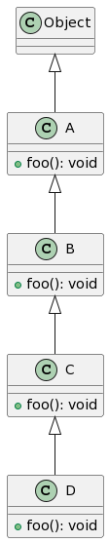






Determining Illegal Type Casts
Step 4: Check for Runtime Errors
Runtime errors are caused by invalid casting
A legal type cast is one where:
The casted type is within the inheritance hierarchy of the class Object down to the instantiation type
All other type casts are illegal and will cause a runtime error
Notes:
Draw UML on the board for accounts
Account
|
/ \
SafetyDepositBox BankAccount
/ \
SavingsAccount CheckingAccount

Slide 10
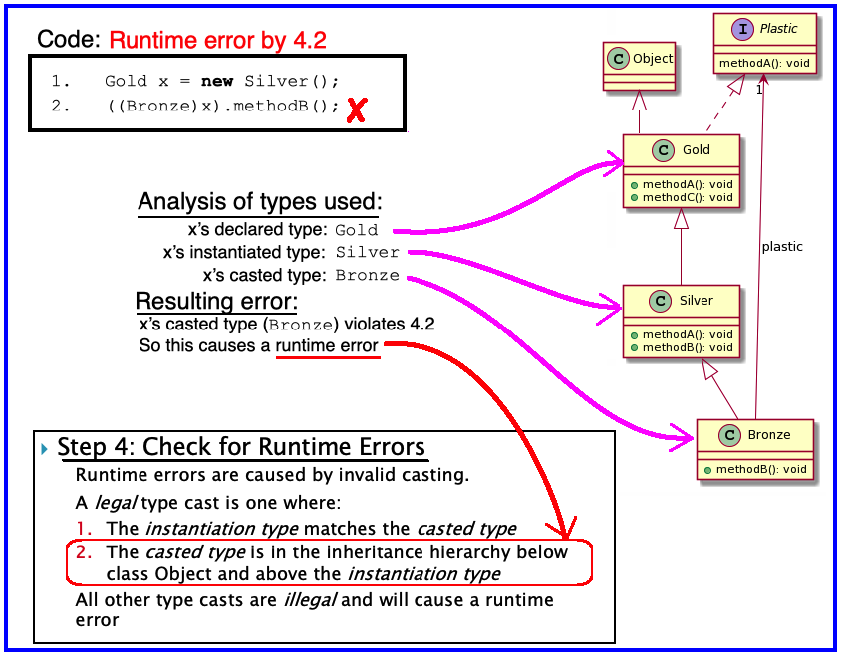
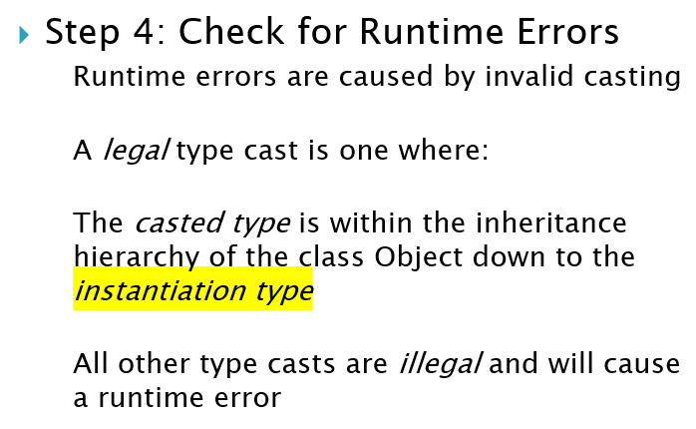
Example: Determining Illegal Type Casts
Step 4: Check for Runtime Errors
Notes:
Draw UML on the board for accounts
Account
|
/ \
SafetyDepositBox BankAccount
/ \
SavingsAccount CheckingAccount

Slide 11
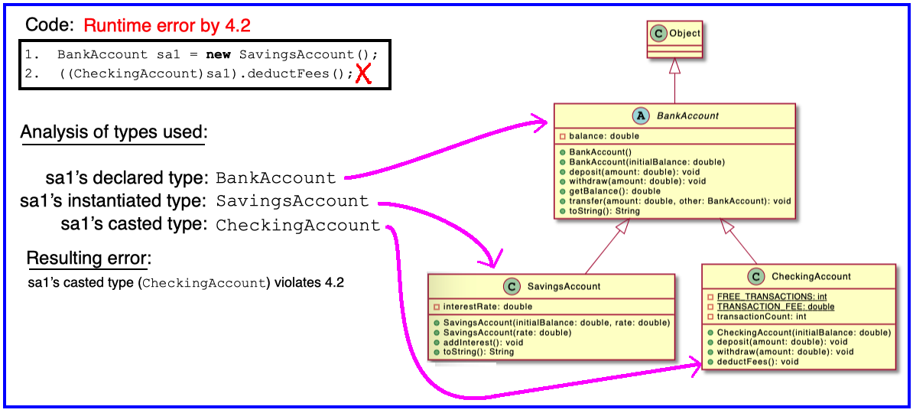
Example: Determining Illegal Type Casts
Step 4: Check for Runtime Errors
Notes:
Draw UML on the board for accounts
Account
|
/ \
SafetyDepositBox BankAccount
/ \
SavingsAccount CheckingAccount

Slide 12
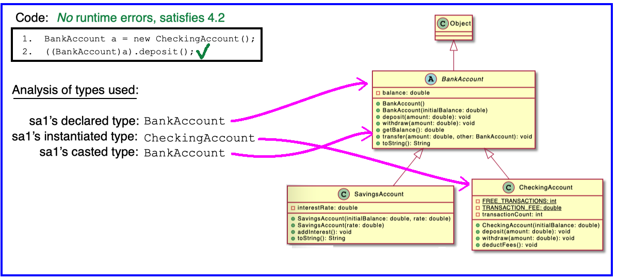
Example: Determining Illegal Type Casts
Step 4: Check for Runtime Errors
Notes:
Draw UML on the board for accounts
Account
|
/ \
SafetyDepositBox BankAccount
/ \
SavingsAccount CheckingAccount

Slide 13
Determining Method at Runtime
Step 5: Find Method to Run
Find the instantiation type in the hierarchy.
If that type implements the given method, then use that implementation.
Otherwise, move up to the parent type and see if there’s an implementation there.
If there is an implementation, use that.
Otherwise, repeat step 2 until an implementation is found.
Notes:
Draw UML on the board for accounts
Account
|
/ \
SafetyDepositBox BankAccount
/ \
SavingsAccount CheckingAccount

Slide 14
Tasks
Finish Quiz
Start the PolymorphicTracingAndInheritance HW assignment
Important Distinction
Today’s Quiz is Collaborative
Can work together, share answers, etc.
Polymorphic Tracing HW is Individual
Work separately, use TA/Instructor Help Hours
Notes:
Changes to the “depended on” thing may necessitate changes to the dependent thing. So we want to (1) minimize dependencies and (2) structure dependencies to point to the more stable pieces.

Slide 15
Determing Method at Runtime
Step 1: Identify the Declared/Casted Type
DeclaredType var = …. (can change!)
CastedType var2 = (CastedType)var;
Step 2: Identify the Instantiation/Actual Type
(Never changes! To the right of original “= new *”)
…= new InstantiatedType();
Step 3: Check for Compilation Errors
Method not available based on declared/casted type
Incompatible type assignment: Dog x = new Cat()
Invalid cast: casting to type not below declaration type
Step 4: Check for Runtime Errors
You can only cast to types within the inheritance hierarchy from Object to the instantiation type
Step 5: Find Method to Run
Start with instantiation type and look to super class!
Notes:
Optional: look in solution code for sample of create 4 minimal classes and playing around with what happens when you add and remove methods at different levels.

