Slide 1
Exam 1 Prep and Review Video
CSSE 220

Slide 2
Exam Format
Exam 1 will be given over two class days
On the first class day:
a written part (an hour or less)
two small programming questions
On the second class day:
several programming questions
a graphics-based problem

Slide 3
Written Part
Allowed resources:
OO Design Principles (blue handout)
UML Cheatsheet (yellow handout)
Boxes & Pointers cheatsheet (green handout)
An 8.5” x 11” sheet of paper with handwritten notes of your choice (may use both sides)
Computers WILL be closed during this portion of the exam

Slide 4
Questions/problems to expect
Given a couple of classes, draw 2 different Boxes & Pointers diagrams
Predict the output of two given code blocks
Given a problem description, identify designs that violate OO Design Principles and/or “good” designs.
If any violations, specify which principles are violated with an accompanying small explanation
True/False questions covering various topics in the course such as the use of static, Strings, etc.

Slide 5
First-day Programming
Immediately after finishing paper part
Allowed resources:
Open book, open notes
You may view previous in-class exercises, previous assignments
The ONLY website allowed is the Java API
Problems to expect:
Two “SmallProgramming” problems, similar to TwelveProblems with simple to medium difficulty range

Slide 6
Second Day Programming
Same allowed resources as the programming part on Day 1
One more “Small Problem” with medium-hard difficulty range
One 2D Array problem
One HashMap problem
One small graphics question

Slide 7
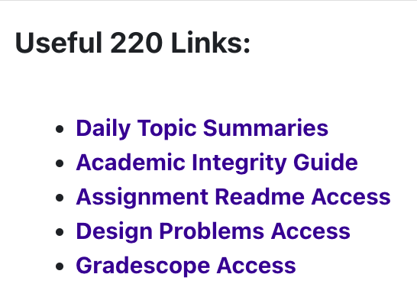
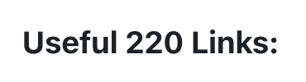
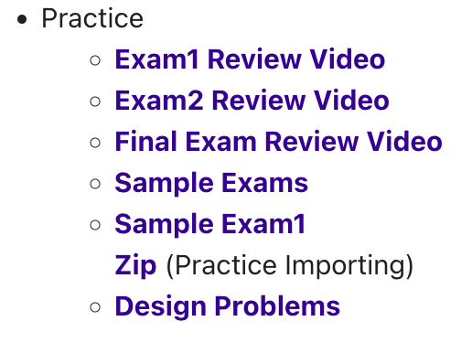
Best way to prepare and review
For written part, go through in-class quizzes, slides and Daily Topic Summaries and Design Problems
For programming part, review previous homework assignments and in-class coding exercises
BEST review source is previous Sample Exams

