Slide 1
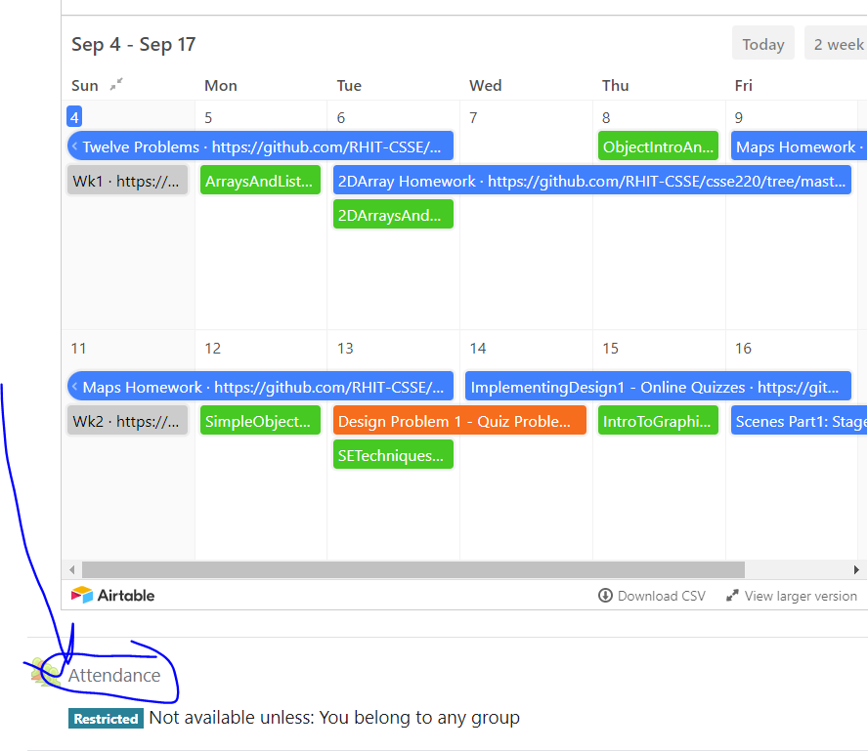
CSSE 220
Today’s Attendance password
simpleClasses
MapsHW & StudentGradebook
The git projects for today are:
PracticeSuperSimpleObjects
PracticeSuperSimpleObjectsSolution
PracticeSuperSimpleObjectsBoxAndPointers
The Quiz for today is
SimpleObjectsQuiz
Notes:
JAY: Introduce FOURTH row today (Identity Pie)
Aim to start quiz with 5+ minutes to spare in the first hour.

Slide 2
Plan for today
Talk about object references and box and pointer diagrams
Talk about static methods
Continue working on writing your own classes
Get started on your new assignment

Slide 3
Finishing up from last time...
Complete the StudentGradebook problem in the SuperSimpleObject project (or the one from last class)
Notes:
Live code the solution with them, you can intentionally leave in a bug by now initializing the HashMap and then use the debugger to trace through and see what happens
3

Slide 4
CSSE 220
Object References & Box and Pointer Diagrams
The git projects for today are:
PracticeSuperSimpleObjects
PracticeSuperSimpleObjectsSolution
PracticeSuperSimpleObjectsBoxAndPointers
Notes:
Aim to start quiz with 5 minutes to spare in the first hour.

Slide 5
What Do Variables Really Store?
Variables of primitive type store values
Variables of class type store references reference = memory address
10
box
20
5
x
10
5
int x = 10;
int y = 20;
Rectangle box = new Rectangle(x, y, 5, 5);
y
20
Notes:
Draw box and pointer diagrams on board showing:
x : 10
y : 20
Rectangle object with values 10, 20, 5, 5
box : arrow pointing to Rectangle object
Primitives always lower case
Usually not using byte, short, float
The value stored in the box variable is a memory location it is a reference to a memory location

Slide 6
Assignment Copies Values
Actual value for number types
Reference value for object types
The actual object is not copied
The reference value (“the address or pointer”) is copied
Consider:
× 9
5
×10
6
x
10
box
7
×20
int x = 10;
int y = x;
y = 20;
Rectangle box = new Rectangle(5, 6, 7, 8);
Rectangle box2 = box;
box2.translate(4, 4); // called shallow copy
y
10
box2
8
Notes:
Draw step-by-step on the board.
Translate moves 4->9, 6->10

Slide 7
Reference vs Value: == & .equals
What gets printed here?
1. ArrayList<Integer> l1 = new ArrayList<Integer>();
2. l1.add(1);
3. l1.add(2);
4. ArrayList<Integer> l2 = new ArrayList<Integer>();
5. l2.add(1);
6. l2.add(2);
7. System.out.println(l1 == l2);
8. System.out.println(l1.equals(l2));
Prints false
Prints true
On line 7, == operator compares references of two objects
0
1
0
1
l1
327
l2
781
1
2
1
2
On line 8, equals(), in general, compares values of two objects
Notes:
7

Slide 8
String - Reference vs Value: == & .equals
What gets printed here?
May print true or false
1. String t1 = "hello";
2. String t2 = "hello";
3. System.out.println(t1 == t2);
4. System.out.println(t1.equals(t2));
Always prints true
Version 1: Java run-time
might store t1 and t2 like this:
Version 2: Java run-time
might store t1 and t2 like this:
String
String
t1
130
hello
t1
130
hello
String
t2
150
hello
t2
130
On line 3 for Version 1: false is printed
On line 3 for Version 2: true is printed
.equals always compares the characters stored
in t1 and t2, so on line 4, for both versions:
true is printed
Notes:
== operator in String is a weird animal. Depending on which JVM you are using, it may cache the string literal or not. If the JVM caches the String literal, then == returns true otherwise it returns false. It is always the best to use the equals() method on String.
8

Slide 9
Boxes and lines exercise
NO ARROWS FOR PRIMITIVES!
Key word new is a clue… draw 2 boxes 1 for the tail of the arrow and 1 for the arrowhead
When you pass an Object to a method THE REFERENCE (memory address) GETS PASSED, so if you change what is referenced, other parts of the program with the same reference see that change!
Notice arrow pointing to null, null is not in a box!
SMALL BOXES (arrow tail boxes) MUST NOT POINT TO OTHER SMALL BOXES
Q1 – Q11
Notes:
Defoe: This is when they complete the quiz.
Yoder: Point out the box and pointer diagrams on the course page
NO ARROWS FOR PRIMITIVES!
Key word new is a clue… draw a box
When you pass an Object into a method YOU PASS THE REFERENCE, so if you change it, it changes elsewhere!
Notice arrow pointing to null, null is not in a box!
SMALL BOXES MUST NOT POINT TO OTHER SMALL BOXES

Slide 10
CSSE 220
Static Fields & Methods
The git projects for today are:
PracticeSuperSimpleObjects
PracticeSuperSimpleObjectsSolution
PracticeSuperSimpleObjectsBoxAndPointers
Notes:
Start at second hour 0:30 minutes to have the 20 minutes needed to go over this
Look at schedule, EXAM soon! Non-coding/Written part first, programming part second.
Review Exams
Grades – see me at break or after class if you feel your grade is wrong.

Slide 11
Why fields can’t always be static – StudentV1
public class StudentV1 {
private String name;
private char grade;
public StudentV1(
String name,
char grade){
this.name = name;
this.grade = grade;
}
@Override
public String toString(){
return name +
" has a grade of "
+ grade;
}
}
Client program – of StudentV1 Class
// StudentV1Driver
public static void main(String[] args) {
Student a = new StudentV1("Adam", 'A');
Student b = new StudentV1("Becky", 'B');
Student c = new StudentV1("Casey", 'C');
System.out.println(a);
System.out.println(b);
System.out.println(c);
}
OUTPUT – from Client program:
Adam has a grade of A
Becky has a grade of B
Casey has a grade of C

Slide 12
Why fields can’t always be static – StudentV2
Client program – of StudentV2 Class
public class StudentV2 {
private String name;
private static char grade;
public StudentV2(
String name,
char grade){
this.name = name;
StudentV2.grade = grade;
}
@Override
public String toString(){
return name +
" has a grade of "
+ grade;
}
}
// StudentV2Driver
public static void main(String[] args) {
Student a = new StudentV2("Adam", 'A');
Student b = new StudentV2("Becky", 'B');
Student c = new StudentV2("Casey", 'C');
System.out.println(a);
System.out.println(b);
System.out.println(c);
}
OUTPUT – from Client program:
Adam has a grade of C
Becky has a grade of C
Casey has a grade of C
Static means there's only one shared copy of a field/method for ALL instances of a class that's created.
So when you change a grade, they all change.

Slide 13
In Eclipse
In PracticeSuperSimpleObjects
Right now – draw Box & Pointer diagram of StudentV1Driver
Work in pairs
After you all finish I’ll do Box & Ptr of StudentV2Driver
Notes:
Yoder- I don’t use this normally

Slide 14
When do we make methods static?
Utility Methods
Things like Math class's abs, sqrt, etc.
Don’t need an instance of a class to run them
Examples { double y = -3.3; double absY = Math.abs(y); double ySqR = Math.sqrt(absY); }
How do I know if it is static?
No references to non-static fields/methods
No “this” keyword used in method
Notes:
Math.pow( )
Math.sqrt( )
Utilities, nothing specific to an instance

Slide 15
When do we make fields static?
Never
Seriously, this is disallowed for all the code you submit in CSSE220 (exception: CONSTANTS)
It almost always makes your designs worse
If it wasn’t disallowed, when would you use it?
Very rarely for memory efficiency, state that can’t be duplicated, or really meta code/variables
BUT even professional programmers misuse static and cause themselves major problems
They’ll talk about some positive uses in CSSE374

Slide 16
Two Example Classes With Static
Car
Bicycle

Slide 17
public class Car {
private double mileage;
//other stuff
public double getMilesTravelled() {
return this.mileage;
}
public static double convertMilesToKm(double numberOfMiles) {
return numberOfMiles * 1.609344f;
}
}
//Elsewhere in a client program of Car class
//requires you to have a car object
Car myCar = new Car();
// getMilesTravelled requires you to have a car object
System.out.println(myCar.getMilesTravelled());//output depends on code
//convertMilesToKm can be called on the class Car itself
System.out.println(Car.convertMilesToKm(77));//output is 123.919488

Slide 18
public class Bicycle {
private int speed;
private static int numCreated = 0;
public Bicycle(int speed) {
this.speed = speed;
Bicycle.numCreated++;
}
public int getSpeed() {
return this.speed;
}
public static int getNumCreated() {
return Bicycle.numCreated;
}
}
// Client does not need Bicycle object for calling getNumCreated
System.out.println(Bicycle.getNumCreated());
Bicycle myBike1 = new Bicycle(18);
Bicycle myBike2 = new Bicycle(1);
System.out.println(Bicycle.getNumCreated() + " " + myBike1.getSpeed());
0
2 18
Q12 - Q16
Notes:
NOT allowed to write code like this ☺

Slide 19
Two ways to do one thing: Static and Instance
Consider the Point class we used as a Quiz
Let’s write code to enable the following to run
Point a = new Point( 0, 0 );
Point b = new Point( 3, 4);
System.out.println( Point.distanceBetween(a,b) );
System.out.println( a.distanceTo( b ) );
Notes:
Prompt the students, which is static? Which is non-static/instance?
Might consider asking the students to role play as point A and point B and point C, ask a random student how far apart A and B are?
Then ask A how far away he/she is from B? Then ask C how far away they are from B?
It DEPENDS upon who you ask with and instance call, but it does matter who you ask with a static call.
Then live code the class methods with them. distanceFormulaCalc is provided to make this as quick as possible.

Slide 20
Live code

Slide 21

Static vs. Instance Variables
Static
Belongs to the CLASS
Does NOT require any objects to be created
NOT related to any specific object
CANNOT use the keyword this
The main method is static
Instance
Belongs to an INSTANCE or specific object
Requires creating a specific object since it pertains to a specific object
CAN use the keyword this
The main method is NOT an instance method

Slide 22
Reminder
You can work on the HWMaps Work with a partner on 1 of the operations
If you are confused about what to do, get help!
Fail in front of Instructor or TA -> Now is the time to fail, not at 23:45 the night it is due
Review MS Team Channel for Pairings
Notes:
22

Slide 23
Teams – HWMaps
First1 | Last1 | Email1 | First2 | Last2 | Email2
Jayce | Dayton | daytonja@rose-hulman.edu | Baruni Jigisha | Cherukuri | cherukbj@rose-hulman.edu
Maddy | Alfeldt | alfeldme@rose-hulman.edu | Ryan | Scholten | scholtrr@rose-hulman.edu
Garrett | Canova | canovagj@rose-hulman.edu | Denis | Fulks | fulksdm@rose-hulman.edu
Alexa | Miller | milleral@rose-hulman.edu | Dane | Blackburn | blackbdr@rose-hulman.edu
Mushfiq | Alam | alamm1@rose-hulman.edu | H.M. Ibtihal | Utsho | utshoh@rose-hulman.edu
Joseph | Zeru | zerujb@rose-hulman.edu | Minyoung | Park | parkm1@rose-hulman.edu
Jack | Banta | bantajs@rose-hulman.edu | Iman | Noorani | noorani@rose-hulman.edu
Zihang | Zhuang | zhuangz@rose-hulman.edu | Harrison | Ji | jix@rose-hulman.edu
Aaron | Slisher | slishear@rose-hulman.edu
Mugdha | Vuyyuru | vuyyurm@rose-hulman.edu
Hampton | Gryniewicz | gryniehd@rose-hulman.edu
Ashutosh | Komali | komalia@rose-hulman.edu

