Slide 1
CSSE 220
Project Reminders
These are identical to the previous reminders from the LinkedLists class material, just here for help during the project
Notes:
1

Slide 2
Milestone Due Soon!
Make sure to meet as a whole team to stay in sync
Should be sure it is scheduled (Driver)
Should be sure there is an agenda (Navigator)
Should be sure there are minutes taken (Reviewer)
Make sure to track your time
Required to help track contributions to project
Make sure to complete in your Milestone Report
Review responsible to submit it
Parts of report should be completed by Driver/Nav
The Milestone Report is Submitted via GradeScope
It provides a link to the template for you to complete the report.

Slide 3
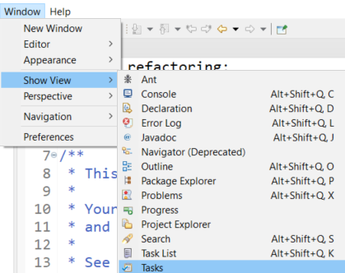
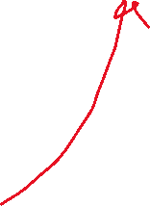
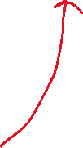

DNR: Driver, Navigator, Reviewer
Reviewer - The review has a number of important responsibilities
Look at each piece of code and either correct or mark TODOs in the code
If its easy and obvious, just fix it
If NOT, add a TODO to complete later
Eclipse can provide a view of your TODOs in a project
Generate the PlantUML for the current project and next Milestone before the TA meeting
Use to easily generate UML: https://plantuml.com/eclipse
Can copy the source code and modify as needed
Identify violations of the 5 OODP based on code and UML
Mark TODOs in code or add comments to review document (notes for meeting with TA)
Provide a log of the results of the review
This is easily done with a good commit record
Evaluation of the current UML
Production of the planned UML for the next milestone with notes
During the TA meeting, the reviewer will discuss their review of the code and discuss concerns they have

Slide 4
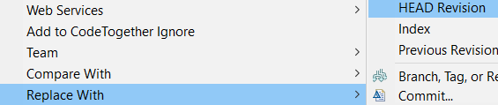
Git Workflow Reminders
Team->Pull (gets code from GitHub)
Edit (make local changes)
Team->Commit (add a message)
Team->Pull (to be safe and get latest version)
Team->Push (puts code on GitHub)
IF you get an error during step #1
File conflicts with FileX.java
Then IF you don’t care about .java on your computer and want the version on GitHub you can:
Right Click on FileX.java ->Replace With-> HEAD Revision

Slide 5
Rejected “Non-Fast Forward”
Your code is out of sync with the remote repo
- i.e. You are at version V2, and it is at version V3
You need to get the latest version of the code in your repo BEFORE you can Push, thus:
FIRST be sure to do a
Team->Pull

Slide 6
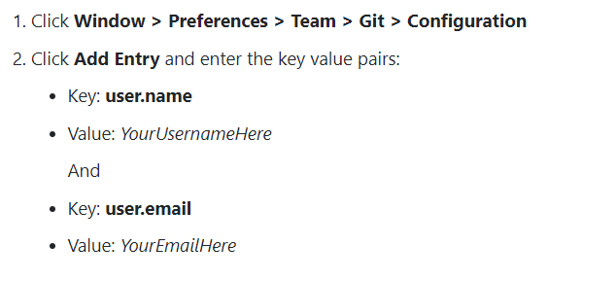
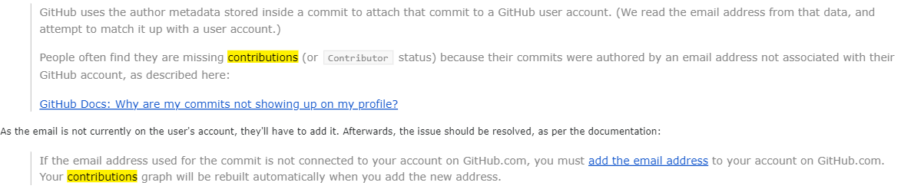
Why are my contributions not showing up on my profile?
https://docs.github.com/en/account-and-profile/setting-up-and-managing-your-github-profile/managing-contribution-settings-on-your-profile/why-are-my-contributions-not-showing-up-on-my-profile#your-local-git-commit-email-isnt-connected-to-your-account

Slide 7
Meetings with your TA
Team must schedule a meeting with the TA
Schedule it as soon as you finish each Milestone
If you have trouble communicating with the TA let your instructor know right away!
During the TA meeting
Have your report ready
Have your program ready to demo
Each person should be participating (based on role)
There can be flexibility within roles

Slide 8
Project advice
When done with Milestone1 (or beyond)
Add “final Milestone1 Commit”
To your commit message so graders will know to check out that version
Build an end-to-end solution
Build the next thing you can TEST
Don’t focus on cool graphics and other extra items early in the project, focus on basic functionality
Complete the milestone and keep moving forward!

