Slide 1
CSSE 220
Object Oriented Design Principle #4:
Minimizing Dependencies
Coupling and Cohesion

Slide 2
Today’s topic – Tell Don’t Ask
Minimize dependencies between objects when it does not disrupt usability or extendibility
If you can see a simpler design that works, use it
But if you can’t see a simpler design than the one that you have, at least ensure that you:
Tell don't ask
Don't have message chains
Notes:
If we can remove them we should
When we can’t remove them

Slide 3
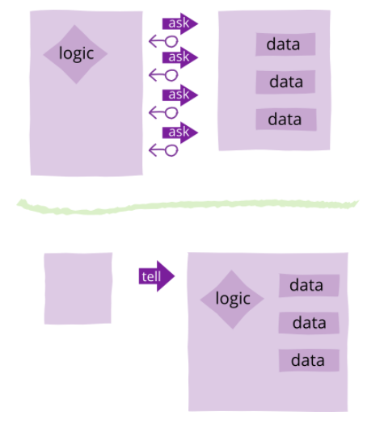
Tell Don’t Ask
https://martinfowler.com/bliki/TellDontAsk.html
Notes:
https://martinfowler.com/bliki/TellDontAsk.html

Slide 4
Tell Don’t Ask – getter methods
Many ASKS
// Client program of region
Point2D center1 = region1.getPosition();
Point2D center2 = region2.getPosition();
double dist = center1.distance(center2);
if(dist < region1.getRadius() + region2.getRadius()) {
region1.setIsOverlapping(true);
}
// This code is determining if two regions intersect
Sometimes you’ll have code that calls a lot of getters on some other object. In essence, this code is Asking for a lot of information from the region object.
Note how much this code “knows” about the Region class. It knows about many of its fields. It has a very strong dependency on the Region class.
Notes:
Code depends heavily on the region class

Slide 5
Tell Don’t Ask Use Procedural Abstraction
TELL
region1.flagOverlappingWith(region2);
When client uses a collection of getters to do some computation, then that computation is a good candidate to become a new method in the called-upon class
In this code, we’ve moved the center point and distance calculations into the Region class. Now rather than asking the Region for all sorts of data we simply tell the region to handle the problem itself and rely on it to do it.
Now, because we rely on the Region object to handle its own data, we have a weaker dependence on the region object.

Slide 6
Tell Don’t Ask – Bad Design
public LogFramework getLogFramework() {
return this.framework;
}
ASK
Asking is especially a bad design when you return some internal class that the caller would otherwise not know exists. Why does the caller want the framework? Maybe that should be a tell?
Violates “separation of concerns” – Client now knows “how” called on code works – this increases “coupling” between client and called-on class/code, high coupling is usually a poorer design choice
public void activateVerboseLogging() {
this.framework.setLevel(5);
}
TELL
If the caller only needs to do one thing, just add a method to do that thing and insulate the caller from dependence on LogFramework.

Slide 7
Tell Don’t Ask
Be wary of getter methods
Prefer methods that command (tell) a class to do something and be responsible for its own state and responsibilities
If client code accesses a lot of internal data of another class, consider check to see if a tell method in that other class might improve the design

Slide 8
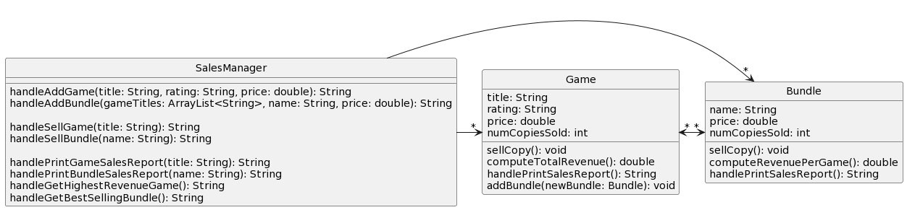
Recall: DP2 Solution
Notes:
In your VaporSalesManager classes, you need to calculate a game’s total revenue, including revenue from its bundle sales. This could be accomplished by 2 different approaches:
Adding a computeTotalRevenue() method to the Game class which adds up the revenues
Adding a getBundles() method to the Game class, which the SalesManager class could call, and then use in handleGetHighestRevenueGame() and handlePrintGameSalesReport()

Slide 9
A simple example of Tell Don’t Ask
In your VaporSalesManager classes, you need to calculate a game’s total revenue, including revenue from its bundle sales. This could be accomplished by 2 different approaches:
Adding a computeTotalRevenue() method to the Game class which adds up the revenues
Adding a getBundles() method to the Game class, which the SalesManager class could call, and then use in handleGetHighestRevenueGame() and handlePrintGameSalesReport()

Slide 10
Tell (better design)
Ask (worse design)
getBundles()
Notes:
In your VaporSalesManager classes, you need to calculate a game’s total revenue, including revenue from its bundle sales. This could be accomplished by 2 different approaches:
Adding a computeTotalRevenue() method to the Game class which adds up the revenues
Adding a getBundles() method to the Game class, which the SalesManager class could call, and then use in handleGetHighestRevenueGame() and handlePrintGameSalesReport()

Slide 11
A simple example of Tell Don’t Ask
Approach #1:
Adding a computeTotalRevenue() method to the Game class
This approach engineers the Game class so that it “knows” more about what goes on with Games, and SalesManager “knows” less
Notes:
May make sense to put this on Friday instead, if time could introduce here, but provides nice example of tell don’t ask

Slide 12
A simple example of Tell Don’t Ask
Approach #2:
Second approach increases coupling between SalesManager and Game class, i.e., SalesManager “knows” more about Game
Adding a getBundles() method to the Game class, which the SalesManager class could call, and then loop over the game’s bundles
Notes:
May make sense to put this on Friday instead, if time could introduce here, but provides nice example of tell don’t ask

Slide 13
Tell (better design)
Ask (worse design)
getBundles()
Notes:
In your VaporSalesManager classes, you need to calculate a game’s total revenue, including revenue from its bundle sales. This could be accomplished by 2 different approaches:
Adding a computeTotalRevenue() method to the Game class which adds up the revenues
Adding a getBundles() method to the Game class, which the SalesManager class could call, and then use in handleGetHighestRevenueGame() and handlePrintGameSalesReport()

Slide 14
Diagrams look similar!
How would the actual code compare when performing the stated task “calculate a game’s total revenue”?
Notes:
TIME CHECK: get to slide 18 by 32-minute mark

Slide 15
getBundles()
public class SalesManager {
…
private String handleGetHighestRevenueGame() {
double maxRevenue = Double.MIN_VALUE;
String maxRevenueGameTitle = "";
for (Game game : this.games) {
double revenueIndividualSales = game.getPrice() * game.getNumCopiesSold();
double revenueFromBundles = 0;
for (Bundle b: game.getBundles()) {
revenueFromBundles += b.computeRevenuePerGame();
}
double revenueTotal = revenueIndividualSales + revenueFromBundles;
// logic for updating maxRevenue, maxRevenueGameTitle
}
return maxRevenueGameTitle;
} … }
Calculation happening in SalesManager class!
Notes:
Red code shows the revenue being calculated

Slide 16
computeTotalRevenue()
public class SalesManager {
…
private String handleGetHighestRevenueGame() {
double maxRevenue = Double.MIN_VALUE;
String maxRevenueGameTitle = "";
for (Game game : this.games) {
double revenueTotal = game.computeTotalRevenue();
// logic for updating maxRevenue, maxRevenueGameTitle
}
return maxRevenueGameTitle;
} … }
Calculation happening in Game class!
Notes:
Red code shows the revenue being calculated

Slide 17
Why does this improve the design?
Reduces coupling between two classes:
It makes the Game object more featureful, and puts the code in an expected place
Reduces the code in SalesManager which is already quite long
Allows you to change how the Game’s total revenue is calculated, should you wish to (e.g., give more weight to individual sales)

Slide 18
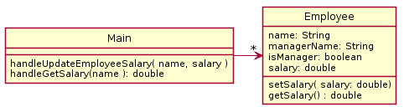
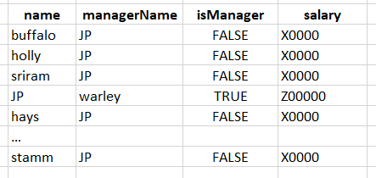
In-Class Quiz Qs #1 & #2
Employee Salary Problem: There is a company which has employees, each of which has a salary. There are managers which oversee other employees. Employees have salaries which can be updated from time to time. Unlike employees, a manager’s salary is always 10% more than the salary of their top paid employee.
PAUSE HERE for 10 minutes!
Try to see what you can think might be wrong
When you have an idea, then continue
Notes:
QUIZ QUESTION 1 and 2
What is wrong with the following design?
Design your own improved UML diagram.
How could we actually write code for this?

Slide 19
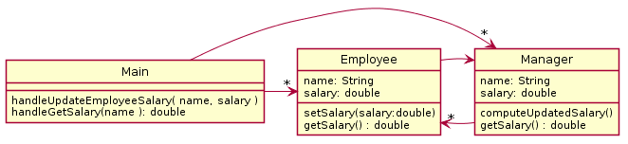
Better Solution
Anything wrong?
Room to improve?
PAUSE HERE for 5 minutes!
Try to make your own improved design
Using plantuml is good practice!
Notes:
What happens when we go to update the salary?

Slide 20
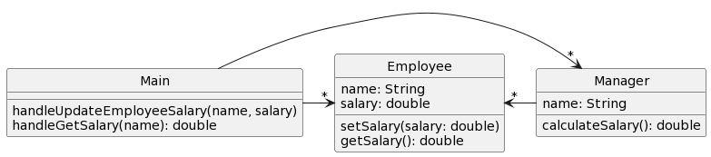
Eliminate manager salary field!
Data is technically duplicated if manager contains its own salary field.
What if the two pieces of data were out of sync?
Works well to calculate the salary as needed since it depends upon other data.
Notes:
QUIZ QUESTION 3
Notice the removed dependency (no line from Employee to Manager) this is possible since we don’t need to look up the manager to update its salary. We might want this for other reasons, but It is not strictly necessary here.
Lazy evaluation → pros and cons
@startuml
skinparam style strictuml
class Main {
handleUpdateEmployeeSalary(name, salary)
handleGetSalary(name): double
}
class Manager {
name: String
calculateSalary(): double
}
class Employee {
name: String
salary: double
setSalary(salary: double)
getSalary(): double
}
Main -right-> "*" Employee
Manager -left-> "*" Employee
Main -right-> "*" Manager
@enduml

