Slide 1
CSSE 220
Object Oriented Design Principle #4:
Minimizing Dependencies
Coupling and Cohesion

Slide 2
Today’s topic – Don’t have message chains
Minimize dependencies between objects when it does not disrupt usability or extendability
If you can see a simpler design that works use it
But if you can’t see a simpler design than the one that you have, at least ensure that you:
Tell don't ask
Don't have message chains

Slide 3
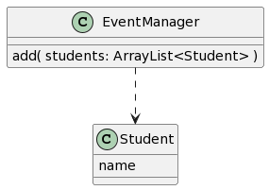
UML Interlude: Dependency Relationship
When one class requires another class to do its job, the first class depends on the second
Shown on UML diagrams as:
dashed line
with open arrowhead
Notes:
Note EventManager depends on Student
But Student does NOT depend on EventManager
@startuml
EventManager ..> Student
class EventManager{
add( students: ArrayList<Student> )
}
class Student {
name
}
@enduml

Slide 4
Message Chains – Don’t Have Them
A message chain is code in the form:
someObject.someMethod().otherMethod().stillOtherMethod();
For example
myFrame.getBufferStrategy().getCapabilities().getFlip().wait(17);
This is generally considered to a warning sign of excessive dependency and problems.

Slide 5

Message Chain Rewritten using variables
Message chains are not better if you space them across multiple lines, but it does make it more obvious what the problem is.
BufferStrategy strategy = myFrame.getBufferStrategy();
BufferCapabilities capabilities = strategy.getCapabilities();
FlipContents flip = capabilities.getFlipContents();
flip.wait(17);
You are depending on internal classes deep within some other object’s data
Notes:
@startuml
skinparam style strictuml
hide methods
hide fields
class YourCode {
}
YourCode -> JFrame
JFrame -> BufferStrategy
BufferStrategy -> BufferCapabilities
BufferCapabilities -> FlipContents
YourCode .> BufferStrategy
YourCode .> BufferCapabilities
YourCode .> FlipContents
@enduml

Slide 6
Message Chain Rewritten using variables
Message chains are not better if you space them across multiple lines, but it does make it more obvious what the problem is.
BufferStrategy strategy = myFrame.getBufferStrategy();
BufferCapabilities capabilities = strategy.getCapabilities();
FlipContents flip = capabilities.getFlipContents();
flip.wait(17);
You are depending on internal classes deep within some other object’s data
Client program – “knows” details 4 levels deep in called ops
So client is highly coupled with “how” things work
Notes:
@startuml
skinparam style strictuml
hide methods
hide fields
class YourCode {
}
YourCode -> JFrame
JFrame -> BufferStrategy
BufferStrategy -> BufferCapabilities
BufferCapabilities -> FlipContents
YourCode .> BufferStrategy
YourCode .> BufferCapabilities
YourCode .> FlipContents
@enduml

Slide 7
Message Chain: Solution
The solution is usually to embed the required feature in the first class in the chain. This insulates the caller from the inner classes. Then the first class might implement the feature itself OR if it still needs to rely on its internals repeat the message chain removal.
myFrame.setFlipWait(17);
This approach also actually decouples:
BufferCapabilities from FlipContents
BufferStrategy from BufferCapabilities
JFrame from BufferStrategy
Notes:
Unavoidable to communicate somehow…
@startuml
skinparam style strictuml
hide fields
hide YourCode methods
class YourCode {
}
class JFrame {
setFlipWait(seconds)
}
class BufferStrategy {
setFlipWait(seconds)
}
class BufferCapabilities {
setFlipWait(seconds)
}
class FlipContents {
wait(seconds)
}
YourCode -> JFrame
JFrame -> BufferStrategy
BufferStrategy -> BufferCapabilities
BufferCapabilities -> FlipContents
@enduml

Slide 8
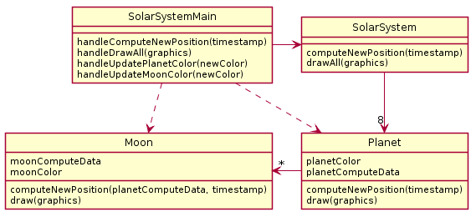
In-Class Quiz Questions #4 & #5
Solar System Problem: A java program draws a minute-by-minute updated diagram of the solar system including all planets and moons. To update the moon's position, the moon's calculations must have the updated position of the planet it is orbiting. The diagram is colored - all planets are drawn the same color and all moons are drawn the same color. However, it needs to be possible to reset the planet color or the moon color and the diagram should reflect that.
What is wrong here?
Notes:
SECOND HOUR START HERE
QUIZ QUESTION 4 and 5
Ask students to design a better version

Slide 9
What is wrong here?

Slide 10
What is wrong here?
Violates 4b. There is a methodChain to update moon
ss.getPlanets().get(0).getMoons().get(0).setColor(color);
Make your own improved design
Using plantuml is good practice!

Slide 11
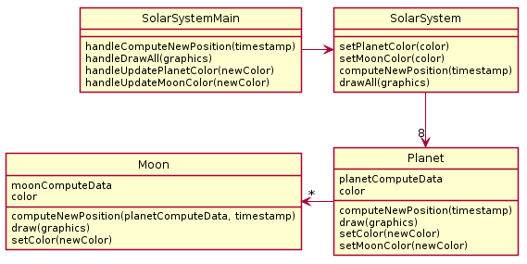
Partial Solution
Notes:
QUIZ QUESTION 6
This is what you'll get if you mechanically follow our advice to propagate the method into the first class of the chain.

Slide 12
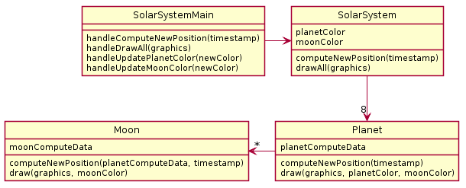
Better Solution Eliminate Data Duplication

Slide 13
Global/Static Variables are bad, why?
What if planetColor, moonColor were static?
Notes:
What if we suddenly wanted to add a second solar system…
Static makes for bad design, i.e. hard to use/reuse/extend

Slide 14
Coding Exercise
An implementation of the SolarSystem Problem can be imported
We provide the bad implementation with the message chain
We would like you to refactor it to implement this solution
Notes:
Note: this might or might not be ready for Spring 2023-24

