Slide 1
CSSE 220
Object Oriented Design Principle #4:
Minimizing Dependencies
Coupling and Cohesion

Slide 2
Today’s topic – Coupling and Cohesion
Minimize dependencies between objects when it does not disrupt usability or extendibility
If you can see a simpler design that works, use it
But if you can’t see a simpler design than the one that you have, at least ensure that you:
Tell don't ask
Don't have message chains
Now two related terms:
coupling
cohesion

Slide 3
Object Oriented Design Terms:
3 essential terms
Encapsulation (done- previously covered)
Coupling
Cohesion

Slide 4
Coupling and Cohesion
Two terms you need to memorize
Good designs have:
High coHesion
Low coupLing
Consider the opposite:
Low cohesion means that you have a small number of really large classes that do too much stuff (i.e., do more than one thing)
High coupling means you have many classes that depend (“know”) too much on each other
Notes:
Easy way to remember:
H for High coHesion
L for Low coupLing

Slide 5
Imagine I want to make a Video Game. Here are two classes in my design. Which is more cohesive? high cohesion = better design
GameRunner
main(args:String)
loadLevel(levelName:String)
moveEnemies()
drawLevel(g:Graphics2D)
computeScore():int
computeEnemyDamage()
handlePlayerInput()
doPowerups(…)
runCutscene(cutsceneName:String)
//some more stuff
Image
loadImageFile(filename:String)
setPosition(x:int,y:int)
drawImage(g:Graphics2D)
*Note that in both these classes I’ve omitted the fields for clarity

Slide 6
Imagine I want to make a Video Game. Here are two classes in my design. Which is more cohesive? high cohesion = better design
GameRunner
main(args:String)
loadLevel(levelName:String)
moveEnemies()
drawLevel(g:Graphics2D)
computeScore():int
computeEnemyDamage()
handlePlayerInput()
doPowerups(…)
runCutscene(cutsceneName:String)
//some more stuff
Image
loadImageFile(filename:String)
setPosition(x:int,y:int)
drawImage(g:Graphics2D)
GameRunner does:
moves
draws
compute score
compute damage
… etc.

Slide 7
Cohesion (Good)
A class should represent a single concept. All of of the class's interface features should be closely related to the single concept that the class represents. Such a class is said to be cohesive.
- Your textbook
On to coupling...

Slide 8
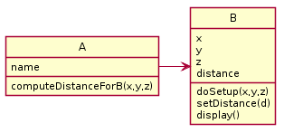
Coupling (Bad)
Coupling is when one object depends strongly on another
//do setup must be called first
this.myB.doSetup(1, 2, 3);
//now we compute the parameter
double distance = computeDistanceForB(0,0,0);
this.myB.setDistance( distance );
//finally we display
this.myB.display();
Notes:
Maybe these two object ought to be of same class?
@startuml
skinparam style strictuml
class A {
name
computeDistanceForB(x,y,z)
}
class B {
x
y
z
distance
doSetup(x,y,z)
setDistance(d)
display()
}
A-> B
@enduml

Slide 9
Note that in this design, GameRunner probably had many objects of the image class, but Image does not know the GameRunner class even exists. That’s a sign of low coupling between Image and GameRunner.
GameRunner
main(args:String)
loadLevel(levelName:String)
moveEnemies()
drawLevel(g:Graphics2D)
computeScore():int
computeEnemyDamage()
handlePlayerInput()
doPowerups(…)
runCutscene(cutsceneName:String)
//some more stuff
Image
loadImageFile(filename:String)
setPosition(x:int,y:int)
drawImage(g:Graphics2D)

Slide 10
Coupling – UML Diagrams
Lots of dependencies ➔ high coupling
Few dependencies ➔ low coupling
How hard will it be to change code with:
High coupling? Low coupling?
Notes:
Makes it easier to swap out and replace a component when there are fewer lines going to and from it. Those represent places where code would need to change.

Slide 11
Coupling – UML Diagrams
Note:
“essential” dependencies cannot be eliminated
if they are eliminated, then functionality fails
Notes:
Makes it easier to swap out and replace a component when there are fewer lines going to and from it. Those represent places where code would need to change.

Slide 12
If we do our design job carefully
Divide & Conquer - Break our larger problem into several classes
Each of these classes will do one thing well (i.e., they will have high cohesion)
Our classes will only need to depend on each other in specific, highly limited essential ways (i.e., they will have low coupling).
Many classes won’t even “know” of most of the other classes in the system

Slide 13
Final Example
Coupling and Cohesion
School/Student Design problem example
How do Coupling and Cohesion vary with increasing # of classes?

Slide 14
Imagine that you’re writing code to manage a school’s students
Things your design should accommodate:
Handle adding or removing students from the school
Students should have a name, phone number, and grades for specific courses (can use a courseId String)
Setting the individual course grades for a particular student
Compute the average GPA of all the students in the school
Sort the students by last name to print out a report of students and GPA
Discuss and come up with a design with those near you. How many classes does your system need?
Notes:
Give students 3-4 minutes to come up with a design with a group of 2-3
Suggest to the students after they have one design, to try to do a different design with 1 more or 1 less class
Then follow the slides to walk through examples of each design identifying coupling/cohesion levels

Slide 15
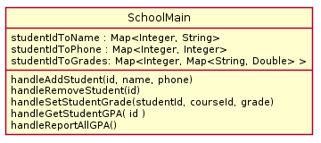
1 class solution
# classes | coupling | cohesion
1
Coupling?
Cohesion?
Notes:
Coupling low (ZERO), (good!)
Cohesion low (VERY BAD!)
@startuml
skinparam style strictuml
class SchoolMain {
studentIdToName : Map<Integer, String>
studentIdToPhone : Map<Integer, Integer>
studentIdToGrades: Map<Integer, Map<String, Double> >
handleAddStudent(id, name, phone)
handleRemoveStudent(id)
handleSetStudentGrade(studentId, courseId, grade)
handleGetStudentGPA( id )
handleReportAllGPA()
}
@enduml

Slide 16
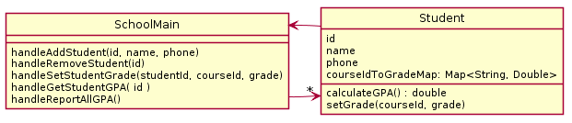
2 class solution
# classes | coupling | cohesion
1 | ZERO | LOW
2
Coupling?
Cohesion?
Notes:
Coupling HIGH (BAD!)
Cohesion somewhat LOW (better than before!)
Ask students: IS EVERYTHING NEEDED HERE?
NO: Student does not need a SchoolMain to allow functionality
@startuml
skinparam style strictuml
class SchoolMain {
handleAddStudent(id, name, phone)
handleRemoveStudent(id)
handleSetStudentGrade(studentId, courseId, grade)
handleGetStudentGPA( id )
handleReportAllGPA()
}
class Student{
id
name
phone
courseIdToGradeMap: Map<String, Double>
calculateGPA() : double
setGrade(courseId, grade)
}
SchoolMain -> "*" Student
Student-> SchoolMain
@enduml

Slide 17
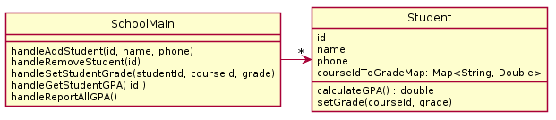
2 class solution
# classes | coupling | cohesion
1 | ZERO | LOW
2
Coupling?
Cohesion?
Notes:
Coupling OK (Better! At least Student doesn’t have a SchoolMain)
Cohesion OK somewhat low (higher than before)
@startuml
skinparam style strictuml
class SchoolMain {
handleAddStudent(id, name, phone)
handleRemoveStudent(id)
handleSetStudentGrade(studentId, courseId, grade)
handleGetStudentGPA( id )
handleReportAllGPA()
}
class Student{
id
name
phone
courseIdToGradeMap: Map<String, Double>
calculateGPA() : double
setGrade(courseId, grade)
}
SchoolMain -> "*" Student
@enduml

Slide 18
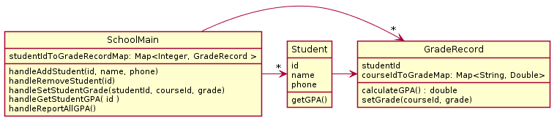
3 classes
# classes | coupling | cohesion
1 | ZERO | LOW
2 | LOW | medium
3
Coupling?
Cohesion?
Notes:
Coupling HIGH (BAD)
Cohesion HIGH (GOOD)
Student is data holder now
@startuml
skinparam style strictuml
class SchoolMain {
studentIdToGradeRecordMap: Map<Integer, GradeRecord >
handleAddStudent(id, name, phone)
handleRemoveStudent(id)
handleSetStudentGrade(studentId, courseId, grade)
handleGetStudentGPA( id )
handleReportAllGPA()
}
class Student{
id
name
phone
getGPA()
}
class GradeRecord {
studentId
courseIdToGradeMap: Map<String, Double>
calculateGPA() : double
setGrade(courseId, grade)
}
SchoolMain -> "*" Student
Student -> GradeRecord
SchoolMain -> "*" GradeRecord
@enduml

Slide 19
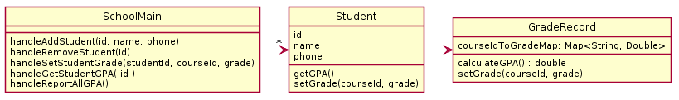
3 classes improved
# classes | coupling | cohesion
1 | ZERO | LOW
2 | LOW | medium
3
Coupling?
Cohesion?
Notes:
Coupling LOW (higher),
cohesion HIGH (good!)
Student now has useful behavior
@startuml
skinparam style strictuml
class SchoolMain {
handleAddStudent(id, name, phone)
handleRemoveStudent(id)
handleSetStudentGrade(studentId, courseId, grade)
handleGetStudentGPA( id )
handleReportAllGPA()
}
class Student{
id
name
phone
getGPA()
setGrade(courseId, grade)
}
class GradeRecord {
courseIdToGradeMap: Map<String, Double>
calculateGPA() : double
setGrade(courseId, grade)
}
SchoolMain -> "*" Student
Student -> GradeRecord
@enduml

Slide 20
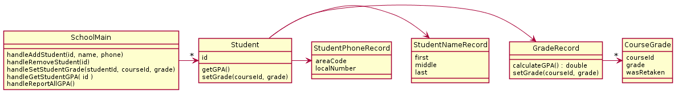
…6 classes
# classes | coupling | cohesion
1 | ZERO | LOW
2 | LOW | medium
3 | LOW | high
6
Coupling?
Cohesion?
Notes:
WOAH – things out of control…. Student has very high coupling-if it changes everything breaks!
Coupling HIGH
Cohesion HIGH
@startuml
skinparam style strictuml
class SchoolMain {
handleAddStudent(id, name, phone)
handleRemoveStudent(id)
handleSetStudentGrade(studentId, courseId, grade)
handleGetStudentGPA( id )
handleReportAllGPA()
}
class Student{
id
getGPA()
setGrade(courseId, grade)
}
class GradeRecord {
calculateGPA() : double
setGrade(courseId, grade)
}
class CourseGrade {
courseId
grade
wasRetaken
}
class StudentNameRecord {
first
middle
last
}
class StudentPhoneRecord {
areaCode
localNumber
}
GradeRecord -> "*" CourseGrade
SchoolMain -> "*" Student
Student -> GradeRecord
Student -> StudentNameRecord
Student -> StudentPhoneRecord
@enduml

Slide 21
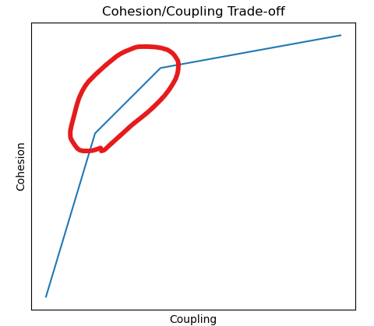
Note that
Cohesion makes us want:
Many smaller classes
Each does one thing well
If classes are too small
Tend to need to depend on each other
Coupling rises
Want “Goldilocks” design
# classes | coupling | cohesion
1 | ZERO | LOW
2 | LOW | medium
3 | LOW | high
6 | HIGH | HIGH

Slide 22
Reminder
DesignProblems3 is due soon!
Check schedule page
DesignProblems Homework Page
Example Problems:
Here are a set of design problems for you to practice on your own. In addition, there is a solution with commentary and good designs to compare with the designs you produce on your own.

