Slide 1
Critical Logistics
You have 2 homework assignments in the very near future
To see all assignment due dates, look at the Airtable view on Moodle (next slide)
We will only go over the course policies if we have time, but they are covered in the "Course Policies" page link on Moodle
Notes:
Airtable in moodle

Slide 2
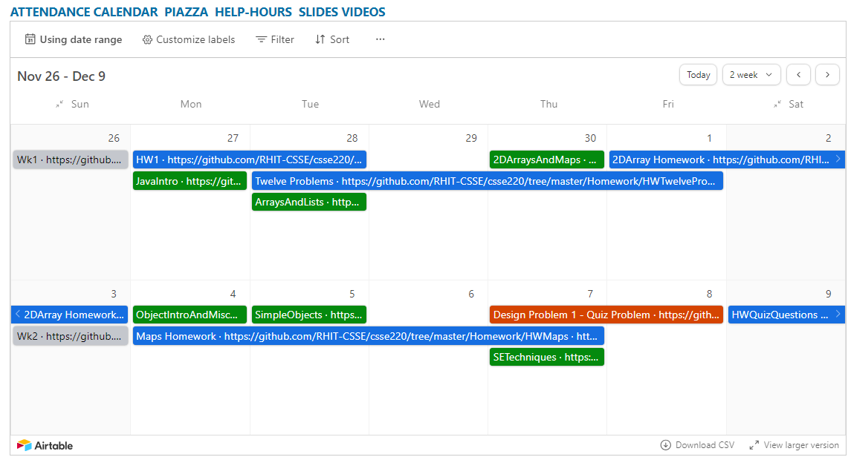
Airtable View on Moodle
DUE:
Last
Day
DUE:
Last
Day
DUE:
Last
Day
DUE:
Last
Day

Slide 3
Agenda
Critical logistics
We write some java code
Conditionals
Strings
Loops

Slide 4
Let’s write hello world together
Notes:
JAY: I suggest actually writing some code out on the board - things to note:
{ } enclose code in blocks – Eclipse highlights them for you
Special words have different colors
Semicolons are required
Capitalization matters and is important

Slide 5
A First Java Program
In Java, all variable and function definitions are inside class definitions
main is where we start
public class HelloPrinter {
public static void main(String[] args) {
System.out.println("Hello, World!");
}
}
System.out is Java's standard output stream. This is the variable called out in the System class.
System.out is an object from the PrintStream class. PrintStream has a method called println( ).
Q6
Notes:
Argument for main is not optional. Must be there.

Slide 6
HelloPrinter.java
To run a Java program:
Right-click the .java file in Package Explorer view
Choose Run As → Java Application
Introduce yourself to your neighbor and change the program to say hello to them
Introduce an error in the program
See if you can come up with a different error than your neighbor
Fix the error that your neighbor introduced
Notes:
Discuss errors and error messages

Slide 7
In Class Coding
You can do this in pairs or on your own. There are 3 files:
ConditionalExamples.java
StringProbs.java
LoopProbs.java
Each file contains several solved functions and several unsolved functions. Understand the code in the solved functions, and then use that code to help you write the unsolved functions.
If you have a problem that you can’t quickly debug, or need a hint – call me or the TA over
Test your code to ensure you’re right
In ConditionalExamples.java, modify “main” to call your new functions with test values (print to see results)
In the String/Loop problems, run the corresponding Test file

Slide 8
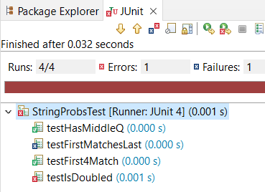
Running as App vs. JUnit
When running as an application, the first thing that runs is the “main” method
When running as a Junit Test all tests run:
Green Check means success
Blue X means tests failed
Red X means Exception (Error)

Slide 9
What are Types?
All variables in Java have a “type”
Describes the data that can be stored in a variable
String – text only
short/int/long – whole numbers only
float/double – numbers with decimals
boolean – true or false
char – a single text character
Classes – Class names are also types, let you define your own, more complex, types

Slide 10
Strings
String myString = “hello”;
String otherString = new String(“hello2”);
Java’s way of storing text data
Has many handy functions like substring, charAt, etc. that you will slowly learn
But how do you find out about these cool functions?

Slide 11
Java API Documentation
What’s an API?
Application Programming Interface
The Java API on-line
Google for: java api documentation 7
Or go to: http://download.oracle.com/javase/8/docs/api/
Also hopefully on your computer at
C:\Program Files\Java\jdk1.8.0_9\docs\api\index.html
You need the 7 (or 8) to get the current version of Java
Note: Your version may be something other than 8.0_9.
We recommend that you bookmark this page in your browser, so you can refer to it quickly, with or without an internet connection.
Notes:
Find the documentation for the String class from one of the above links, as follows:
Click java.lang in the top-left pane
Then click String in the bottom-left pane
Describe the parts of the String API documentation:
- description of the class
- summaries of all the fields, constructors, and method
detailed descriptions of everything

Slide 12
Quick Rule for Comparisons
Fast rules for now:
Use .equals() for comparing Strings
String alpha = “aaa”;
if (alpha.equals(“bbb”) {
System.out.println(“Yes!”)
} // end if
Use == comparing numbers or char (primitives)
boolean a = (5 == 6);
boolean b = (‘T’ == ‘F’ );
Notes:
Can decide to say this for next class or mention it now at least…

Slide 13
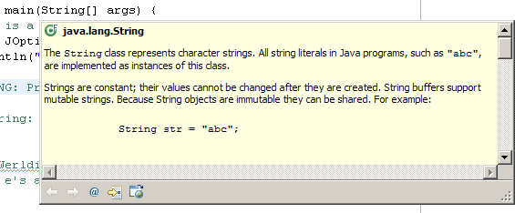
Java Documentation in Eclipse
Setting up Java API documentation in Eclipse
Should be done already,
Using the API documentation in Eclipse
Hover text
Open external documentation (Shift-F2)
Notes:
Point students to the link in the homework if everyone does not have the docs setup.
Demo hover text, F2 to focus on hover text, icon to open in web browser.
Shift-F2 to open external browser immediately.

Slide 14
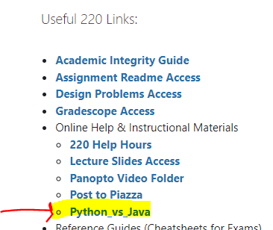
Review Loops: while & for Loops
While loop syntax: Similar to Python
while (condition) { statements
}
For loop syntax: Different from Python
for (initialization ; condition ; update) { statements
}
In both cases, curly braces optional if only one statement in body; but be careful!
Notes:
Point students to Python vs Java features linked from session 1 of course schedule.

Slide 15
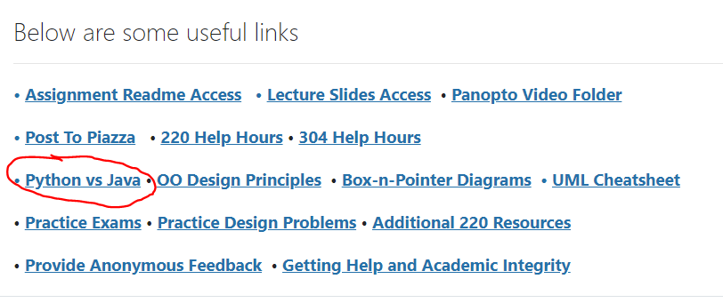
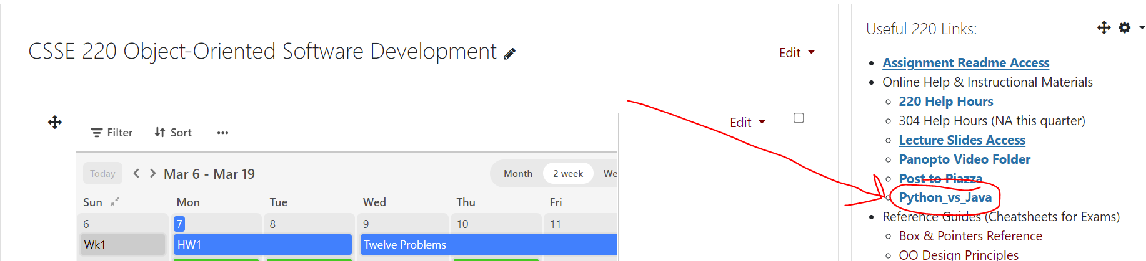
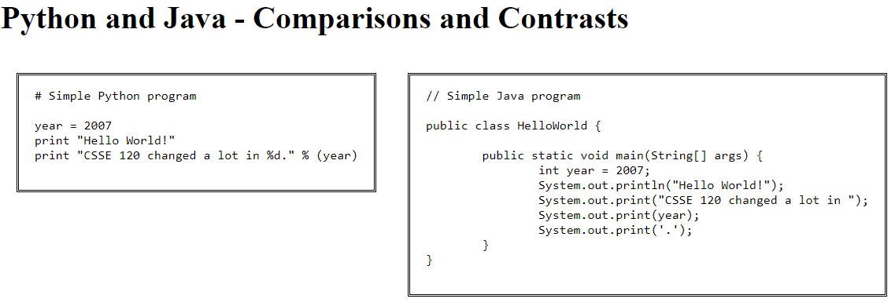
Java vs. Python

Slide 16
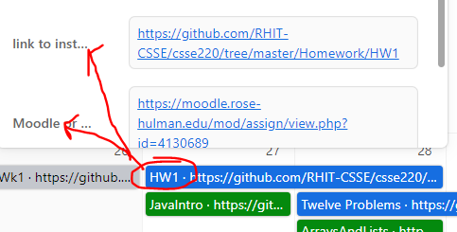
How to submit homework assignments
You'll submit your .java files via GradeScope
There's instructions in the Homework section of the course Moodle (linked in Airtable too)
Helpful:
Python vs Java features link

Slide 17





Deadlines
You should AIM to complete these early, start working on them the day they appear on the Calendar
However, if exceptional circumstances arise, I will ask you to complete a form requesting an extension.

Slide 18
HW1 due soon, see Moodle/Gradescope (It is your responsibility to keep up with the schedule) Post on Piazza or email me if you have any questions

Slide 19
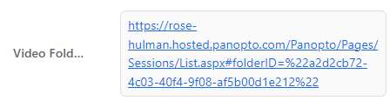
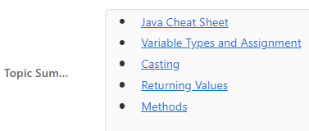

Reminder: Useful Links in Airtable
Pre-recorded lectures of content. Useful for reviewing confusing material, when you miss part or all of a class.
Various Topic Summaries for CSSE220 Topics. Useful for checking your understanding, review daily material preparing for exams.
Direct link to the Moodle Quiz for the Day

