Slide 1
CSSE 220
Java Primitive Types

Slide 2
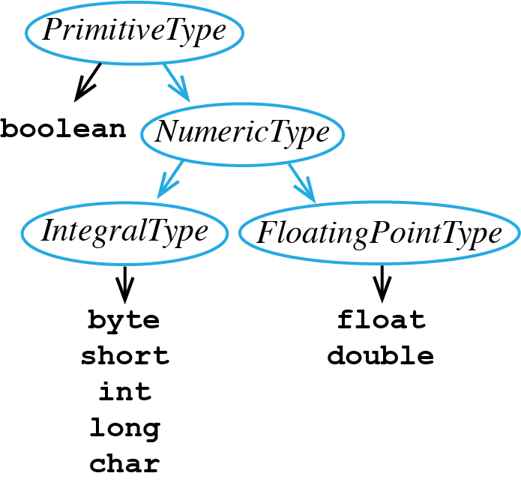
Review of Java’s Primitive Types
Here is the breakdown:
boolean – used for storing true or false
IntegralType – used for storing Integer numbers
FloatingPointType - used for storing numbers with digits to right of decimal point

Slide 3
Declaring a Primitive Variable
Use these Java keywords

Slide 4
A Client Program Using boolean
Notice the following lines:
#4 variable b1 declared and initialized
#6 (5 < 10) evaluates to true, so true is assigned to b1
#7 if evaluates b1 and sees it stores true, so then branch is taken
#8 outputs "b1 = true"
1 public class BooleanClient {
2
3 public static void main(String[] args) {
4 boolean b1 = false;
5
6 b1 = (5 < 10);
7 if(b1) {
8 System.out.println("b1 = true");
9 } else {
10 System.out.println("b1 = false");
11 } // end if
12 } // main
13 } // end class BooleanClient

Slide 5
A Client Program Using int
Notice the following lines:
#4 variables x1 and x2 declared
#6 x1 is set to 17
#7 x2 gets result of x1 divided by 2, this is integer division, so the result is truncated
#8 outputs "x1 = 17"
#9 outputs "x2 = 8"
1 public class IntClient {
2
3 public static void main(String[] args) {
4 int x1, x2;
5
6 x1 = 17;
7 x2 = x1 / 2;
8 System.out.println("x1 = " + x1);
9 System.out.println("x2 = " + x2);
10 } // main
11 } // end class IntClient

Slide 6
A Client Program Using double
Notice the following lines:
#4 variables f1 and f2 declared
#6 f1 is set to 17.5
#7 f2 gets result of f1 divided by 2, this is floating point division, so the result is a double
#8 outputs "f1 = 17.5"
#9 outputs "f2 = 8.75"
1 public class DoubleClient {
2
3 public static void main(String[] args) {
4 double f1, f2;
5
6 f1 = 17.5;
7 f2 = f1 / 2;
8 System.out.println("f1 = " + f1);
9 System.out.println("f2 = " + f2);
10 } // main
11 } // end class DoubleClient

Slide 7
IntegralType Values
Below are the ranges of legal values for all IntegralTypes:
byte [-128, 127]
short [-32768, 32767]
int [-2147483648, 2147483647]
long [-9223372036854775808, 9223372036854775807]
char [0, 65535] for representing UTF-16 code units from '\u0000' to '\uffff'
Source: Java Language Specification, Java SE 14 Edition

Slide 8
IntegralType Sizes
Question:
Why can a variable of type long store bigger numbers than an int?
int [-2147483648, 2147483647]
long [-9223372036854775808, 9223372036854775807]
Answer:
Storing a number requires computer memory, each primitive variable is allocated a different amount of memory
int 32 bits are allocated
long 64 bits are allocated
Source: Java Language Specification, Java SE 14 Edition

Slide 9
Terminology Review
client – uses the services of a primitive type or class by declaring variables from these types and then calling operations to manipulate these variables
object – a variable that stores a reference to an object instance
primitive type – boolean, byte, character, short, int, float, double variables of these these types are not objects in Java
variable – stores either primitive data (e.g., from type int) or reference data (i.e., a reference to an object instance)
wrapper class – a built-in Java class that turns a Java primitive type into an object version of the primitive type, e.g., Integer wrapper class is an object version of the primitive type int

