Slide 1
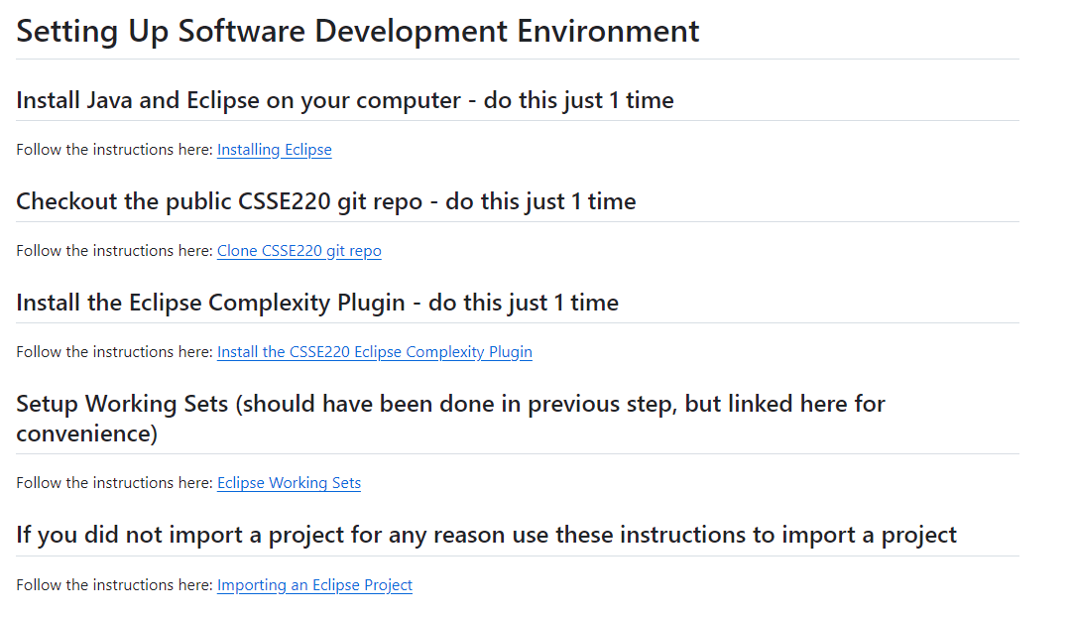
Setting Up Environment for CSSE220
These Slides:
tinyurl.com/csse220setup
https://github.com/RHIT-CSSE/csse220/blob/master/Docs/environment_setup.md
Notes:
Only needed for students that struggled to get things setup before day 1.

Slide 2
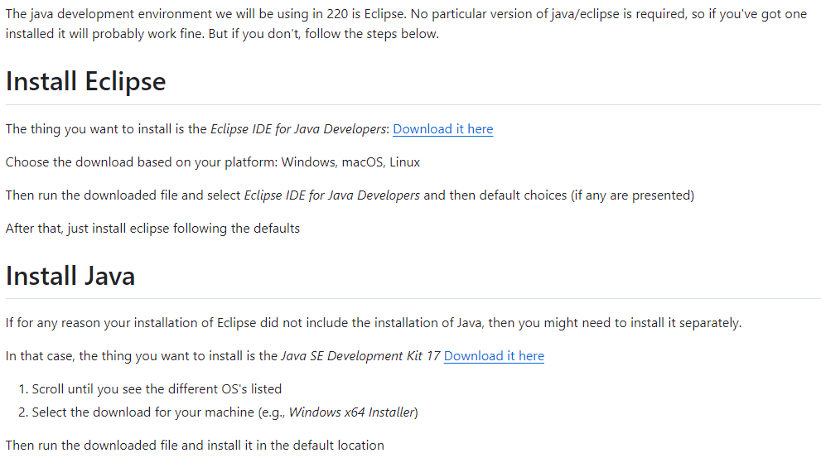
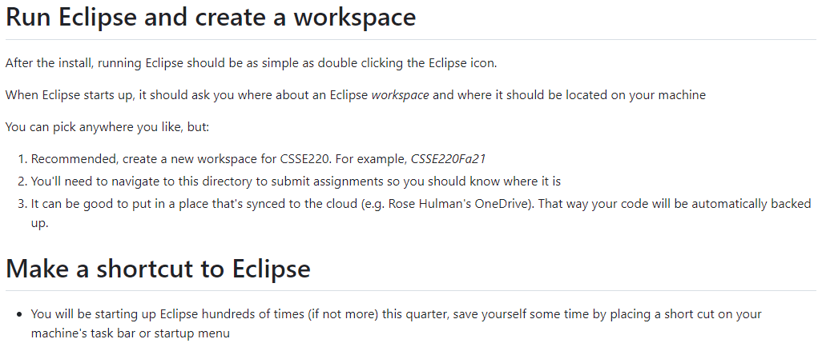
Installing Java and Eclipse
https://github.com/RHIT-CSSE/csse220/blob/master/Docs/installing_eclipse.md

Slide 3
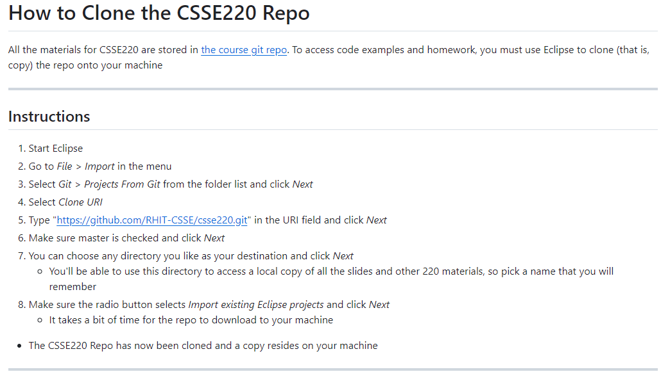
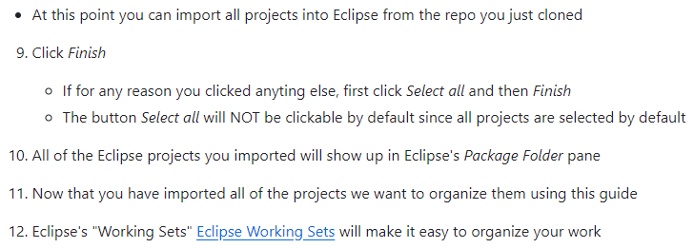
Cloning the Repo (copy files to your computer)
https://github.com/RHIT-CSSE/csse220/blob/master/Docs/getting_the_repo.md

Slide 4
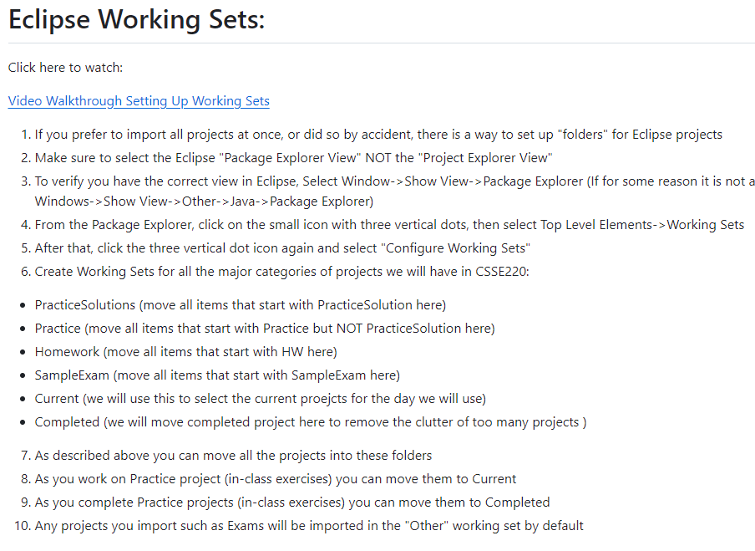
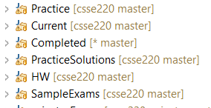
Eclipse Working Sets
https://github.com/RHIT-CSSE/csse220/blob/master/Docs/eclipse_working_sets.md

Slide 5
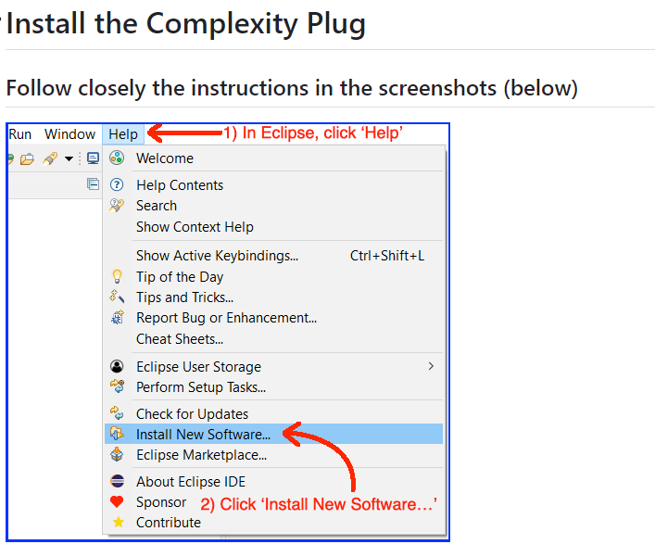
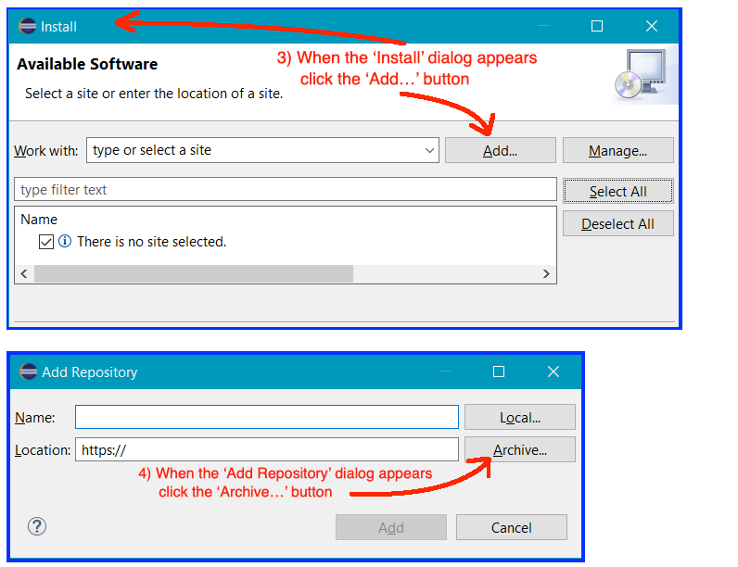
Eclipse Plugin – Coding Complexity
New Spring 2024 Custom Eclipse Plugin
Provides you feedback on several HWs
Informs you if your code is getting slightly or excessively complex

Slide 6
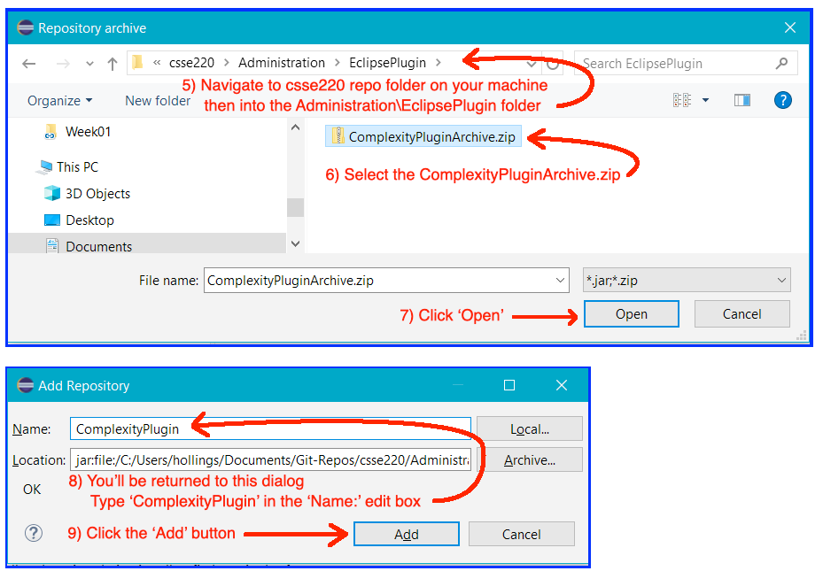
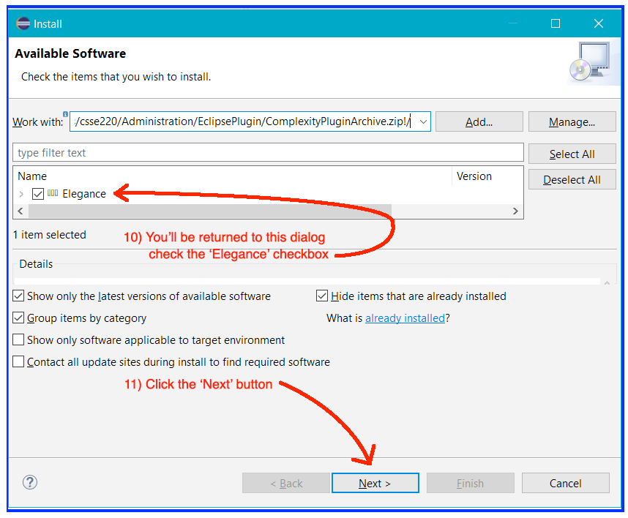
Eclipse Plugin – Coding Complexity

Slide 7
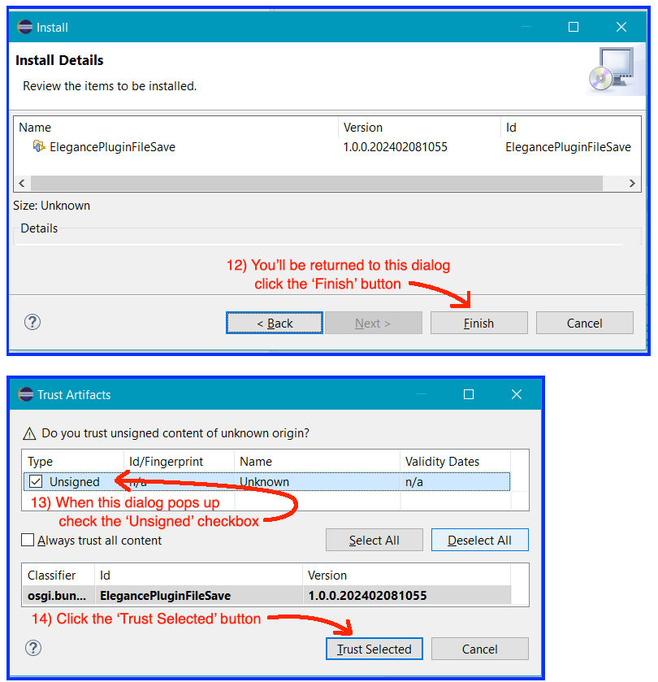
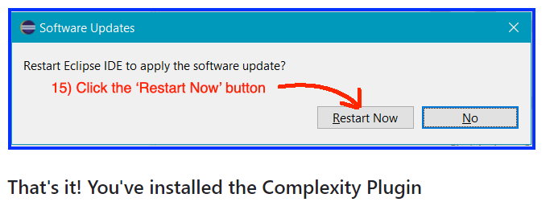
Eclipse Plugin – Coding Complexity

